Slide 1
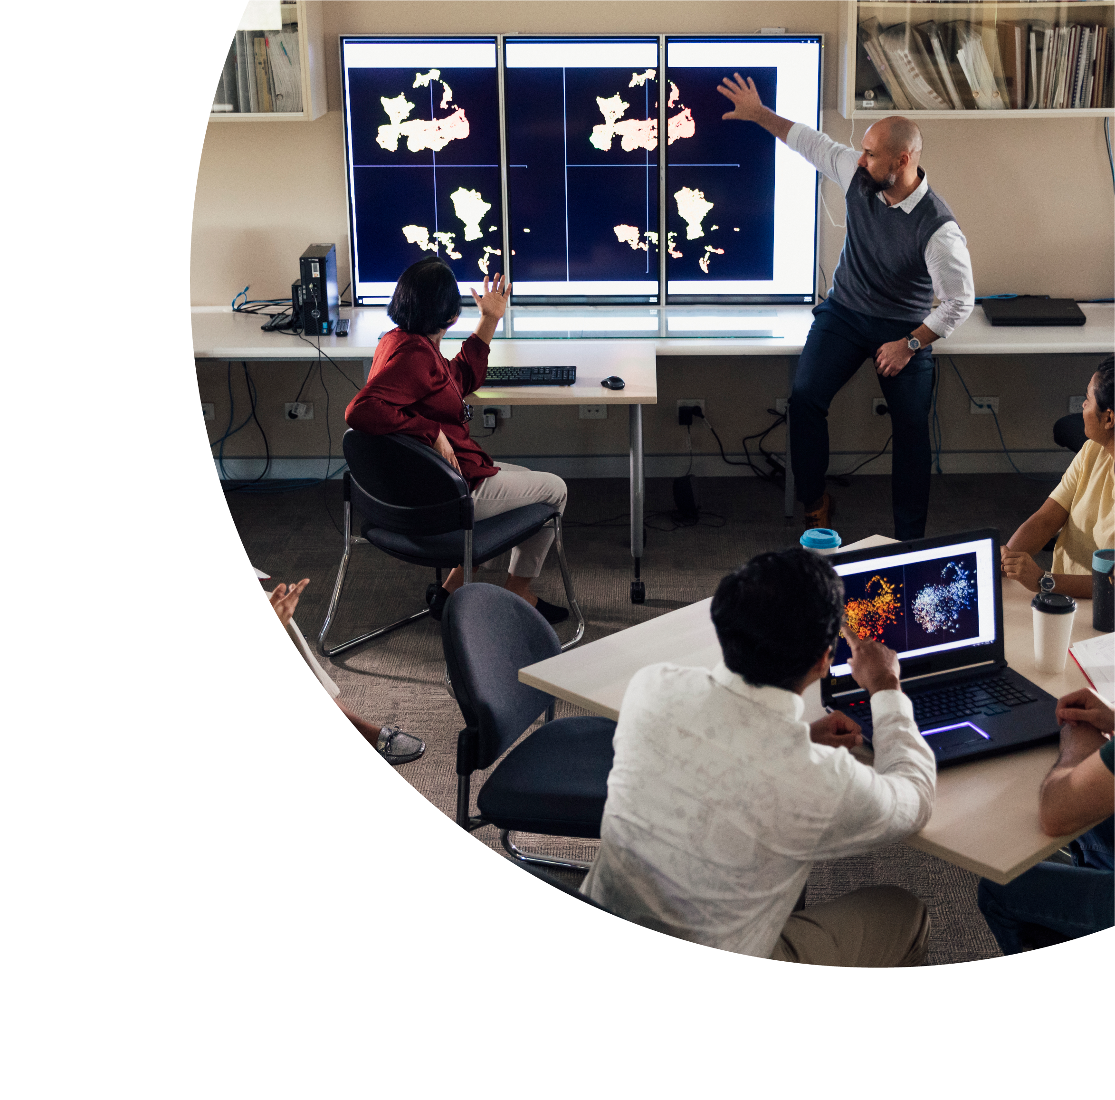


Inclusive by Design
Dr Charmaine Herfkens-Fernandez
Alejandra Speziali
Heather Pate

Slide 2

About this Session
This session is being recorded. If you do not wish to appear on screen please hide camera
This session will be captioned (either live captioning or closed captions)
Session etiquette
Use Chat or Q+A function as directed by presenter
Indicate in the Q+A if you have a question throughout this session
Use Raised hand emoji to ask questions after the presentation, during the Q+A segment
Ensure your surrounding environment is quiet when mic is on (e.g., phones, pets etc)
Turn off mic when not speaking

Slide 3
Acknowledgement to Traditional Custodians
Edith Cowan University is committed to reconciliation and recognises and respects the significance of Aboriginal and Torres Strait Islander peoples’ communities, cultures and histories. In particular, we acknowledge and respect the Nyoongar people, the traditional custodians of the land upon which ECU’s campuses stand and where we are zooming in from today.

Slide 4
Overview
Background to workshop initiative
Using Universal Design for Learning (UDL) in our workshop design
Elements of the Engaging and Supporting International Students PD Workshop
Informal feedback & next iteration
Q&A

Slide 5
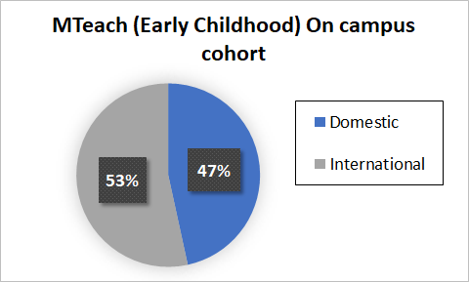
Background: The Cohort

Slide 6
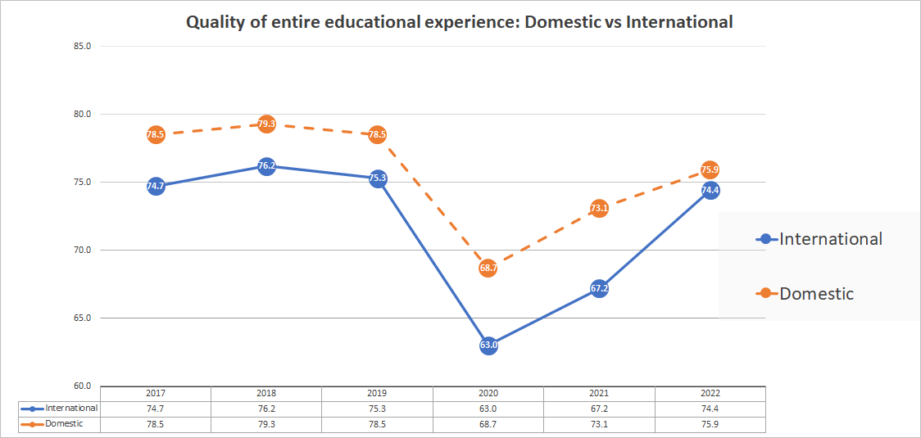
Universities Accord
Equity groups include students that:
Non-English speaking backgrounds (NESB)
Have disability
Women in non-traditional areas
Indigenous
From low socioeconomic status
From regional and remote locations
Australian Government, 2020

Slide 7
Challenges Faced by Students
Local and international students
Oral presentations
International students
Culture
Disciplinary content and discourse
Foreign university context
Activity​ | International students​ | Australian Citizens PR​
Presentation​ | 34%​ | 41%​
Personal attribute​ | 39%​ | 21%​
Evaluation​ | 27%​ | 38%​

Slide 8
Challenges Identified by Staff
Shifting staff attitudes to actively support diverse cultural groups
Preparing staff to navigate complexities teaching international students
Providing adequate contextual knowledge for international student success
Engaging international students classroom discussions
Addressing inadequate grasp of study processes and skills
Identifying potential unconscious bias

Slide 9
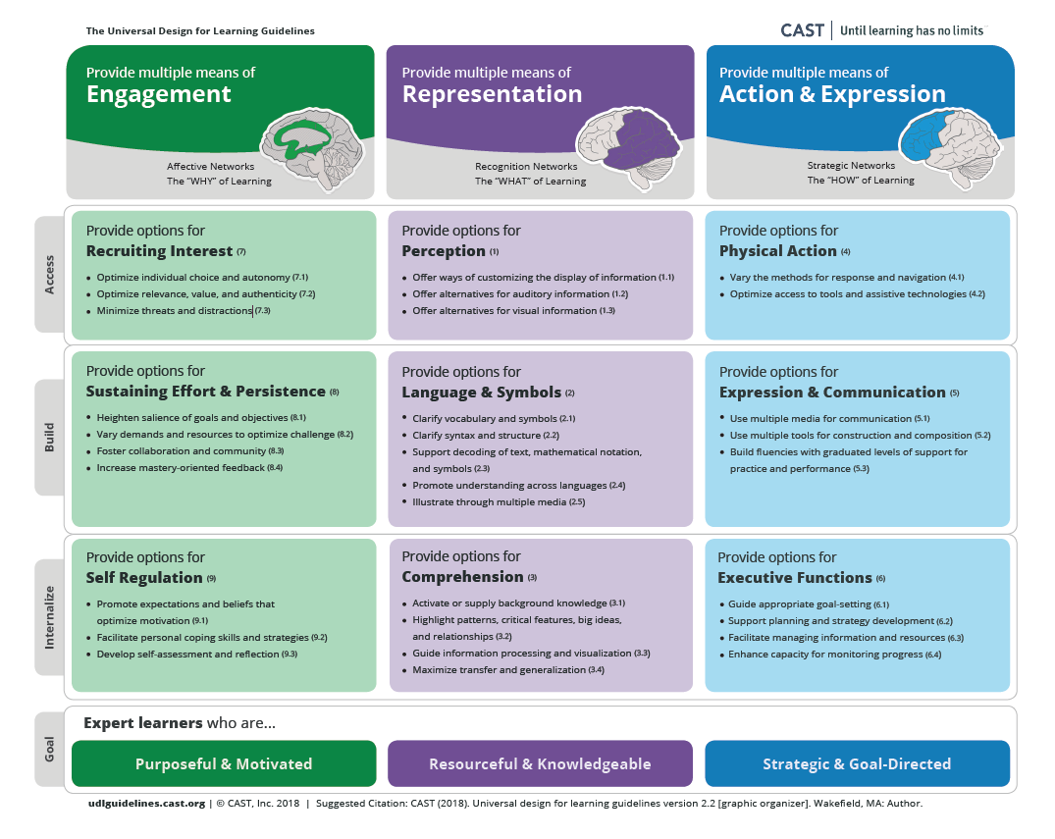
The Universal Design for Learning Guidelines
Engagement
  Use a range of ways to engage students
Representation
  Use a range of ways to present the content
Action and expression
  Use a range of ways to show their learning

Slide 10
Overview of the
Engaging and Supporting International Students Workshop
Module 1
Teaching and Learning with an International Cohort
Module 2
Building Inclusive Canvas Sites and Unit Resources
Module 3
Developing Meaningful Connections with International Students
Next Steps
Establishing a Community of Practice in the Course

Slide 11
Module 1: Teaching and Learning with an International Cohort
Provide multiple ways to engage with learning.
Goal: Expert learners who are purposeful and motivated
Self regulation
Recruiting interest
Sustaining effort and persistence
This module addresses:
Strategies on engaging and supporting international students in an Australian higher education context.

Slide 12
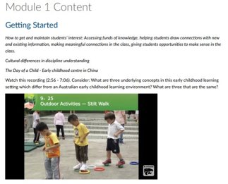
Self Regulation
Develop self-assessment and reflection.
Facilitate personal coping skills and strategies.
Task: Flipped the class – participants were given opportunity to engage with content before attending workshop

Slide 13
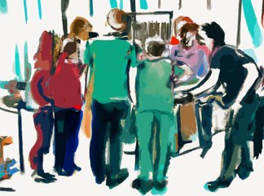
Recruiting Interest
Optimise relevance, value, and authenticity
Optimise individual choice and autonomy
Task: Discuss your own experience of world childhood education
Image by Gerd Altmann from Pixabay​

Slide 14
Sustaining Effort and Persistence
"In Australia, when the lecture or tutorial is finished, everyone lives all over the town and they hardly ever meet each other. That makes it very hard to pick the useful points of studies from the books. It is almost impossible for a Chinese student to read every single word of a textbook." ​
Foster collaboration and community.
Heighten salience of goals and objectives.
Task: Consider ways to engage students outside class and while on placement
Bachelor of Business graduate, University of New England (international student)​

Slide 15
Module 2: Building Inclusive Canvas Sites and Unit Resources
Provide multiple means of representation.
Goal: Expert learners who are resourceful and knowledgeable
Perception
Language and Symbols
Comprehension
This module addresses:
The use of available learning technologies to create inclusive and accessible Canvas unit sites;
Unit resources to enhance learning for international students.

Slide 16
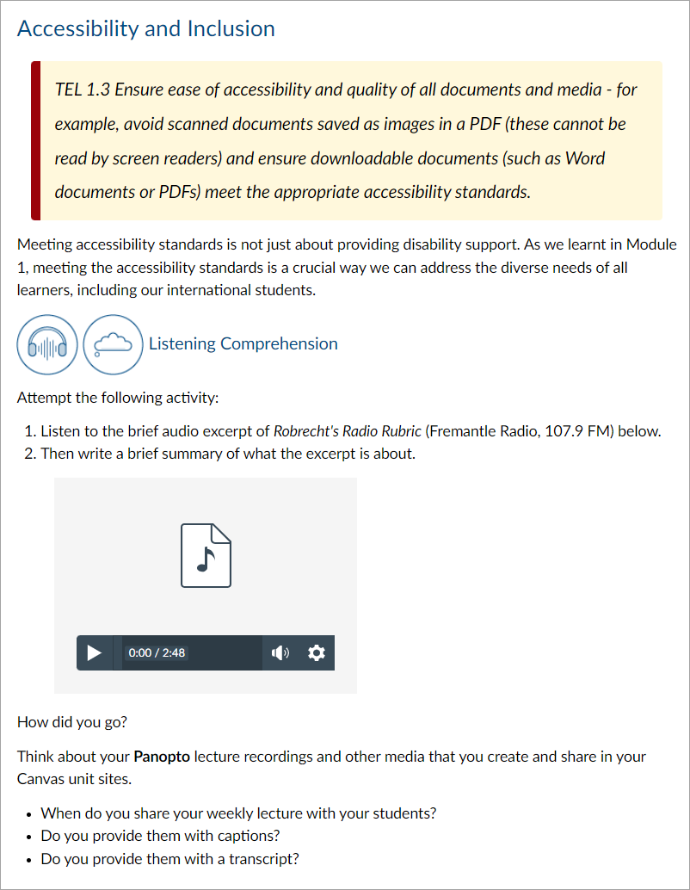
Perception
Offer ways of customising the display of information.
Offer alternatives for auditory information.
Task: Summarise what the audio recording is about.
Use the Transcribe and Translate functions in Word 365.

Slide 17
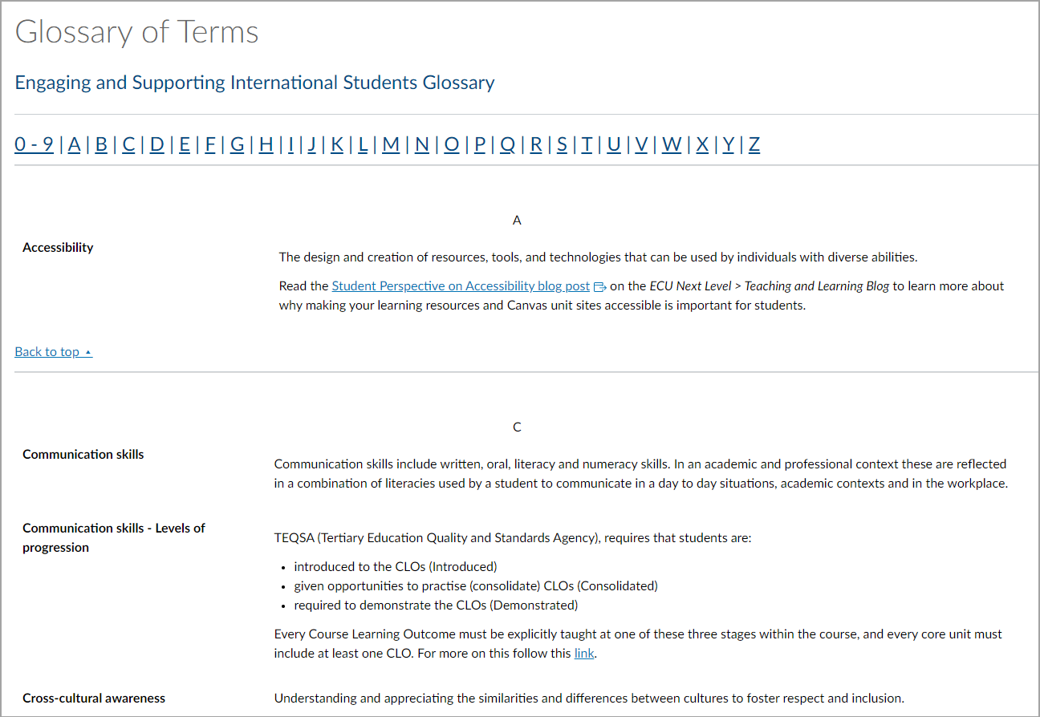
Language & Symbols
Clarify vocabulary and symbols.
Promote understanding across languages.
Illustrate through multiple media.
Task: Use the glossary template provided to clarify key terms and concepts in your units.

Slide 18
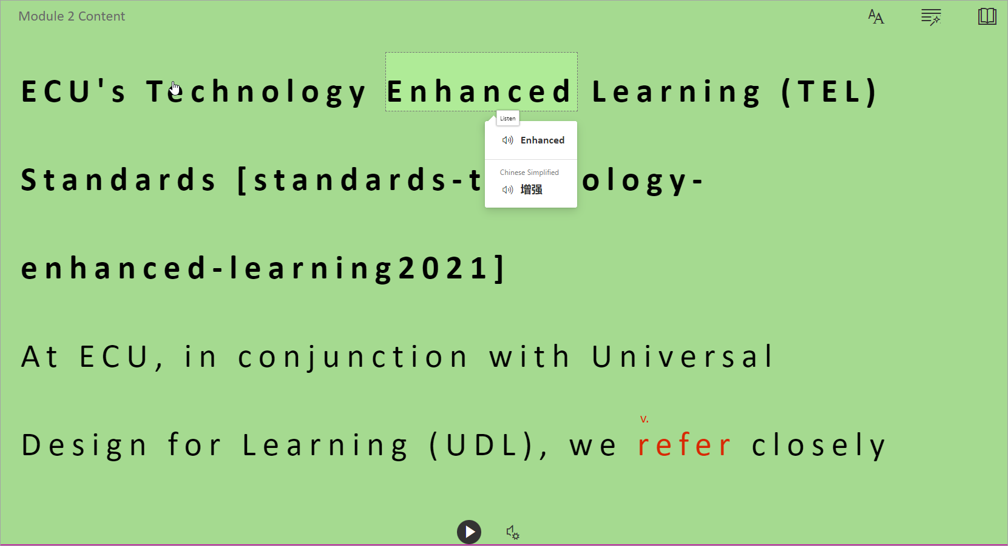
Comprehension
Activate or supply background knowledge.
Guide information processing and visualisation.
Task 3: Explore the Immersive Reader in Canvas, Microsoft Edge, and M365 apps

Slide 19
Module 3: Developing meaningful connections with international students
Provide numerous ways of action and expression
Goal: Expert learners who are strategic and goal directed
Physical action
Expression and communication
Executive functions
This module addresses:
Principles underpinning effective engagement and support for international students;
Strategies and approaches to support international students in higher education.

Slide 20
Physical action
Vary the methods for response and navigation
Task: Use Mentimeter to indicate the percentage of students that reported these activities as a source of anxiety according to a recent survey?

Slide 21
Expression & communication
Text: [15:08]​​
"In China when teacher lectures we take notes. We are surprised that in the US students answer easy questions, because in China teachers only ask very hard questions, so when lecturers ask easy questions we won’t answer immediately, because we don’t think the teacher needs the answer, so to answer it is mainly to show off. Also we would consider easy questions be to insult their intelligence; we think maybe the easy question the question itself could be some kind of a trap…"​​
Build fluencies with graduated levels of support for practice and performance.
Task: Are any of the challenges with class participation shared by the three international students on the video reflected in your students' feedback?

Slide 22

Executive functions
Reflective Activity
Consider a strategy you would like to implement in your unit next semester to encourage international student engagement (eg, group work, oral presentations):
How would you introduce it to the students?
How would you embed it across the course to vary the level of scaffolding in the activity?
First iteration: low stakes, high scaffolding
Second iteration: medium stakes, medium scaffolding
Third iteration: more challenging, low scaffolding
Provide scaffolds for higher level executive skills and strategies
Task: Reflective activity: How could you scaffold one skill throughout the unit/course?

Slide 23
References
Adil, M. (2020). Exploring the Role of Translation in Communicative Language Teaching or the Communicative Approach. SAGE Open, 10(2). https://doi.org/10.1177/2158244020924403
Arkoudis, S. (2005). Teaching International Students: Strategies to enhance learning. Centre for the Study of Higher Education, The University of Melbourne. https://msd.unimelb.edu.au/__data/assets/pdf_file/0007/3064372/ArkoudisS-Teaching-International-ST.pdf
Arkoudis, S. and Harris, A. (2018). Strengthening the evidence base for graduate communication skills. https://ltr.edu.au/resources/SP14-4612_ArkoudisHarris_FinalReport_2018.pdf
Biggs, J. (2003). Aligning teaching for constructing learning. Download citation of Aligning Teaching for Constructing Learning (researchgate.net)
ECU. (2018). Course Learning Outcomes – Exemplars. https://secure.ecu.edu.au/service-centres/staffonly/CLT/CLO-Resources/Exemplars/1!-ECU-Course-Learning-Outcomes-exemplars-all-courses.pdf
Elliot and Chong (n.d.). Presentation Anxiety: A challenge for some students and a pit of despair for others. https://isana.proceedings.com.au/docs/2004/paper_elliott.pdf
Mahdi, D. A. (2022). Improving Speaking and Presentation Skills through Interactive Multimedia Environment for Non-Native Speakers of English. SAGE Open, 12(1). https://doi.org/10.1177/21582440221079811
O'Donoghue, C. (2022). Supporting International Students Using UDL. https://research.thea.ie/handle/20.500.12065/4118
Tran, L.T. (2020). Teaching and Engaging International Students. Journal of International Students, 10(3), xii-xvii. https://doi.org/10.32674/jis.v10i3.2005

Slide 24

Workshop feedback
"I will certainly review my Canvas sites – resources/strategies – to support and enhance learning for international students (all students really)."
"The video showing the international contexts was very helpful. Discussion and sharing of strategy ideas."
"Opportunity to share experiences within the team to highlight areas for improvement."
"Very interesting and relevant content - I liked using the Canvas site and gives us a reference point to go back to afterwards. Great. Thanks very much!"

Slide 25

What's next?
Review workshop for next iteration in the School
Work with other Schools
Share with other interest groups
Conduct research

Slide 26
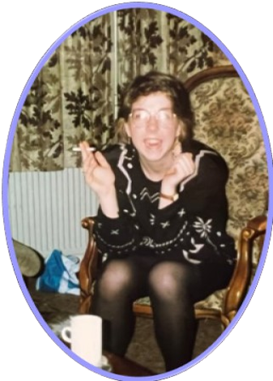
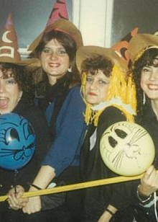
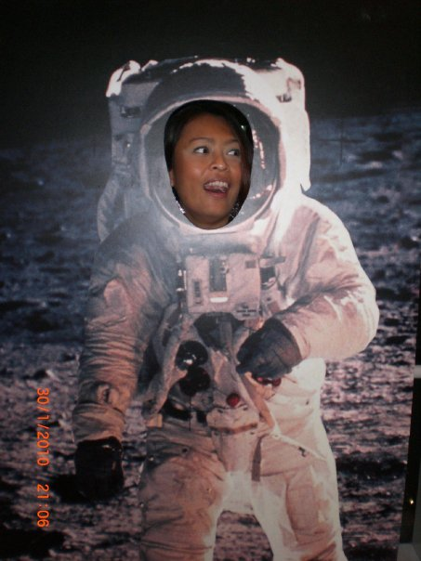
Contact Us
Dr Charmaine Herfkens-Fernandez
Learning Designer
c.herfkens-fernandez@ecu.edu.au
Heather Pate
Senior Learning Designer
h.pate@ecu.edu.au
Alejandra Speziali
Senior Learning Adviser
a.speziali@ecu.edu.au
Centre for Learning and Teaching​, Edith Cowan University​

Slide 27
Q & A session

Slide 28
Thank you!

