Slide 1
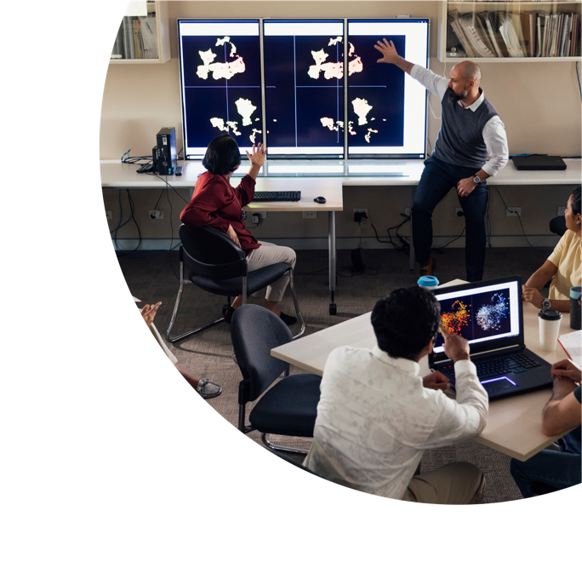


UDL for online students with mental health conditions
Jacquie Tinkler, Gene Hodgins, Charlotte Wardell

Slide 2

About this session
This session is being recorded. If you do not wish to appear on screen, please hide camera
This session will be captioned (either live captioning or closed captions)
Session etiquette
Use Chat or Q+A function as directed by presenter
Indicate in the Chat or Q+A function for questions as directed by presenter
Where appropriate use raised hand emoji to ask questions
Ensure your environment is quiet when mic is on (e.g., phones, pets, etc.)
Turn off mic when not speaking

Slide 3

Acknowledgement to traditional custodians
I would like to acknowledge the Wiradjuri people who are the Traditional Owners and custodians of the unceded land on which we are meeting today. I would also like to pay respect to the Elders both past and present of the Wiradjuri Nation and extend that respect to other Indigenous Australians who are present.

Slide 4
What we’ll be covering
An overview of a research project that investigated the learning experiences of online students with mental health conditions
How learning design and teaching approaches impacted on their studies
How these findings can be used as a starting point for the incorporation of the UDL framework into the design of online learning for these students
Suggested strategies and approaches to improve their learning experience and outcomes.

Slide 5
Background
University students have much higher levels of poor mental health and psychological distress than the general population (Brown et al., 2017; Rickwood et al., 2017).
Pre-COVID, almost two‐thirds of students reported high/very-high levels of psychological distress (Rickwood et al., 2017), and is higher post-COVID (Heim & Heim, 2021; Gogoi, et al., 2022).
Stigma about mental illness means students feel afraid, anxious, embarrassed, or ashamed (McManus et al., 2017), so they often avoid health services, and work hard at concealing their illness (Andrews, 2016; Kent, 2016).
Students don’t always recognise symptoms of mental health issues, meaning symptoms can go unrecognised and untreated (Gewin, 2012).
There is a lack of research on students’ mental wellbeing in a distance learning environment (Lister et al., 2021).

Slide 6

Research questions
What are the experiences of online learning at CSU for students with mental health conditions?
What elements of online subject design do students with mental health conditions find helpful to their learning?
How might a UDL approach to learning design be used to improve the learning and university experience of these students

Slide 7

Participants
220 participants completed the survey, 10 were interviewed.
Average age = 32, range = 18-68, 81% female
21% identify as LGBTQI+, 4% identify as ATSI
52% full-time, 66% fully online, 78% undergraduates
A spread of disciplines, but: 28% teaching & education, 16% allied health & pharmacy, 11% business
88% have sought treatment for their mental health
83% have a formal diagnosis
Main issues identified are anxiety and depression

Slide 8

Method
All current online Charles Sturt University students were invited
Mixed methods: survey and semi-structured interviews
The online survey included:
  demographic questions
  the K-10 scale (a general measure of psychological distress)
  A range of open-ended questions
Semi-structured interviews explored and captured individual students’ experiences in further depth

Slide 9

What did we ask about?
Their experience studying while living with a mental illness
If they let their lecturers or the university know
If and how they seek support
What sort of accommodations were given or asked for
The difficulties and benefits of online study while living with a mental illness
What learning or teaching approaches helped them succeed
What types of assessments were difficult or caused anxiety
What would they like to see improve in their online subjects

Slide 10
What learning and teaching approaches helped?
Findings Overview – Part 1
Understanding & approachability | Openness, trustworthiness, understand stigma, provide support information, have ‘contact hours’.
Assume capacity & effort | Mental illness can be invisible, or look like a ‘difficult’ or ‘lazy’ student. Often very high performing and keen to do well despite their struggle.
Clarity & organisation | Have all materials available, recordings, careful, clear, and consistent LMS design and organisation, clear explanations for assignments, achievable amount of content.
Build connections | Build in opportunities for students to work online together (not necessarily group assignments), make classes welcoming, provide options for contact with others

Slide 11
What learning and teaching approaches helped?
Findings Overview – Part 2
Flexibility | Asynchronous options, recordings, extensions, accommodate the need for enough time, achievement options (pass level with extra-effort options).
Assessments | Formative assessment, alternative assessment options (UDL), ePortfolios are good for chunking work, exams and essays are especially stressful.
Promote support services | Find out what is offered for students and promote these in class and materials. Reaching out is very difficult for students, normalising support is important.
Different modes of representation & expression | A range of assessment options offered, formative assessment, a variety of learning material modes available, assume there is no ‘average’ student.

Slide 12

Informing UDL approaches from these findings

Slide 13
Informing UDL approaches from these findings
Be flexible, supportive and non-judgmental
Collaboration and belonging is important despite social anxiety
Enable safe/reliable ways for students to seek help, & a timely response
Use positive and encouraging feedback
Avoid stressful assessments (all due at once) e.g. exams, essays
Alternative assessments for students to gain confidence
Use technology to provide flexible learning approaches (recordings, early and asynchronous access to work around episodes of illness
Ensure learning materials are clear and well organised

Slide 14

Conclusions and takeaways
There is a need to interrogate the UDL framework in more detail in relation to cognitive impairments in general, and mental health in particular
What sorts of learning approaches benefit those with episodic illnesses such as mental illness (not just extensions)
Stigma (both internal and external) is still a big problem
The inability of students to access support without a formal (and expensive/difficult to access) diagnosis means many students don’t seek or receive help, so UDL can help.

Slide 15

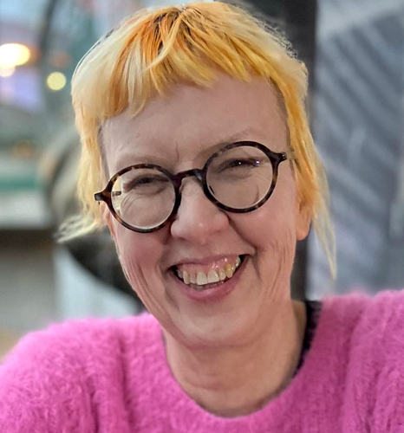
Contacts
Dr Jacquie Tinkler: jtinkler@csu.edu.au
A/Prof Gene Hodgins: ghodgins@csu.edu.au

Slide 16

Q & A session
I can take questions from chat or raise your (emoji) hand. If you see someone wanting to ask a question that I’ve missed, please let me know!

