Slide 1
How Applying a UD Framework can Lead to Tertiary Education that is Accessible & Inclusive
Sheryl Burgstahler
sherylb@uw.edu

Slide 2
2 Units in Accessible Technology Services
IT Accessibility Team
1984–
Funded by UW
DO-IT Center
USA, 1992–
Supported with federal, state, corporate, private funds
DO-IT Japan, 2007–
Center on UD in Education, 1999–
Disabilities
Opportunities
Internetworking
Technology
NNL

Slide 3
Basic approaches
When we are working with students, we promote SELF DETERMINATION
When we are working with faculty, staff, institutions, technology companies, we promote UNIVERSAL DESIGN (UD)

Slide 4
We need a paradigm shift
from excluding groups of students who should be able to participate to being inclusive
from design for the “average” student to design for everyone
from reactive reliance on accommodations alone to proactive, universal design (UD) of accessible, inclusive, & sustainable products, environments, & services
Once upon a time we already did this…

Slide 5
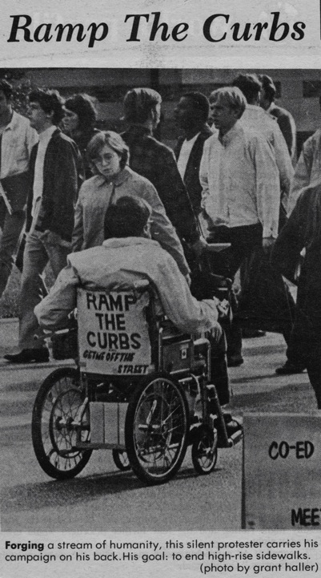
UD of physical spaces “The Daily” UW 1970

Slide 6
Consider ability on a continuum
Not Able Able
understand English, social norms
see
hear
walk
read print
write with pen or pencil
communicate verbally
tune out distraction
learn
manage physical/mental health

Slide 7
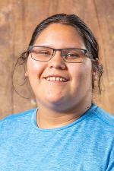
Note
Races/ethnicities, gender identities, disabilities, other characteristics may not be obvious
Consider intersectionality
Many students with disabilities do not disclose them
Campuses primarily offer accommodations to individuals after inaccessibility is discovered

Slide 8
Common/expensive accommodations for online courses
Making inaccessible documents accessible, mainly reformatting PDF files
Captioning videos

Slide 9
Universal design (UD) =
“the design of products & environments to be usable by all people, to the greatest extent possible, without the need for adaptation or specialized design.”
—The Center for Universal Design North Carolina State University

Slide 10
UD characteristics
Usable
Accessible
Universal Design
Inclusive

Slide 11
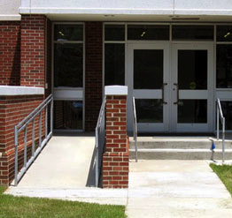
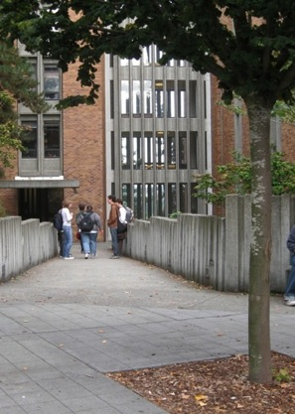
UD provides inclusive access

Slide 12
Framework for UDHE
Scope
Definition
Principles
Guidelines
Process
Practices

Slide 13
Scope: Students diverse wrt
race, ethnicity, cultural background,
sexual identity,
socioeconomic level,
age, marital status,
religious beliefs, values,
academic interests,
work experiences,
specific abilities, …

Slide 14
Scope:
All applications in education
Instruction
Services
Technology
Physical spaces
Projects, conference exhibits, presentations
Professional organizations

Slide 15
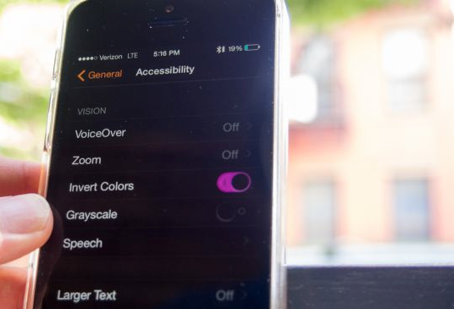
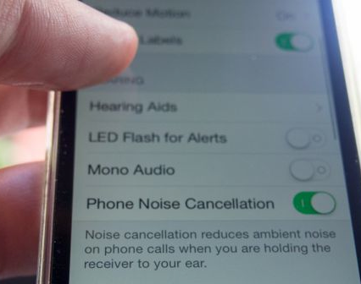
UD of technology
builds in accessibility features
ensures compatibility with assistive technology

Slide 16
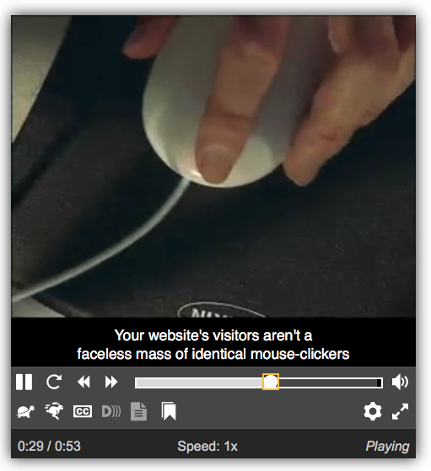
Multiple beneficiaries of UD, e.g. captions on videos…People who:
are unable to hear the audio
are English learners
are in a noisy or noiseless location
have slow Internet connections
want to know the spelling of words
need to find content quickly

Slide 17
3 sets of principles underpin UD guidance for all aspects of education
UDL
WCAG
UD
7 Universal Design
3 Universal Design for Learning
4 Web Content Accessibility Guidelines

Slide 18
In a nutshell,
Provide multiple ways for participants to learn, to demonstrate what they have learned, & to engage.
Ensure all technologies, facilities, services, resources, & strategies are accessible to individuals with a wide variety of disabilities.

Slide 19
When developing a course, consider characteristics of students who might attend & the assistive technologies (AT) they might be using.

Slide 20
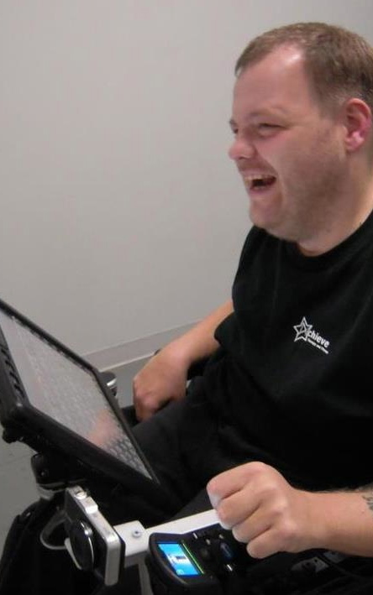
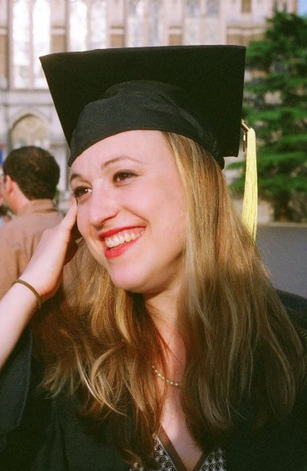
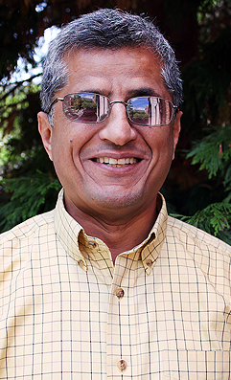
students
Consider students & instructors with range in English language skills, cultures, interests, comfort using technology, environments, abilities
Zayn
Anthony
Jesse
Hadi

Slide 21
For my presentation today I
Used MS PowerPoint template
Spoke critical content presented on the slides
Designed accessible PPt document, e.g., used text format; structured headings, lists, tables using formatting tools within PPt
Used uncluttered slides; plain backgrounds, high contrast with text
Spelled out acronyms, explained jargon

Slide 22
Additional tips for online courses, 1 of 3
Point students to specific resources to gain needed knowledge & skills
Recognize & avoid cultural, ability, & other assumptions
Examples, assignments relevant to diverse audience
Offer multiple ways to learn, demonstrate learning, & engage
Caption videos

Slide 23
Tips, 2 of 3
Avoid long lectures & massive slide decks
Chunk content & organize with headings
Overview at beginning & summary at end
Outlines, other scaffolding tools
Simplify, break down images, tables
Avoid strict cameras-on policy
Clear instructions & expectations

Slide 24
Tips, 3 of 3
Adequate time for practice, activities, projects, tests. Feedback on parts of large assignments & corrective opportunities
Use small number of technology tools; all accessible (e.g., operate with keyboard alone)
Avoid PDFs; accessible HTML in content pages ideal for primary content
Use descriptive wording for hyperlinks, alt text for images

Slide 25
An attitude; a framework, goal, process—UD:
Values diversity, equity, & inclusion
Promotes best practices & does not lower standards
Is proactive & can be implemented incrementally
Benefits everyone
Minimizes the need for accommodations

Slide 26
Resources
DO-IT uw.edu/doit
AccessComputing, NNL
Resources—videos, publications, stickers, line drawings
Center for UD in Education
UD Framework
Equal Access: UD of Instruction
20 Tips for Teaching an Accessible Online Course
Links to articles
Accessible Technology uw.edu/accesstech
Sheryl Burgstahler sherylb@uw.edu

