Slide 1



Glean: What’s new in 2023 and a HUGE new update!
ADCET Webinar - Friday 8th September, 2023
Presenters: Lee Chambers and Jim Sprialis

Slide 2
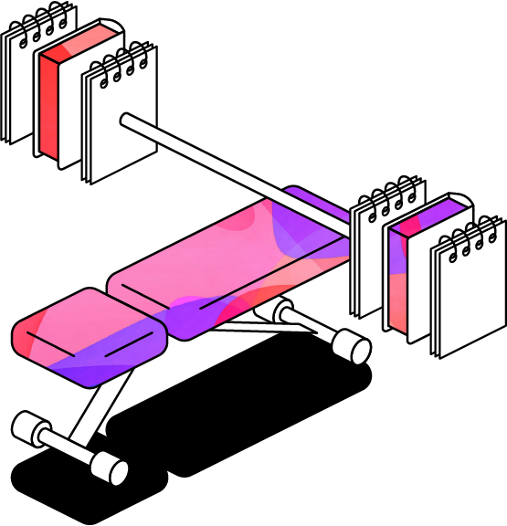
A quick Glean refresher demo
Recording in-person lectures.
Working with presentation slides.
Playing back and editing events.
Adding images, definitions and tasks.
Reading and exporting notes.

Slide 3
2023 enhancements we’ll cover today
Audio import
Mobile app parity
Shared collections.
Single sign-on (SSO)
Live captions

Slide 4


Update #1 - Audio Import
We’ve added the ability to import audio files into Glean!
You can now build out your notes in Glean using recordings from other devices, older and pre-recorded files.
The ability to import audio has been one of our most requested features.
Now you can add pre-recorded lectures, podcasts, audiobooks, and more into Glean and start making notes!

Slide 5
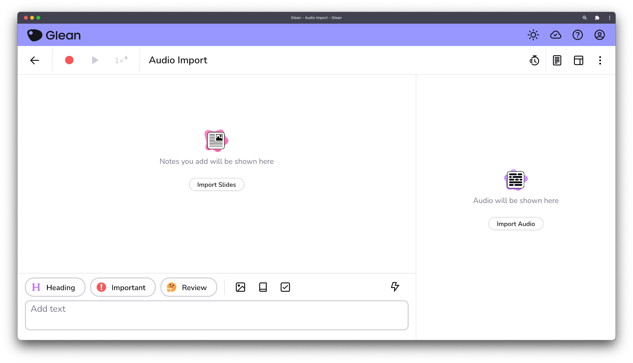
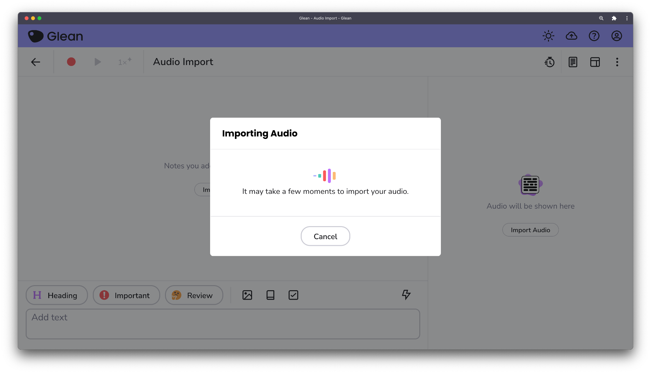
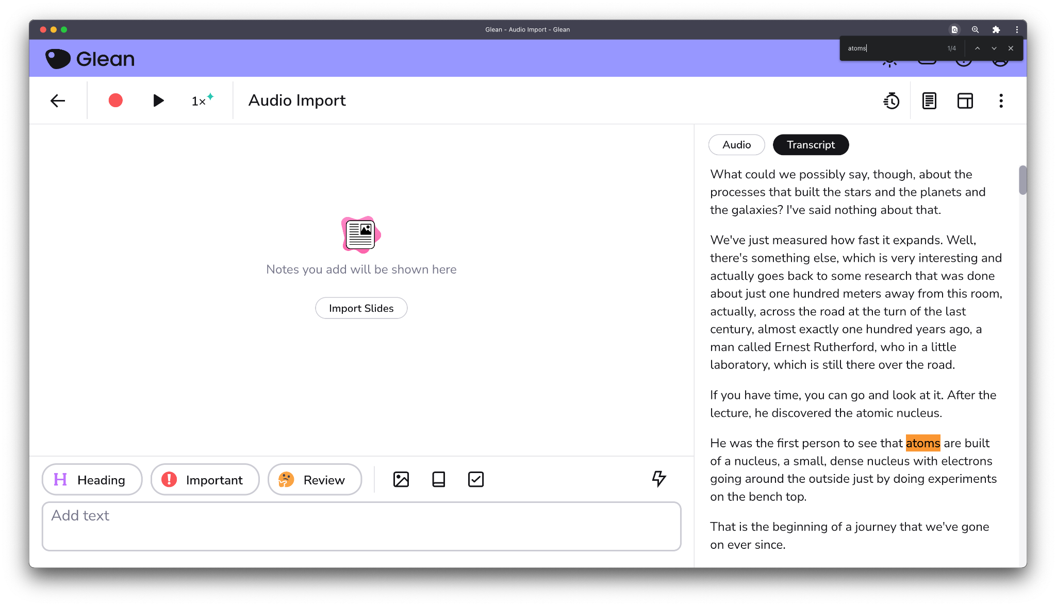
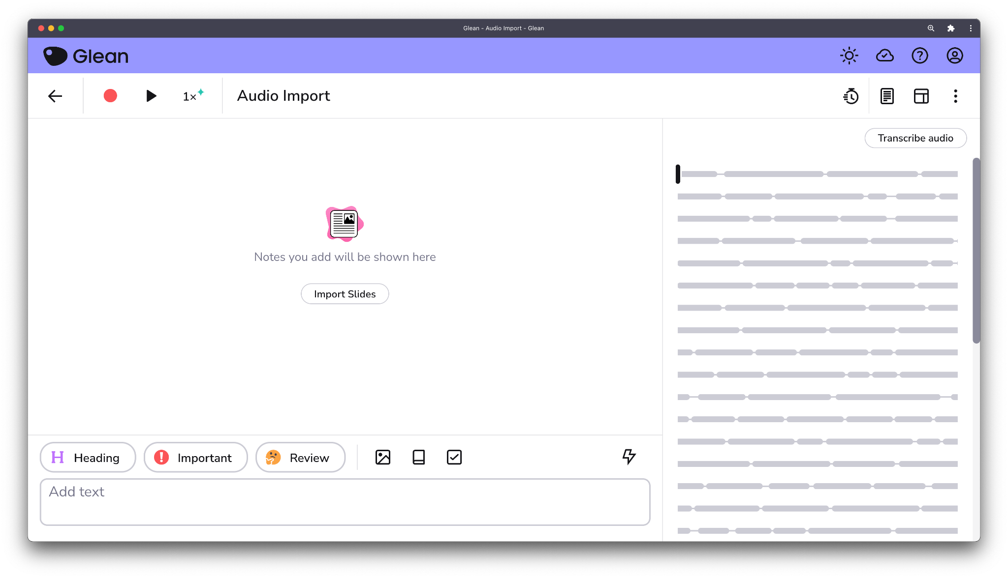
Audio Import flowchart

Slide 6



Most students initially use their mobile device to be more effective on the move
Record discreetly in lectures
Review notes on the move
Add photos more easily

Slide 7
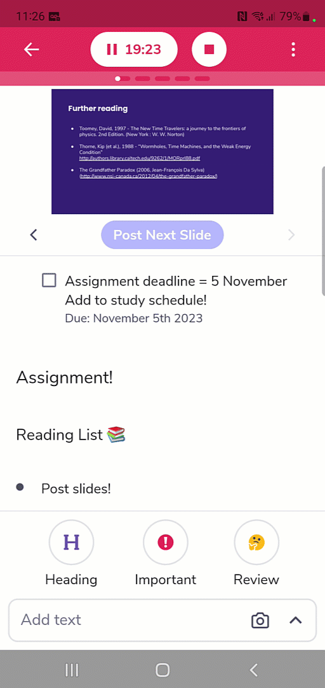
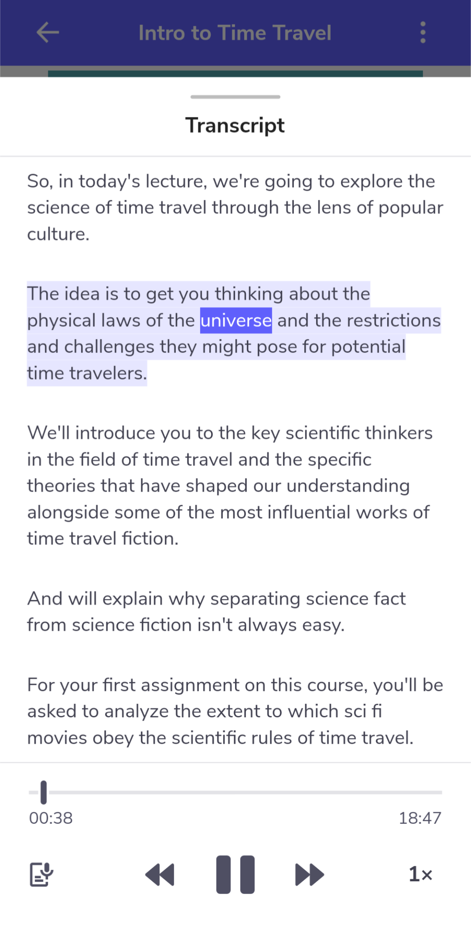

Update #2 - Mobile app parity
Full Slide Support
Add definitions and photos
Add tasks and due dates
Generate and view transcripts

Slide 8




Issues with traditional peer note taking
Challenging to administer
Coordinating support is time consuming and complex.
Poor notes impacts learning
Studies show that better notes lead to better learning outcomes.
Unreliable and of
variable quality
Poor quality or missing notes from peer notes affects compliance.
Creates dependence,
not independence
Relying on peer notes limits the own student’s note taking skills.

Slide 9


Update #3 - Shared Collections
Shared Collections allow you to seamlessly offer peer note taking support via Glean.
Shared Collections is a means of sharing notes anonymously between two students - where one is a designated notetaker, and the other a note recipient.
Compared to traditional support, Shared Collections drastically reduce the burden placed on support services and offer a much-improved experience for note takers and recipients alike.

Slide 10



How does the process work?
Admin sets up new Shared Collection.
Notetaker takes notes and adds them to Shared Collection when ready.
Recipient instantly receives full notes with audio recording.

Slide 11

Benefits of peer note taking in Glean for your support service
Easy to administer
Set up in 3 clicks. Simple as that!
Parity of student experience
Offer an equivalent experience to students whether they require a peer notetaker or work independently with Glean.
Confidence in completeness of provided notes
Student gets notes in Glean, plus a full recording and transcript of class.
Confidence in quality of provided notes
Admins can access any Events shared within shared collections.

Slide 12
Benefits of peer note taking in Glean for your students
Share notes with two clicks
It’s so easy for the note taker to share notes with the note recipient!
Less stress for peer notetakers
They send notes, recording and transcript, they don’t need to note everything down.
Receive access to notes, slides, recording, & transcript
Minimise reliance on the notetaker for clarifications.
Supports independent skill development
Recipients can add to and edit provided notes, creating a truly personalised study resource.

Slide 13


Update #4 - Single Sign-On
Single Sign-On (SSO) is an authentication method that enables users to securely authenticate with multiple applications and websites by using just one set of credentials.
For Glean, this means that students and admins can log in using their institutional credentials rather than relying on separate login for Glean.

Slide 14




Why implement SSO?
Easy access for students
Reduce friction during sign-up
Increased security
Apply stronger security requirements for authentication
Staff can use it too!
Access Glean Admin via SSO
Peace of mind for faculty
Knowledge that access to Glean is backed by the security of the university’s SSO credentials
Notes:
.

Slide 15

Update #5 - Live Captions

Slide 16

Live Captions + Glean
Glean’s beloved note taking tool
Live Captions
and
= even more students supported
90% of users say Glean has helped them achieve better grades
88% find studying less stressful using Glean
85% say Glean has helped them become a more confident learner

Slide 17

Accommodations streamlined
Live captioning tool
or
Note taking tool

