Slide 1
Implementing Universal Design for Learning at the University of Sydney
Lessons Learned and Scaling Strategies
Presented by:
Sarah Humphreys
Educational Design Manager – UDL Lead
27 July 2023

Slide 2
Acknowledgment of country
I wish to acknowledge all the Traditional Owners of Australia and recognise their continuing connection to land, water and culture.
I would like to pay my respects to the Garigal people, the Traditional Owners of the land I am joining you from today. I further acknowledge the Traditional Owners of the country on which you are on and pay respects to their Elders, past, present and future.

Slide 3

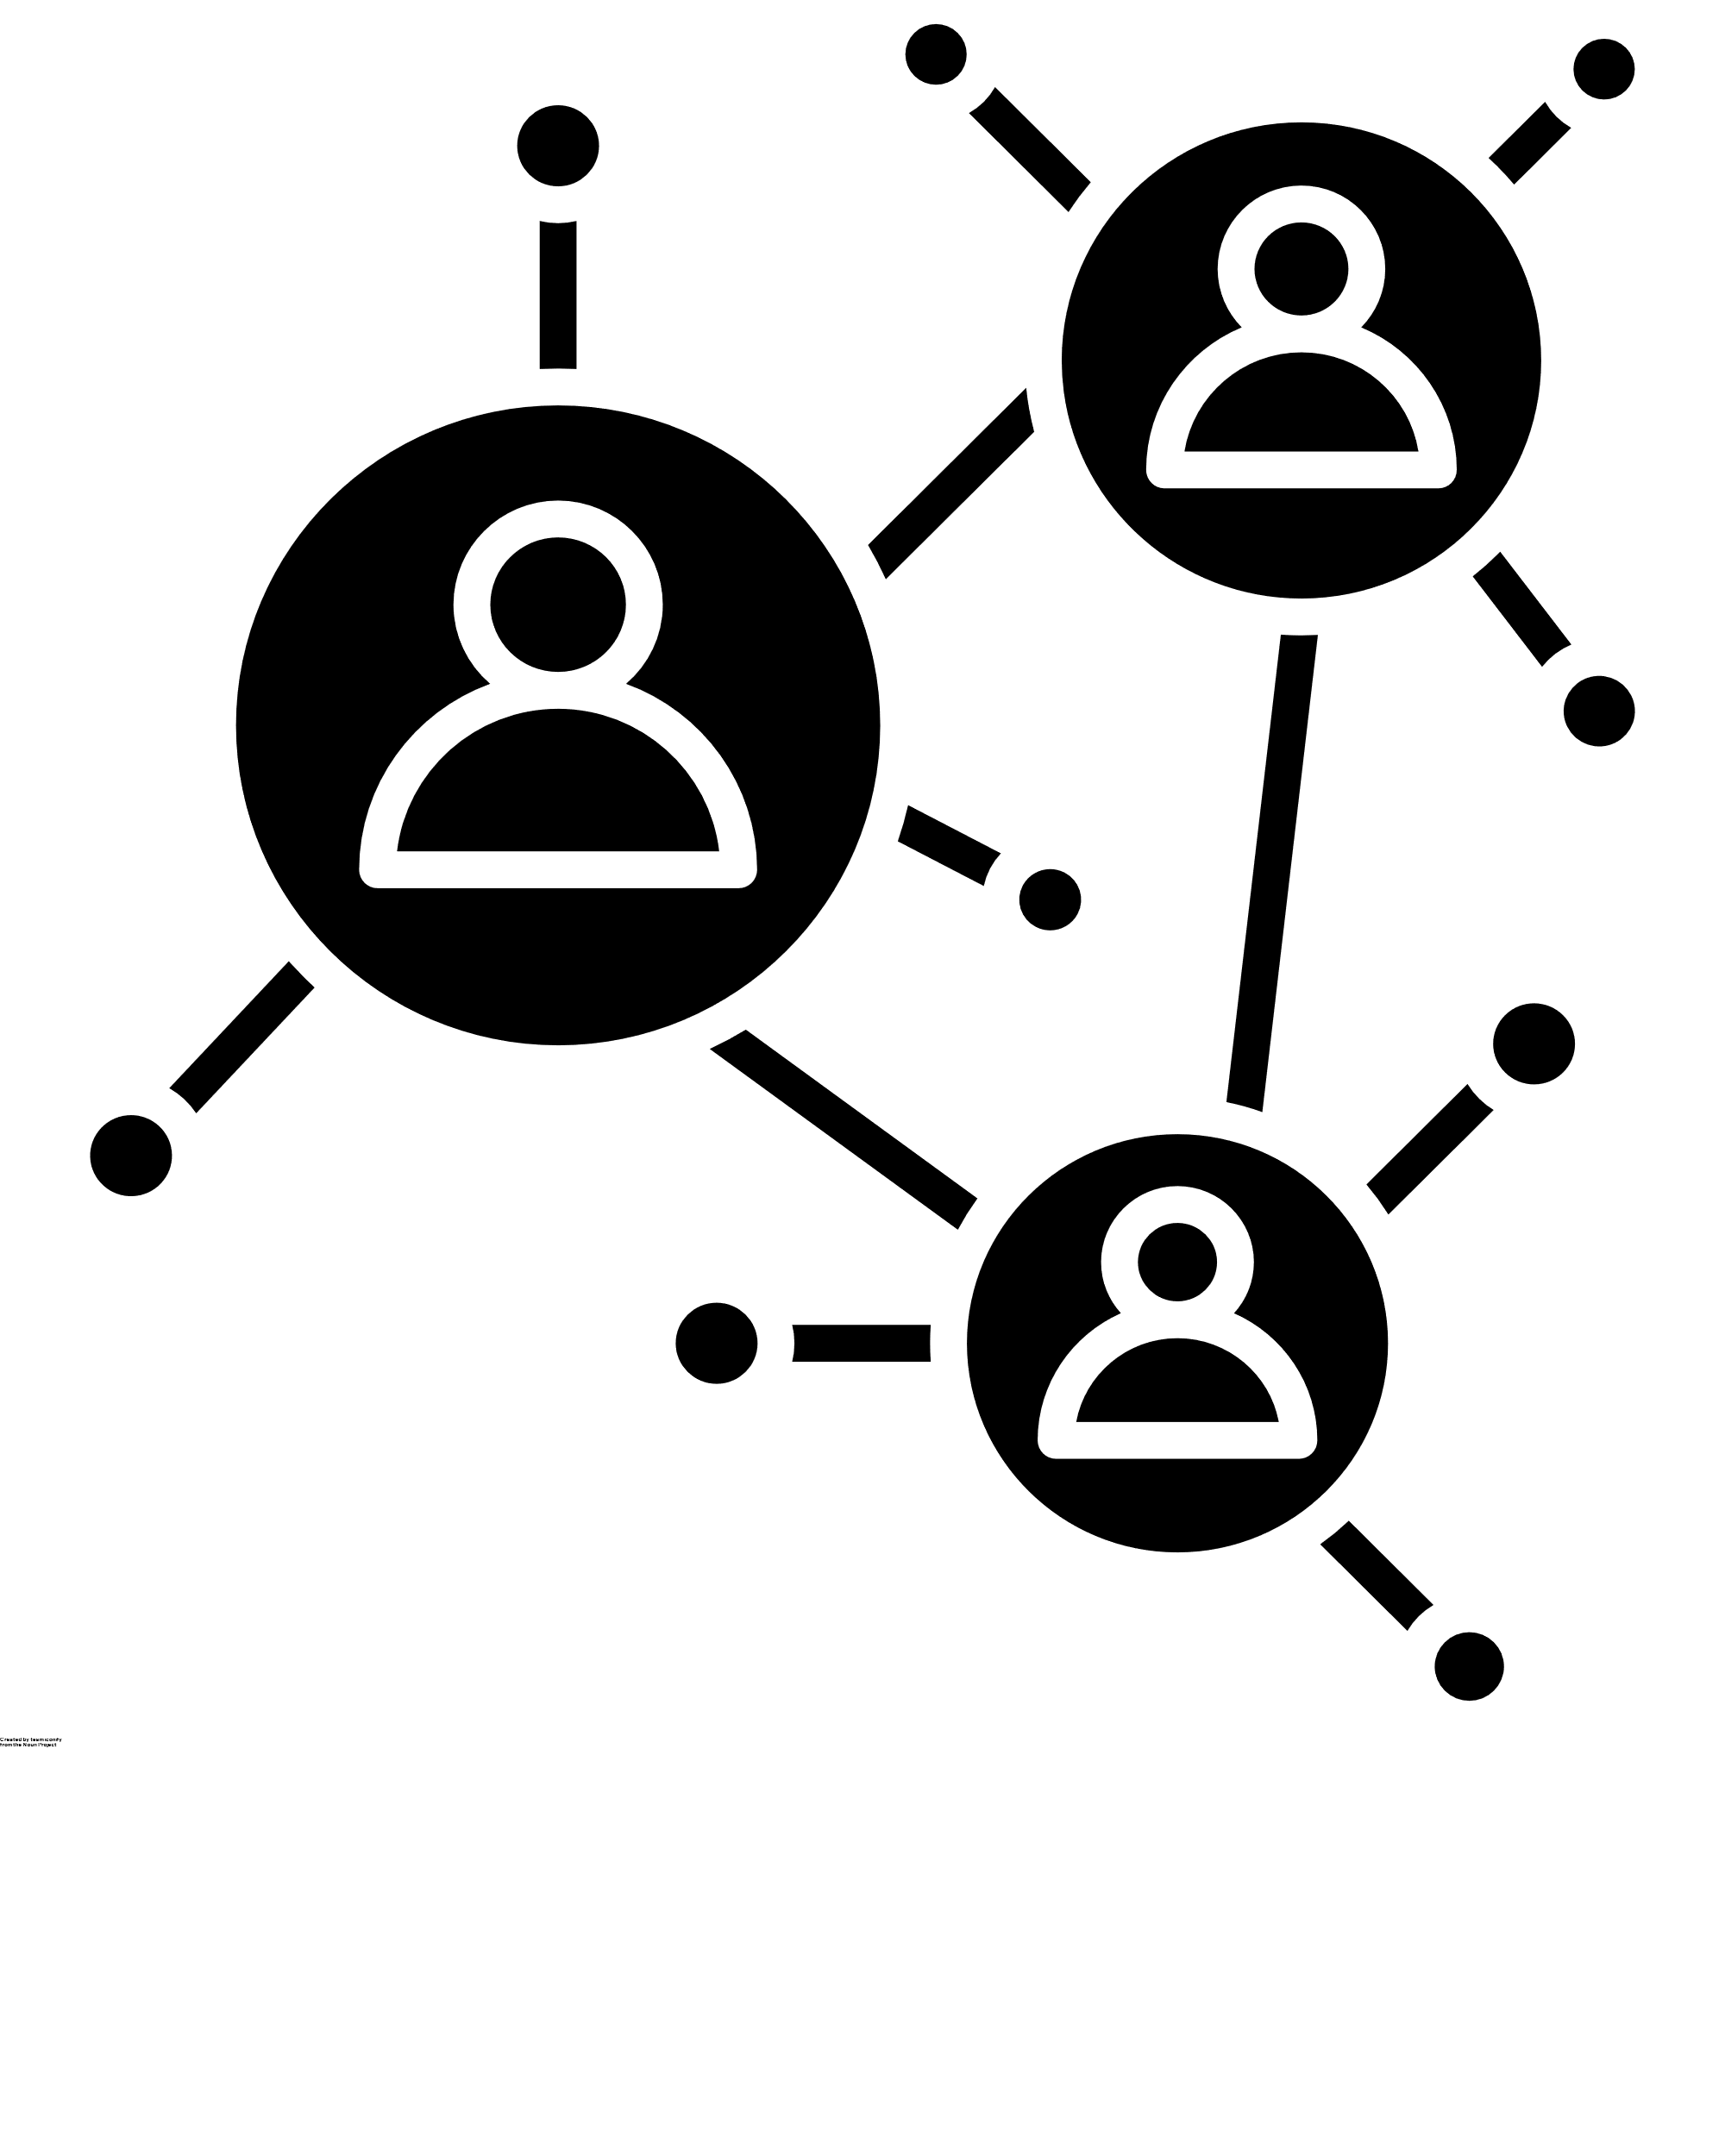

UDL implementation – an iterative process
UDL Pilot Project
Sep 2021 – Jun 2022
Disability Inclusion Action Plan (DIAP)
1x Educational Designer (ED)
Educational Innovation Team
A shared UDL language
Business As Usual
The Strategic Plan
2022 - 2032
Designing for Diversity Project
Phase 1
May 2023 – Dec 2023
1x ED Manager – UDL Lead
2x Educational Designers

Slide 4

UDL Pilot Project
Disability Inclusion Action Plan
Objective 2: The University of Sydney is a higher education provider of choice for all students:
2.2 Provide an innovative, creative, flexible and open learning environment that maximises access, participation and success for all learners.
Outcome 2.2.5
University curriculum will demonstrate application of the principles of Universal Design for Learning.

Slide 5
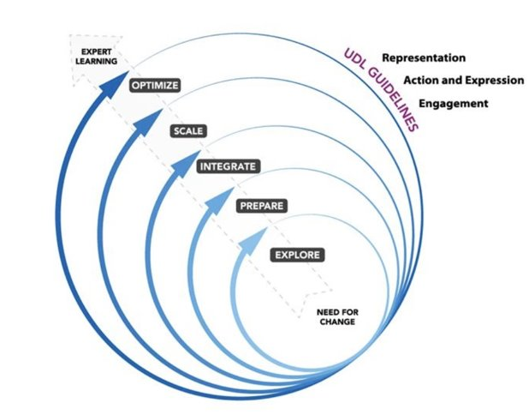
UDL Pilot Project - activities
USER NOTE:
There are more Content Slide options available to add to your presentation
by going to:
Home > New Slide > Drop down arrow
Redesign a unit of study to provide an exemplar of a universally designed unit of study that supports the inclusion of all learners.
Review of current data
Build a new Canvas site with content that incorporates UDL principles
Review unit delivery and teaching materials in line with UDL principles
Document design decisions and application of UDL principles
Gather data
Evaluate the effectiveness of UDL in the unit
Optimise
Scale
Integrate
Prepare
Explore

Slide 6
Starting a UDL conversation
Tell me about your learners
Approx 900 first-year students (across 2 semesters)
70% international students
32 different languages spoken at home
1% indigenous students
9% students with a disability
7% first in family
Falling student engagement
What do your learners find challenging?
Students don’t engage with the required readings
Students do not complete the individual practice activities
What’s your goal for these learning activities?
For students to understand the value of the reading, to embed reading as a good habit for their ongoing studies, and to improve the effectiveness of how they use that information.
The individual activities provide an alternative to a lecture-style session and create opportunities for more active learning as well as to prepare students for their assessments.

Slide 7
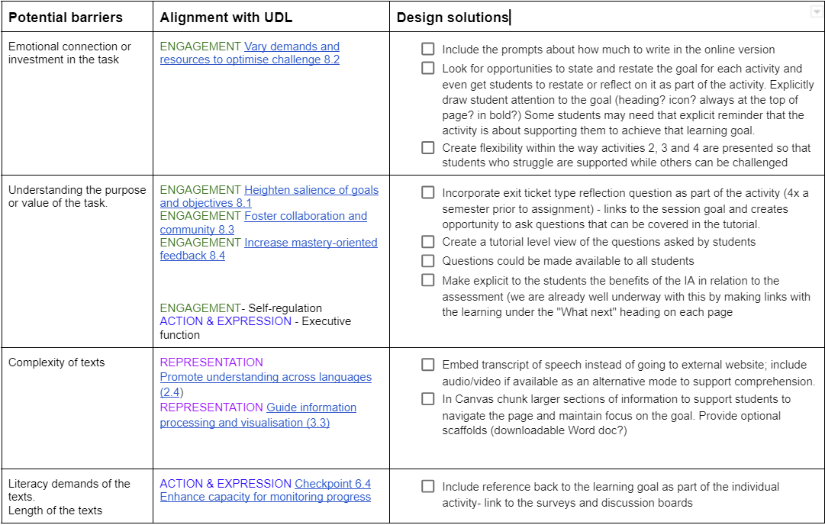
Building trust to brainstorm solutions
How does the current design create potential barriers to learning?

Slide 8
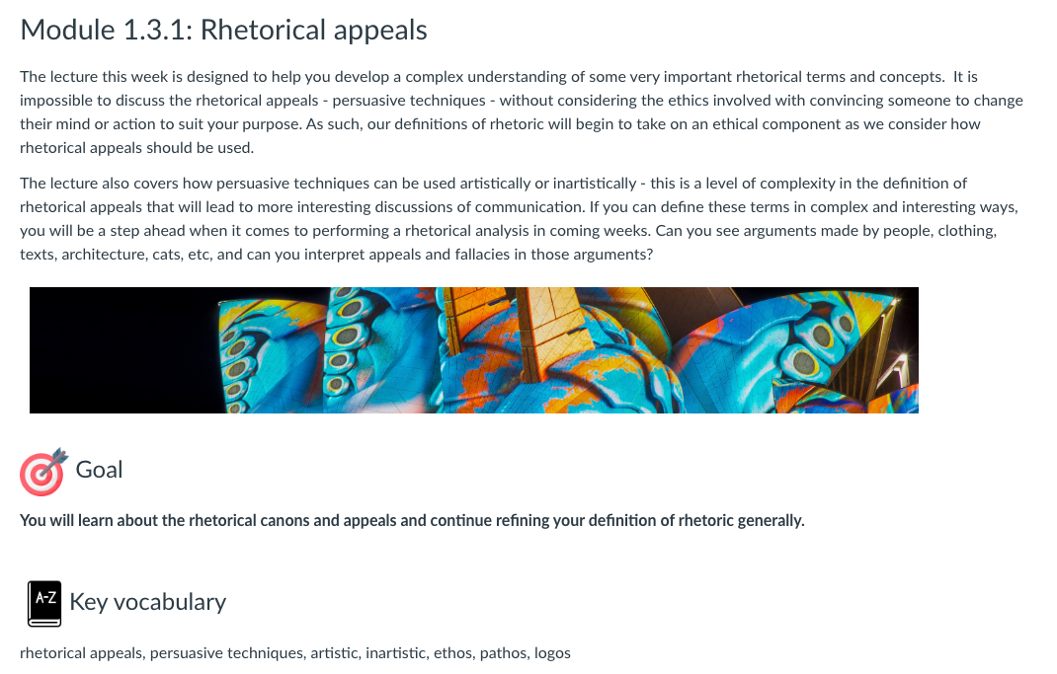

How will your students know what they need to learn?
Provide clear goals for every learning activity
Clear goal at top of page
Prompt to ‘check your understanding’ at bottom of page
Short relevance statements
Heighten salience of goals and objectives (8.1)

Slide 9

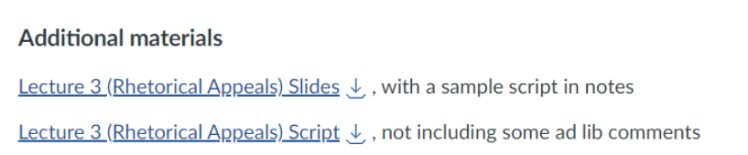
How will you ensure all students can access this information and make sense of it?
Provide choices in learning activities
Present lecture in multiple formats
Offer alternative formats for the readings
Offer ways of customising the display of information (1.1)

Slide 10
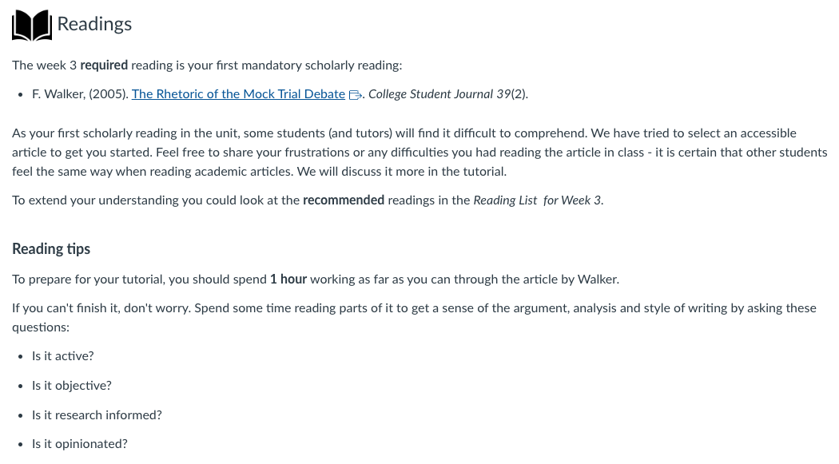

How can you support all of your students to engage with the task and complete it?
Offer guidance to support self-regulation
Highlight key vocabulary
Offer empathetic statements
Provide tips and tricks
Facilitate personal coping skills and strategies (9.2)
Vary demands and resources to optimise challenge (8.2)

Slide 11
Measuring impact
Questions relating to… | S2, 2021 Agree+Strongly agree | S1, 2022 Agree+Strongly agree
Feelings of acceptance and safety | 91% | 96%
Recognition of choices in learning | 91% | 95%
Understanding the importance of learning activities | 89% | 96%
Perceptions of relevant, helpful feedback | 91% | 96%
Finding learning support during difficult times | 88% | 96%
Being given the opportunity to reflect on learning | 89% | 95%
UDL Student Feedback Survey (Katie Novak, 2020)

Slide 12
Additional outputs
Knowledge sharing
UDL Canvas site
UDL chat
1:1 UDL consultations
Workshops and presentations
Blog articles and video interviews
ADCET UDL community of practice
International conference presentations
Optimise
Optimise
Scale
Scale
Integrate
Integrate
Prepare
Prepare
Explore
Explore

Slide 13
Lessons learned and scaling strategies
Avoid UDL acronym – use Universal Design for Learning
The entire UDL framework (31 checkpoints) is overwhelming, ask questions instead
Cultivate a shift in thinking / developing a shared language
Start with small changes (Plus one)
Be transparent with your students about the intent behind the design
Know what you want change to look like – gather data
Start where you know you will have most success
Celebrate your UDL champions - share their stories

Slide 14
Voices from the field
Pharmacy
Canvas design
https://educational-innovation.sydney.edu.au/teaching@sydney/transforming-a-pharmaceutical-compounding-unit-using-competency-based-assessment-and-universal-design-for-learning-udl/
Veterinary Science
Group work design
https://educational-innovation.sydney.edu.au/teaching@sydney/making-group-work-relevant-meaningful-and-accessible-universal-design-for-learning-in-practice/
Exercise and sport science
Assessment design
https://educational-innovation.sydney.edu.au/teaching@sydney/rethinking-assessment-design-one-small-step-at-a-time/

Slide 15
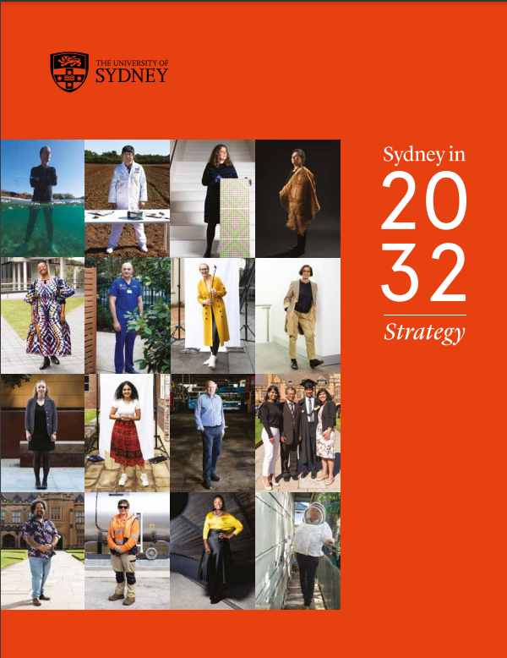
Designing for Diversity Project
Response to the Strategy:
We will design purposeful learning environments which are flexible and deliver the best outcomes to allow all students to flourish, anytime and anywhere.
- embed best practices for online and blended teaching delivery, such as accessibility standards and Universal Design for Learning…

Slide 16
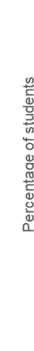
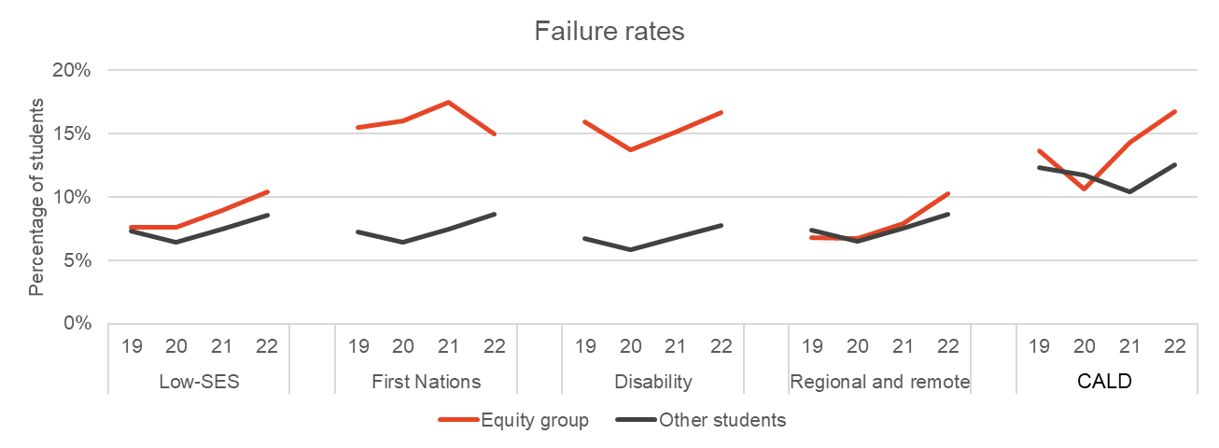
Failure rates
Failure rates vary hugely within student cohorts with noticeably lower success rates for:
  First year students
  International students
  Equity students

Slide 17
Start with student voice
Tell us about a unit of study that presented barriers to your learning
Tell us about a unit of study that really supported your learning
International student
Barrier: inadequate audio set up and accessibility to lectures and associated material
Solution: designing more accessible content by utilising multiple means of communicating material and adjusting mode of delivery
Impact: all students desiring or requiring different modes of engaging with the lectures needs were met.
Student with a disability
Barrier: inflexible learning environment and rigid assessment forms
Solution: designing more flexibility into the course and presenting an adaptive framework for assessment
Impact: all students needing flexibility due to competing priorities, illness, disability or other needs are met.

Slide 18
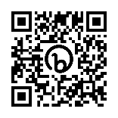





Designing for Diversity project
Read more:
https://bit.ly/44YXBuu
Student diversity is the norm (mindset)
Identify student needs and reframe as potential barriers in environment (proactive)
Start by changing one thing to remove that barrier (intentional)
Evaluate and iterate (iterative)
LEARNERS
Who are my learners?
GOAL
What is the learning goal?
BARRIERS
What are the barriers to learning?
SOLUTIONS
What’s one possible solution to removing a barrier?
NEXT STEPS
How will you evaluate and iterate?

Slide 19
Designing for Diversity Project – activities
Implement UDL principles in large*, first-year units of study
Review of current data
Invite Unit Coordinators to participate in project
Review learner variability and barriers to learning in line with UDL principles
Document design decisions and application of UDL principles
Evaluate the effectiveness of UDL in the unit
Plan next steps
*>200 students
Optimise
Scale
Integrate
Integrate
Prepare
Prepare
Explore
Explore

Slide 20
Designing for Diversity – phase one
12 Unit Coordinators
6 faculties / schools Project teams
Led by Unit Coordinator, supported by Educational Innovation
May includes faculty Educational Designers, co-coordinators, tutors, students
Started end of Sem 1 during STUVAC
Barriers | Solutions to be tested
Prior / assumed knowledge | Acknowledge range of skills Offer support materials Use encouraging language
Physical space creates a barrier for students to communicate | Ice breaker activities: - get to know each other - adjust the physical space
Volume of content and workload | Lectures – normalise difficulties by giving examples from personal experience Tutorials - check-in with students before they fall behind.

Slide 21
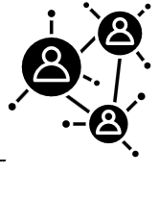
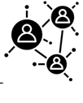
Additional project outputs
Optimise
Optimise
Knowledge sharing
Designing for Diversity workshops
More ‘voices from the field’ added to UDL Canvas site
UDL community of practice
Continue with:
UDL chat
1:1 UDL consultations, individual projects with a focus on UDL/designing for diversity
Workshops and presentations
Teaching@Sydney blog articles and video interviews
ADCET UDL community of practice
International conference presentations
Scale
Scale
Integrate
Integrate
Prepare
Prepare
Explore
Explore

Slide 22
Measuring impact
Goal: Reduced achievement gaps for equity groups
Outcomes:
Changes in Units of Study design
Use of UDL language in design
Uptake of UDL across whole faculties / schools
Measures:
student data; before and after stories
statement of learning design shared with students; most significant change stories
UDL language and concepts in faculty processes, procedures, guidelines
UDL Reporting Criteria
Universal Design for Learning Implementation Research Network (UDL-IRN) 2018

Slide 23
End slide
Sarah Humphreys
Educational Design Manager – UDL Lead
Educational Innovation Team
University of Sydney
first.last@sydney.edu.au
sarah.humphreys@sydney.edu.au

