Slide 1

Inclusive assessment for students with disability
Dr Joanna Tai
13 June 2023
ADCET Webinar
Notes:
Educational institutions are legally required to ensure their assessments are not discriminatory, hence adjustments are implemented for students with disability. However, these students still report difficulties with exams, and some avoid them altogether (Grimes et al., 2021).
Substantial changes to exams in higher education occurred during the COVID pandemic. A research grant from the National Centre for Student Equity in Higher Education explored how examination arrangements in higher education impacted on students’ experiences of inclusion.
In this presentation, Dr Tai will share findings from her research on how examination arrangements in higher education impact on students’ experiences of inclusion and ways to improve inclusion in exams as part of a holistic approach to Universal Design for Learning.

Slide 2

Acknowledgement of Country

Slide 3


Acknowledgements
Research team members: Rola Ajjawi, Margaret Bearman, Joanne Dargusch, Mary Dracup, Lois Harris, Paige Mahoney
“Re-imagining exams: How do assessment adjustments impact on inclusion?”, was conducted under the National Centre for Student Equity in Higher Education (NCSEHE) Research Grants Program, funded by the Australian Government Department of Education, Skills and Employment.
We thank all people (staff, students, advisory group members) who have participated in the project for their contributions

Slide 4
Outline
Why inclusive assessment?
The research project: how do exams impact students’ experiences of inclusion?
  Phase 1: student narratives
  Phase 2: workshop series
Implications for inclusive assessment
Overview of project resources

Slide 5
Student diversity is increasing in higher education
Increasing numbers of diverse students in higher education who may belong to multiple equity groups: disability, Indigenous, low socioeconomic status background, regional/rural/remote, study in a non-traditional area (Grimes et al. 2017, Marginson 2016)
We are morally and legally obliged to ensure students have the same opportunities to demonstrate achievement (Disability Discrimination Act (Cth) 1992; Disability Standards for Education (Cth) 2005)
Some students do not disclose their condition(s) (Grimes et al. 2019)
Accommodations and adjustments approach cannot help these students!

Slide 6
Unequal outcomes persist
Department of Education Skills and Employment (2020)
Notes:
Beyond the success rates – for which we don’t have numbers for disability, we do however know that from the graduate outcomes survey reporting that students with disability also enjoy employment rates that are roughly 10% below non-disabled students.

Slide 7
Assessment impacts on progress and therefore success
Even when available, adjustments often do not address student needs (Waterfield & West 2006; Weis & Beauchemin 2019)
Can make students feel excluded (e.g. separate room)
Can still create exam-related stress and anxiety
While our project focussed on students with disabilities, there is evidence that assessment has impacts on success for other students also (Crawford 2021, Devlin & O’Shea 2012, Naylor & Mifsud 2019, Nelson et al 2017)
It’s not just about exams: essays, quizzes, group projects, oral presentations, and placements can also be problematic

Slide 8
Adjustments by assessment type (2018)
Notes:
2018 total: 2860 access plans
Exams and online tests were found to be the biggest site of adjustments in access plans in our Deakin 2018 data, and thus merited further investigation.

Slide 9
What approaches could we take to make assessment more inclusive?
Move away from deficit discourse of equity groups (O’Shea et al. 2016)
Consider how assessment can be designed to proactively address student diversity, e.g. Universal Design for Learning (CAST 2018, Boysen 2021); Universal Design of Assessment (Ketterlin-Geller et al. 2015)
Take a broader contextualised perspective to assessment design (Bearman et al. 2017)
BUT, there is little evidence about students’ exam-related experiences to help us understand what could be done differently (Tai, Ajjawi & Umarova 2021)
Notes:
Many researchers and equity practitioners have already made suggestions for how we could promote inclusion in assessment. One underpinning concept is that we need to move away from a deficit discourse of equity groups, which means that we should not see them as lacking in and of themselves as students who need to be “fixed” or “brought up to the same level” where we need to react to their plight and make adjustments, rather that circumstances have conspired to discriminate against them. We then need to consider what strengths and capabilities these students have, and how they can draw upon them to demonstrate their capabilities.
One way to approach this is through Universal Design, which takes a proactive approach to diversity in students. There are various ‘flavours’ of Universal Design, which focus on different aspects, such as physical access, and cognitive diversity.
Within assessment, we also suggest that we need to take a more contextualised perspective to understand what is broadly influencing assessments.
In the case of exams, we found limited contemporary evidence for the current state of play on what students’ exam-related experiences are. This is crucial to understand what matters most in inclusive assessment design.

Slide 10
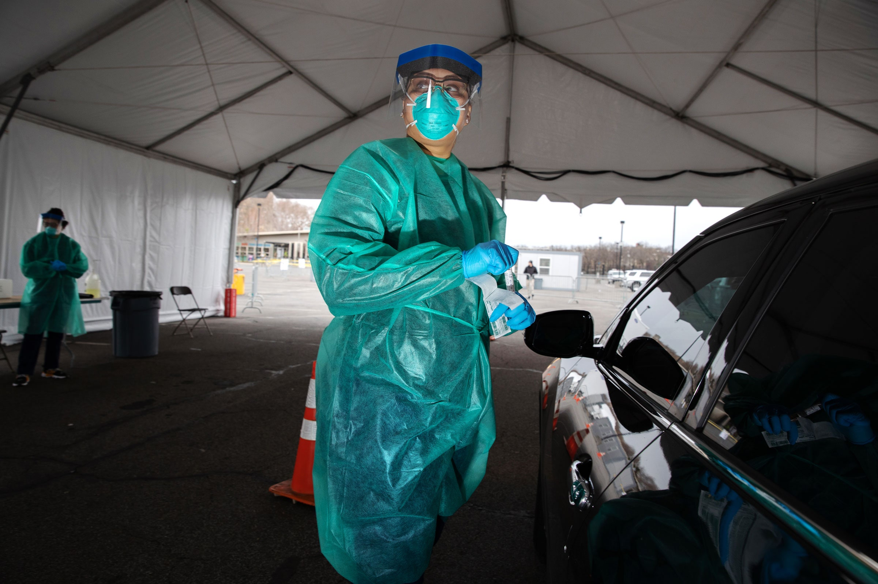
But then… the pandemic happened
This Photo by Unknown Author is licensed under CC BY-SA

Slide 11
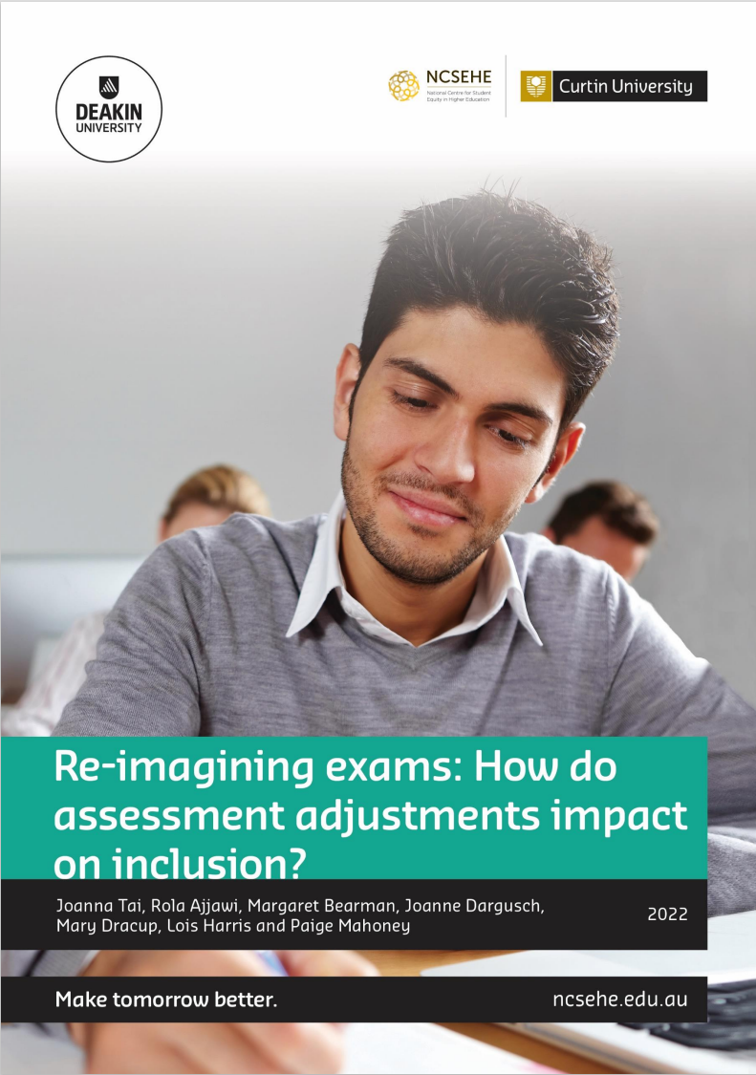
Can a sociomaterial lens help us better understand inclusion in exams?
Sociomaterial theories conceptualise phenomena as dynamic interactions between spaces, objects, and people (Fenwick 2010)
Shifts the focus to consider how exams unfold through time and space
Considers the relationships between exam halls, desks, chairs, laptops, screens, administrators, students, teachers, invigilators
Social and material arrangements can contribute to students’ “inclusion” or “exclusion” in exams
Notes:
Pandemic context shifted the way assessment was carried out

Slide 12
Project research questions
What are the social and material arrangements that impact on the inclusivity of high-stakes timed assessments?
Within high-stakes timed assessment practices, how does disadvantage for SWDs intersect with RRR, FiF and/or low SES?
How are the social and material arrangements of high-stakes timed assessment amenable to change?
Can modifying social and material arrangements result in more inclusive assessment design?
Notes:
This presentation draws on data from a NCSEHE funded research grant on re-imagining exams.
This project included gathering SWD student voice data, and using this to underpin collaborative work to re-imagine exams that was undertaken in a series of workshops with SWDs, accessibility staff and academic staff. This presentation refers to the first phase of the project and we’ll be focussing in this presentation on the first two research questions

Slide 13
Phase 1: Student narratives

Slide 14
Methods - interviews
40 semi-structured interviews targeting students with disabilities across CQU & Deakin
    25 from low socio-economic backgrounds or first in family to attend university
    21 from rural, regional or remote areas
Conditions represented: learning disability, physical disability, medical and mental health conditions
High interest from students: additional 11 submitted narratives responding to interview questions
Full HREA approval since research focussed on a vulnerable population
NB: all quotes presented with pseudonyms

Slide 15
Findings overview
How inclusion was experienced varied:
Social arrangements
Technological arrangements
Exam spaces
Exam temporalities
Task layout and configuration

Slide 16
Social arrangements
“My units where I've been successful and I've received high distinctions, the difference was the unit chair and their empathy and flexibility and I think that made the most difference for me.”
– Yasmin, science, FiF, mental health condition
“I had a lot of support from the Accessibility team. […] I felt like I was going to fail at one stage and they were just so supportive. They got me through it.”
– Arlene, health professions, low SES, mental health and medical conditions
“With a disability and being a sole carer, I need to be highly organised to be able to do my academic best. I often need information quite in advance to be able to plan and prepare.”
– Rosanna, arts, medical and mental health conditions
Notes:
Both academics and accessibility staff had a substantial impact on students’ exam experiences. Where academics were flexible and empathetic, students reported they had a good experience. However, when academics were insensitive to student situations, this usually resulted in additional stress for students in ensuring they had adjustments in place. Overwhelmingly, students spoke very positively of the accessibility/disability centre staff, who were very supportive and understanding, and more available for students to discuss their concerns. Students were also more familiar with the accessibility liaison team, as they interacted with the same person or people over time, rather than their unit chairs who would change most semesters.

Slide 17
Technological arrangements
“one of my assessments [was] a mock court for evidence law. I just found that really difficult to do because this was all on Zoom. I was struggling to hear people and there was a lag”
– Rebecca, law, FiF, medical condition and mental health condition
“handwriting and speed is not my friend […] even though my knowledge base is good”
– Samira, health professions, mental health condition and learning disability

Slide 18
Exam spaces
“There's no distractions within the home environment, I have all the different software packages I need to be able to use, and I can go and use my computer. It's essentially being within my own exam room, just being at home, rather than at the university. I don't need to worry about my exam accommodations being ignored or something like that, or the room changing. None of those problems occur.”
– Ben, science, low SES, medical condition and learning disability
“Previously, when I had to go to the physical place, I would see other people also getting extra time and stuff to go have breaks. It was really nice to feel normal.”
– Olivia, arts, mental health condition
Notes:
Students reported positive on-campus exam experiences, where their adjustments had been properly implemented, such as having a quiet room, or opportunity for breaks and extra time. However, shifting to remote/online exams due to COVID had substantial benefits for students with a range of conditions. For many it removed the requirement for a separate room and breaks. For others, the use of technology – especially being able to type answers rather than handwrite – was helpful. Finally, online exams were also usually differently configured, with longer time periods to allow for technological issues, and were usually open book. Both of these changes alleviated stress and anxiety for students with a range of conditions.

Slide 19
Exam temporalities
“One of my exams was more like an assignment. It came out on Thursday at 1:00 PM and it was submitted Friday at 1:00 PM […] Me and whoever I spoke to, we found that we were working on it from one o'clock until 9:00 PM. They said it should take two hours but it really took much longer, and you just don't know when to stop. That I found wasn't really helpful.”
– Charli, science, FiF, mental health condition
“‘if I wake up with a migraine, I can drug up, download it, think about it, lay down for a bit, [chuckles] come back and do it’.”
– Lisa, business and commerce, medical condition
Notes:
Alterations to exam design for COVID, however had both pros and cons. Some students had the opportunity to commence the exam at any time within a set period which suited them, and have a set amount of hours to complete the task. This was beneficial to students who had caring or work commitments which they couldn’t alter. Other exam configurations involved extending the time period the exam was open for, e.g. the task was open for 24 or 38 hours. This meant that some students felt it was difficult to not spend more of that timeframe on the task, even though it might have been introduced as a 3-hour exam. Some students also found that a longer answer format was difficult for them to respond to due to their condition, and preferred multiple choice style exams. However, given the concerns about cheating and the open book possibilities, these were not used as frequently during COVID. Students did acknowledge though that particular exam styles encouraged data dumping rather than the application of concepts to problems, and identified the potential ramifications for graduate practice if students were unable to demonstrate their application of knowledge.

Slide 20
Task layout and configuration
“I definitely missed multiple choice [… it] is definitely the more relieving option because you have no idea what you're doing when you're typing things in and you always feel a little bit scared.”
– Jacob, health sciences, FiF, mental health condition
“[Open book] has been a positive experience for me as it has forced the exam questions to [be] re-written and focused on assessing understanding of the material rather than ability to memorise facts and figures.”
– Vicki, health sciences, medical and mental health condition

Slide 21
Phase 1 summary
Many arrangements contribute to inclusion or exclusion
Likely no “one-size-fits-all” approach to inclusive assessment
  Discipline requirements
  University resources
  Student circumstances
But what could be modified?

Slide 22
Phase 2: Workshop series

Slide 23
Methods - workshops
Identified and invited stakeholders
Unit chairs
Academic developers
Access services team (Disability Liaison Officers)
Students (with previous experience in the unit)
Series of 5 workshops over 4 months, 1-1.5hrs in duration
Prompting questions for participants to reflect on prior to each workshop
Workshops recorded (for consistency across the two institutions)
Multiple case study design to investigate impacts

Slide 24
Workshops overview
Get to know each other, and the project aims, discuss equity and inclusion
Explore roles and relationships in successful exams – drawing on student narratives
Consider assessment design frameworks and how they might apply
Explore how Universal Design for Learning could work in assessment
Reflect on progress and challenges, identify what else could be done (at university/system level)

Slide 25
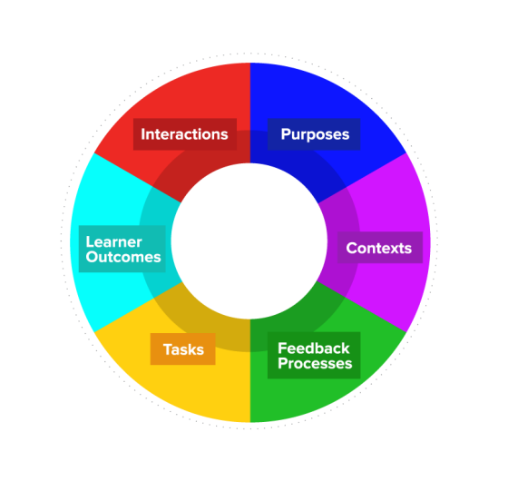
Assessment Design Decisions
Notes:
Guide-to-the-Assessment-Design-Decisions-Framework.pdf (assessmentdecisions.org)

Slide 26
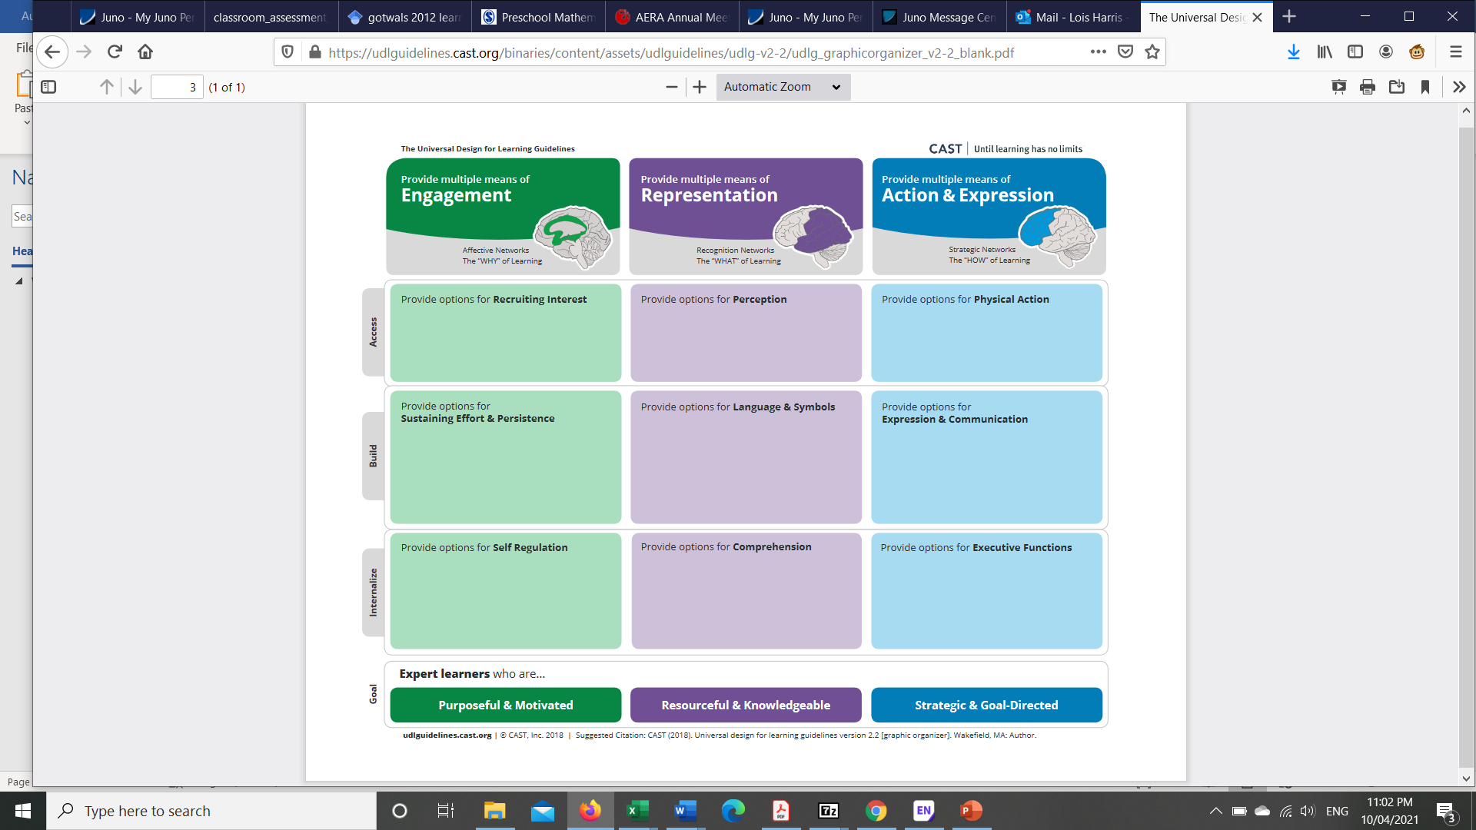
Provide multiple means of Engagement
Is there variety within the task itself (different types of questions, topics to choose from)?
What materials will be necessary to support students to complete the assessment?
How does the assessment in the unit encourage student self-regulation?

Slide 27
Provide multiple means of representation
Will the assessment task include options for perception (visual and auditory information; alternatives for visual and auditory information)? Multimodal information?
How will the wording of the instructions clearly express what must be done? Have the tasks been clearly explained?

Slide 28
Provide multiple means of action and expression
Are there alternative ways students could respond? (mode, rate, timing, volume)
What opportunities are there for student choice (task, mode)?
How does this task encourage students to engage in learning across the unit?
What course design decisions could mitigate student anxiety regarding the assessment?

Slide 29
Case studies – what actually happened
Shifts in understanding through staff & student interactions
A Marie Kondo approach: reducing content, changing expectations
Use of scenario-based assessment
Developing assessment literacy
Small changes to exam logistics
Challenges remained in assessment
Existing assessment arrangements
University operations
Logistics and information communication

Slide 30
Implications for inclusive assessment

Slide 31
What have we learned?
Inclusive assessment is an ongoing process involving many stakeholders
Need to address inclusive assessment at multiple levels:
Task design which supports diversity
Task conditions which account for contexts
Supporting staff & student interaction around assessment
Policy environment which allows for flexibility
Notes:
There are some things that we can change, and others that we cannot. However, it was clear from the interviews that inclusion in assessment required more than just the right forms to be completed. It is an ongoing process which involves many stakeholders. From the data there are several messages we can take away. Firstly, while a move away from invigilated exams to open-book take home tasks might address some time pressure related concerns, this should not mean there are more/longer tasks. Assessment tasks need to support diverse ways of demonstrating capability, and also sample students’ capabilities appropriately. The conditions of exam type tasks also need to account for the contexts in which students are doing the task. Physical spaces and the availability of technology do make a difference to students in their experiences of exams, but we must be careful to consider the impact of mandating or restricting certain conditions. More broadly, we could work on ensuring staff and student interactions around assessment meet students’ access needs better, and in a more efficient way: students expended substantial effort on ensuring their access requirements are met, and this takes away from the energies they can actually devote to the task. Finally, we could consider at the policy and procedure level how institution wide changes might support these types of recommendations.

Slide 32
How can we extend inclusive assessment beyond considering specific equity groups?
The problems with [poor] assessment design are amplified for diverse students
Modifications made to include specific groups (e.g. students with disabilities) are likely to support many diverse students
  Universal Design for Learning principles
Important ingredients
  Time & space for discussions to work through design processes (support at faculty, university levels)
  Stakeholder representatives present at discussions (focus on student voice)
  Safe environment for incremental changes
Notes:
There is likely a link between inclusive assessment design, and “good” assessment design

Slide 33
The project resources

Slide 34
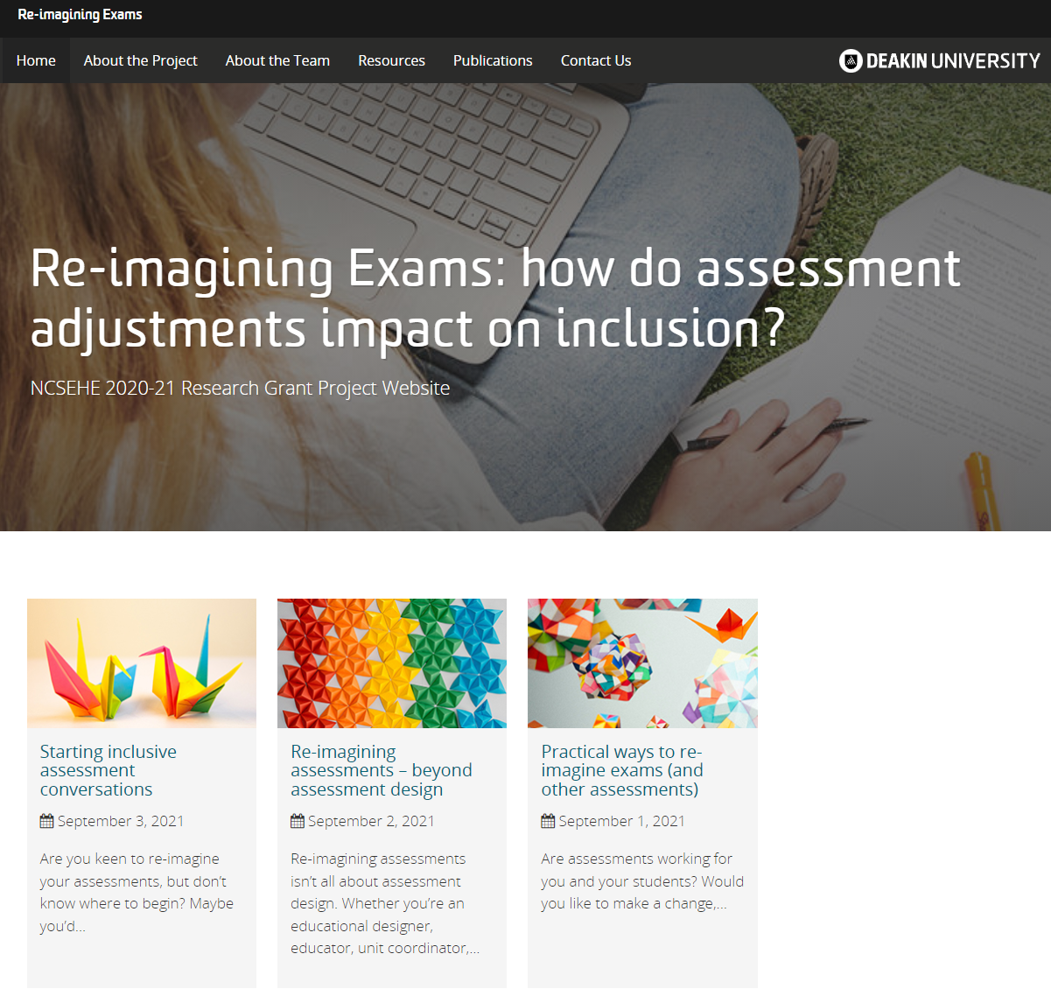
Resources are available via the project website
https://blogs.deakin.edu.au/reimagining-exams/resources/

Slide 35

5 top tips for inclusive exam design
Ensure task requirements are realistic
Set reasonable conditions
Communicate and be approachable
Streamline adjustment requests
Replace the exam with a different task
Notes:
Photo by Tamanna Rumee on Unsplash
Drawing on our student voice data, we’ve developed 5 top tips to guide inclusive exam design.
Ensure task requirements are realistic. This includes whether they are feasible in terms of what can be achieved in a high-stakes, timed environment. It is includes whether they are realistic in terms of authenticity and the extent to which tasks reflect what students might be expected to do in their future beyond university.
Set reasonable conditions that mimic ‘real-world’ situations. Short term frames and closed book exams are unlikely to stop students finding ways to cheat. Typing documents, using spell check and searching the internet for facts are commonplace today and can assist students with a range of disabilities, medical conditions, or who are ESL.
Communicate and be approachable. Students reported that greater and earlier communication about the exam’s topic area and requirements can reduce anxiety. What can help is clarification about assessment processes, for example an assessment FAQ or a Q&A session prior to the exam.
Streamline adjustment requests. Rather than creating complex processes that mean students are negotiating adjustments at the level of individual units, students’ access plans and adjustments should be clearly communicated between disability/accessibility services and academic staff.
Replace the exam with a different task. Consideration should be given to whether an exam is the only way to gather evidence that students have met the unit learning outcomes. This not only works to reduce student stress, but also provides opportunitie s for more diverse demonstrations of capability.

Slide 36
The inclusive assessment framework & development lifecycle
Assessment should credential or develop capability in relation to learning outcomes, not extraneous attributes, skills, or behaviours
Assessment should support diverse students to demonstrate what they know and what they can do, in a way that benefits their development, without unfair barriers.
Evaluate and reflect
Develop assessment tasks
Plan for inclusive change
Implement assessment
Notes:
This guide prompts you through the four elements of the inclusive assessment lifecycle, building on these two principles. Importantly it illustrates that there are aspects to consider across planning, developing, implementing, and evaluating. You can start wherever you are, and follow the loop around.

Slide 37

Institution wide strategies
Create a culture of inclusion.
Support the reimagining of exams.
Improve the clarity of inclusive assessment processes.
Streamline access procedures.
Promote evaluation with respect to inclusive assessment.
Notes:
From the work we also noted that there were institution wide actions that could support inclusive assessment.

Slide 38
Workshop materials
Workshop preparation resources
Objectives
Student vignettes
Reflection prompt questions
Slides for five workshops as outlined in the resources
CC-BY-4.0 so you are free to:
Share — copy and redistribute the material in any medium or format
Adapt — remix, transform, and build upon the material
for any purpose, even commercially.

Slide 39
Questions?
Access the full report: https://www.ncsehe.edu.au/publications/exams-assessment-adjustments-inclusion
Access the resources: https://blogs.deakin.edu.au/reimagining-exams/resources

Slide 40
References
Bearman, M., Dawson, P., Bennett, S., Hall, M., Molloy, E., Boud, D., & Joughin, G. (2017). How university teachers design assessments: a cross-disciplinary study. Higher Education, 74, 49–64.
Boysen, G. A. (2021). Lessons (not) learned: The troubling similarities between learning styles and universal design for learning. Scholarship of Teaching and Learning in Psychology. https://doi.org/10.1037/stl0000280
CAST. (2018). Universal Design for Learning Guidelines version 2.2. http://udlguidelines.cast.org
Crawford, N. (2021). “On the Radar”: Supporting the mental wellbeing of mature-aged students in regional and remote Australia. https://www.ncsehe.edu.au/wp-content/uploads/2021/04/Crawford-Equity-Fellowship-Report_FINAL.pdf
Devlin, M., & O’Shea, H. (2012). Effective university teaching: Views of Australian university students from low socio-economic status backgrounds. Teaching in Higher Education, 17(4), 385–397. https://doi.org/10.1080/13562517.2011.641006
Department of Education Skills and Employment. (2020). 2019 Section 11 Equity Groups.
Disability Discrimination Act (1992) Commonwealth of Australia
Disability Standards for Education (2005) Commonwealth of Australia
Fenwick, T. (2010). Re‐thinking the “thing.” Journal of Workplace Learning, 22(1/2), 104–116. https://doi.org/10.1108/13665621011012898
Grimes, S., Scevak, J., Southgate, E., & Buchanan, R. (2017). Non-disclosing students with disabilities or learning challenges: characteristics and size of a hidden population. Australian Educational Researcher, 44(4–5), 425–441. https://doi.org/10.1007/s13384-017-0242-y
Grimes, S., Southgate, E., Scevak, J., & Buchanan, R. (2019). Learning impacts reported by students living with learning challenges/disability. Studies in Higher Education, 46(6), 1146-1158. https://doi.org/10.1080/03075079.2019.1661986
Harper, R., Bretag, T., & Rundle, K. (2021). Detecting contract cheating: examining the role of assessment type. Higher Education Research & Development, 40(2), 263–278. https://doi.org/10.1080/07294360.2020.1724899
Ketterlin-Geller, L. R., Johnstone, C. J., & Thurlow, M. L. (2015). Universal Design of Assessment. In S. Burgstahler (Ed.), Universal Design in Higher Education: From Principles to Practice (2nd edition, pp. 163–175). Harvard Education Press.
Marginson, S. (2016). The worldwide trend to high participation higher education: dynamics of social stratification in inclusive systems. Higher Education, 72(4), 413–434. https://doi.org/10.1007/s10734-016-0016-x
Naylor, R., & Mifsud, N. (2019). Structural inequality in higher education: Creating institutional cultures that enable all students. https://www.ncsehe.edu.au/wp-content/uploads/2019/09/NaylorMifsud-FINAL.pdf
Nelson, K., Picton, C., McMillan, J., Edwards, D., Devlin, M., & Martin, K. (2017). Understanding the Completion Patterns of Equity Students in Regional Universities. 1–46. https://www.ncsehe.edu.au/wp-content/uploads/2017/06/Nelson-Completion-patterns.pdf
O’Shea, S., Lysaght, P., Roberts, J., & Harwood, V. (2016). Shifting the blame in higher education – social inclusion and deficit discourses. Higher Education Research and Development, 35(2), 322–336. https://doi.org/10.1080/07294360.2015.1087388
Tai, J., Ajjawi, R., & Umarova, A. (2021). How do students experience inclusive assessment? A critical review of contemporary literature. International Journal of Inclusive Education, 1–18. https://doi.org/10.1080/13603116.2021.2011441
Waterfield, J., & West, B. (2006). Inclusive Assessment in Higher Education: A Resource for Change. https://doi.org/10.4324/9781315045009
Weis, R., & Beauchemin, E. L. (2019). Are separate room test accommodations effective for college students with disabilities? Assessment and Evaluation in Higher Education, 45(5), 794-809. https://doi.org/10.1080/02602938.2019.1702922

Slide 41
Data collection and analysis
Semi-structured interviews
Conducted remotely via Zoom or phone
Interview organisation: Experiences with exams/timed assessments; assessment more broadly; adjustments/consideration for exams; background and impacts on university study
Thematic analysis (emergent themes/sub-themes, initial, codebook, refinement, testing, distribution to team)
NVivo software for coding and data management

Slide 42
What about cheating, assessment security and academic integrity?
Exams themselves are vulnerable to third-party cheating (Harper et al 2021)
Academic integrity education required so that all students know what is [not] acceptable, staff understand approaches and relative risks
Need to take a programmatic approach to assessment security
Trialled within open-book/open-ended tasks:
Use of Zoom vivas for students to explain their rationale and working
Use of scenario-based questions where it is more difficult to obtain “Googleable” answers

