Slide 1
Welcome to the Celebrating Accessibility in Action event 2023
As part of Global Accessibility
Awareness Day #GAAD

Slide 2
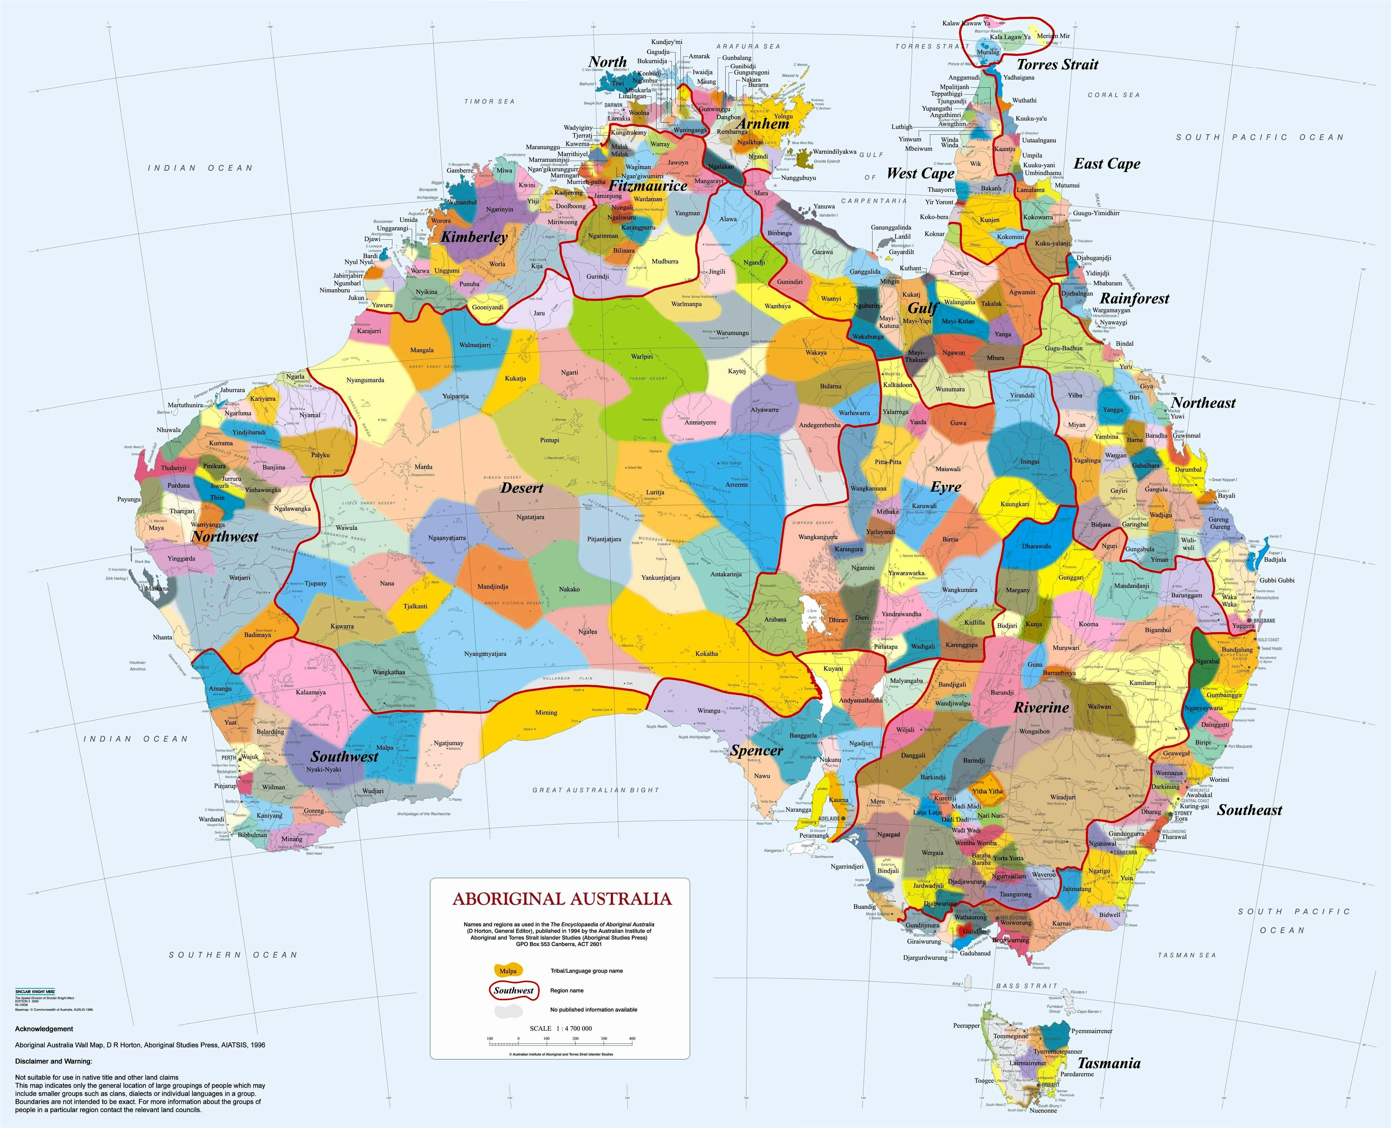
Acknowledgement to country
https://aiatsis.gov.au/explore/map-indigenous-australia

Slide 3
About the awards
ADCET is proud to continue our Accessibility in Action awards in line with Global Accessibility Awareness Day, May 18 2023, as a way of highlighting and showcasing the amazing work in promoting and advancing accessibility and inclusive practice across the tertiary education sector.

Slide 4
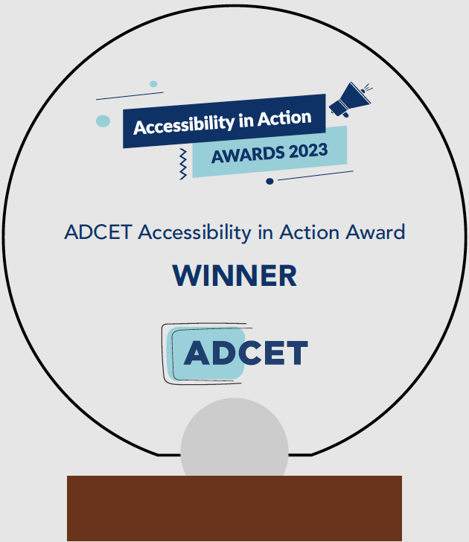
Awards are coming out to winners in the mail

Slide 5
Highly Commended
4 winners

Slide 6
Ensuring Occupations are Responsive
to People with Disability
Professor Karen Fisher and Professor Iva Strnadova
― ACOLA (Australian Council of Learned Academies)

Slide 7
Developing a Student-centric
Accessibility Service
Gillian Smith, Jordon Milroy, Filia Armstrong-Marks, David Fletcher, Erin Loo
― University of Canterbury (NZ)

Slide 8
Sustainable Disability Support
Priyanka Choudhury, Faye Sakelariou, Peter Battaglia
― Kangan Institute, TAFE Victoria

Slide 9
An integrated approach to Embedding Open Education
Bill Borrie, Patricia Corbett, Rachel Lee,
Trevor Thornton, and Tricia Wevill
― Deakin University

Slide 10
Team Awards
14 winners

Slide 11
Improving digital accessibility

Slide 12
Multi-platform accessibility audit
Danielle Johnson, Rachael Wilson
Matthew Lyons, Jeshmine Bajracharya, Michael Horn
― Deakin University

Slide 13
Digital Accessibility Enhancement
Dr. Veronica Jiang, Seda Cokcetin, Associate Professor Helen Kang & Md Badiuzzaman
― The University of New South Wales

Slide 14
Student-led or
Co-designed

Slide 15
Enhancing Digital Accessibility Student Project
Ryan Armer, Phillippa Combrink, Dale Gavlik, Maria Daniele, Josh Oldershaw & Shaun Basson:
Student Equity Advisors Digital Accessibility
― Edith Cowan University

Slide 16
Disability Inclusion Student Group
Bailey Weymss & Jennifer Watson: Student Leaders
Belinda Brear & Ciara Hablado: UniSC Student Partnership Office
― University of the Sunshine Coast

Slide 17
Diversified
Aaron Saint-James Bugge, Josephine Bober, Chantel Le Cross: Students
Professor Terry Cumming, Associate Professor Ian McArthur, Karen Kriss, Dr Karin Watson, Dr Alexander Smith, Dr Scott Brown, Dr Veronica Jiang, Dr Holi Birman & Charlotte Long: Staff
― University of New South Wales

Slide 18
Student Aid Program
Carol Witney, Minh Do, Anh Tran Thi Tram, Tu Nguyen, Melanie Casul, Giang Le and 27 Students Aid Staff
― RMIT Vietnam

Slide 19
Student
Support

Slide 20
ECU Campus
Sensory Spaces
Deb Duffy, Kiara Fletcher, Hannah Pickup and Fiona Navin: Access and Inclusion team
Katherine Huck, Stevie Lane and Kay Barnard: Equity Projects team
Dave Brierley: Digital and Campus Services
― Edith Cowan University

Slide 21
Teaching &
Learning

Slide 22
Embedding Accessibility:
Disability Confidence Training; Accessibility Champions Network; Accessible Technology Online Training
Dr Olivia Whalen, Katie Butler and Sam Rykers and the Accessibility Champions
― University of Newcastle

Slide 23
Accessibility Champions Project
Mahen Jayawardena, April Bjork, Lisa Foster, Tricia Ong, Karen Lake, Michael Wright, Liza Marsh, Elizabeth Delacretaz, Emily Partington, Francesca Bussey, Ismail Zengin, Mary Ishak, Matthew Griffiths, Pennie White, Rene Hahn, Darren Britten, Travis Zimmer, Ambili Sasidharan
― Deakin University

Slide 24
High-level support for
Subject Design Project
Katie Duncan, Ashley Willcox & Elham Hafiz: LX.lab Inclusive Practices Team
Justin Dewhurst & Liz Penny: UTS Accessibility Service
― University of Technology, Sydney

Slide 25
Accessibility Hub
David Beaumont, Vivienne Bennett, Annie Carney, Dean Champ,
Andrew Corbett, Samuel Edward, Annemaree Gibson, Tania Teese
― Box Hill Institute, Victoria

Slide 26
Foundation Maths Program
Kim Jones, Dawn Jones, Tom Petsinis & Megan Theodore: Staff partners
Eliza Osborn & Molly McKenzie: Student partners
― Deakin University

Slide 27
CQU Renew Accessible Moodle Template
The Learning Design Team - Learning Design & Innovation
Nadine Adams (Senior Learning Designer), Zoe Allen (Associate Learning Designer), Faith Appleton (Senior Learning Designer), Marie Foreman (Senior Learning Designer), Rob Hoyland (Associate Learning Designer), Nicholas Lawler (Learning Designer), Paul Oliveri (Senior Learning Designer), Rikki Scott (Associate Learning Designer), Monique White (Senior Learning Designer), Sean White (Associate Learning Designer), and Justin Wylie (Learning Designer)
― Central Queensland University

Slide 28
Inclusive Design Standards
Inclusive Design Team, Educational Quality Enhancement Team, Product and Quality Group:
Naomi McGrath, Teresita Eslava, Gail Mercado, Carla McMillan, Kelly Connor, John Fardoulis, Kathy Simic, Stephen Belbin, Kerrie Hammond, Sue Wakefield, Danicka Ryan, Stacey Mathers
― TAFE NSW

Slide 29
Individual Awards
5 winners

Slide 30
Student Support
Kay Barnard
Equity Projects Coordinator
― Edith Cowan University

Slide 31
Student Support
Tracy Jennings
Inclusive Resource Developer
― Deakin University

Slide 32
Teaching & Learning
Rae Jobst
Educational Designer
― Griffith University

Slide 33
Improving Digital Accessibility
Andrew Normand
Web Accessibility Lead
― University of Melbourne

Slide 34
Teaching & Learning
Dr Emma Ryan
Lecturer, Faculty of Arts & Education
― Deakin University

Slide 35
Coming up!
Look out for some of our amazing winners in webinars, podcasts and articles!
For more information on AIA visit:
www.adcet.edu.au/our-work/accessibility-in-action-award

Slide 36
Congratulations
& Thank You

