Slide 1
A practical solution to increasing accessible content with Anthology Ally
ADCET Webinar Series
Michael Garner
May 2023

Slide 2
About Anthology
Anthology offers the largest EdTech ecosystem on a global scale, supporting over 150 million users in 80 countries.
Through over 60 SaaS products and services, Anthology advances learning in partnership with K-12, higher education, business and government institutions.
Tapping into this unmatched portfolio of solutions, only Anthology can leverage data from across the EdTech ecosystem to create intelligent experiences that lead to better outcomes.
150M+
users
80+
countries
60+
SaaS products

Slide 3
Combining Best-in-Tech Solutions to Power Your Success
Anthology and Blackboard completed their merger on October 25, 2021, creating the largest EdTech ecosystem at a global scale.
Our passion is making the lives of learners, educators, and leaders easier. That’s why we create experiences that are more informed and personalized to support learning, teaching, and leading more effectively.
By responsibly leveraging data, our solutions enable insights and information at the right time, in the right way, to support the right actions—with data privacy and security at the forefront of our approach.

Slide 4
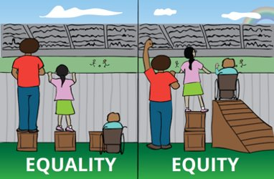
Definitions – What is Accessibility and Digital Accessibility?
“Accessibility involves designing systems to optimise access. ​ ​
Being inclusive is about giving equal access and opportunities to everyone wherever possible”. (Jisc, 2018)

Slide 5
What is Digital Accessibility?
Digital accessibility is the ability of a website, application, or electronic document to be easily navigated and understood by a wide range of users, including those users who have visual, auditory, motor, or cognitive disabilities.​
Accessibility means making your content and design clear and simple enough so that most people can use it without needing to adapt it, while supporting those who do need to adapt things. (Central Digital and Data Office (CDDO), 2018)

Slide 6
Why is it important?
At least 1 in 6 people in Australia have an impairment or disability. (AIHW, 2022)​
Many have temporary disabilities
It prepares learners to succeed in diverse working environments. ​
Learners value an inclusive approach​
Benefits all

Slide 7
Diverse 21st Century Learners
Visible disability
Invisible disability
International
students
Professionals seeking more education
Temporary
disability
First-time college students and their family
Parents
Commuters
Mobile

Slide 8
Challenges of building an inclusive environment
Limited or no insight into how institution is performing
Lack of awareness and understanding on how it can affect users
Explicit alternative format requests often exclude many students and include long delays
Increased legal requirements and expectations
Lack of instructor guidance on how to improve accessibility
Students are looking for more universally designed content and flexibility

Slide 9
Ally has something for each learner

Slide 10
Ally in numbers
Over
Over
Over
1300
81 Million
3.4 Billion
Institutions Around the World
Courses Processed
Content Items Processed
Since
2017
Creating more inclusive learning environments for all

Slide 11
Fix your content day competition
A 24-hour competition committed to creating accessible and more inclusive digital learning content across classrooms and institutions globally for Global Accessibility Awareness Day (GAAD).
MAY
18
Are you up for the challenge?
https://www.anthology.com/fycd
Learn tips and strategies for mobilizing team members with our Communications Pack.
Notes:
https://www.anthology.com/fycd
https://www.anthology.com/fix-your-content-day/communications-pack

Slide 12
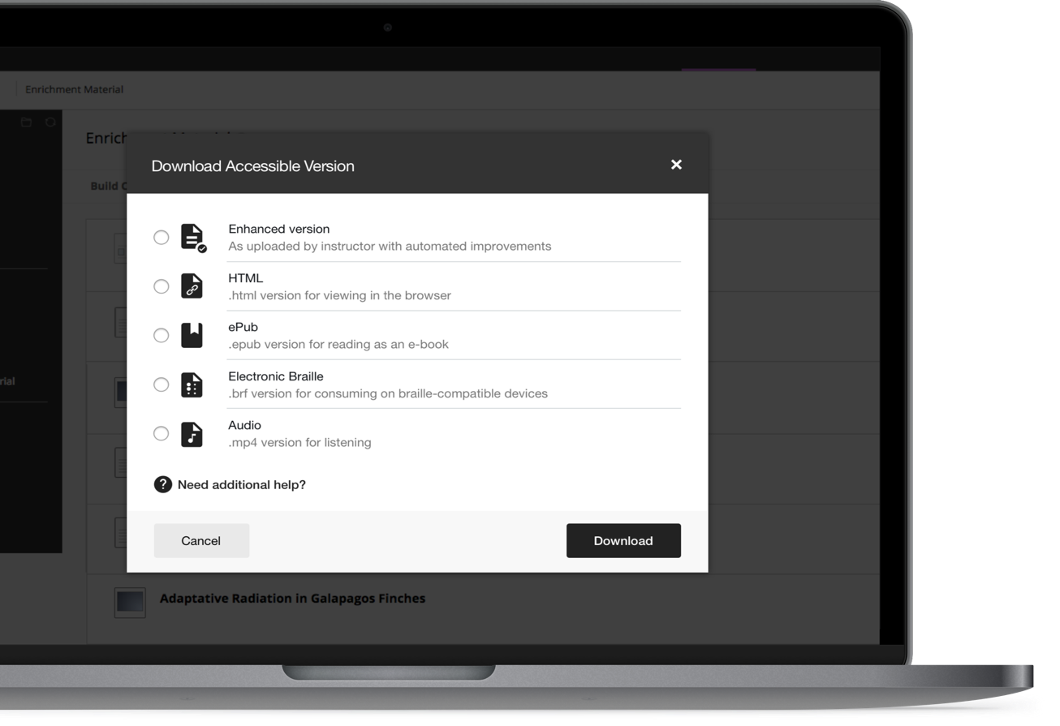
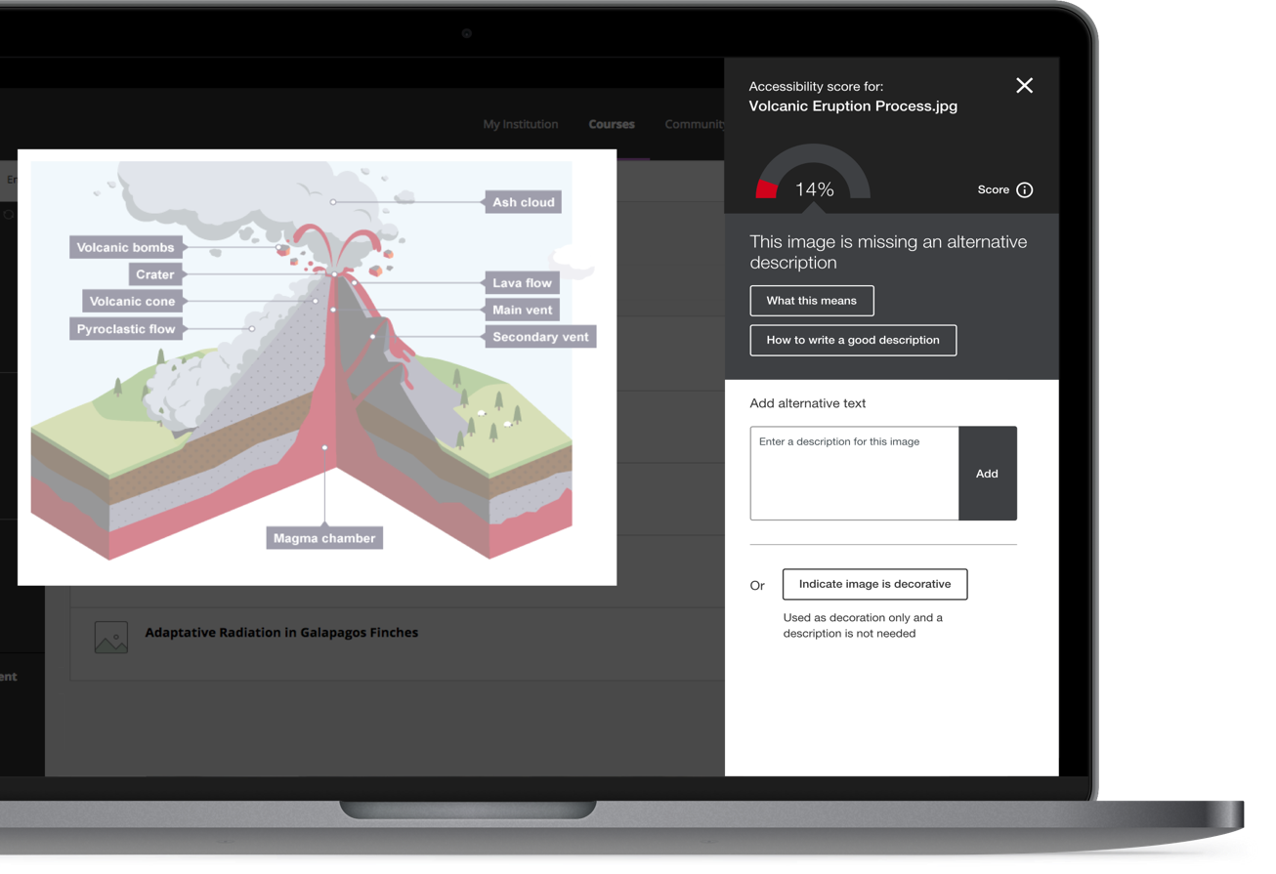
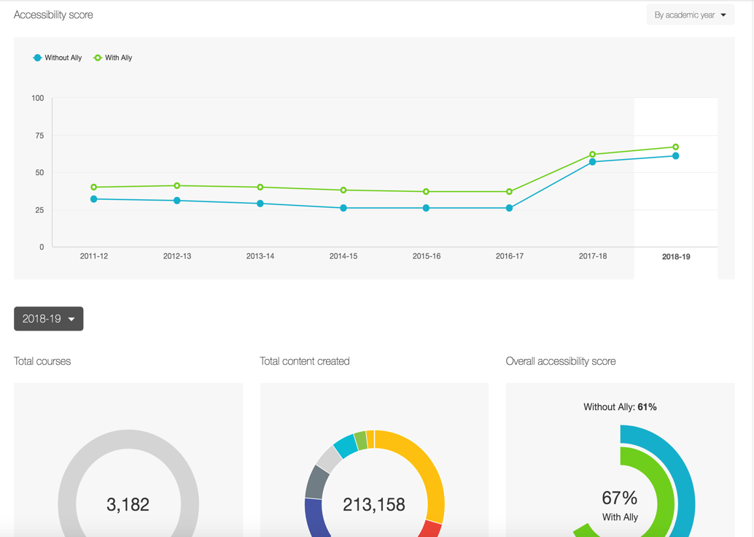
Ally Components
Alternative Formats
Automatically provide alternate formats for web pages and embedded media to provide more flexibility to your visitors
Content Creator Feedback
Educate and increase awareness with detailed guidance to help improve content.
Accessibility Report
Automatically checks your website for accessibility issues and provides detailed insight into problem areas

Slide 13
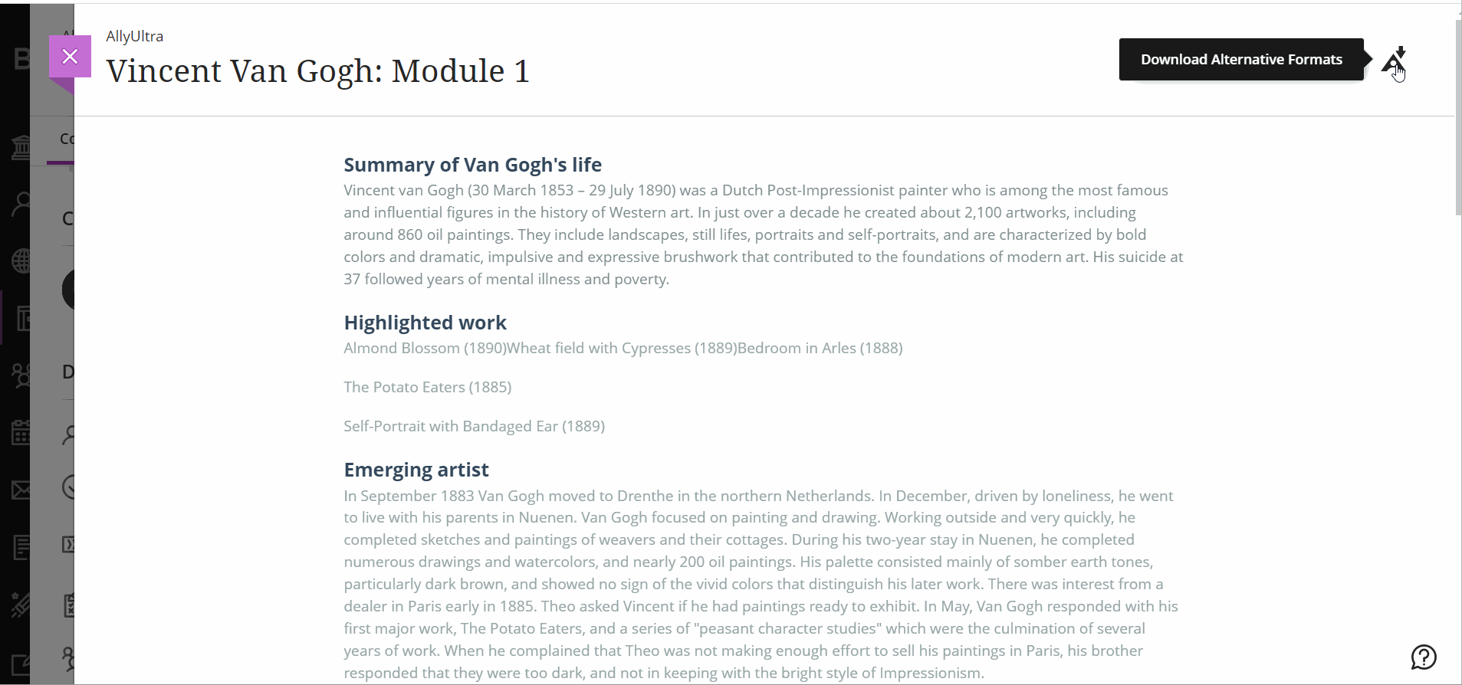
Alternative Formats for Inclusive Environments

Slide 14
Instructor Feedback
Identify an Issue
Based on WCAG 2.1 (Web Content Accessibility Guidelines)
Give Guidance
How to solve or prevent the issue
Quick Fix
With a couple of clicks, fix the issue

Slide 15
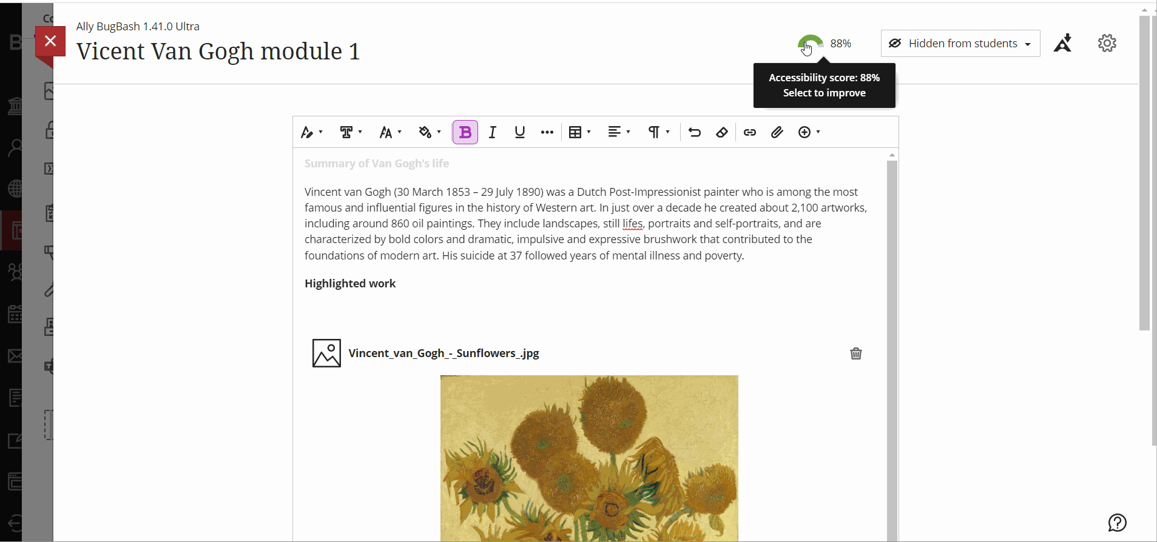
Content Creator Feedback

Slide 16
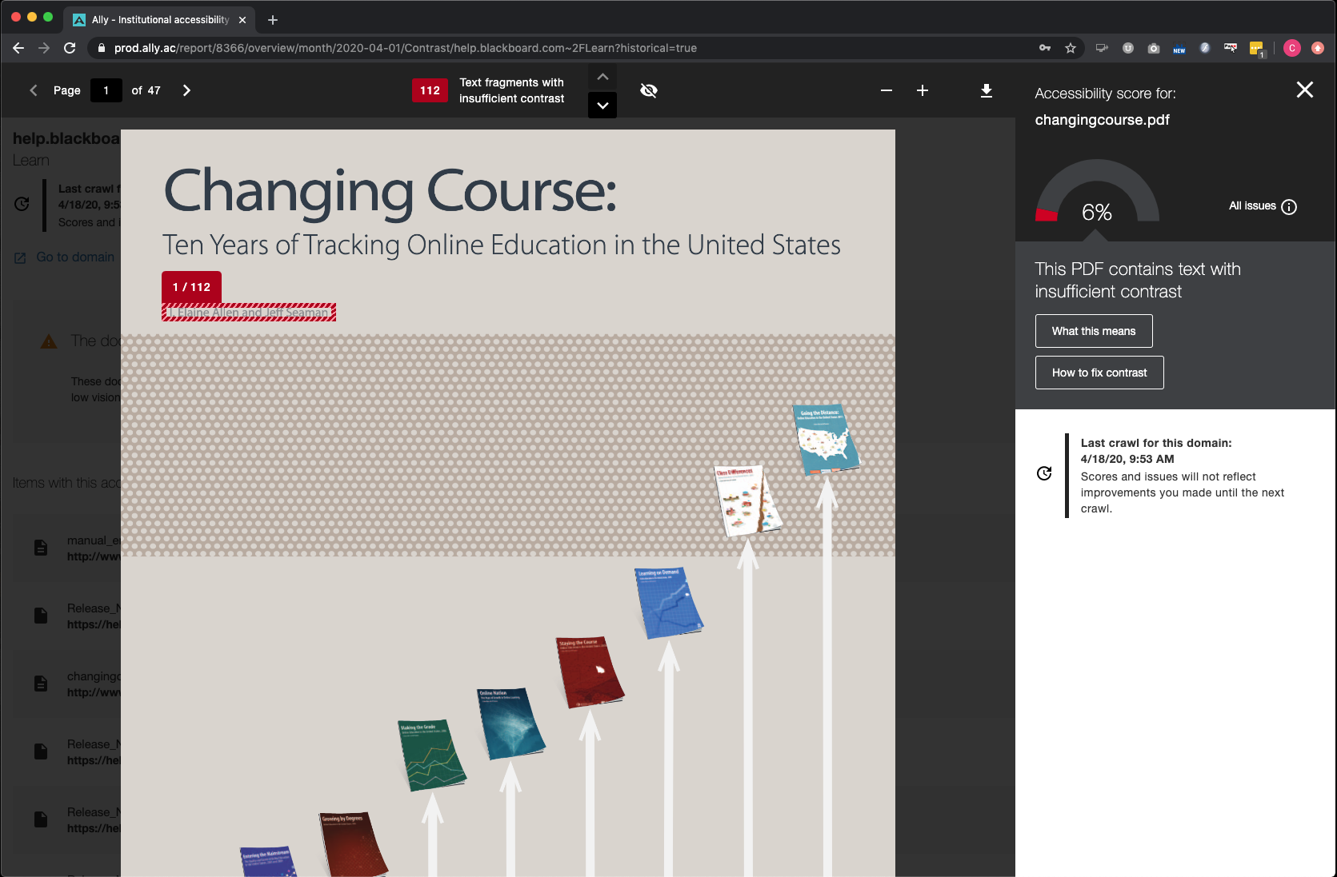
Ally's feedback and preview for a PDF document with contrast issues
Accessibility score
View all identified issues
Issue highlight
Most impactful change
Documentation
In-browser preview
Step-by-step guidance
Last Crawl Date

Slide 17
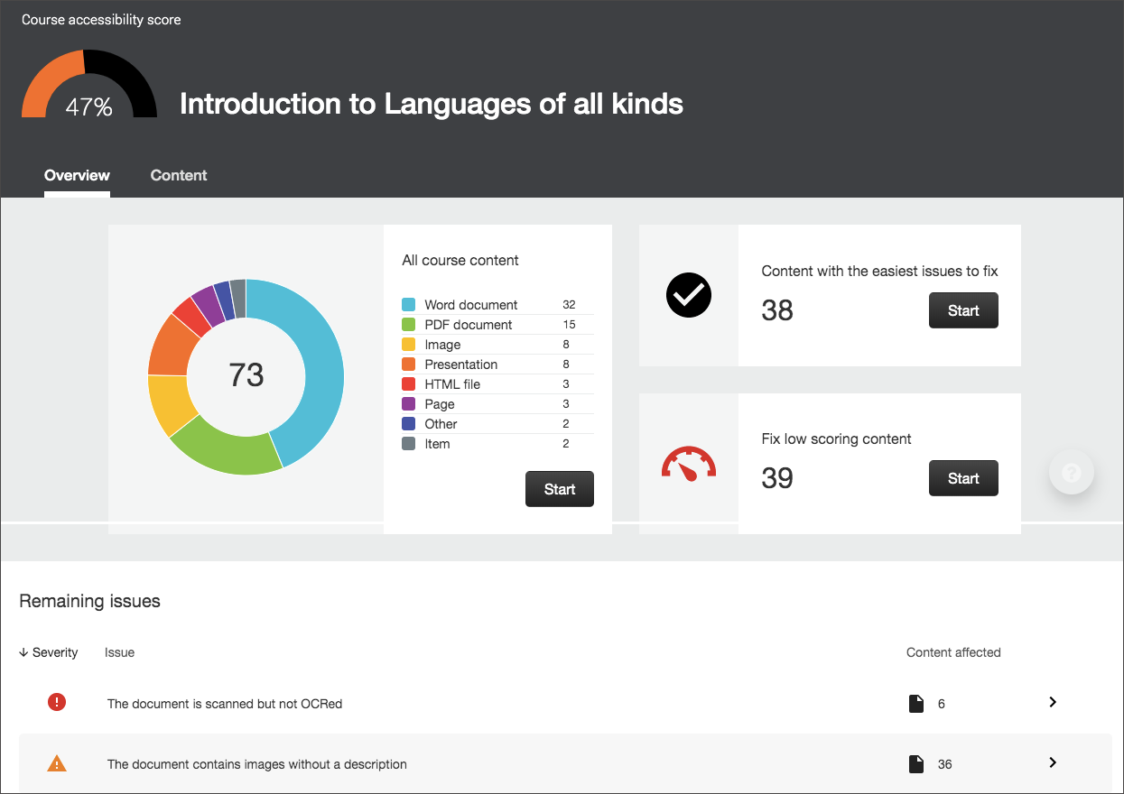
Reporting
At the course level
Can be seen by the instructor
Number of files / content
Number of issues
AX score
At the institution level
At department / domain levels
Number of files/content
Number of issues
AX score
List of courses (LMS Version)
Number of Students
Number of Files
AX score
Usage
Alternative Format Launches

Slide 18
Demonstration

Slide 19
Using Ally VS What Ally checks
Ally needs to be assessed also
It is a web application
Users with disabilities must be able to use Ally
How are we assessed?
VPAT (Voluntary Product Accessibility Template)
Level of compliance of a software
What Ally checks in LMS content
WCAG 2.1 (Web Content Accessibility Guidelines)
Is divided into three levels
A
AA
AAA
Ally looks for AA checks
It does not contain ALL checks
We are continuously including more checks and guidelines

Slide 20
Ally capabilities
LMS agnostic
Works with multiple LMS
Blackboard Original
Blackboard Ultra
Moodle
D2L Brightspace
Instructure Canvas
Schoology
CMS Integration
Embedded script
Provide admins with ability to correct issues
Easy administration
Toggling options
Feature flags
Language support
+20 Languages
User interface
Translated versions
Audio format

Slide 21
Some Existing Ally Clients
Curtin University
James Cook University
TAFE SA
Charles Darwin University
Charles Sturt University
Griffith University
University of NSW
Victoria University of Wellington
Victoria University
Western Sydney University
University of Wollongong
Southern Institute of Technology
Dept of Education Tasmania
Deakin University

Slide 22
“Ally has increased awareness of accessibility, phenomenally.”
Caroline Briggs
Assistive Technology Officer
University of Cumbria

Slide 23
In Summary
Alternative Formats
Automatically provide alternate formats for web pages and embedded media to provide more flexibility to your visitors
Content Creator Feedback
Educate and increase awareness with detailed guidance to help improve content.
Accessibility Report
Automatically checks your website for accessibility issues and provides detailed insight into problem areas

Slide 24
Useful Resources
Ally User Group
Receive updates about Blackboard Ally
Participate in UX research, usability testing, early access, etc.
Read institutional stories and case studies
Sign up at:
https://usergroup.ally.ac
Notes:
https://usergroup.ally.ac

Slide 25
More Useful Resources
Ally Documentation
End-user documentation
Ally release notes
https://help.blackboard.com/Ally
Notes:
https://help.blackboard.com/Ally

Slide 26
Questions

Slide 27
Anthology Ally – The End

