Slide 1
University Support Program
How we can support your university

Slide 2


Self care routine

Slide 3
acknowledgement of country
headspace would like to acknowledge Aboriginal and Torres Strait Islander peoples as Australia’s First People and Traditional Custodians. We value their cultures, identities and continuing connection to country, waters, kin and community. We pay our respects to Elders past and present and are committed to making a positive contribution to the wellbeing of Aboriginal and Torres Strait Islander young people, by providing services that are welcoming, safe, culturally appropriate and inclusive.

Slide 4
what we'll cover
Brief history of headspace supporting the higher education sector
Introduce the University Support Program and service options, including awareness of existing mental health and wellbeing resources to support universities
Next steps for accessing support

Slide 5




setting up the space

Slide 6


history
2011
headspace School Support received funding to support secondary schools impacted by suicide, contributing to the evidence-base for best practice approaches to support education settings impacted by suicide
2020
headspace partnered with Universities Australia to develop the first ever Responding to suicide: a toolkit to support Australian Universities, building on the knowledge obtained from 10 years of experience supporting secondary schools, and nuancing the recommendations to meet the needs of higher education settings
2021
headspace partners with University Australia to develop the Real Talk Framework to build the capacity of all members of a university community to engage in safe, and appropriate conversations about mental health and wellbeing when they notice changes to mood and behaviour in their colleagues and students that indicate a potential mental health difficulty.

Slide 7

university support program
Receives grant funding from the Australian Government to build mentally healthy university communities across Australia by developing and strengthening:
Capacity to manage mental health and wellbeing of staff and student
Capability of universities to respond to suicide
Confidence to engage in conversations regarding mental health and wellbeing, and
Knowledge of referral pathways for students requiring additional mental health support

Slide 8


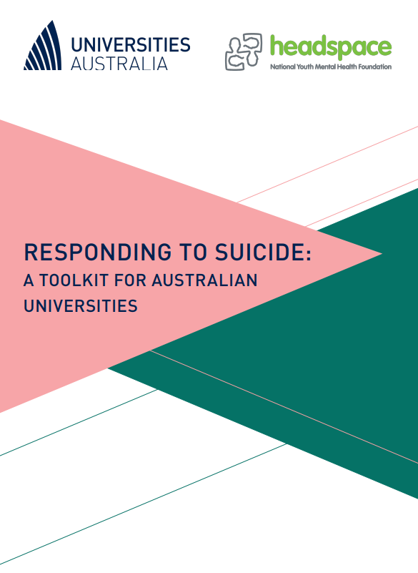
guiding documents
Responding to suicide: a toolkit for Australian universities
Real Talk Framework

Slide 9

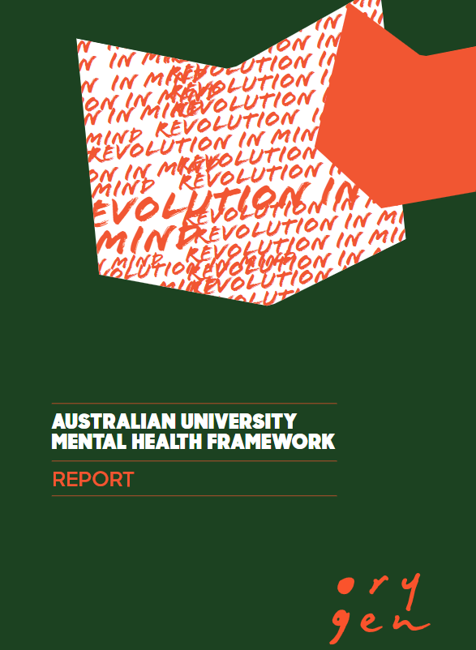
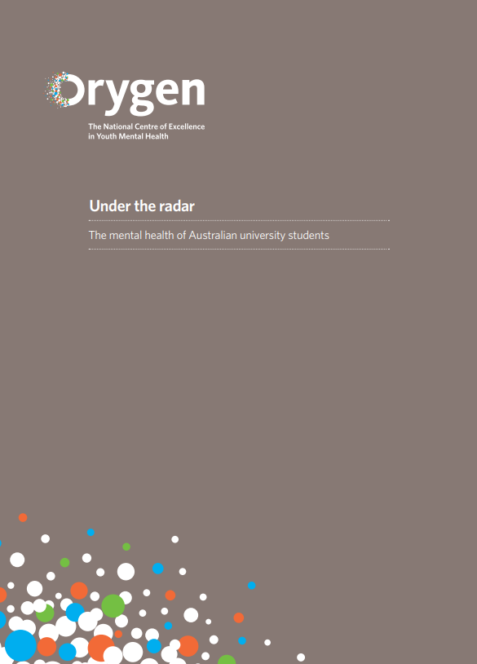


other resources

Slide 10




what is postvention?
is effective in reducing risk of subsequent harm
activities that assist those bereaved by suicide
promotes help-seeking messages
has been referred to as prevention for the future

Slide 11






suicide postvention
Response
Recovery
Planning
Secondary consultations
Resources
Training and education
Postvention response support
Implementation support
Mode of delivery is tailored to meet the needs of the university

Slide 12




guiding principles
Complexity
Suicide exposure
Safety
Impact of suicide
Self-care
Planning

Slide 13
service options
Planning
Response
Recovery
Training on the Responding to suicide: a toolkit for Australian universities.
Training and education to build mental health literacy, nuanced for specific roles (Real Talk Framework).
Consultation and review of university suicide prevention and postvention policy and frameworks.
Implementation guidance and support to embed toolkit with new or existing frameworks to develop a bespoke university postvention response plan.
Clinical support to implement the steps outlined in the suicide postvention response toolkit following exposure to a suicide.
Secondary consultations with university staff by a clinical workforce to guide a response.
Support to manage media following impact of a suicide.
Recovery action planning, critical incident review and support as required.
Consultation and review of university suicide prevention and postvention policy and frameworks.
Training on the Responding to suicide: a toolkit for Australian universities.
Continued, or enhanced training and education to build mental health literacy, nuanced for specific roles (Real Talk Framework).
Clinical support to continue to implement the toolkit, including secondary consultations related to recovery and postvention planning.
Consultation and review of university suicide prevention and postvention policy and frameworks.

Slide 14
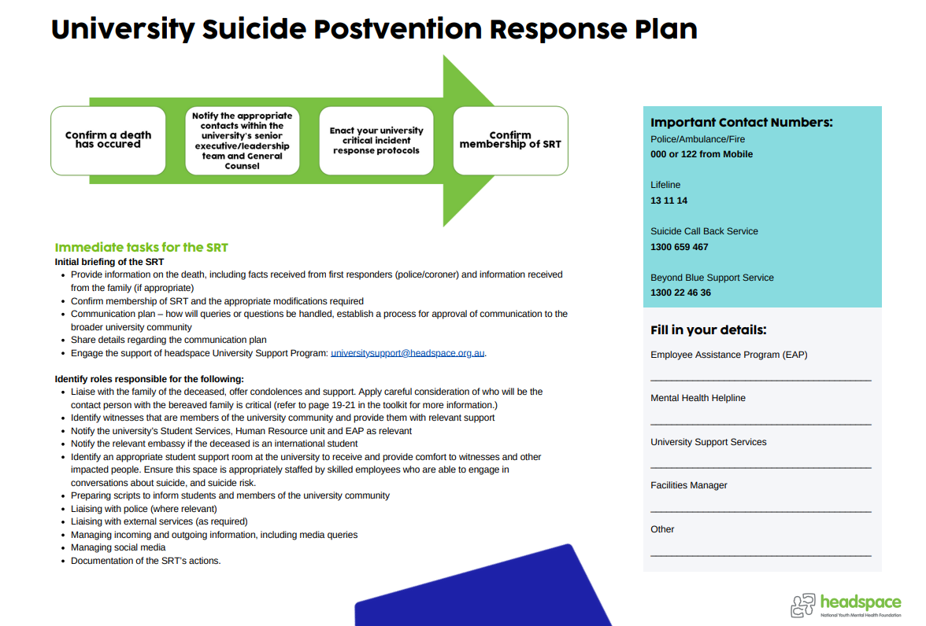
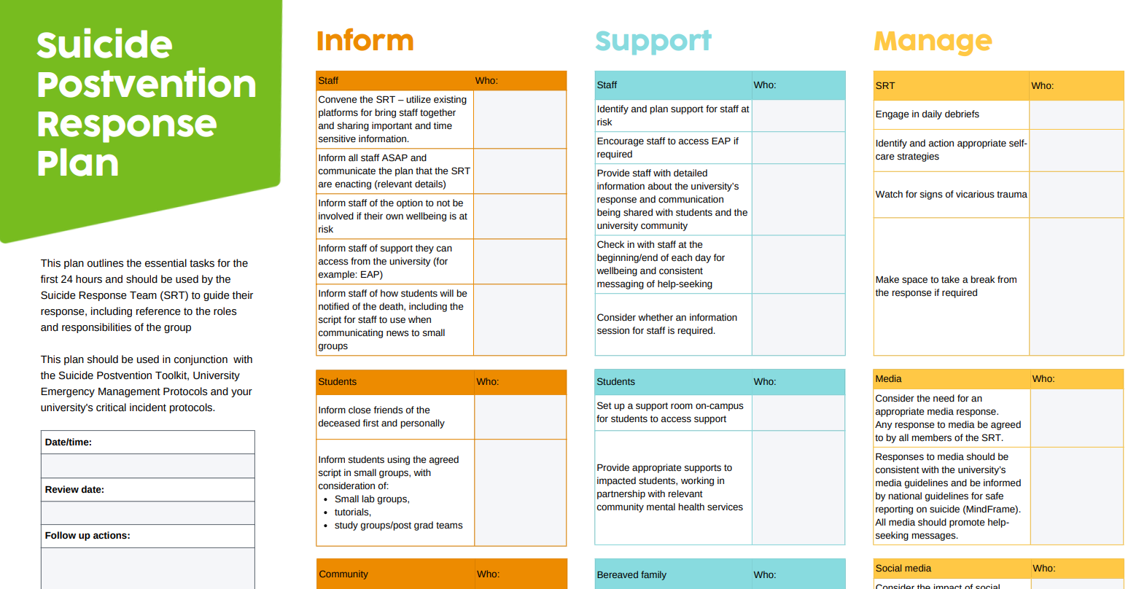
postvention planning

Slide 15

building capacity
University 1
University 2
University 3

Slide 16
questions?

Slide 17

next steps
Review of existing mental health and wellbeing policies and frameworks
Consideration of current efforts to enhance and strengthen mental health approaches, including identified gaps
University wide priorities for health, safety, inclusion and wellbeing
Contact us: universitysupport@headspace.org.au

Slide 18
thank you

