Slide 1

Mental ill health in the student population and the impacts for educators
TAFE QUEENSLAND
Brandon Taylor
Mental Health & Wellbeing Strategy Manager
RTO 0275 CRICOS 03020E

Slide 2

Acknowledgement of Country

Slide 3
We will address 4 key questions
Are more students disclosing and displaying mental health problems?
How can we support and refer students who are experiencing mental ill health?
Why and how we can maintain our boundaries?
What are some simple proactive self-care measures that protect and maintain our own wellbeing?
RTO 0275 CRICOS 03020E

Slide 4
Are more students disclosing and displaying mental health problems?
Increasing numbers and complexity
Observed across the tertiary sector for many years
Pre-COVID
Three quarters of all lifetime mental health disorders will have emerged by the age of 25
In 2004 WHO (World Health Organisation) stated that by 2030, depression would be the leading cause of disease burden globally
RTO 0275 CRICOS 03020E

Slide 5
What does the data and evidence tell us?
Mission Australia conduct the largest annual survey of Australian 15 -19yr olds (approx. 25,000) to capture their current concerns and trends over time
Since 2012, the survey has included a measure of non-specific psychological distress using the Kessler 6 (K6)
A six-item scale that asks respondents how frequently in the past four weeks they have felt:
nervous
hopeless
restless or fidgety
so depressed that nothing could cheer them up
that everything was an effort
worthless
RTO 0275 CRICOS 03020E

Slide 6
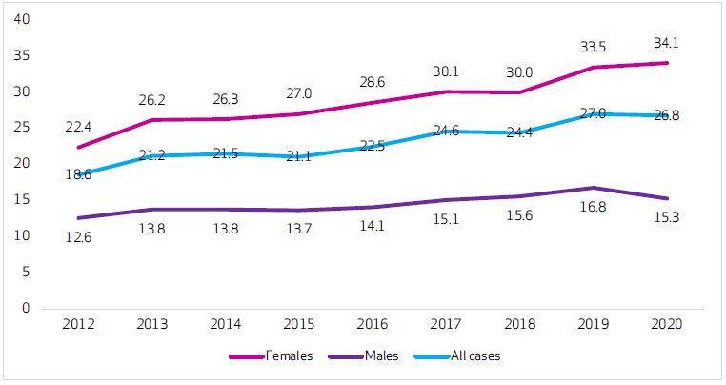
Psychological distress in young people aged 15-19, by gender, 2012-2020
https://www.blackdoginstitute.org.au/wp-content/uploads/2021/09/Youth-Mental-Health-Report-2012-2020.pdf
RTO 0275 CRICOS 03020E

Slide 7
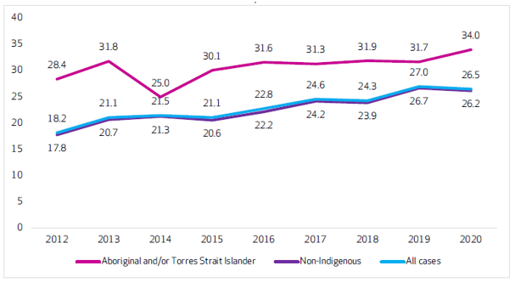
Psychological distress in young people aged 15-19, by Aboriginal and/or Torres Strait Islander status, 2012-2020
RTO 0275 CRICOS 03020E

Slide 8
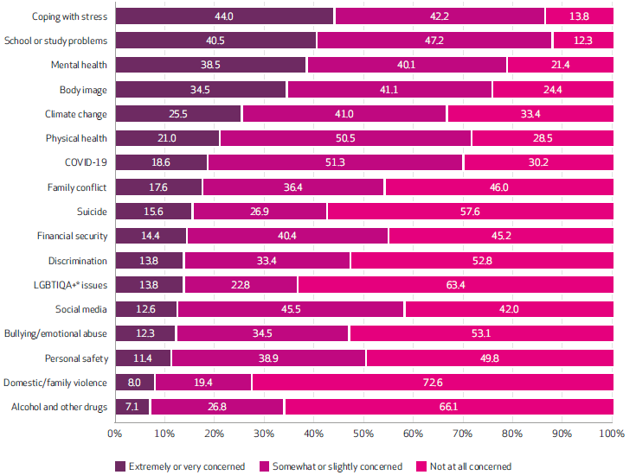
Top issues of personal concern

Slide 9
Screen-time and mental health prevalence
Of those who reported very high-levels of psychological distress
9+ hours a day on devices (in addition to time for school / study)
had the lowest amount of sleep time, being less than 6 hours per night
and took part in no exercise
This does not suggest that excessive screen-time causes mental health problems but rather those with mental health concerns spend longer on their devices
Most young people who require help remain undiagnosed and untreated
RTO 0275 CRICOS 03020E

Slide 10
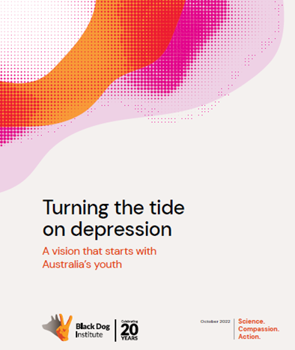
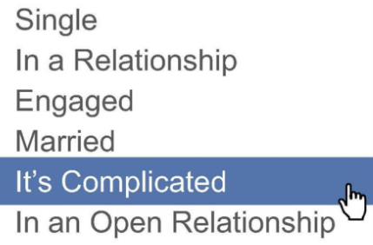
Why is this happening and what has changed?
https://www.blackdoginstitute.org.au/news/new-report-on-youth-depression-launched-turning-the-tide-on-depression/#:~:text=The%20Black%20Dog%20Institute%20has,and%20young%20First%20Nations%20peoples.
RTO 0275 CRICOS 03020E

Slide 11
What does the research tell us?
Fewer Australian adolescents are obtaining their driver’s licence these days relative to previous decades (Household, Income and Labour Dynamics in Australia)
This kind of change has occurred alongside similar declines in the number of adolescents:
working in paid roles
going out without their parents
having romantic relationships, and
drinking alcohol
(Twenge & Park, 2017)
Almost two-thirds of adolescents report exposure to online content that depicts suicide, self-harm, drug taking, pornographic content, or violent material (eSafety Commissioner, 2022)
Together, these factors paint a picture of modern adolescence as a time of fewer opportunities for practising maturity and independence in day-to-day life, coupled with increasing exposure to mature content in the digital world
RTO 0275 CRICOS 03020E

Slide 12

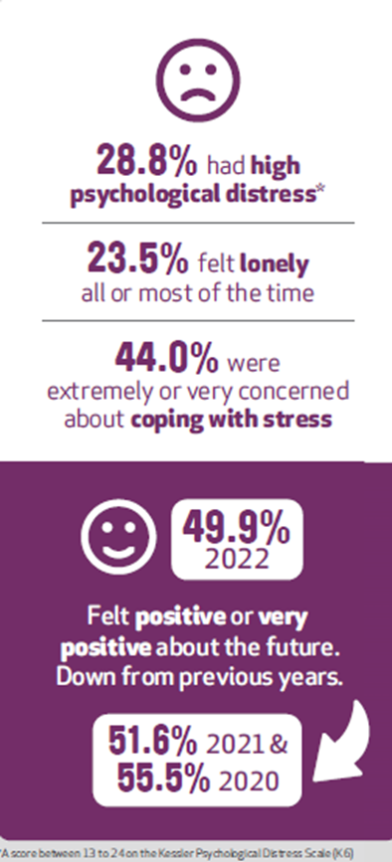

How can we support and refer students who are experiencing mental ill health?
The three most commonly cited barriers that prevent young people from seeking help are:
scared/anxious to get help
feeling embarrassed
feeling I can deal with it myself
Young people stated that they needed more help in:
how to study effectively
how to balance study and work at home
help to create a study plan / timetable

Slide 13
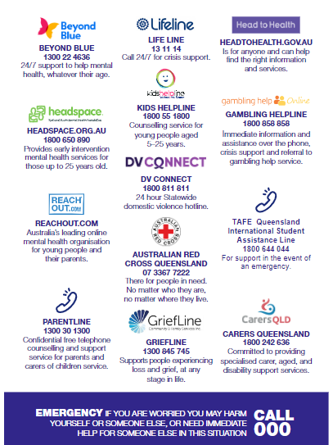

Early intervention is key
Early intervention is key
not knowing where to go
not knowing what help I need
fear of judgement / stigma
and confidentiality
RTO 0275 CRICOS 03020E

Slide 14

What about us?

Slide 15


Values and Purpose
High Values and High Purpose
without restoring energy
= BURNOUT
Symptoms include:
low energy, motivation or mood; feeling isolated or trapped;
feeling cynical or disengaged from work; decreased life satisfaction; procrastination; irritability; feeling exhausted or drained; disrupted sleep; and physical responses like headaches and body pain.

Slide 16


Establishing boundaries is good for you and the people around you
When we are clear about our boundaries, people will better understand our limits and know what we are (and aren't) OK with, and they'll often adjust their behaviour.
Having boundaries:
is a part of self-care and supports our own wellbeing
enables us to position our mental health and wellbeing as important
can give ourselves permission to say no or consider a situation before taking on another commitment / responsibility
can help and encourages students to meet their commitments and deadlines
It does not mean being inflexible or unapproachable

Slide 17
What are some simple proactive self-care measures that protect and maintain our own wellbeing?
RTO 0275 CRICOS 03020E

Slide 18
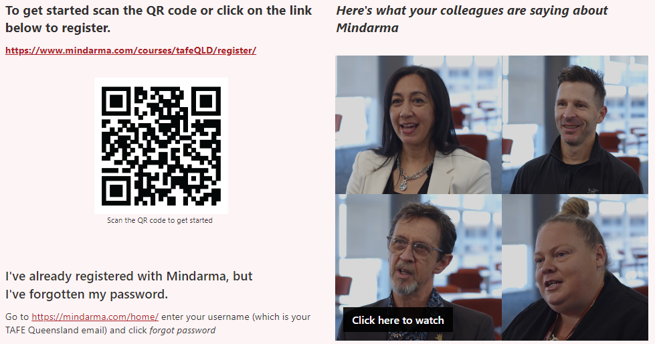
Mindarma is an award-winning evidence-based e-learning program, proven to enhance psychological resilience and protect mental health.

Slide 19

Mental Health First Aid
MHFA is face-to-face 2-day training course
Dates will made available in 2023 for educators as a priority
Dates will be scheduled around semester commitments to enable attendance
Both days must be attended
Watch here for what to expect at a MHFA course
You will learn how to assist an adult who may be experiencing a mental health problem or mental health crisis until appropriate professional help is received or the crisis resolves, using a practical, evidence-based action plan.
RTO 0275 CRICOS 03020E

Slide 20

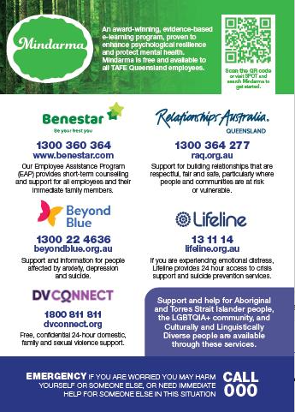
Support posters
RTO 0275 CRICOS 03020E

Slide 21
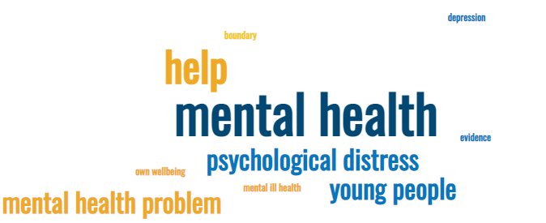
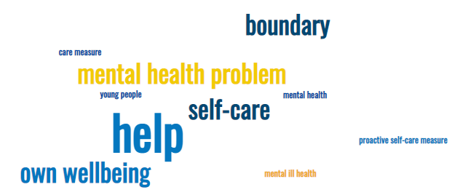
Questions, comments, observations…
RTO 0275 CRICOS 03020E

Slide 22
References
Turning the Tide on Depression - A vision that starts with Australia's Youth. Black Dog Institute.
Psychological distress in young people. Fifth biennial Youth Mental Health Report 2012-2020
https://mindarma.com/home/
https://mhfa.com.au/
RTO 0275 CRICOS 03020E

