Slide 1
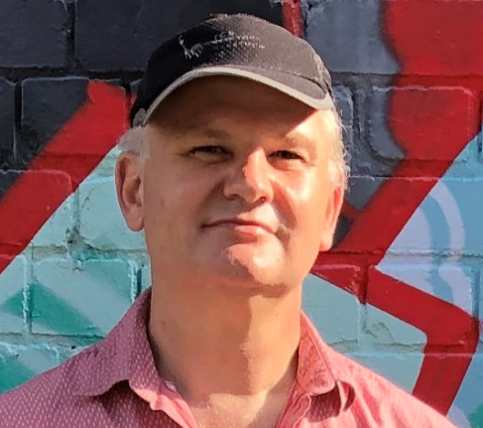
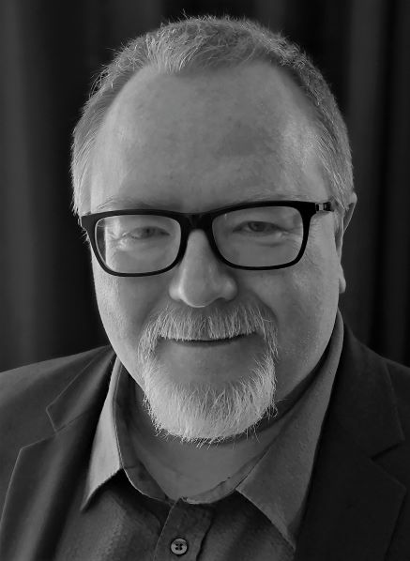


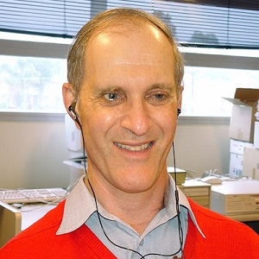
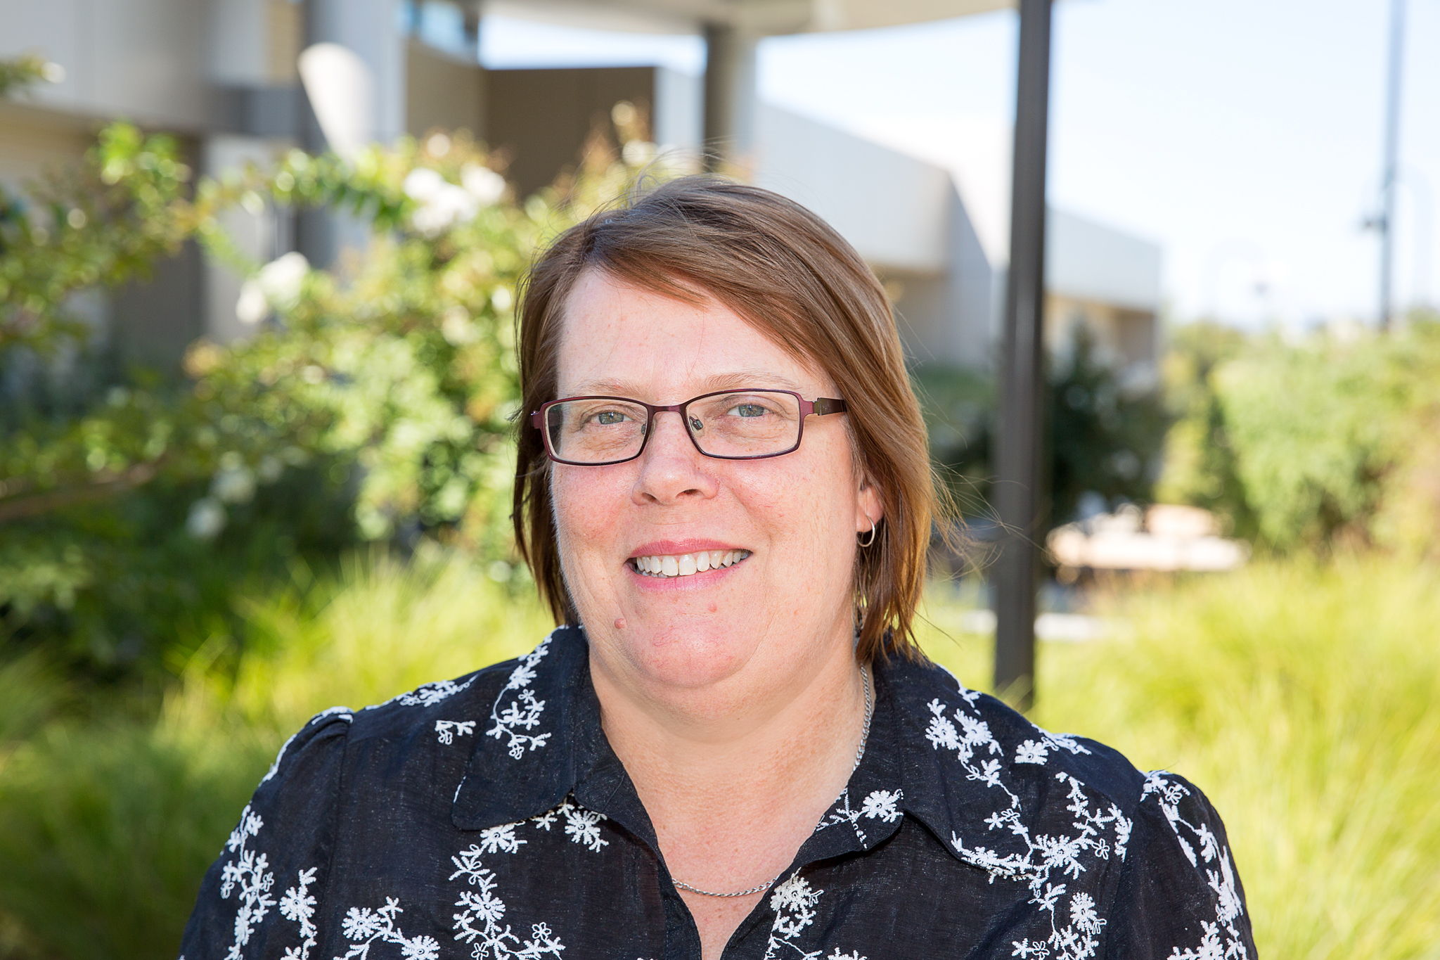
Assistive Technologies: Everything Access and Teaching Staff should know
Darren Britten • Sandra Boyd • Andrew Downie • Francois Jacobs • Steven Zelko

Slide 2
Acknowledgements
In the spirit of reconciliation we would like to acknowledge the Traditional Custodians of country throughout Australia and their connections to land, sea and community. We pay our respect to their elders past, present and emerging and extend that respect to all Aboriginal and Torres Strait Islander peoples today. While virtually connected today we are presenting geographically dispersed and acknowledge the Wurundjeri people of the Kulin nation in Victoria, the Cammeraygal and Wiradjuri peoples in NSW.

Slide 3
Assistive Technology (AT) in the tertiary environment
What is assistive technology ? Who uses it? How does assistive technology support students and staff in accessing and participating in their educational goals?
Our panel today will seek to unpack these and other questions and dispel some of the myths around assistive technology and how it is used. They will share their unique insights and experiences in using and working with students and staff who use assistive technology, and hopefully answer some of your questions in the process.

Slide 4
Darren Britten

Slide 5
Sandra Boyd

Slide 6
Steven Zelko

Slide 7

Francois Jacobs

Slide 8
Andrew Downie

Slide 9
Types of Assistive Technology
Definition: Purpose-built or modified products to meet needs of people who have disabilities.
For the purpose of todays webinar we will be focusing on assistive technologies that can support staff and students in the educational setting.

Slide 10
Forms of Assistive Technology
Physical devices
Installed Local Software
Online Software / Software As A Service (SAAS)
Apps: mobile devices and desktop computers
Browser extensions

Slide 11
Vision Loss and Blindness
Text/graphics enlargement
Both hardware and software
Screen readers
Synthetic speech
Audio Description
Electronic Braille displays
Hardcopy Braille and tactile diagrams

Slide 12
Hearing Loss and Deafness
Hearing aids
Hearing loops
Captions
Sign Language as a Service (SLaaS) / Remote Auslan
Visual sounds

Slide 13
Physical Disabilities
Alternative keyboards
Onscreen keyboards
Mouse emulation devices
Switches
Speech input

Slide 14
Neurological Disabilities
Reading and writing assistance software
Word prediction software
Electronic dictionaries
Notetaking assistance software

Slide 15
What are the best questions to ask new students that may need new or additional assistive technology?

Slide 16
Are students ‘digital natives’ when it comes to assistive technology?

Slide 17
What is the best way to introduce new assistive technology to a student?

Slide 18
How long does it take students to adopt new technology?

Slide 19
What is the best way for students to get training in assistive technology?

Slide 20
Do you approach AT differently with students at different levels/years in their course?

Slide 21
Can a person using a screen reader read information as fast as their sighted colleagues?

Slide 22
What is the most common assistive technology you recommend to students?

Slide 23
Are students the best source for accessibility testing?

Slide 24
How can we get teaching staff to engage with assistive technology in the classroom?

Slide 25
Is there something simple staff can do that can help make their teaching and learning resources more accessible?

Slide 26
What has been the biggest change you have seen in the development of assistive technology in recent years?

Slide 27
Where do you see the future of assistive technology and what are the challenges ahead?

Slide 28
Questions

Slide 29
Further ADCET information and resources
ADCET Assist
Guidelines and eLearning - Online Access for Tertiary Students who are Blind or Vision Impaired
Guidelines: Supporting Deaf and Hard of Hearing Students Online
Teaching with technologies
Creating Accessible Content
A guide to Hierarchical Headings and The Importance of Correct Document Structure
Disability Awareness eLearning

Slide 30
Thank you
Thank you to our panellists for sharing their insights and experience with us and to you for joining us today.

