Slide 1
A guide to language about disability
A brief introduction for career practitioners working with students with disability

Slide 2
Overview
It’s okay to talk about disability.
Language around disability is important.
Language can be person-first or identity-first, depending on the student’s preference.
Ask the student for clarification around their preferred language use.

Slide 3

Why language is important
Language about disability is important because it portrays a person’s attitude and perception regarding disability.
Two main viewpoints on disability are the medical model of disability (where the disability is something to fix or cure) and the social model of disability (where society is not set up to accommodate difference).
When working with students with disability, use strengths-based language around disability, not deficit language.

Slide 4
What language should be used?
Firstly, it is important for career practitioners to ask whether the student is comfortable discussing disability.
Example: “Do you have any condition or disability that you think will have an impact on the kind of job or career you’re interested in? Would you be okay with talking to me about this?”
Also, let the student know that they do not have to share anything about their disability or condition that they are not comfortable with.
Example: “You can tell me as much or as little about your condition or disability as you like. There is absolutely no pressure or requirement to disclose. My main priorities are that you feel safe and comfortable talking to me and that we can give the right kind of career advice for you.”

Slide 5
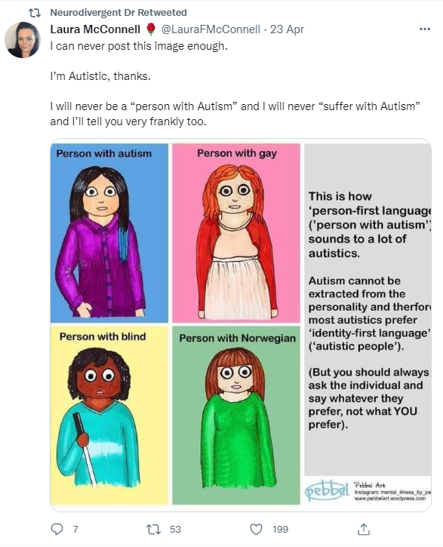
What language should be used?
Until recently, people had been encouraged to use “person-first” language. This means that the person is identified first in the sentence, then the disability; for example, “a person with autism”.
Increasingly, the disability community is claiming the word disability, or their specific disability, as part of their identity; for example, “I am autistic”.
Seek clarity around language from the students you work with as they will tell you which language they prefer.

Slide 6
If unsure, ask
In your work as a career practitioner, be led by the student. If the student uses the person-first approach, then follow that lead. If they use a disability-as-identity approach, then follow that lead.
If unsure, ask how the person would like you to refer to their disability. Open and respectful discussion helps build trust.

Slide 7
Terms to avoid
Avoid descriptions that suggest pity; for example, do not use “afflicted by”, “suffering from” or “victim”. Instead, use neutral language; for example, “they have muscular dystrophy”.
Don’t describe a person as “being” their condition; for example, “Vanessa is paraplegic”. Instead say, “Vanessa has paraplegia”, unless the student uses identity-first language to describe themselves; for example, “Vanessa is Deaf”.
Avoid describing someone as “wheelchair bound”. Instead, use the term “wheelchair user”.
When discussing mental health, avoid referring to it as “mental illness”. Instead, use “mental health condition”.

Slide 8
What if I get it wrong?
It is okay to be fearful about language; for example, you may wonder whether you are using the wrong terminology or whether your language is unintentionally offensive.
We are all learning. Let your student know that you are committed to their comfort. Examples:
“I don’t have a lot of experience talking about this disability or condition. Please let me know if I say something that upsets you.”
“Please tell me if you have a preference for communicating around your disability.”

Slide 9
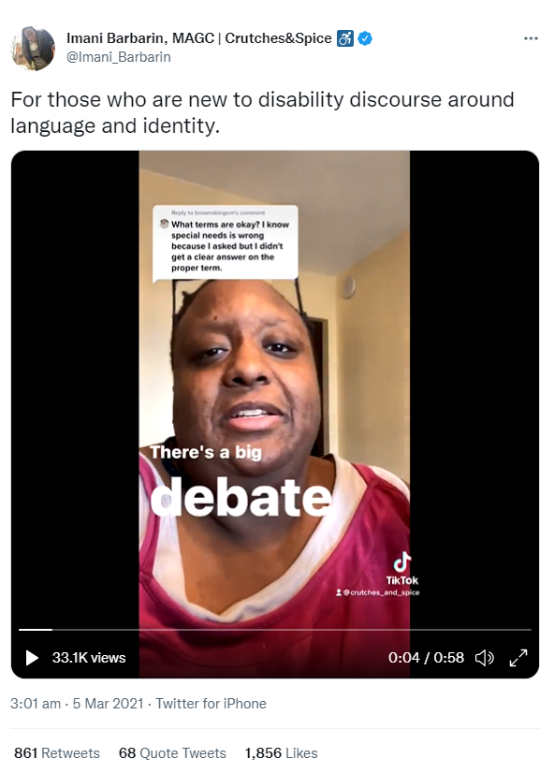
What if I get it wrong?
Seek out understanding in this area. Resources that explain more about language and disability are listed at the end of this slide presentation.
Reassure the student that you are learning what language to use and you are open to correction.

Slide 10
Common terms
disability: can be described in a medical manner (e.g. a range of physical, intellectual, neurological and psychiatric impairments*) or through the social model of disability, which asserts that society has a role in enabling people by providing supports to all
Deaf/deaf: unable to hear or hard of hearing; note that the Deaf community often embraces the word Deaf as part of identity
neurodiverse/neurodiversity: describes the diversity of human brain function within society and includes neurotypical
neurodivergent: an umbrella term for neurological differences such as ADHD, autism, dyslexia and dyspraxia where cognitive function diverges from the societal norm
non-speaking: now used in preference to non-verbal; this term recognises various forms of verbal and non-verbal communication such as selective mutism and use of assistive technology
chronic illness: long-lasting condition/s with persistent effects; often an invisible energy-limiting disability
* National Disability Services (n.d.). Disability Types and Description. https://www.nds.org.au/disability-types-and-descriptions

Slide 11
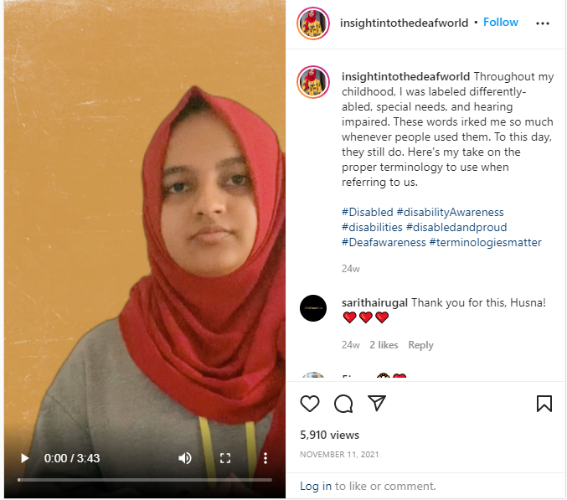
First person:
Deaf terminology
Husna Naleer
insightintothedeafworld
https://www.instagram.com/tv/CWIr14so7Fd/?utm_medium=copy_link
Notes:
https://www.instagram.com/tv/CWIr14so7Fd/?utm_medium=copy_link

Slide 12

First person: neurodiversity
Dr Nick Walker
https://www.youtube.com/watch?v=uj5_GH1CeLQ
Notes:
https://www.instagram.com/tv/CWIr14so7Fd/?utm_medium=copy_link

Slide 13

First person: cerebral palsy
Zach Anner
https://www.youtube.com/watch?v=w-Sh8ZuGbMI
Notes:
https://www.instagram.com/tv/CWIr14so7Fd/?utm_medium=copy_link

Slide 14
Interested in learning more?
For more information on terminology about disability, see the following documents:
  PWDA Language Guide: a guide to language about disability (2021).
  https://pwd.org.au/wp-content/uploads/2021/12/PWDA-Language-Guide-v2-2021.pdf
  Australian Federation of Disability Organisations Language Guide. https://www.afdo.org.au/news/language-guide/
  Walker, Nick. Neurodiversity: some basic terms and definitions.
  https://neuroqueer.com/neurodiversity-terms-and-definitions/?fbclid=IwAR1hn-QWGiQuvaJE7jhjDbd8kZ2yu3moo3sRIl_Ebbxe9qyQE3PAjOL7zQ8
  National Center on Disability and Journalism. Disability Language Style Guide.
  https://ncdj.org/style-guide/

