Slide 1
Supporting disabled students into employment

Slide 2
Agenda
What is included under the term ‘disability’?
Understanding the challenges faced by disabled students:
  ‘Openness’
  Issues, challenges and questions
Disability as a strength
  What’s my ‘plus’?
Employer engagement
Supporting disabled students through the recruitment process:
  Requesting support
The MyPlus Students’ Club Toolkit

Slide 3
Poll question
Do you feel you have the knowledge, expertise, support and resources to confidently advise disabled students about careers and support them through the application and recruitment process?
  Yes: I do have the knowledge, expertise, support and resources to do this
  No: I don’t have the knowledge, expertise, support and resources to do this

Slide 4
What is Disability?
A person has a disability if he or she has a physical or mental impairment which has a substantial and long term adverse effect on his or her ability to carry out normal day to day activities.

Slide 5
Arthritis Asperger’s Syndrome Anxiety Bi-polar Cancer Cerebral Palsy Depression Diabetes Dyslexia Epilepsy Hearing Impairment HIV +ve Lukemia Muscular Dystrophy Spinal Cord Injury Visual impairment …

Slide 6
Understanding this talent pool

Slide 7
Why disability matters
13% of students in UK Universities have a disability
Disabled graduates are less likely to obtain full-time employment than non-disabled graduates
76% of disabled students were concerned to inform an employer about their disability
55% of disabled students saw that there were benefits of being open
Students miss out on all the benefits of employment if they don’t work
Employers miss out on a huge talent pool if they are not inclusive

Slide 8
Understanding your talent pool
Why may students be reluctant to
be open about their disability?
Fear of discrimination
Do not want to cause a fuss or be
a hassle
Do not want to appear ‘different’
in front of other candidates
Ashamed or embarrassed
Do not see their condition as a disability
Do not require any adjustments
Fear of favourable treatment
What concerns may disabled individuals have?
Judgements / assumptions made
How will be perceived
May require adjustments:
  What is ‘reasonable’ to ask for?
  Costs
Will on going support be provided?
Is there anyone else who has a disability / will I fit in?
Can I do the job?

Slide 9
My ‘Plus’

Slide 10
Disability as a ‘plus’
“I don’t believe I am any more special than anyone else. But I do believe my disability has give me something extra.”
  Determination: to overcome the barriers in front of me and do what I want when others are trying to stop me.
  Problem solving: to get around daily challenges and obstacles such as lack of access or lifts not working.
  Communication: to articulate to others what I need when I can’t do it myself.
  Interpersonal skills: to build relationships with others, particularly when I need them to assist me.”

Slide 11
Employer engagment

Slide 12
What do employers want?
TALENT!
The applicant to:
  Submit a high quality application
  Inform them about their disability
  To be honest and reasonable about what they require
  To be an expert in what support they require
  To be available to communicate
  To provide feedback on support / adjustments
  To help them to understand!

Slide 13
Recruitment adjustments

Slide 14
Workplace adjustments: what is reasonable?
The following factors are likely to have a bearing on whether an adjustment is reasonable for the employer to make:
How effective the adjustment is in preventing
the disadvantage?
How practical it is?
Whether it causes / is likely to cause disruption
The employer’s financial and other resources

Slide 15
Making adjustments
He is deaf; communicates mainly by lip reading; sometimes uses an interpreter. Can speak for himself
A 45 minute interview
A written exercise
A group discussion
  What adjustments could he ask for to ensure he can demonstrate his potential?

Slide 16
Making adjustments
To accompany his application, an applicant includes a covering letter outlining the adjustments that he will require; these include:
    To be exempt from any online psychological tests
    An additional 25% of time to be applied to all timed assessments
    Not to be assessed on confidence, or motivation for the role
    Be able to pause the interview & take breaks
Which, if any, of these adjustments ‘reasonable’?

Slide 17
The applicant must…
Engage in conversation
Be honest about what they require
Become an expert in what they require
Help the employer to understand their requirements

Slide 18
Top tips for students

Slide 19
Top Tips for Students
If you need support through the recruitment process, be open about your disability.
Learn how to be open:
  Be relevant
  Use every day language
  Request what you require
Position your disability as a positive
  What’s your ‘plus’?

Slide 20
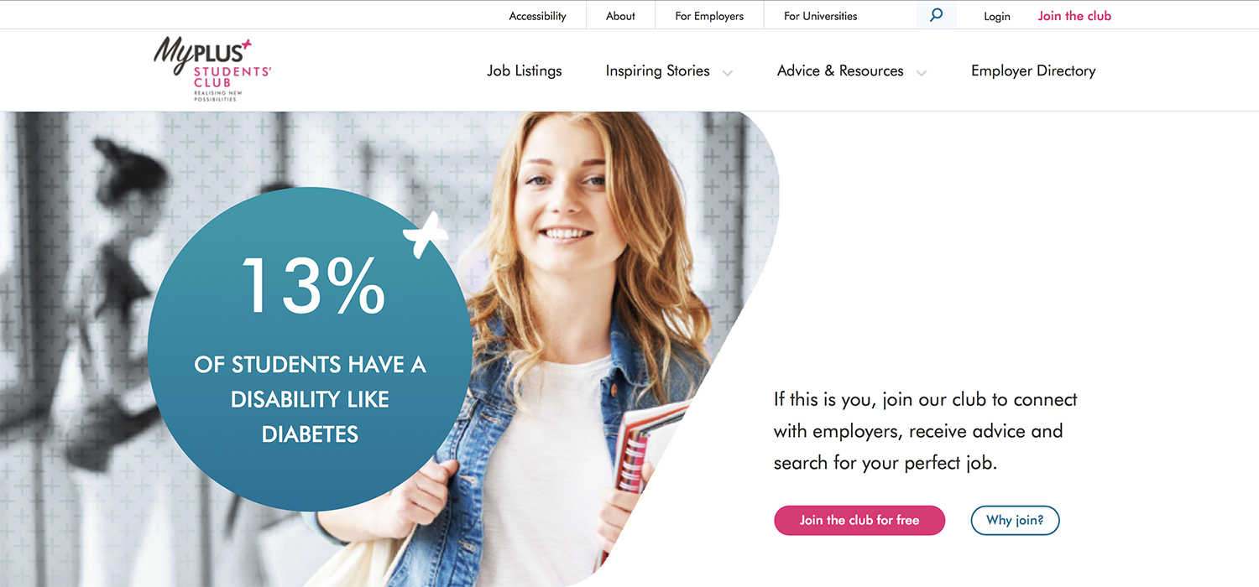

Slide 21


Slide 22
helen@myplusconsulting.com

