Slide 1
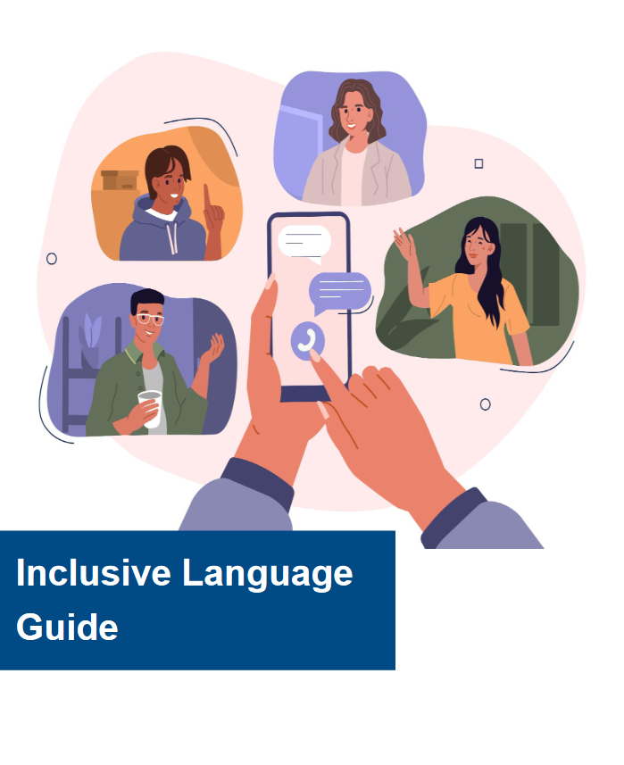
Words Matter: Developing inclusive language guides in a tertiary setting
Office of DVC (Students, Equity and Indigenous)
Stevie Lane (they/them)
Kay Barnard (they/them)

Slide 2
Acknowledgement of Country

Slide 3
Content Warning
This presentation will contain upsetting or sensitive topics including racism, colonialism, intergenerational trauma, LGBTIQA+ discrimination, mental health and ableism.

Slide 4
Why an Inclusive Language Guide?
It ensures:
We have respectful conversations about ourselves and others
Use consistent language across the university
We are putting people and their lived experience at the forefront of what we do
Language reflects society and culture

Slide 5
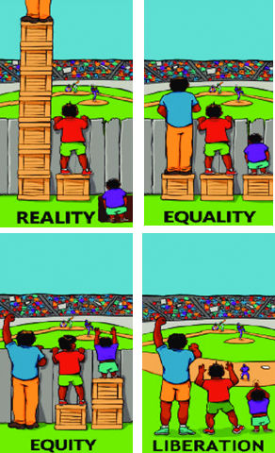
What is Inclusive Language and why is it important?
Relevant
A sign of respect and reflects how far we’ve come
Develops and maintains a welcoming and inclusive culture
Promotes mental health and wellbeing
Goes beyond tolerance - acceptance, value and celebrated
It can be empowering to people and communities
It ensures we avoid stereotypes and disrespectful and discriminatory language and behaviour
Reflects society and culture

Slide 6
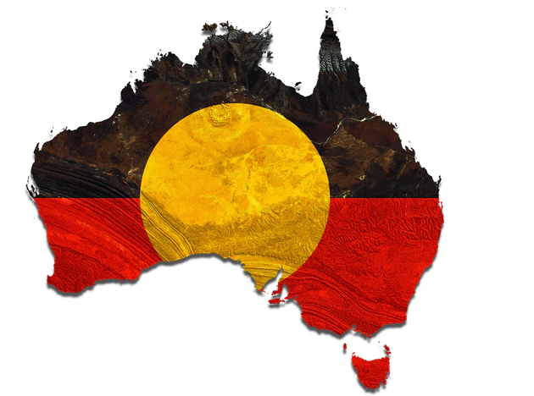
We need to acknowledge the impact of Colonisation on Language
Colonisation has had a devastating impact on Aboriginal and Torres Strait Islander peoples
Still severely impacted by disparaging health and social determinants.
Racism is still a huge social problem
Colonisation impacts the lives of, and language we use to refer to Aboriginal
and Torres Strait Islander people, and many other communities to this day.
A shift from collectivism to individualism
Binary systems e.g., gender
Western patriarchal views of men and women
Negative views on aging
Inherited British laws
Deficit / medical model of disability, sexuality etc

Slide 7
ECU’s Inclusive Language Guide: Collaboration
Coordinated by ECU’s Equity Projects team in collaboration with and input from:
Staff and students with lived experience
Kurongkurl Katitjin (Centre for Indigenous Australian Education and Research at ECU)
Athena Swan team
International Office
Pride @ ECU (LGBTIQA+ subcommittee)
Disability, Access and Inclusion subcommittee (DAISC)
Corporate Communications team (to align with existing comms guidelines)
Staff without specific knowledge / extensive exposure to inclusive language – to sense check

Slide 8
ECU’s Inclusive Language Guide: Content
Key Focus Areas
Aboriginal and Torres Strait Islander
Age
Disability
Sex, Gender and Sexuality
Race, Ethnicity and Culture
Religion and Belief
Mental Health
It is an evolving document as language is always changing and evolving

Slide 9
ECU’s Inclusive Language Guide: Feedback
Staff, students and people beyond ECU have found value in the guide for things like:
Embedding inclusive language in curriculum
Inclusive language in assessments
Students advocating for inclusive language in the classroom
Developing their own guidelines
Most people just want to know how to be respectful and consistent with their language
We have been asked to provide a quick guide to refer to
Mental health section has been added

Slide 10
Case Scenario 1: Autistic student
An autistic undergraduate psychology student attends a lecture on the topic of developmental disabilities. The lecturer starts talking about autism and how devastating an autism diagnosis can be to a child’s family. They go on to show a video of an autistic child having a ‘meltdown’ in a shopping centre and negative reactions from onlookers. The lecturer talks negatively about what they describe as ‘low functioning autistic children’. They then show a picture of the character Sheldon Cooper from the Big Bang Theory and say that people with Aspergers syndrome can be very intelligent and ‘high functioning’ but struggle with social situations. The student leaves that class early and upset. She was initially excited about covering this topic, but is now not interested in engaging in the content.
What kind of language did the lecturer use that was not inclusive / outdated?
How might this lecture impact this student beyond their initial response?
What kind of language could the lecturer have use instead?

Slide 11
Case Scenario 1: Non-binary student
A non-binary student is participating in a volunteer peer mentoring program which assists new students to the university during orientation. When the student registers for the program, they are assured by administrators that their affirmed name has been noted and used in all interactions and communications moving forward. When they arrive at orientation, they notice the Program Coordinator has printed their program materials and name tag with their legal name (which some trans and gender diverse people may refer to as their ‘deadname’). The student tries to quietly explain the issue to the Program Coordinator, who says their legal name out loud while trying to rectify the situation, explains that it’s not his fault, and tells the student that he understands because people use his full name instead of his nickname all the time.
What kind of language did the Program Coordinator use that was not inclusive / outdated?
How might this have made the student feel?
How could the Program Coordinator have approached this situation differently?

Slide 12
Thank you
Stevie Lane (they/them)
Equity Projects Officer
Access and Equity
Office of DVC (Students, Equity and Indigenous)
s.lane@ecu.edu.au
Kay Barnard (they/them)
Equity Projects Officer
Access and Equity
Office of DVC (Students, Equity and Indigenous)
k.barnard@ecu.edu.au

