Slide 1



Universal Design for Learning as a Facilitator for Improved Student Engagement, Retention, and Success
Dr Erin Leif, Senior Lecturer, Monash University
David Swayn, National Disability Coordination Officer, STEPS Group Australia
Elicia Ford, National Disability Coordination Officer, Centre for Disability Studies

Slide 2

Objectives
What is UDL?
UDL in the Australian Context
Ways to integrate UDL into your institution
A few practical strategies to help you get started!

Slide 3
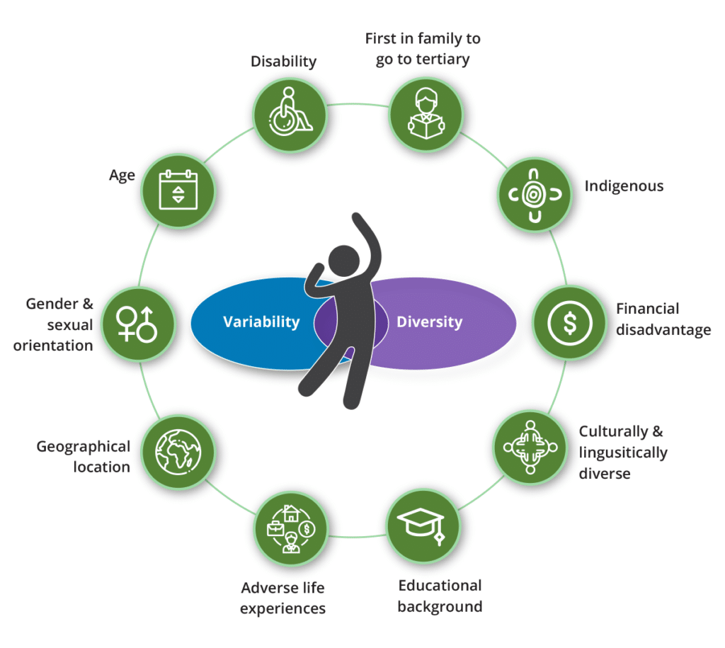
Universal Design for Learning: Overview
Universal Design for Learning (UDL) recognises there is no ‘average’ learner and that learners come with a wide variety of prior experiences, abilities, preferences and needs, and enables curricula to be written flexibly so they are accessible to the highest number of learners, addressing the variance in the student population.

Slide 4

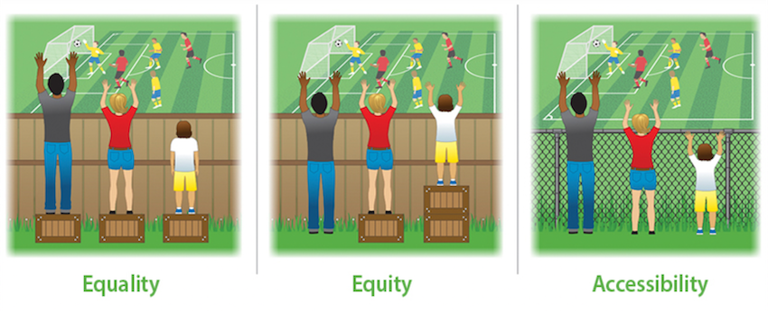
Equality, equity and accessibility soccer game analogy
Notes:
When a group focuses on equality, everyone has the same rights, opportunities, and resources. Equality is beneficial, but it often doesn’t address specific needs.
Equity, on the other hand, provides people with resources that fit their circumstances. It matches supports to student need.
Accessibility in education gives all people the same access to educational experiences, services, and information, whether a person has a disability or not.

Slide 5
The Science Behind UDL
Inspired by the concept of Universal Design in the field of architecture and product development
Based on the assumption that student difference is the norm, rather than the exception
Education institutions and educators should be deliberate in creating learning experiences that proactively meet the needs of the widest range of learners
Underpinned by research findings from the fields of learning science, instructional design, cognitive psychology, neuroscience, assistive technology, and disability studies

Slide 6
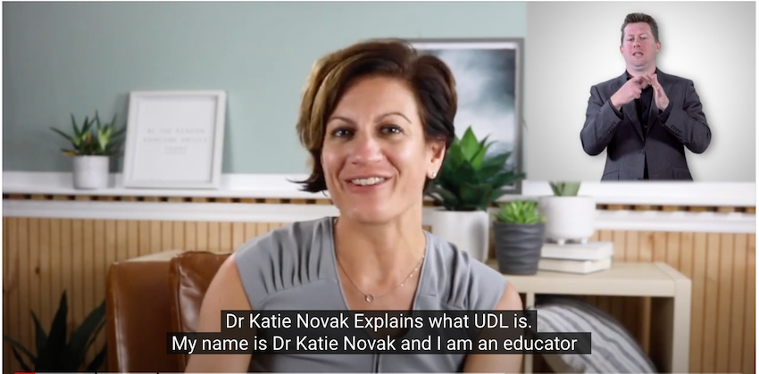
Katie Novak explains why UDL is valuable

Slide 7
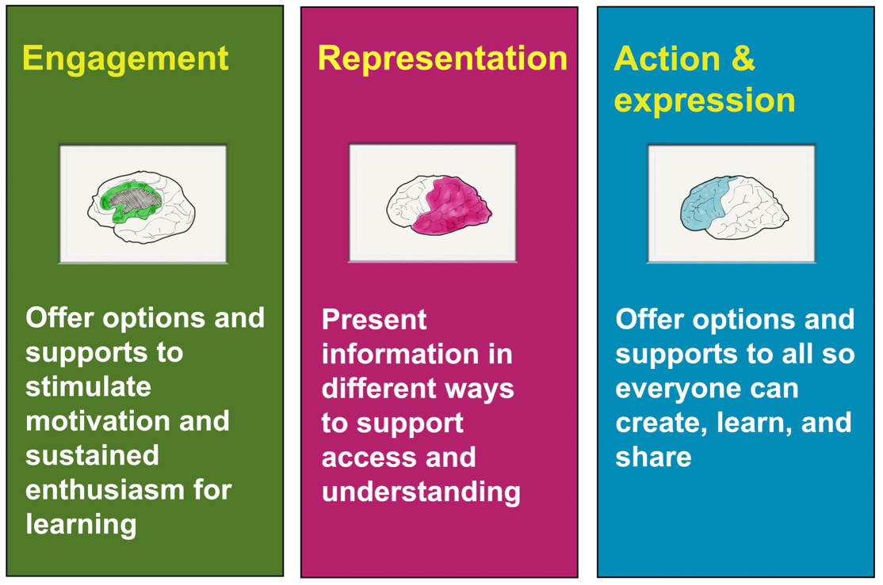
UDL Principles

Slide 8

UDL is About Proactively Reducing Barriers to Participation and Learning

Slide 9
UDL in Australian Tertiary Education: A Systematic Review
How are the principles of UDL used in tertiary education?
How is UDL enacted in the tertiary education sectors in Australia?
What options are there to guide educators in designing and delivering more accessible courses?
How could we shift tertiary education policy towards inclusive design that will better meet the needs of diverse learners?
Notes:
Thanks, Erin. As a collective, we had and have an interest in helping to move the adoption of UDL forward in tertiary education in Australia. But, before we began looking at how we could support the growth and utilization of UDL, we commissioned a literature and desktop review with a remit across four domains and a request for recommendations and options to give us a more solid base to launch from.
The paper is titled ‘Universal Design for Learning in Tertiary Education: A Scoping Review and Recommendations for Implementation in Australia’ and is available for all on ADCET’s website.
It was authored by Dr Noor Jwad, Associate Prof. Mary-Ann O’Donovan at the Centre for Disability Studies, Dr Erin Leif at Monash, Dr Elizabeth Knight at VU and my NDCO colleagues Elicia Ford and Jess Buhne, hosted at the Centre for Disability studies.
The framing for the systematic review was to
01 Identify and describe the ways in which the principles of UDL are used in tertiary education, drawing on international research and examples
02 Identify the ways in which UDL is enacted in the tertiary education sectors in Australia, drawing on publicly available policies and online resources from Australian tertiary education institutions
03 Provide us with options and ways to guide educators in designing and delivering more accessible courses
04 With an intent to add to a literature base that may shift tertiary education policy towards inclusive design that will better meet the needs of diverse learners

Slide 10

Systematic Review: Findings
A lack of evidence available on the use of UDL in tertiary level education in Australia
International examples show support for whole of institution approaches
Students and UDL - mostly report high levels of satisfaction with course content, learning experience and staff
Notes:
The authors found that:
1: That there was a lack of evidence available on the use of UDL in tertiary education in Australia. UDL as a strategy did appear in a number of available policies and tertiary institute websites but is not widely referenced to. This is likely attributed to lack of reinforcement in Government policies in higher education and VET, and subsequent slow adaptation of UDL in these sectors.
2: International examples where UDL is applied in teaching curriculum indicate that effectiveness occurs when there is a whole of faculty or institute approach, and where faculty members are educated in its application
3: Importantly, students enrolled in courses where a UDL approach has been implemented mostly report high levels of satisfaction with course content, learning experience and staff.
So while the literature base for Australian adoption is not broad at this stage, the paper did give us options about how to support the sector to move forward which I’ll now discuss.

Slide 11

Systematic Review: Recommendations
Training in UDL should be a requirement for all staff
Tertiary education institutes should commit to the application of UDL in strategy and policy
Supported by a coordinated and strategic sector approach
Notes:
Three of the most pertinent recommendations were that:
1: Training in UDL should be a requirement for all staff involved in course design and student facing engagement in the tertiary education sector. Now, for this to happen, there would need to be training available.
2: Tertiary education institutes should commit to the application of UDL through organisational strategy and policies, adequate resourcing, procurement practices and staff development. This aligns with the evidence that a whole of institution approach is impactful, possibly more so than the efforts of passionate individuals for example which was occurring in Australia, most certainly
3: And that we could help to ‘push the UDL wheelbarrow forward’ through a coordinated approach of working parties, consortiums, and/or communities of practice, where tertiary educators and learning designers could strategically share and document learnings for continuous improvement in effective implementation of UDL in tertiary settings.
In summary, the report provided us with the impetus to develop training about UDL implementation and gave us good guidance on how to put supportive scaffolding around the training to work together in an ongoing way.
Next, we will talk about specifically how we have actioned the recommendations.

Slide 12
Actioning the Recommendations
Advisory group established who worked together to develop an introductory eLearn focusing on understanding and implementing UDL in tertiary education
A Community of Practice established which focuses on implementing a whole-of-institution approach to UDL.
Dedicated UDL webpages
Regular UDL e-newsletter
Masterclass with Frederic Fovet on Monday 12th December.
Notes:
To bring a coordinated effort toward UDL to life in tertiary institutions in Australia, we assembled an advisory group of tertiary educators, researchers, learning designers, disability advocates and people with disability from across Australia. We came together in 2021 (virtually, of course) to design an eLearning program about the principles and practice of UDL in our context.
The program is designed to provide an introduction to understanding and implementing UDL in tertiary education and offers practical Australian case studies and exemplars to demonstrate the application of UDL in both VET & Higher education settings. It now has some research attached to it, which will help us build the literature base we found somewhat lacking. At this stage, the evidence from the post completer feedback indicates it is helping people to strengthen their understanding of UDL in tertiary settings – and so it is meeting our expectations.
There is now an active community of practice about UDL in tertiary education, which we welcome you to join if interested, and a dedicated section on the Australian Disability Clearinghouse on Education and training which includes articles, templates, webinars and more.
We also have available for you a regular UDL e-newsletter covering good practice, research and events which has grown to more than 400 subscribers.
Lastly, and this is a bit of a plug really – we have an in-person masterclass coming up in Melbourne featuring Frederic Fovet, an international inclusive education expert and I think we have just a few seats left. They are deceptively low cost, as it is sponsored by ADCET and the NDCO Program. You can learn more about that from us afterward or the ADCET website.
I’d now like to hand over to my colleague Elicia to talk through some provocations and practice challenges associated with UDL implementation.

Slide 13

Provocations and Practice Challenges
What is your/your team/your university’s level of familiarity/experience with UDL?
Who is responsible for implementation of UDL?
Consider: Have attitudes towards inclusion been positively or negatively affected by the shifts occurring due to the pandemic?

Slide 14
Integrating UDL within your institutional structures and policies
The case for change
Student voice: Co-led, co-designed and student-centred
An equity informed and impactful approach
Notes:
The landscape of inclusion and access to learning in higher education is fast evolving and changing; we’re embarking on an Australian Universities Accord process touted to be the largest scale reform to our higher education system since the Bradley Report in 2008; the pandemic necessitated rapid pivots between on campus and online learning and student engagement, and of these pivots innovations were born; it also constrained university fiscal environments. Even prior to that:
Increasing diversity and complexity of learners is becoming the norm, within and beyond students who identify with equity characteristics
- Universities have a responsibility to produce agile, flexible and adaptable graduates who are ready to meet the demands of the changing nature of work
And Students have expectations of a quality higher education experience which extends to co-curricular activities
So, Designing to include student variance makes good business and financial sense.
Involve Students!
View them as partners to facilitate the transition to more inclusive and accessible ways of doing, and to overcome any resistance to change
Find the language to discuss UDL with students, and engage them in the shift to a more student-centred approach
An Equity Informed and Impactful Approach
- Leverage your equity perspective to inform development of a unique UDL implementation plan that is right for your institution. Involve students wherever you can as leaders and designers, but also make sure that their voices and perspectives are shared by you when they can’t, so that they are not left out or left behind.
- Capture meaningful data to measure the impact of your practice changes and the benefits for student success and retention. UDL is an iterative process, change, revise and refine as you go, gathering evidence along the way.

Slide 15
Practical ways to start:
Pinch Points and Plus Ones
A “pinch point” is a persistent source of struggle or confusion for students
To identify pinch points, think about:
  What we know about our students?
  What do we need our students to know?
  Where do our students always have questions?
  At what points in the student lifecycle do students fail, withdraw or disengage?
  What are the potential barriers for students?
A “plus one” is the one thing we can do or change to universally support our students
Some example plus ones might include:
  Check my online materials for accessibility
  Provide information in more than one format
  Make the why of learning more explicit

Slide 16
Further Provocations and Practice Challenges
How might learning analytics data inform a systems approach to UDL implementation?
What existing systems, structures and policies does your university already have to support a UDL approach (e.g., Disability Inclusion Action Plans, strategic plan objectives, Widening Participation priorities and KPIs, equity and accessibility champions)?

Slide 17
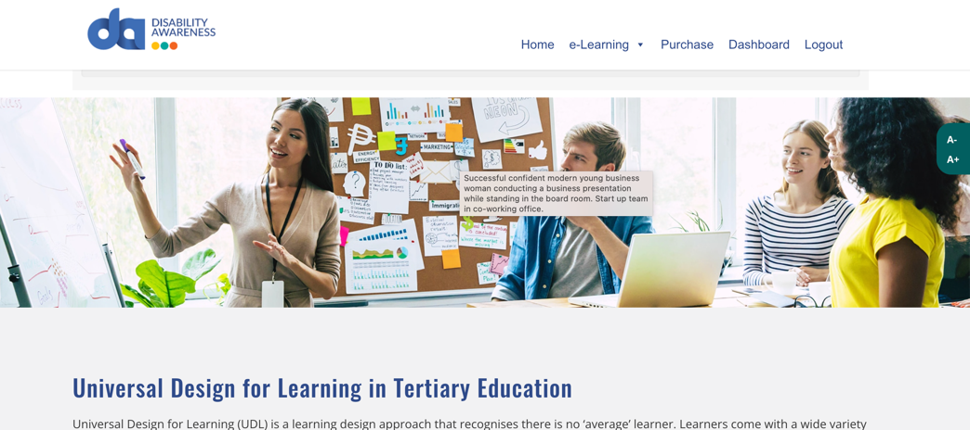
Stay in touch and continue your UDL learning
Dr Erin Leif
Ph: +61 3 99052808
E: erin.leif@monash.edu
David Swayn
Ph: +61 488 794 483
E: davids@stepsgroup.com.au
Elicia Ford
Ph: +61 431 463 955
E: elicia.ford@sydney.edu.au
https://disabilityawareness.com.au/elearning/udl-in-tertiary-education/

