Slide 1


TAFE SPECIALIST EMPLOYMENT PARTNERSHIPS
(TSEP)
Information Session
Notes:
Welcome to the TAFE Specialist Employment Partnerships (TSEP for short) information session. Before we being I would like to acknowledge the traditional custodians of these lands we walk upon and pay my respect to elders past, present and emerging including any who may be present with us during this session.

Slide 2


What is TSEP?
a specialist employment program
based onsite at a TAFE campus
specific needs of graduating or graduate students with disability
for students identified with a disability
access support due to the impact of their disability
Notes:
What is TSEP?
TAFE Specialist Employment Partnerships is a specialist employment program
based onsite at a TAFE campus
specific needs of graduating or graduate students with disability seeking employment
available for students identified with a disability
access support due to the impact of their disability

Slide 3
Why TSEP?
People living with disability study in order to achieve their employment goals
4.1 million students enrolled nationally
32,880 with disability
456,970 without disability
Employment success is considerably lower for graduates with disability
With Disability : 52.6%
Not living with Disability : 78.8%
Gap = 26.2%
Source: NCVER data 2019
Notes:
Why TSEP? According to the National Centre for Vocational Education Research, over 4.1 million students are enrolled in Vocational Training in Australia. This includes approximately 33,000 people with disability compared to 457,000 people without. Many people living with disability are in some form of study in order to achieve their employment goals. Unfortunately, at this current time, employment success is considerably lower for graduates with disability (52.6%) in comparison to graduates without disability (78.8%). This leaves a gap of 26.2% which we hope to improve with new initiatives like the TSEP program.

Slide 4
Why TSEP?
  Many TAFE students living with disability are not supported with their job search until they have completed their studies
  Evidence indicates there is significant positive impact on achieving career goals
  Expert assistance to access the labour market
  TSEP aims to provide expert employment advice prior to and post graduation
Notes:
Other reasons: Many TAFE students living with disability are not supported with their job search until they have completed their studies. Evidence indicates there is significant positive impact on achieving career goals if an individual is taking steps before they finish their studies . Expert assistance to access the labour market is a key support that is currently missing. TSEP aims to provide this expert advice prior to and post graduation to ensure students enter employment within their preferred industry sector and one which aligns with their TAFE qualification.

Slide 5


How does it work?
TSEP brings a Specialist Employment Service into a TAFE environment
    Allows students living with a disability to access a specialist disability
    Recruitment consultant to help achieve career goals and gain subsequent employment after study
The consultant works closely with TAFE Careers & Disability Services
Notes:
How does it work? TSEP brings a Specialist Employment Service Provider into the TAFE environment. Allows students living with a disability to access a specialist disability recruitment consultant to help achieve career goals.
The consultant works closely with TAFE Careers & Disability Services, Jobs and Skills or Skills and Jobs Centres in both Victoria and WA. The consultant will target employers suitable to each individual student's qualification for employment when they complete their studies.

Slide 6

Who is involved?
TAFE
Specialist Employment Service Provider/s
Employers
Notes:
Who is involved? Partners include TAFE and Specialist Employment Services. TSEP is only successful if all partners are working closely together to market and promote the program to students with disability including staff located within TAFE, whether that be Skills and Jobs centres, careers teams, disability, ACCESS AND equity services, TAFE teachers and anyone else who may be working with students located at a campus. Another important partner with TSEP is the industry and business sector willing to employ a qualified student after graduating from their course.

Slide 7
TSEP Statistics*
18 TSEP partnerships across Australia
120 students with disability studying at TAFE accessed the TSEP program
40 students with disability have been placed into employment relevant to their qualification
56% of students were not registered with any employment service prior to accessing TSEP
80% of students were not employed prior to accessing TSEP
78% of students with disability surveyed advised the TSEP consultant:
“Assisted them with getting into employment and going for interviews”
88% of students with disability advised they would recommend the TSEP program to others
96% of TAFE and Employment Providers (Partners) advised the TSEP Partnership met their expectations.
* The above data recorded by students via Survey Monkey 1st October 2018- 1st June 2022 (Collected by NDCO program)
Notes:
TSEP statistics from current and previous partnerships include the following:
18 TSEP partnerships across Australia
120 students with disability studying at TAFE accessed the TSEP program
40 students with disability have been placed into employment relevant to their qualification
56% of students were not registered with any employment service prior to accessing TSEP
80% of students were not employed prior to accessing TSEP
78% of students with disability surveyed advised the TSEP consultant:
“Assisted them with getting into employment and going for interviews”
88% of students with disability advised they would recommend the TSEP program to others
96% of TAFE and Employment Providers (Partners) advised the TSEP Partnership met their expectations.

Slide 8

Disability Category
.

Slide 9
Age Range

Slide 10
Employment status when entering the TSEP program
80% were not employed
16% worked casually
3% had part time jobs
1% had full time work

Slide 11
What did students want help with?
Advice about how and when to talk about my disability or mental health condition with employers | 45
Guidance regarding how to start searching for employment related to my qualifications | 68
Assistance in creating a resume | 35
I'd like to learn about career options and supports available to me | 70
Coaching about job interviews and how to succeed in these | 55
Someone to keep me motivated and on track with my career searching | 48
Other | 15

Slide 12
How did Students hear about TSEP?

Slide 13
TSEP Process
Expression of Interest sent out to local Specialist Employment Providers
Partnership MOU/Agreement/Letter & Site Establishment Plan created
Partnership Group Meeting to follow then every month
TSEP Consultant recruited via employment service provider
Marketing & referral process to students through TAFE Campus & Staff
TSEP commences at TAFE Campus
TSEP Partnership Group meetings to be held frequently
TSEP MOU Gordon TAFE Example
TSEP Site Establishment Plan
Notes:
How to set it up – The TSEP process. TAFE can access all required information and toolkit via the TSEP toolkit website. First step is to engage with specialist employment providers by sebding out expression of interest letters and proposal template. TAFe can also invite providers along to an information session (see TSEP powerpoint introduction on website). Once discussions have taken place and processes have been defined, there is a Partnership MOU/Agreement or Letter developed along with a Site Establishment Plan to implement TSEP on campus. Interviews may be held with each employment provider to establish the most suited provider for the TSEP program. From here a partnership group meeting will be held to finalise agreements and discuss implementation
A TSEP consultant will be recruited via the Specialist Employment Provider (may be one of their current staff). Marketing and referral process to students through TAFE disability services and Skills and Jobs Centres or in WA – Jobs and Skills Centres
TSEP commences at the campus. (An available space will be agreed upon and may also include meeting students off campus).

Slide 14

TSEP Marketing
TSEP Branding and Marketing Guidelines
Digital Banners and Postcards
Logo in various format
Available in graphic designer format
(for marketing departments)
TSEP Branding Guidelines
TSEP Banners
TSEP Postcards
TSEP Logo
Notes:
TSEP marketing is all done you just add in your logo and the DES provider logo….

Slide 15


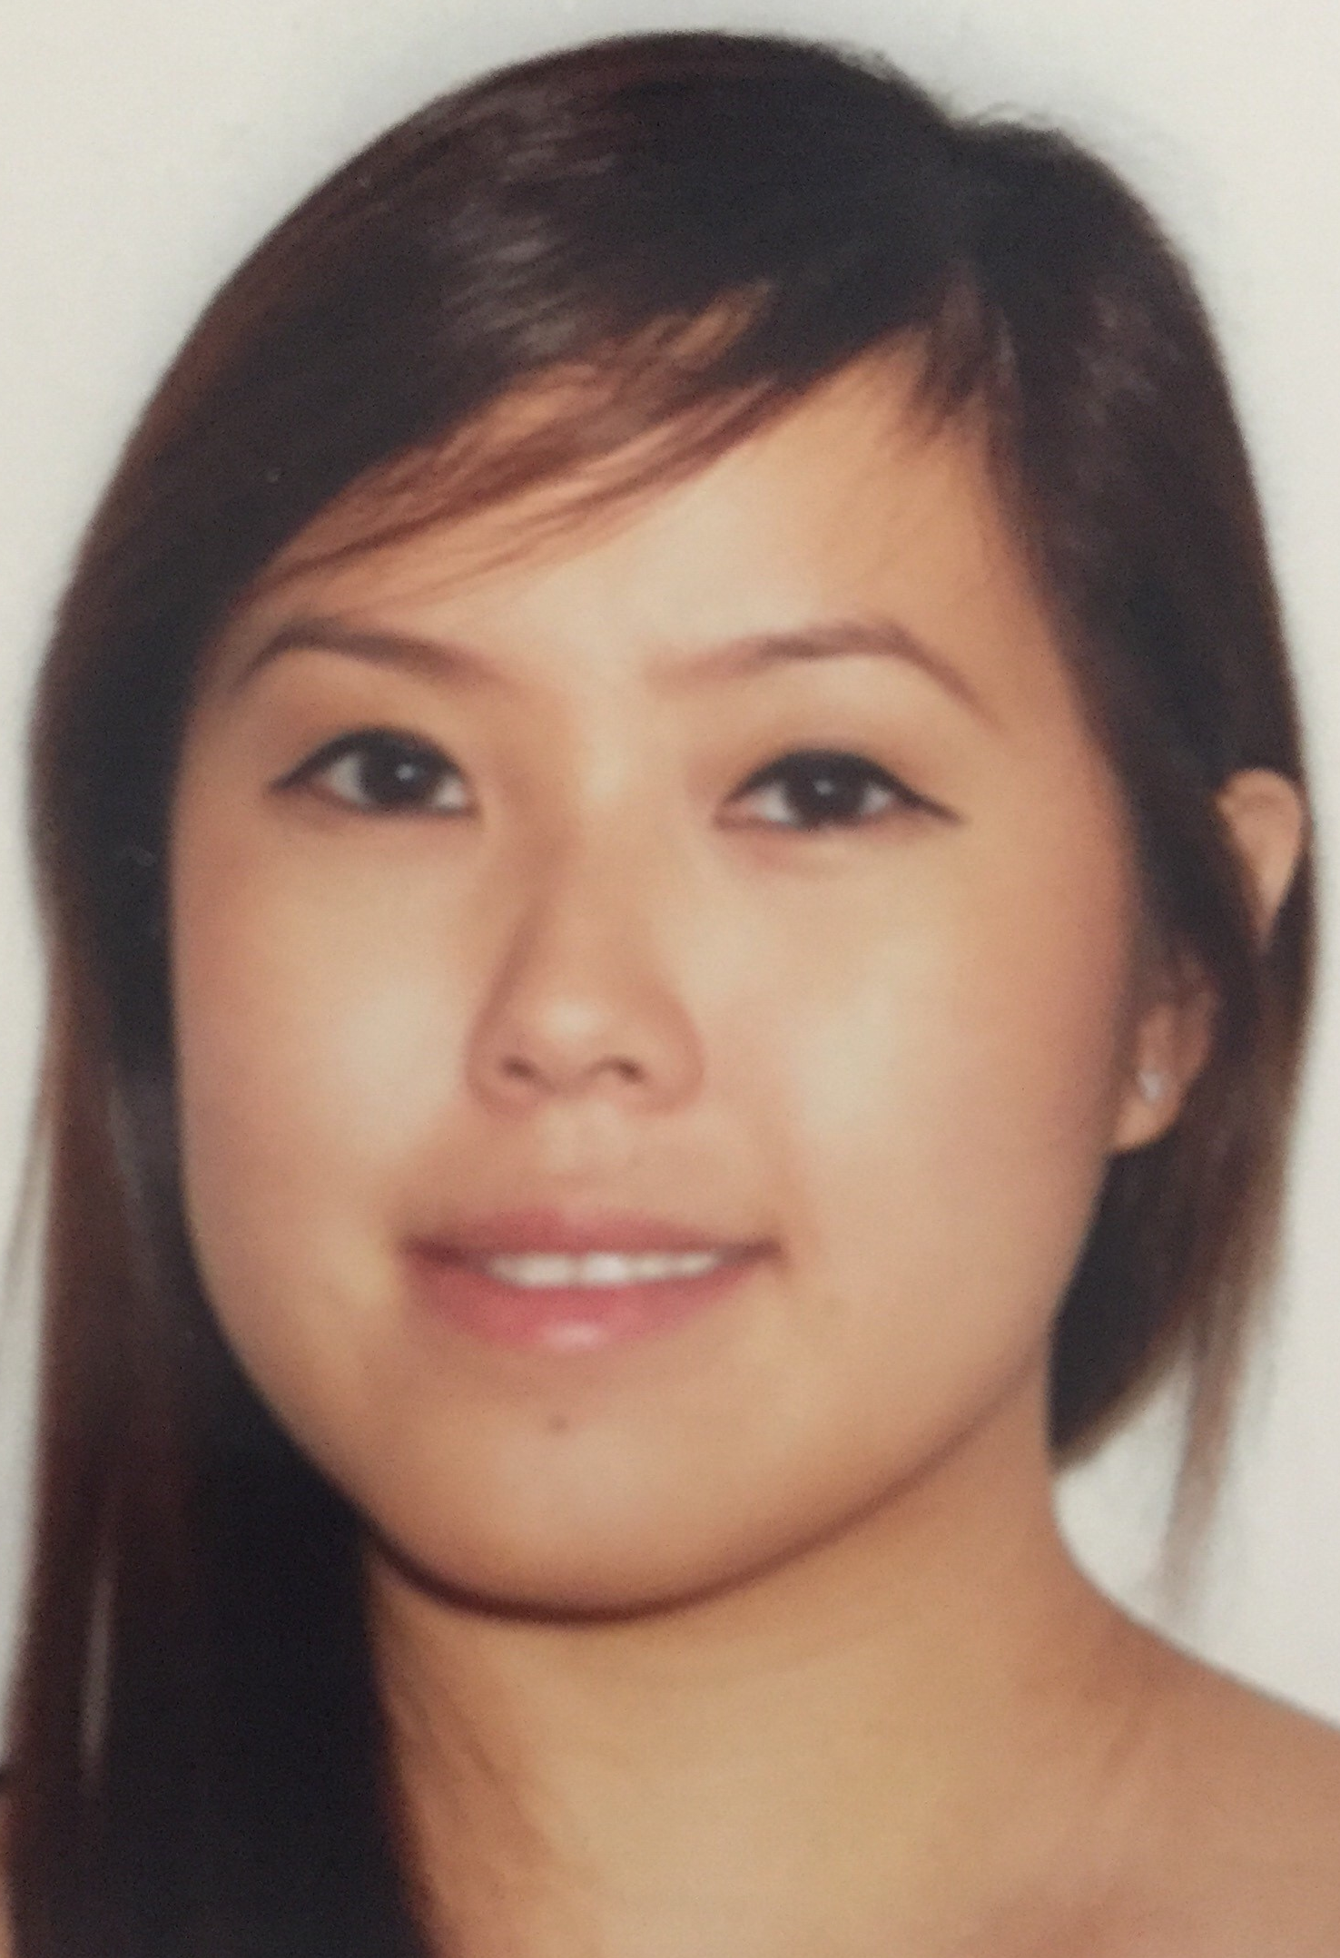

A TAFE Experience
Debbie Teh South Metro TAFE, WA
decorative shape
decorative shape
Notes:
Debbie Teh from South Metro TAFE in WA who will talk about how they set up their TSEP program.

Slide 16



“I believe the key ingredients to making a successful partnership are to ensure that all partners are aligned with the same vision and values. The aligned vision is the glue that holds the partnership together.”
!”
“Being able to improve employment outcomes for students with disability by helping them to connect with local employers and supporting them throughout their employment journey is what has motivated Maxima to be part of this program.”
Andrew West, Maxima Employment
Notes:
Andrew West from Maxima Employment in Gippsland talks about his experience from a employment service point of view.

Slide 17

Specialist Employment Provider commitment?
Initially as required or when referrals are forwarded
Attend and report to frequent Partnership Group Meetings
Active engagement with students and staff – in kind support to gain employment post study
Active promotion of:
  - TSEP to students and teachers, and
  - students with disabilities to employers
Notes:
What is the commitment?
Initially one day per week or as required
- Regular updates – monthly Partnership Group Meetings
- Active engagement with students
- Active promotion of:
- TSEP to students and teachers at appropriate events, and
- students with disabilities to potential employers

Slide 18














decorative shape
Notes:
Some of the TSEP partners who have commenced the program : TAFE Queensland (Ipswich and Toowomba), The Gordon (Geelong City, East Geelong and Werribee), North Metropolitan TAFE and South Metropolitan TAFE in WA, TAFE Gippsland (across seven campuses). Employment Service providers include Mylestones Employment, Westgate Community Initiatives Group, Bizlink Employment Services and Maxima Job link. Jobs and Skills in WA and Skills and Jobs Centres in Victoria are also integral partners to the program.

Slide 19

Start the TSEP Conversation… or contact:
www.tsep.com.au
Notes:
The TSEP website page is hosted on the USEP website and you can access it via www.tsep.com.au. Thank you for your time today and I hope you enjoyed this presentation.

