Slide 1
Disability inclusion in a post-COVID world
Australian Disability Clearinghouse on Education and Training (ADCET)
Presented by
Darlene McLennan, Manager & Gabrielle O’Brien, Senior Project Officer
Notes:
Abstract:
The global experience of COVID has been dire; but also nurtured innovation, engagement, and better understanding of health and disability. Universities should aspire to be inclusive, engaging, and strengths based. Staff awareness and training is key, reinforcing compliance obligations, best practice in disability inclusion and Universal Design principles. Only 17% of students with disability aged 20 and over have a bachelor’s degree or higher compared with 35% of those without disability. Exponential increases in enrolments of students with disability has widened participation. However, educational attainment and graduate outcomes are lower than other equity groups. In a post-COVID world disability inclusion in universities is framed by a myriad of levers. These include the National Disability Strategy, Disability Royal Commission, a social model of disability, legislation and rights reform, student experience survey data, and skills shortages. With the right framework of staff awareness training, teaching strategies, and capacity-building in place universities can be socially inclusive places for everyone. The online training ADCET has developed can address attitudes and culture; redress structural barriers; and adopt uniform standards resulting in successful outcomes for people with disability. ADCET will showcase new resources which strengthen capacity amongst providers and glean feedback on our latest Disability Awareness training project.

Slide 2
Acknowledgement
We acknowledge the Traditional Custodians of the ACT, the Ngunnawal people. We acknowledge and pay our respects to Elders past, present and emerging.
Courtesy: http://www.nungalacreative.com/
Notes:
We acknowledge the Traditional Custodians of the ACT, the Ngunnawal people. We acknowledge and pay our respects to Elders past, present and emerging.

Slide 3
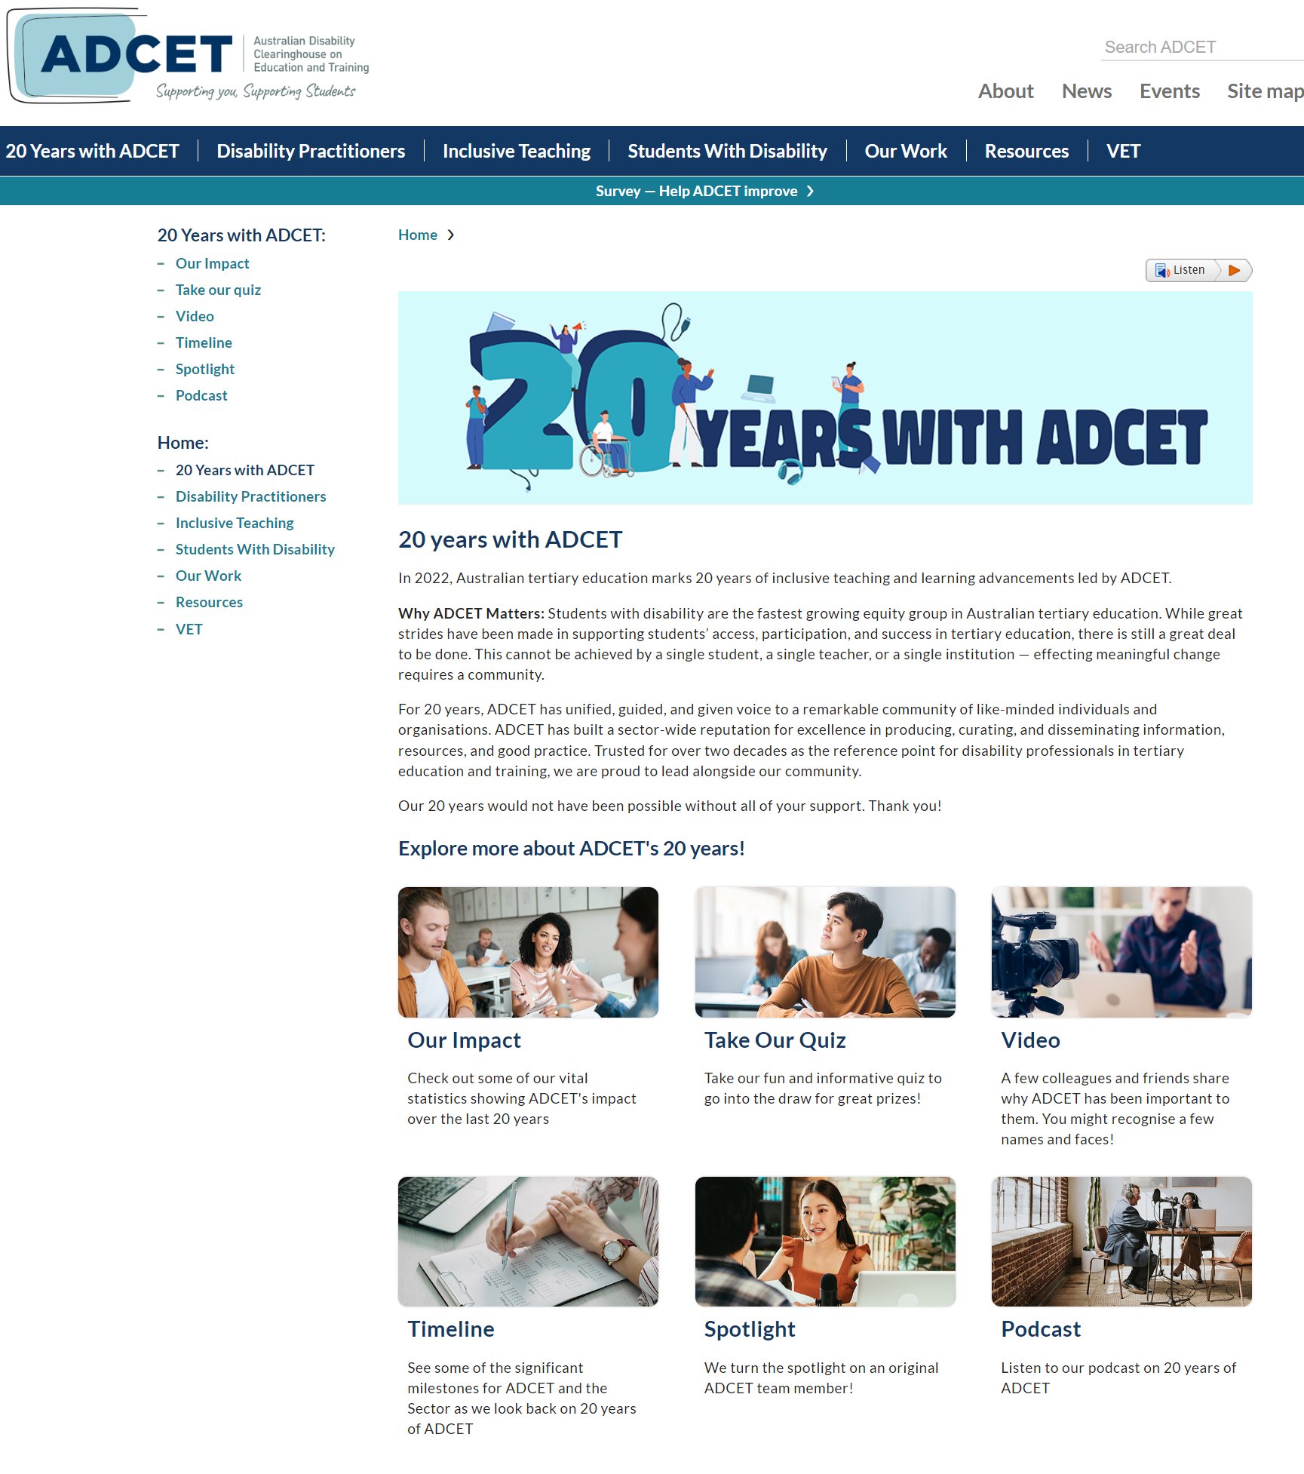
Intro
Notes:
The aim of this presentation is to highlight ADCET’s recent work and consider disability inclusion in the context of a post-COVID world. As part of the presentation we will get you to think about disability inclusion within your own institution and what you need to do to enhance disability inclusion in the future.
We all know that COVID has raised some unbelievable challenges for us globally – especially in relation to the University sector and continuing to service students including those with disability.
COVID also produced some amazing innovations and out-of-the-box thinking. COVID sharpened our focus on health and disability because in lockdown we had to think more about online learning, digital accessibility, inclusive teaching strategies, reasonable adjustments for people with disability and other equity groups.
ADCET has also been prolific over this time by continuing to develop resources to assist the sector towards greater disability inclusion.

Slide 4
Mentimeter poll
As part of today’s presentation we have some polling questions to ask throughout.

Slide 5
Mentimeter poll – Question 1
Go to Menti.com or click QR code Use the code 4660 5044
1. Describe your role at your university
Mentimeter results
Notes:
Twenty-seven participants responded
Academic, Equity Director, Manager, Student_Experience, Disability_adviser, Inclusion, Disability,_professional, Lecturer_and_researcher, Equity_Project_Officer, EDI_strategy,_governance, Outreach_coordinator, Run_student_volunteer,_project manager,_Diversity_Inclusion Project_lead, Manager_of_Student_Equity, Researcher, Manager_of_inclusion, Student_equity Associate_lecturer, Associate_Director, Disability_adviser, Manager,_student_accessibility, Equity_officer

Slide 6
About ADCET
Australia’s leading resource on disability in tertiary education.
National focus and strategy to provide resources to support student success by empowering inclusivity and accessibility
Collaborative across HE and VET
Supporting students across life-cycle
Capacity building and good practice through PD
Hosted by University of Tasmania
Turning 20 this year!
2
0
Notes:
For those who don’t know what we do we are Australia’s leading resource on disability in tertiary education
We are in our 20th year now still operating on a tiny budget but with the aim to develop nationally significant resources to support people with disability within the tertiary education sector.
We develop our resources and projects in partnership with a range of stakeholders including the National Disability Coordination Officer Network (NDCOs) and other partners such as the Dept of Education, VET providers, Universities Australia, NCSEHE, ATEND (Australian Tertiary Education Network on Disability) and of course EPHEA just to name a few.
While hosted with the University of Tasmania we draw on our national and international partners and expertise to develop good practice.

Slide 7
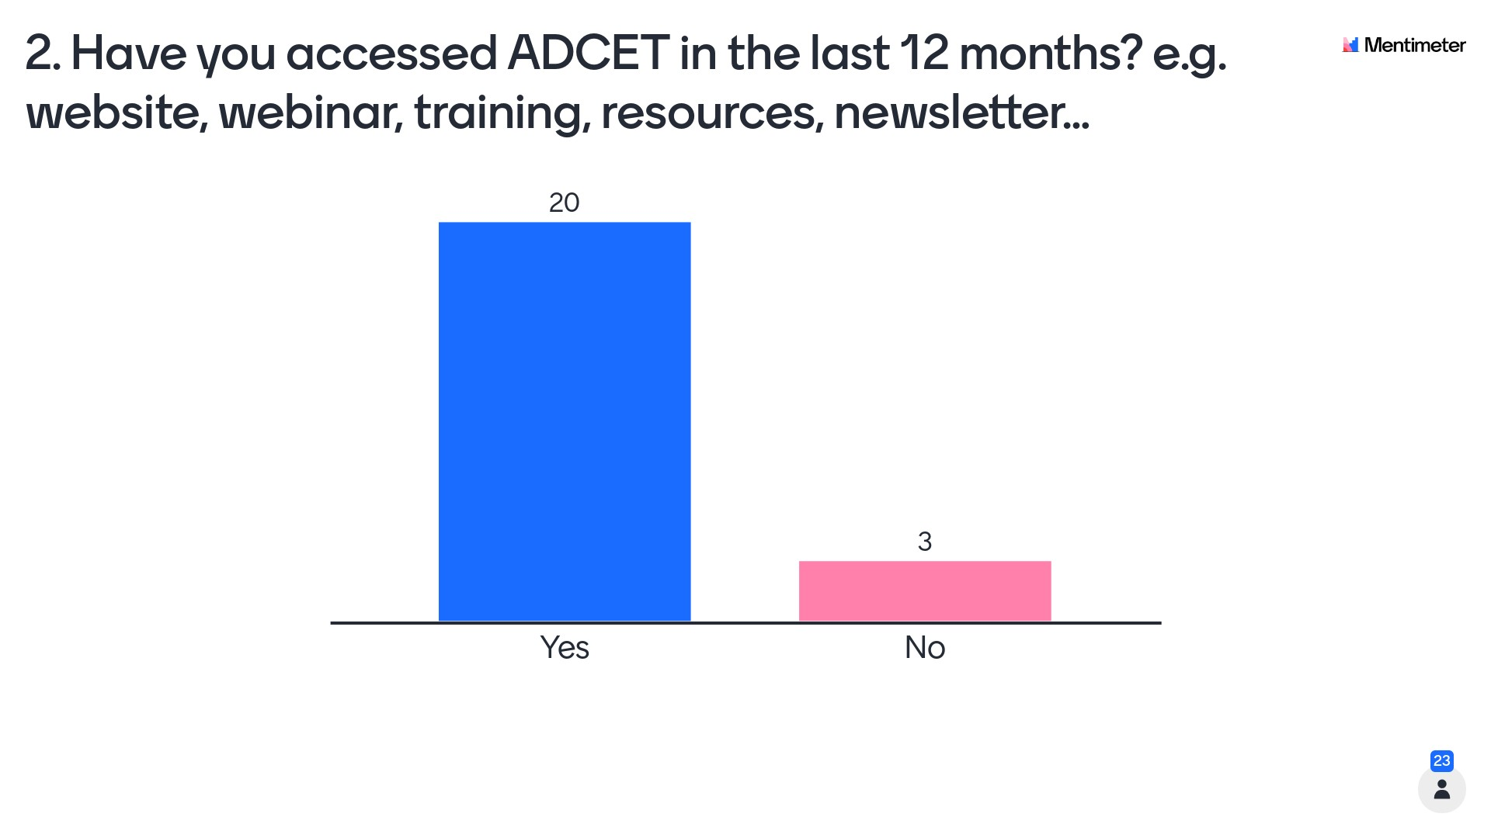
Mentimeter poll – Question 2
Go to Menti.com or click QR code Use the code 4660 5044
2. Have you accessed ADCET in the last 12 months? e.g. website, webinar, training, resources, newsletter…
Mentimeter results

Slide 8
Our impact – 2021
1 million website engagements
4.7k webinar recordings accessed
22k+ YouTube views of video content
53k engagements with webinars
30,000 people enrolled e-learning
1.6k social media followers
1.5k newsletter subscribers
521 organisations adopted our eLearning
Notes:
Just as a snapshot of our impact these are some of the stats about our engagement. We have over 500 pages of web content which is regularly updated as well as eLearning, webinars and social media.
This week we have great info reflecting on 20 years so check it out and we welcome suggestions for new content, webinars and resources.

Slide 9
What we do
POLICY AND ADVOCACY
To influence national policy to impact positively on the inclusion people with disability within tertiary education environments.
UNIVERSAL DESIGN
To promote the principles of Universal Design (UD) by creating an understanding of, and practical solutions to, UD across the learning, physical and digital contexts within tertiary education environments.
ENGAGEMENT
To promote inclusion and provide practical solutions in education and employment by building networks and collaboration with key strategic partners within tertiary education environments.
GOOD PRACTICE
To promote good practice in disability inclusion by providing advice and practical solutions on emerging trends, research and practice within tertiary learning environments.
Notes:
We have four pillars to our strategy and we aim to support the tertiary education sector across these pillars by supporting you to support students.
Only quickly expand if time....
Policy and Advocacy:
Some examples include providing advice to the Dept of Education, contributing to Review of DSE, collaborations with senior leaders through collaborations with Universities Australia around disability inclusion action plans, working with researchers and practitioners on projects of significance, as well as assisting our audiences navigate legislation such as the DDA, DSE, WCAG and premises standards.
Engagement:
We promote inclusion and provide practical solutions in education and employment through our webinars, podcasts, newsletter and project collaborations. In 2021 the ADCET website had over one million website engagements, 1.6k social media followers, 1.5k newsletter subscribers, and 4.7k webinar recordings accessed. In addition, over 30,000 people enrolled in Disability Awareness e-learning across Australia.
Universal Design:
Promoting the key principles of Universal Design (UD) is one of our pillars and we provide resources and practical solutions through UD in learning, physical and digital contexts. For example UDL eLearning and inclusive teaching resources online, ICT procurement guidelines to improve digital accessibility, inclusive communication, and future projects around best practice in building standards.
Good Practice:
We draw on the expertise of our experts and practitioners on the ground, research, data, benchmarking and feedback to identify the emerging trends and good practice. This manifests as webinars, professional development, and special projects. For example, eLearn packages, communities of practice, inherent requirements symposium and project, benchmarking activities etc

Slide 10
What we know
SWD are fastest growing equity group (NCSEHE, 2019)
Current participation for domestic SWD 7.44% (4.51% in 2010) (DE, 2021)
Retention rate and success rates are lower (DE, 2021)
Only 17% of SWD aged 20+ have a bachelor’s degree or higher compared with 35% of those without disability (AIHW, 2022)
Graduate outcomes are lower (employment rate is 57.7% with disability vs 70% without disability (QILT, 2021)
9 in 10 new jobs are projected to require post-school qualifications (NSC, 2021).
Notes:
One of the greatest challenges for the tertiary sector, especially higher education is for disability inclusive strategies to keep pace with the increasing number of people with disability wanting to enrol and work at our institutions.
Again COVID has sharpened our focus on health, disability and wellbeing and what this means going forward.
1 in 6 people have a disability in Australia and many of us will experience disability in our lifetime. The improved participation of people with disability means we need to ensure our institutions are:
inclusive – attracting and retaining talented people in education and employment
disability aware – ensuring that our staff understand their obligations to people with disability
producing graduates with disability inclusion as part of their graduate capabilities
Enabling graduates with disability to flourish in employment which matches their qualifications and skills
Harnessing the diversity of people with disability in employment – especially given the current skills shortages.

Slide 11
Mentimeter poll – Question 3
Go to Menti.com or click QR code Use the code 4660 5044
3. Rank your uni's disability inclusion from 1 to 5
(1 being the lowest)
Mentimeter results

Slide 12
Drivers (carrots vs sticks)
New Government reform agenda
Australia’s National Disability Strategy 2021 – 2031
Relevant legislation
Higher Education Disability Support Program
Discrimination and risk
Job Ready Graduates Package
Performance-based funding
Royal Commission
Social model of disability
WP and inclusion
Student retention = $$
Student success = reputation
Data
Diverse graduates needed
Skills shortages
Universal design benefits all
Notes:
There are a range of drivers not least of which is the new Government reform agenda which centres people with disability – our senior leaders, and all university communities need to be aware of these drivers.
ADCET’s aim, and the aim of universities should be to be inclusive because they want to not because the have to. Education and employment is a human right and for people with a disability – and all equity groups the benefits which come from a good education and employment prospects influence wellbeing across many domains e.g. financial, health, social participation
What works for students with disability works for all students.
Under pressure from COVID, staffing pressures, casualisation, student needs etc ADCET aims to provide resources to hand that will assist institutions, practitioners, educators and students
These are useful ‘hook’s when talking to senior leaders about disability inclusion within your institution.

Slide 13
Building a framework for inclusion
Person with disability
Policy
Culture
Structural barriers
Strategy
Notes:
Higher Education is at a crossroads and needs to take a more strategic and systematic approach to disability inclusion.
This disability inclusion framework, based on ADCET’s strategic pillars, can assist institutions to drive disability inclusion in a holistic and strategic way.
And you don’t have to reinvent the wheel, for the most part ADCET has resources, guidelines and information that can assist you.

Slide 14
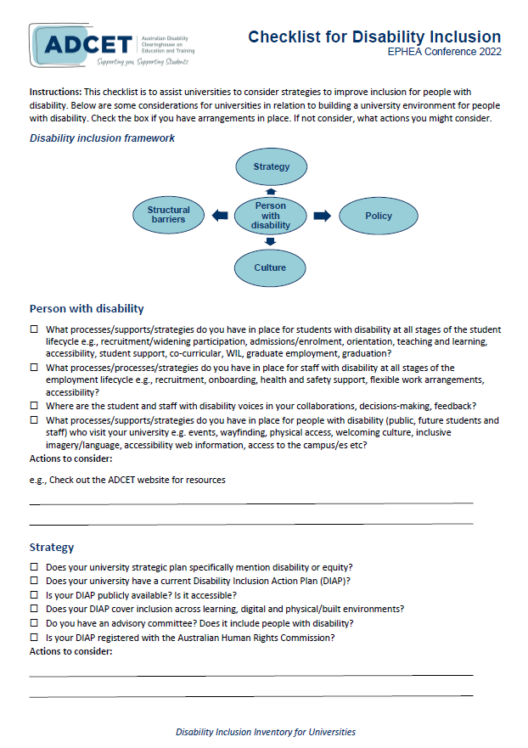
Play along
We have created a Disability Inclusion Inventory for the session – so people can mark areas that have been achieved or to consider actions to develop or review items within in the Disability Inclusion Framework.
www.adcet.edu.au/resource/11201/disability-inclusion-ephea
Notes:
Play along with us by using our Disability Inclusion Inventory to consider some of the key strategies you can introduce, develop or embed using the ADCET resources to hand or building on your existing strategies.

Slide 15
1. Person with disability
Person with disability
Person centred
Strengths-based
Prioritises lived experience in collaborations and decision-making
Examples of ADCET resources for people with disability include:
Pre-planning information for students transitioning to tertiary education
Disclosure information for education and employment
Reasonable adjustments based on specific disabilities
Disability discrimination information for students and practitioners
Information about employment (USEP) including a career development hub coming soon
Notes:
Firstly, it must be person-centred, and strengths-based.
For those is the staff equity space consider how you can foster greater diversity in your staffing profile and support staff with disability in your organisation.
For those in the student equity space consider how you can recruit, retain and support students with disability better across the student journey.
Collaborations and decision-making should include and prioritise lived experience and multiple perspectives in design and delivery of strategies for people with disability

Slide 16
Mentimeter poll – Question 4
Go to Menti.com or click QR code Use the code 4660 5044
4. Does your uni have an up-to-date DIAP (Disability Inclusion Action Plan)?
Mentimeter results

Slide 17
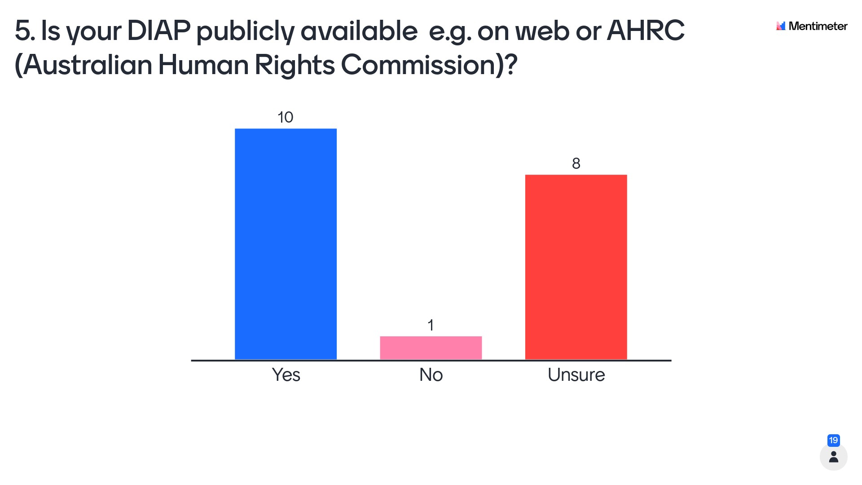
Mentimeter poll – Question 5
Go to Menti.com or click QR code Use the code 4660 5044
5. Is your DIAP publicly available
e.g. on web or AHRC (Australian Human Rights Commission)?
Mentimeter results

Slide 18
2. Strategy
Does your Uni Strategic Plan mention disability or equity?
Do you have a current Disability Inclusion Action Plan?
Senior leadership champions?
Does it cover access and inclusion across learning, digital and physical environments?
Who is on your advisory committee?
How are you monitoring, reporting and evaluating?
Strategy
Examples of ADCET Resources:
Developing a Disability Action Plan and links to AHRC
Universal Design for Learning eLearn, inclusive teaching resources
Digital Accessibility
Accessible ICT Procurement Guidelines
Notes:
Strategy from top down and bottom up is key. Is there a specific reference to disability or even equity in your strategic plan, or associated plans.
Do you have a Disability Inclusion Action Plan? Is it accessible to the public, prospective students and staff?
Do you have senor leaders or champions who are promoting or driving inclusion from the top?
Does it cover access and inclusion across learning, digital and physical environments?
Is your DIAP registered with the Australian Human Rights Commission?
Recently I audited DIAPs and 16/39 unis had a current plan; 29/39 had their plan on the AHRC (even if it was out of date). The oldest plan was from 2013.
Who is on your advisory committee? Who has been consulted? Does it include people with lived experience of disability?
How are you monitoring, reporting and evaluating strategy, interventions and activities, including collecting and analysing data?

Slide 19
3. Policy
Policy
Does your uni have policies and processes which reflect the DDA and DSE?
How do staff understand their legislative obligations?
Is discrimination included in your codes of conduct?
Is there a complaints process for SWD?
Examples of ADCET resources include:
Detailed information on DDA and DSE including guidance notes from Dept of Ed
Information on disability discrimination for students
Applying disclosure, privacy, reasonable adjustments, inherent requirements and ICT standards
Guidelines for working with specific disabilities
Notes:
Underpinning the work of universities if policies and procedures. Disability is somewhat unique in that it is supported by legislation and standards ie DDA and DSE
Some things for universities to consider are:
Do your policies, processes and guidelines consider people with disability?
Is there a specific disability policy?
Is discrimination explicitly covered in code of conduct for students and staff?
Do your policies and processes reflect legislative obligations under the DDA and DSE
Is there a process for making a complaint? The AHRC has had the most significant rise of complaints relating to disability discrimination since COVID and while a good number are related to vaccinations many are related to education and employment.

Slide 20
4.Structural barriers
Do you subscribe to a social model of disability?
Where are the pain points for PWD in accessibility?
How do you recruit, retain and support PWD?
What is your uni’s approach to UDL?
What is digital and physical accessibility like?
Are your approaches evidence-based and consultative?
Structural barriers
Examples of ADCET resources include:
UDL and inclusive teaching strategies including online learning
Accessible ICT procurement guidelines
Digital Accessibility resources and ADCET Assist
Guidelines for specific disabilities including support for COVID and Long COVID
Notes:
Structural barriers in learning, digital and physical environments need to be addressed effectively across your organisation.
Does your university subscribe to a social model of disability? And specifies it in strategy?
What does it look like for a person with a disability to navigate admissions, enrolment, orientation, learning (including online), student support, careers support, graduation?
What does it look like for a person with a disability to apply for a job at your institution or get reasonable adjustments to perform their work effectively?
How easy is it for a person with a disability to navigate your campuses?
What is your institution's approach to UDL?
Can everyone access all ICT?

Slide 21
5. Culture
Do you have disability awareness training for all staff?
Is it recommended, mandatory?
What professional development opportunities are available around disability and inclusion?
Do you actively promote inclusive language and visual representation?
What active inclusion strategies are in place?
Culture
Examples of ADCET resources include:
eLearn training packages on disability awareness and UDL for your LMS
Webinar series, videos and podcasts
Fortnightly newsletter, technology updates, and social media
Web resources, guidelines and communities of practice
Awards and recognition
Notes:
How are you building capacity in your workforce to support people with disability across the organisation.
Are you developing graduates with the capability to work with diverse groups including working with people with disability?
What, if any, training is offered? Is your training recommended or mandatory?
I recently audited all universities and only 8/39 had public reference to disability training for their staff. The remainder may have training within intranets – what does it say to prospective students and staff your institution doesn’t have outward indicators of inclusion?
What opportunities do teaching staff have to engage with UDL and inclusive strategies – especially sessional staff?
What other inclusion strategies are in place? E.g. International Day for People with Disability, inclusive language and imagery, inclusive events etc

Slide 22
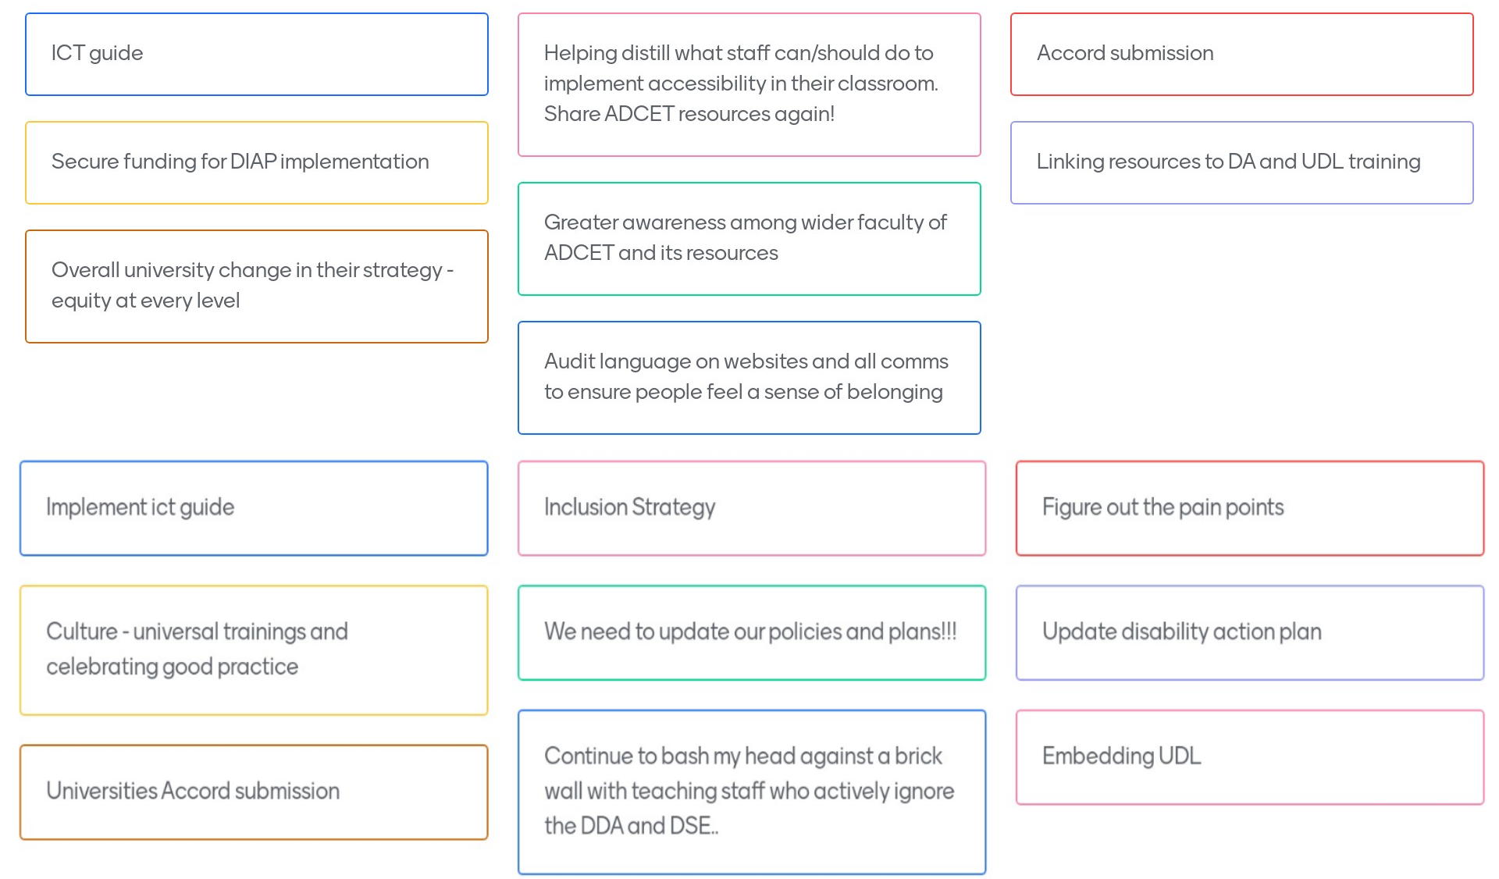
Mentimeter poll – Question 6
Go to Menti.com or click QR code Use the code 4660 5044
Mentimeter results
Notes:
17 Participants responded with the following comments
Implement ict guide Inclusion Strategy
Figure out the pain points Culture - universal trainings and celebrating good practice
We need to update our policies and plans!!!
Update disability action plan
Universities Accord submission
Continue to bash my head against a brick wall with teaching staff who actively ignore the DDA and DSE.
Embedding UDL ICT guide
Helping distill what staff can/should do to implement accessibility in their classroom.
Share ADCET resources again!
Accord submission Secure funding for DIAP implementation
Greater awareness among wider faculty of ADCET and its resources
Linking resources to DA and UDL training
Overall university change in their strategy - equity at every level
Audit language on websites and all comms to ensure people feel a sense of belonging

Slide 23
Contact
Darlene McLennan
Manager
darlene.mclennan@utas.edu.au
Gabrielle O’Brien
Senior Project Officer
gabrielle.obrien@utas.edu.au
www.adcet.edu.au
admin@adcet.edu.au
Notes:
Feel free to contact us with any additional questions

Slide 24
References
NCSEHE Briefing Note — Equity student participation in Australian higher education: 2014–2019 – NCSEHE
Selected Higher Education Statistics – 2020 Student data (Section 11: Equity Performance)
Selected Higher Education Statistics – 2020
National Skills Commission Annual Report 2020-2021
QILT 2021

