Slide 1
SCAFFOLDING students to become independent learners and career ready graduates Julie Kiroluch TEam Leader AccessAbility & Inclusion 2022

Slide 2
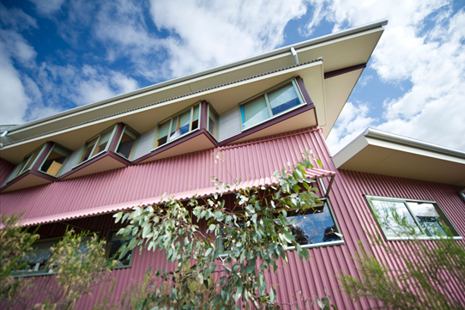
Acknowledgement of country
La Trobe University Bendigo is situated on Jaara country, the traditional land of the Dja Dja Wurrung people. I wish to pay my respect to the Dja Dja Wurrung community, the ongoing custodians of the land and their elders past, present and emerging. I acknowledge their unique cultural and spiritual relationships to the land and their rich contribution to society.

Slide 3
POLL
Which of these student supports are provided by your organisation?
Learning Access Plans (or similar)
Note takers
Alternative formats
Transcripts
Captions

Slide 4
Previous support processes
Learning access plans
Focus on what students can’t do
Recommend what students should be allowed to do instead
Little thought about skill development, even when renewing LAPS
NOTETAKERS
Routinely offered to students with vision, hearing, learning and cognitive difficulties
Often for duration of studies.
Inclusive Resource Development (IRD)
Managed all alternative formatting, transcripts, captions
Combination of inhouse & external services

Slide 5
Notetakers
2019
Advisors identified need for notetaker support & notified Admin
Supported by Admin staff - 0.8 EFT in Bundoora & 0.2 EFT in Bendigo
Students – 38 (2%)
Notetakers – 49

Slide 6
Inclusive resource development (ird)
Referral to IRD (email template)
IRD senior liaison officer contact student to discus details (FT)
IRD source material, starting with LMS search
Scanning textbook/recording/video; download electronic version; request from publisher
IRD convert material-
Use Omnipage to create ‘preformat’ word document
Formatters correct errors, add tags and make changes (e.g. font)
Send to outsource for transcripts – 1 to 7 days depending on ‘tier’
Captions done via library (late addition to service)
Export according to students needs
Student profile
Online index

Slide 7
Changes to our practice
Expanded focus from EDUCATION to EMPLOYABILITY
We aim to educate students for life and for a good career. The latter is obviously becoming
increasingly important as the competition for employment intensifies. Our goal is to
produce some of the most employable graduates in the country – people with the skills and
capabilities necessary for long-term career success anywhere in the world.
La Trobe Strategic Plan 2020-30
Manager
Transformation process
Staff

Slide 8
covid

Slide 9
Are we really helping students?
We may make decisions on students’ behalf as to what they need to be successful
Erring on side of focusing on what students can't do
We can inadvertently project our own expectations and beliefs of what students will and won’t be able to do on their own
We would pre-empt students by offering a range of supports without REALLY exploring other options, certainly not Assistive Technology
We had often been ‘propping’ our students up rather than ‘scaffolding’ them to become independent learners AND workers

Slide 10
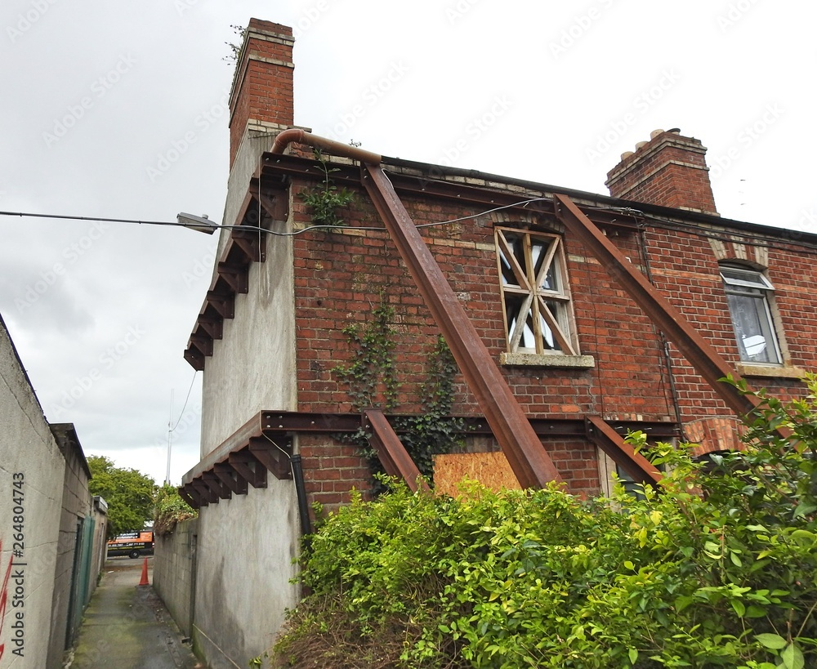
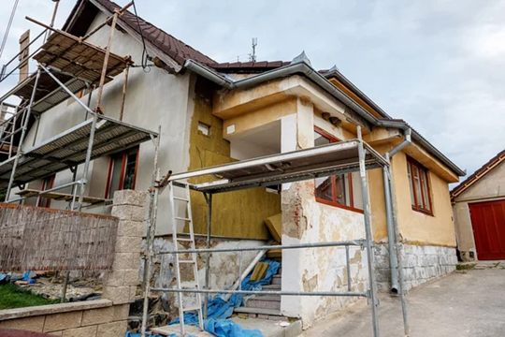
SUPPORT vs SCAFFOLDING
The term ‘scaffolding' originated from construction and refers to a temporary structure that is built for the builders to stand on while putting up new walls and grounds.
In 1976, scaffolding was applied in the context of learning a new concept or skill. Students who were scaffolded were better able to use
knowledge independently.

Slide 11
scaffolding
So ………
Scaffolding has been used to assist students to learn
The question is ………
Are we scaffolding students with disabilities to develop independence?
Can we do it better?????

Slide 12
Major Scaffold
What is the major SCAFFOLD allowing students to become independent learners and career ready graduates?

Slide 13
Assistive Technology
Increased availability of AT - Change in technology meant more things were possible
During 2020, AccessAbility Advisors worked with students to transition them to the use of technology rather than note takers
Lucky to have 2 FT staff who can support students to gain confidence with AT, including support through dedicated TEAM site
also working with academics to change practices such as increased use of TEAMs which facilitates easier recording/transcription
A&I Advisors and IRD Officers are actively encouraging students to engage with AT & explore what it can provide
Promoting AT to prospective students
Students & staff are becoming ‘champions’

Slide 14
TEAMS
Our IRD staff had been using teams for a long time and were able to teach A&I department to use TEAMS before there was a general move to its use by the university at large
All our meetings use teams – recording, captions & transcriptions
Lot of communication within team and university is through teams

Slide 15
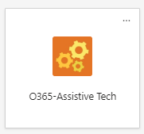
Teams display
General
Staff Communication
Student chat

Slide 16
Notetakers/Captions/Transcripts
25 Glean licenses currently issued
Currently have 4 students receiving note taker support
decrease from 2% to 0.2%
Academic staff encouraged (and supported) to use TEAMS for recordings, transcripts & captions & STREAM for transcriptions
No students currently have formatting support
Assisted to use AT e.g. Immersive Reader (Microsoft); document conversion
*New students have no expectations of what support they may/should get plus many are more familiar with AT

Slide 17
Feedback from Academics re LAPs
LAP recommendations can lead to students potentially not being ready to go on placement
If academics have never seen students work with peers, do presentations, etc, how do they know they can manage on placement and what support may be required?
Placements – students need to be ‘able to work in the real world’
Becoming increasingly more difficult to source placements, esp. for students who require adjustments
Causing us to rethink LAPs so they also scaffold students to become independent

Slide 18
Discussion
Think of students progressing from NOVICE to INTERMEDIATE to PROFICIENT in terms of managing their study
Come up with ways to ‘scaffolds’ students who may:
Struggle with working in groups
Be unable to do presentations
Have difficulty asking for assistance
Require frequent feedback from educators on placement
Need frequent/long extensions

Slide 19
These changes to practice are possible
We can move students to Assistive Technology without compromising their learning
Students want to use AT, especially when shown how
Students (& staff) can develop Digital Literacy
We can Independent learners and graduates – who can manage info in real time
Transfer power - As student acquires more skills can remove scaffolds

Slide 20
What are we thinking now?
Focus on employability – creating graduates who can successfully move into their career of choice
Measure Retention Progression Completion
Paradigm shift – revisioning what is a good service – empowering students & staff
This is an ethical/moral change – and a challenge. Staff have come to understand that we are providing a service that is superior to the previous model

Slide 21
Current & future projects
LAPs often focus on what students CANNOT do
Make LAPs strength based
Involve academics in discussion
Use of TEAMs
Still using ZOOM for online appts – restricted by our appt booking system
Classes run with ZOOM - ED Tech has not yet embraced TEAMS
Use of image pdfs
Research
Graduate outcomes
Interview students who have transitioned to AT

Slide 22
thanks
Special thanks to Matthew Seah, Steve Zelko & Anthony Gartner

Slide 23
Bibliography
Wood, D., Bruner, j., & Ross, g. (1976) The role of tutoring in problem solving. Journal Of Child Psychology and Child Psychiatry, 17, 89-100

Slide 24
Thank you
latrobe.edu.au

