Slide 1
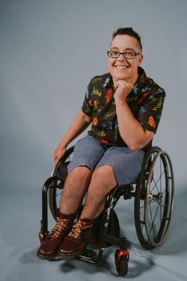
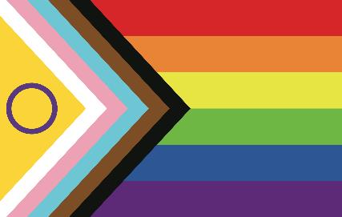
Affirming LGBTIQA+ people with disability
With
Jax Jacki Brown, OAM (they/them)
Notes:
Good afternoon! its great to be with you today!
I’ll be talking to you about the experiences of LGBTIQA+ people with disability and how you can be supportive and affirming when working with us! I’ll be talking for about 40mins and then we will have time for questions.
I’m Jax and I’m an LGBTIQA+ disability rights activist and educator. I’ll introduce myself more in a moment but first…

Slide 2
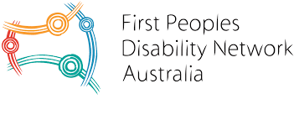
Acknowledgement of country
“I’m inside the culture because I’m Aboriginal; I’m outside because I’m gay.
I’m inside gay culture because I’m gay, I’m outside because I’m Aboriginal.” -Peter Waples-Crowe
https://fpdn.org.au
insideOUT by Ngarigo artist Peter Waples-Crowe
Notes:
I would like to begin by acknowledging the Wurundjeri people of the Kulin Nations on whose land I am on today and pay my respects to their Elders past, present and emerging and I extend my respect to any Aboriginal or Torres Strait Islander people who are present today.
This land was never ceded, and the processes of colonisation, occupation, incarceration and genocide that began over two centuries ago continue to this day. In the face of this I want to recognise the strength, resilience and pride of the first Nations people of this land.
This is an artwork by Peter Waples-Crowe who is Nar-a-goo man from the high country of NSW and also has Wurundjeri connections as well.
Peter lives and works in Naarm also known as Melbourne. He is gay and this work he made a couple of years ago speaks to his experience of feeling part of a group, while also feeling on the outer of that group because of his multiple identities.
He says: ‘I’m inside the culture because I’m Aboriginal; I’m outside because I’m gay.
I’m inside gay culture because I’m gay, I’m outside because I’m Aboriginal.’
I want to take a moment to pay deep respect to the First Peoples Disability Network Australia which is an organization run by and for Aboriginal and Torres Strait Islander people with disabilities. I encourage you to look them up and find ways you can support the important work they are doing.

Slide 3
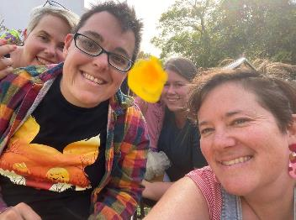
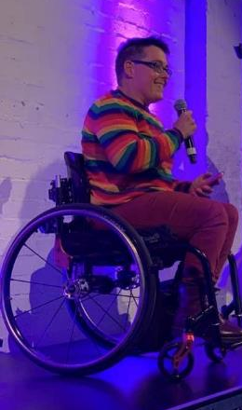
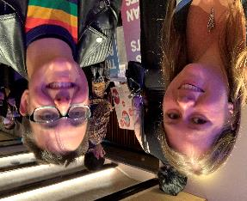
Who am I?
Notes:
Visual description
I’m a white person, with dark short hair and glasses, I’m wearing……
And I'm seated in my black manual wheelchair
My pronouns are they/them
As you can see from the images on screen I am a lot of different things.
I am a queer person, im non-binary, I use two different types of wheelchairs, a power wheelchair, and a manual wheelchair-these 2 different types of chairs influence how im perceived by others and change my access to spaces depending on what chair im using.
I’m also dyslexic so reading notes is hard for my brain but I will do my best but I hope that we can create a space together which is disability affirming and part of that for me it’s about talking about my disabilities openly and my access needs.
Being disabled, queer and non-binary are all super important parts of my identities, as well as being an activist, parent, partner and friend.
I’ve worked in the LGBTQA+ disability rights space for over 10 years and I’m passionate about disability rights and LGBTIQA+ rights and committed to social change and playing my small part in it.
I was awarded a Medal of the Order of Australia last year for my work for LGBTIQA+ disability rights…its weird to have the colonialist nation state recognise my activism and in some way give it value…I am trying to subvert that power, to trouble it, and to use the OAM after my name to get others through the doors and into spaces they wouldn’t otherwise be granted access to.
A note on language, I’ll be using the term disabled in my talk. I’m using it deliberately in the context of the social model of disability where disabled comes to mean a form of oppression or disadvantage because of ablism, so in this context disabled is a political term.
Also I am aware that im using the term intersectionality as a white person and I want to acknowledge its history, that it was first coined by Kimberle Crenshaw, an African-American woman, in the 1980’s, as a way to think about how racism and sexism intersected or overlapped in the lives of black women. At its core it’s a political term that asks us to think about systemic inequality, power and privilege and how we must address these things.

Slide 4
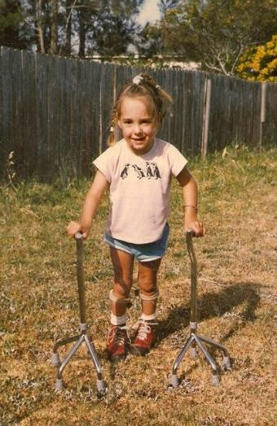
Childhood
A childhood spent in the pursuit of an unattainable ‘normal’ body-at what cost?
The power and influence of the medical model of disability in disabled peoples’ lives and histories
Notes:
Growing up I wasn't taught to expect to have a job, long-term partner or a child. My parents didn't really have a vision for my life where I could achieve things and aspire to the kinds of things other, non-disabled people could, and this was largely because the doctors and specialists were stuck in a negative, deficit view of disability and that my parents didn't seek out adults with disability for me to be connected to.
My disabilities were never going to disappear no matter how many surgeries and therapies my body was subjected to. This elusive idea of ‘normal’, which is also a social construct, was never something I could attain, and yet I was provided with no positive way of thinking about my disability.
The narrative I heard growing up was that I was ‘special’ and ‘brave’ and would ‘overcome my limitations’ and the idea that I would have to learn to live with my body, as it is, and that my disability would remain and become something I could feel proud of and find an identity and community because of, was not something that anyone ever said to me.
The influence of the medical profession, doctors, specialists, physiotherapists, occupational therapists etc in shaping how I and other people with disabilities view ourselves is massive, whether you are born with a disability like I was or acquire your disability.
The Medical model of disability remains the dominant way of thinking about disability in western society. Under this model a persons’ impairment or condition is the problem. Disability is to be cured or minimized. Disabled people are seen to be ‘less than’ ‘flawed’ or ‘in need of help’. From this model comes ideas of ‘special services for special people’ such as special schools, which I am a survivor of, segregated employment and group homes and more.
The medical discourse positions the sexuality of people with disabilities as abnormal, defective, aberrant or deviant, something to be policed, controlled.
The cost of this approach was that I spent years feeling exiled from my body. Disconnected from other disabled people and the disability community.
The medical profession and the medical model shapes how we see our bodies, we learn to view them as ‘less than’ non-disabled people, as bad or unworthy. This does the opposite of allowing us to feel disability pride. We hold these histories in our bodies.
So how did I move from shame to pride?

Slide 5
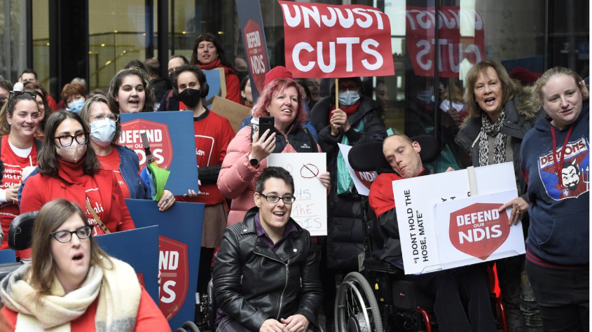
Disabled people are not wrong for the world we live in; the world is simply not yet right for us!
-Stella Young
Notes:
Well, in my early 20s I connected to another disabled person who was living a few streets away from me in my regional country town and we both started reading about the history of disability rights.
I was lucky enough to stumble across a few books on the disability rights movement which showed me that disabled people were not passive or to be pitied but that we have a long and vibrant history of activism and advocacy, of fighting for our rights - together!
The social model of disability arose in the UK in the 1980’s. Societal barriers and attitudes dis-ables people not their bodies or minds being non-normative. ‘Disabled’ is a political term. Disability is an identity.
The Social model enabled me to no longer view myself and my body as the problem but see disability as a socio-political question, a question of access, identity and human rights.
I came to understand that the barriers I was facing as a wheelchair user weren’t because my body was wrong, but because the environment had been built to be inaccessible and people held a lot of outdated prejudices or stereotypes.
This idea that disability is socially created was really transformative in how I saw my body and the world around me and also how I felt about other disabled people.
[Hit next]
Being connected to other disabled people, and I use the term disabled people politically here to describe how we have been disabled or disadvantaged by an inaccessible society and attitudes-being connected to other disabled people has been and continues to be central to me being able to feel disability pride.
There is a long and vibrant history of people with disabilities fighting for our rights both in Australia and internationally.
Understanding that I am not alone in coming up against some of the discrimination and barriers that I face and that I’m part of a movement which is fighting for our human rights also gives me a sense of connection resilience and pride.

Slide 6
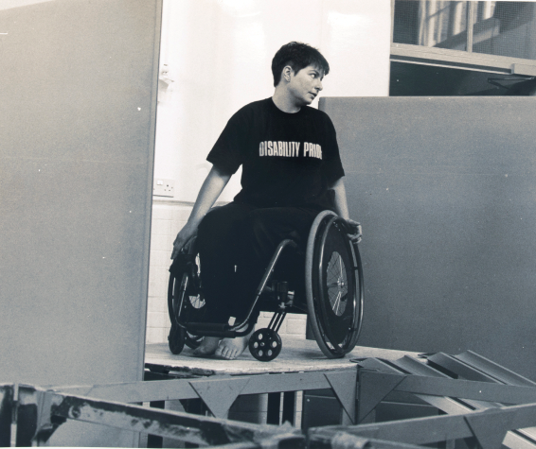
Artist and activist-Liz Crow
‘For years now this social model of disability has enabled me to confront, survive and even surmount countless situations of exclusion and discrimination…
It has enabled a vision of ourselves free from the constraints of disability oppression and provided a direction for our commitment to social change.
It has played a central role in promoting disabled peoples’ individual self-worth, collective identity and political organisation. I don’t think it is an exaggeration to say that the social model has saved lives.’
Artist and activist-Liz Crow
Notes:
UK artist and activist Liz Crow says:
’For years now this social model of disability has enabled me to confront, survive and even surmount countless situations of exclusion and discrimination…
It has enabled a vision of ourselves free from the constraints of disability oppression and provided a direction for our commitment to social change.
It has played a central role in promoting disabled people’s individual self-worth, collective identity and political organisation. I don’t think it is an exaggeration to say that the social model has saved lives.’
This is not to dismiss or downplay the whiteness of the disability rights movement historically and today.
It also needs acknowledging that the movement dismissed cis women and feminist concerns of the gendered nature of their oppression.
Disability feminists were actively told by leaders in the disability rights movement that to bring up concerns around the bodily experience of disability, for example, the experiences of pain, to talk about their intermate lives, sexuality and reproductive rights, were ‘personal issues’, and that airing such issues publicly would confuse non-disabled people and they would again think that disability was a a personal issue and NOT political issue.
But as we know the personal IS political.
However, for many people with disabilities, talking about their intimate lives and the barriers they face in terms of their sexuality and gender expression can be hard because without a political lens, it can be easy to internalise the ableism you are encountering and think that you are ‘the problem.’
Engaging with disability rights as a queer disabled person and then later coming out as non-binary I realised that much of the disability activist space was very heterosexual, very cisgender and not that welcoming to me or other LGBTIQA+ people.
At times it has been hostile and transphobic.
Part of these reactions I think, from disabled folks is due to internalised ablism and trying to ‘fit in’ and ‘not be more different than you already are’ so they see LGBTIQA+ disabled people as pushing the boundaries too much.
The same can be said unfortunately for the LGBTIQA+ communities and their responses to folks with disabilities, in that abelism is present- even tho as queer and trans people we can think radically about gender, power, bodies and sexuality-still too often folks with disabilities continue to be excluded from spaces. We can not get into many of the bars and clubs so we are not there, we are not visible and so are not thought about as potential lovers or partners….or even as a possible hot pash on a Saturday night!

Slide 7
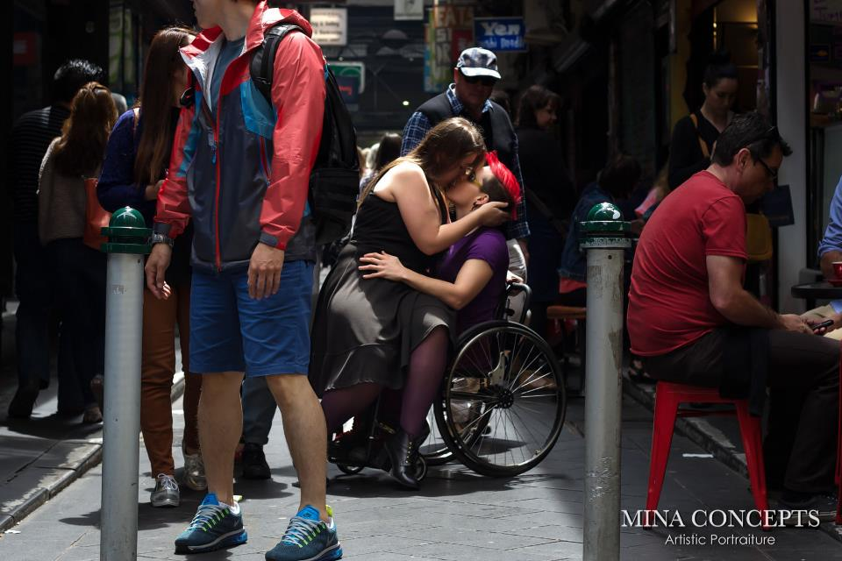
Jax and Anne
Notes:
Speaking of hot pashes…
This picture was taken over 8 years ago now when I was a few months into my relationship with my partner, Anne, at that time in a relationship when you are in lust with each other and can’t keep your hands off each other.
I wrote a little article titled ‘the politics of pashing’ for a sexuality magazine about how pashing my girlfriend in public was a political act because that we rarely see disabled queer people in popular culture, on tv, in books, in film and the editor rung me and said I’d love to take some photos to accompany the article so we got a photographer and took some shots about the CBD in Melbourne on a busy Saturday morning.
We never see images like this in our media or on the streets. We never see our bodies depicted as desired, as loveable, as valued.

Slide 8
‘Sexuality is often the source of our deepest oppression; it is also often the source of our deepest pain.
It’s easier for us to talk about— and formulate strategies for changing discrimination in employment, education, and housing than to talk about our exclusion from sexuality and reproduction.’
Writer and educator -Anne Finger
Notes:
Writer and educator Anne Finger‘ says:
Sexuality is often the source of our deepest oppression; it is also often the source of our deepest pain. It’s easier for us to talk about— and formulate strategies for changing discrimination in employment, education, and housing than to talk about our exclusion from sexuality and reproduction.’
As I've outlined, the disability rights movement has historically and even still today, struggles to include sexuality rights in its understanding of the disadvantages, we, as disabled people face.
This quote and the work of disabled people challenges that erasure
However, gender identity for trans and gender diverse folks is rarely even considered by the disability rights movement- this is the new frontier of disability activism and advocacy.

Slide 9
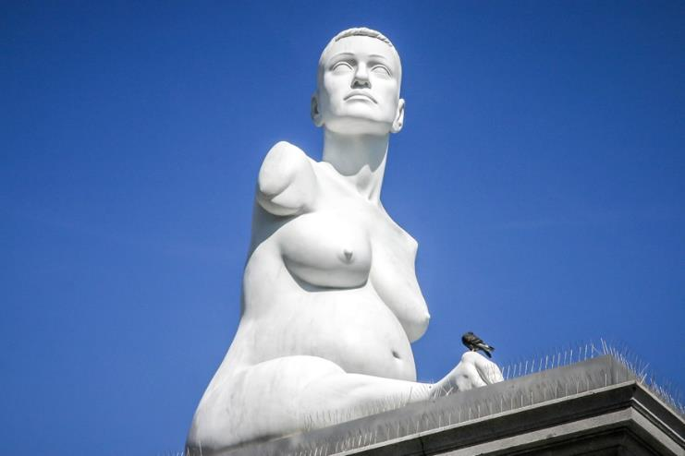
Reproductive rights
Alison Lapper Pregnant 2005, Trafalgar Square by Marc Quinn
Notes:
This is an image of Alison Lapper, a UK artist, when she was pregnant with her son. We rarely see images of disabled people pregnant, we are rarely shown as parents. I want you to think about:
Who is considered the default body or mind when we think about reproductive rights, when we think about pregnancy, birthing, parenting?
The image that springs to mind is of non-disabled people, it’s cis people, ie people who aren’t transgender and white people.
Who is allowed to become a parent and whose reproductive choices are limited, controlled and judged?
Often people with disabilities are not given the opportunities to enact our reproductive choices. Cis women with intellectual disabilities are routinely put on birth control as a means of preventing them from getting pregnant and have less opportunities to form relationships and start a family because of ableist assumptions and attitudes.

Slide 10
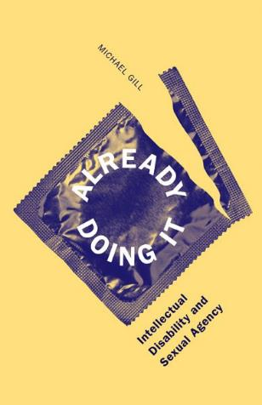
‘Individuals with intellectual disabilities’ sexual needs were ignored; their sexual behavior was punished; they were randomly sterilized; they were closeted in their homes or isolated in large institutions, segregated by sex to prevent them from reproducing. In fact, they were actually oppressed largely because of their sexuality’.
(Gill, Already Doing It: Intellectual Disability and Sexual Agency, 2015)
Notes:
In Michael Gill’s seminal work ‘Already Doing It: Intellectual Disability and Sexual Agency’, he notes: ‘individuals with intellectual disabilities’ sexual needs were ignored; their sexual behavior was punished; they were randomly sterilized; they were closeted in their homes or isolated in large institutions, segregated by sex to prevent them from reproducing. In fact, they were actually oppressed largely because of their sexuality’.
Gendered assumptions regarding mothering impact cis women with disabilities where it is assumed in order to be a ‘good mother’ you need to be able to care for your child completely independently and without the use of assistance from support workers.
Reproductive rights and the choice whether or not to have children, finding a partner to do that with or going it alone as a solo parent- these are choices which are often denied to people with disabilities, often by the very people who are meant to support us in affirming our identities-parents support workers and services gate keep and manage our access to sexual health knowledge, and limit our access to events/pubs or bars where we might form relationships and explore our sexuality.
For LGBTIQA+ people with disabilities we face additional challenges..

Slide 11
‘Gay men and lesbians, gender queer and gender nonconforming persons, racial minority populations, poor people, and disabled people are often discouraged to reproduce for fear that they cannot, will not, or should not contribute to the future of the human race’.
(Gill, Already Doing It: Intellectual Disability and Sexual Agency, 2015)
‘Robert McRuer argues that crip/queer perspectives can challenge assumptions about which bodies are able to inhabit and lay claim to normative conceptions of agency, family, and ultimately, identity’.
(Gill, Already Doing It: Intellectual Disability and Sexual Agency, 2015)
Notes:
‘Gay men and lesbians, gender queer and gender nonconforming persons, racial minority populations, poor people, and disabled people are often discouraged to reproduce for fear that they cannot, will not, or should not contribute to the future of the human race’.
This idea that disabled people will create disabled babies should we reproduce is deeply ableist and holds at its core the idea that disability is inherently ‘a bad thing’ and that disabled people will make bad parents.
{hit next}
‘Robert McRuer however argues that crip/queer perspectives can challenge assumptions about which bodies are able to inhabit and lay claim to normative conceptions of agency, family, and ultimately, identity. We deliberately trouble notions of who is permitted to be sexual and how, who is worthy of love and connection, of value’.
Disability is a part of human variation, it’s an aspect of diversity.
I don’t want to change my body or brain, I want to change society, for it is society which disables me.
I want to challenge ableism including sexual ableism
What are some of the challenges LGBTIQA+ people with disabilities face in this country? Well…

Slide 12
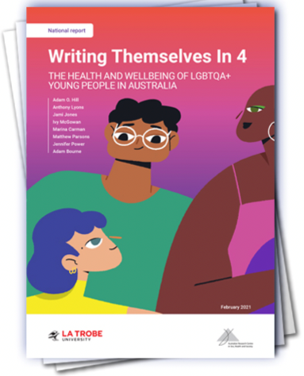
Challenges facing LGBTIQA+ people with disabilities in Australia
In the last 12 months LGBTIQA+ people with disability had experienced the following rates of harassment or assault based on their sexuality or gender identity: 52.7% had experienced verbal abuse, 15.0% physical abuse and 31.7% sexual abuse. (Writing Themselves In 4: The Health and Wellbeing of LGBTQA+ young people in Australia, 2021)
Higher rates of violence, abuse, neglect and exploitation
Living at the intersection of multiple systems of disadvantage: Ableism/homophobia/biphobia/transphobia/
intersexphobia
Family members and support workers often not being affirming of our sexual or gender identities
NDIS is not LGBTIQA+ responsive or supportive
Notes:
We know that LGBTIQA+ people with disabilities experience higher rates of violence, abuse, neglect and exploitation with a recent Writing Themselves In report looking at the Health and Wellbeing of LGBTQA+ young people in Australia finding that:
‘In the last 12 months LGBTIQA+ people with disability had experienced the following rates of harassment or assault based on their sexuality or gender identity: 52.7% had experienced verbal abuse, 15.0% physical abuse and 31.7% sexual abuse’.
It is worth noting that although the report is published in 2021, survey responses were provided in 2019 so it would be interesting to know the impact of living through the Covid pandemic on LGBTIQA+ peoples mental health and experiences of violence.
The Disability Royal Commission has held some closed sessions with LGBTIQA+ people with disabilities into our experiences and found what many of us already knew, that we are subject to intersecting and overlapping forms of disadvantage. We also know that, as I’ve said, family members and support workers, those very people who should be supporting us to be our full selves are often not affirming of our identities, and this is a real issue when we might need support to go to LGBTIQA+ venues or to buy clothes and dress ourselves in ways that express our gender identity.
The NDIS is a big system which only 10% of people with disabilities in Australia have access to but for those of us that do it is a key way that we are able to meet our basic support needs.
The NDIS is not LGBTIQA+ responsive. From the Local Area Coordinators, to the planners who write your plan, to the support workers there is a lack of knowledge on LGBTIQA+ issues and identities leaving many people feeling unsupported and even unsafe to disclose their sexuality or gender identity.
Now let’s explore some practical ways you can be supportive of LGBTIQA+ people with disabilities…

Slide 13
PRONOUNS: WHY THEY MATTER AND HOW TO USE THEM
Gendered pronouns:
he/him/his
she/her/hers
Gender neutral pronouns:
they/them/theirs
Ze/zir/zirs
gender neutral pronouns are generally used by non-binary or gender fluid folks
A person’s pronouns may change over time. Someone might use she/they pronouns but later use they/them so it’s good to gently check-in with the person if you are unsure
Get into the habit of introducing yourself using your pronouns:
‘Hi, my name is ….and my pronouns are…’’
“Can I ask what your pronouns are?’’
Have your pronouns in your email signature and beside your name on zoom/teams
Wear a pronoun badge with your pronouns on it
Notes:
Pronouns are important as they let people know our gender identity and how to talk about us.
Using someones pronouns signals to them, especially if they are trans or gender diverse, that you respect and affirm their gender identity
Gendered pronouns:
he/him/his
she/her/hers
Gender neutral pronouns:
they/them/theirs
Z/ z-ear-/ z-ear-s
gender neutral pronouns are generally used by non-binary or gender fluid folks
A persons’ pronouns may change over time. Someone might use she/they pronouns but now use they/them so its good to gently check-in with the person if you are unsure
Get into the habit of introducing yourself using your pronouns:
‘Hi, my name is ….and my pronouns are…’’
“Can I ask what your pronouns are?’’
Have your pronouns in your email signature and beside your name on zoom/teams
Wear a pronoun badge with your pronouns on it

Slide 14
Practical ways you can be affirming of LGBTIQA+ people with disabilities
Gender is not a binary but a spectrum
80% of disabilities are invisible
Be across what the different letters in LGBTIQA+ stand for and what the issues are
Take a person centred approach and mirror the language the person is using about themself
Celebrate significant days such as: IDAHOBIT, Wear it Purple Day, Trans Day of Visibility, Intersex Awareness Day, IDPwD
Make sure there is space on forms for people to write their preferred name as well as legal name and an open text box for gender
Maintain confidentiality i.e. if they have only told you about their sexuality or gender identity don’t share this information with others
Notes:
Gender is not a binary but a spectrum- with female being at one end and male being at the other and people might move along it across their lifespan.
80% of disabilities are invisible. When people think of what disability looks like they might think of a wheelchair user or someone with a visible disability but it’s much more common for people to have invisible disabilities. We need to create a culture, whether that be in an educational context or a work context, where people feel safe and respected to talk about their disabilities.

Slide 15
Practical ways you can be affirming of LGBTIQA+ people with disabilities
Check in directly about what pronouns someone would like you to use in different contexts
Always use the name the person wants to be called even if their legal name might be different
If you misgender someone apologise politely
Don’t assume someone is in an opposite sex relationship
Don’t make assumptions about a person’s gender identity based on how they look or how their voice sounds
Invest in LGBTIQA+, disability, First Nations, CALD trainings which are designed and delivered by people with lived experience

Slide 16
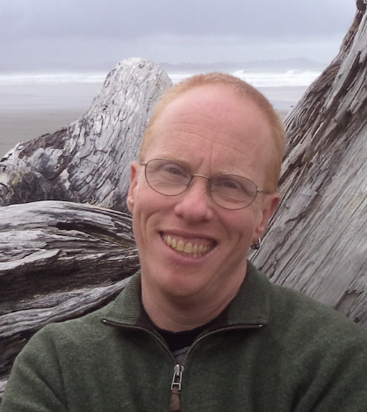
‘Pride works in direct opposition to internalized oppression. The latter provides a fertile ground for shame, denial, self-hatred, and fear. The former encourages anger, strength, and joy.
To transform self-hatred into pride is a fundamental act of resistance.’ (emphasis added)
Trans, queer disabled writer-Eli Clare
Notes:
This is Eli Clare a trans queer disabled writer from the the US.
He says: ‘Pride works in direct opposition to internalized oppression. The latter provides a fertile ground for shame, denial, self-hatred, and fear. The former encourages anger, strength, and joy. To transform self-hatred into pride is a fundamental act of resistance’.
I really love this quote because it shows the power of pride to shift how we feel about ourselves and also how it can give us resilience when we encounter homophobia, transphobia, biphobia or ableism.
To many people, the idea of disability pride seems counter intuitive – how could you feel pride in something which is presumed to be an inherently negative experience? Disability, is often assumed to be just an experience of pain and the experiences of isolation, abuse, and discrimination
It is assumed that the experience of disability gives us nothing of value, nothing positive.
That’s wrong, there are lots of things that are good about being disabled.
Yes, pain, illness are sure a s heck hard to deal with but for me, disability pride doesn’t deny those experiences, but it says that how I experience my body and the barriers that I face and the hard things that I’ve gone through are not my fault and are heavily influenced or impacted by the ablism that I also experience.
My disability gives me access to a different experience of the world, a different understanding of the way that bodies and minds can be, and the value found in being different to the supposed ‘norm’. My disability gives me a different perspective on gender and power as well as access to a vibrant and feisty disability community and disability culture.

Slide 17
Thank you!
jaxjackibrown@gmail.com
jaxjackibrown
Notes:
These are 2 pride flags which mean a lot to me.
The Disability Pride Flag was a collaborative design effort by Ann Mag-ill.
There is also the progress flag which is the rainbow flag with an addition of a brown and black, and blue pink and white colours in triangle lines to signify the inclusion of trans people and first nations, black and brown people of colour.
Here are my contact details as well if you would like to stay connected!
Thanks so much for inviting me to speak today and for giving up your time to listen!

Slide 18
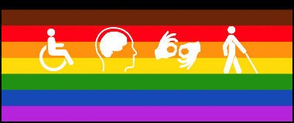
Resources to support LGBTIQA+ people with disabilities
Rainbow Rights: Self-advocacy: A group run by and for LGBTIQA+ people with intellectual disabilities
https://rainbowrights.com.au
Spectrum Intersections: LGBTIQA+ Neurodiverse peer group
https://www.spectrumintersections.org
Rainbow Inclusion: A website for LGBTIQA+ people with disabilities
https://rainbowinclusion.org.au
Our Rainbow Lives Website
https://inclusionmelbourne.org.au/projects/our-rainbow-lives/
Thorne Harbour Health and Inclusion Melbourne-LGBTIQA+ disability NDIS resources
https://thorneharbour.org/lgbti-health/disability/disability-resources/
Sexuality, Education, Counselling and Consultancy Agency (WA) (not LGBTIQA+ specific)
www.secca.org.au
Research about LGBTIQA+ people with disabilities
The Everyday Experiences of Lesbian Gay Bisexual Transgender and Intersex (LGBTI) People Living with Disability Report, 2018
More than Ticking a Box: LGBTIQA+ People with Disability Talking about their Lives Report, 2021

