Slide 1

Realising Disability Inclusion
ADCET Webinar
24 August 2022
Professor Carol Evans
evansc101@cardiff.ac.uk
Inclusivehe.org

Slide 2
Disability Inclusion:
Aim:
Looking for an evidence-based and practice-informed approach to scaling disability inclusion from staff and student perspectives.
How do we get there?
Definition:
The extent to which higher education institutions (HEIs) support students and staff with disabilities (SSwD) to have equal access to university and equal opportunities to do well compared to their peers without disabilities (Evans & Zhu, 2022).

Slide 3
Disability: the poor relation of the inclusion agenda
The Australian Context:
< Access to higher education for students with disabilities 6.2 - 9.6% (compared to 17.7% of the population) (Netherlands 30%, UK 17%, Zambia < 0.1%)
< Student success in higher education (5-10% lower than no reported disability) (1.1% in UK)
Retention rates in Tasmania actually higher for students with disabilities
< Students with disabilities are less satisfied with course experience
< 10% lower employment rates compared to no reported disability

Slide 4
Disability: the poor relation of the inclusion agenda
The Australian Context:
Half of Australian managers have never hired a person with a disability, and one in ten admit they wouldn’t want to in the future
Source: Guardian, July 2022 – YouGov, n = 501 middle managers and HR professionals
Harpur and Szucs (2022) found no evidence of disabled status disclosure among any senior leaders of Australian universities on official employer websites.

Slide 5
Disability: the poor relation of the inclusion agenda
The Australian Context:
What does the data look like when you disaggregate it into specific disabilities, and in interaction with other variables?

Slide 6

Disability Inclusion: The evidence base
Disability Inclusion: the evidence base
A review of 11,000 peer reviewed academic papers and reports on disability inclusion (DI) revealed:
Approximately 600 articles and reports were identified as relevant, and involved lead authors from 50 countries.
Scrutinisation of institutional data on EDI.
Consultation with expert stakeholders in supporting the development of the Disability Inclusion Institutional Framework.

Slide 7

Perspectives on Disability:
We are disabled by our bodies and by organisational and societal constraints
The Disability Institutional Inclusion Framework (DIIF) draws on research on interactionist perspectives on disability (Gustavsson, 2004; Riddle, 2013; Shakespeare, 2014), and critical social perspectives.
).
The DIIF acknowledges the complex interplay of impairments with individual personal characteristics, the specific contextual and situational features students and staff with disabilities (SSwD) encounter, and their responses to this (Bustamante et al., 2020; Kruse & Oswal, 2018).

Slide 8
Disability Inclusion Principles
Disability is personal - experiences of disability are not universal.
Appreciating diversity and its inherent value in impacting organisational effectiveness.
Disability is multifaceted and fluid, where disability may or may not frame an individual’s identity(ies).
Disability is interactional involving the interaction of a person with their context.
We need to examine structures, processes, and agents in ensuring access as part of a social critical discourse.
Disability is intersectional, it intersects with a whole host of individual and contextual variables.
An anticipatory and intentional approach embeds disability inclusion in all structures and processes.
A research-informed and integrated approach utilises research on self-regulation, agentic engagement, and neuro/cognitive sciences and individual differences to inform disability inclusion.
A holist approach considers social and relational and academic dimensions.
Partnership between students and staff with disabilities (SSwD) and organisations to support mutual accommodations is important in supporting SSwD to use their skillsets to best effect.

Slide 9
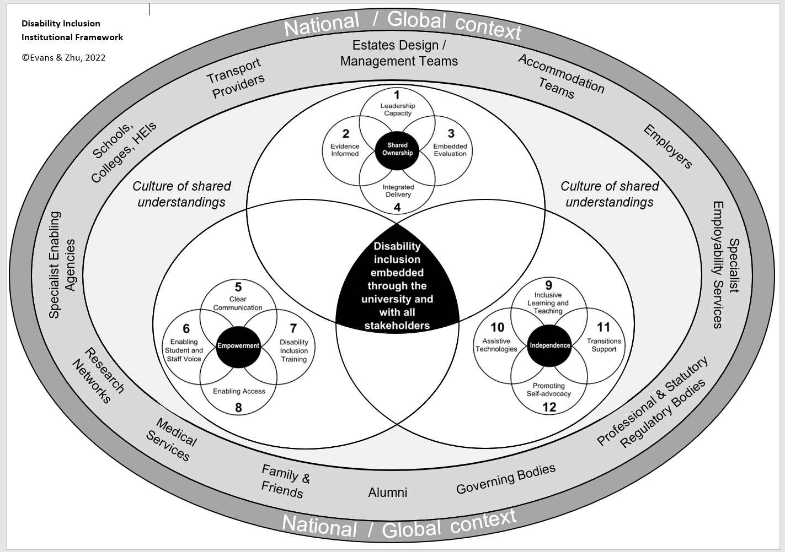
Disability Inclusion Institutional Framework
© Evans & Zhu, 2022

Slide 10

What does the data tell us?

Slide 11
Supporting Self-Advocacy: Balance of Load & Associated Costs
INDIVIDUAL
ORGANISATION
Level of investment
‘The ability to assertively state wants, needs and rights, determine and pursue needed supports and to obtain and evaluate the needed support with the ultimate goal of conducting affairs independently’
(Pfeifer et al., 2021, 20)
Links with work on self-regulation: Effective deployment of the right strategies and in the right amounts to realise goals, and
Agentic engagement: Ability to utilise and impact the environment to realise goals

Slide 12
1. Leadership too removed from practice
Under-representation of staff with disabilities in leadership positions impacts progress in DI (executive, senior research and professional roles, and in research funding).
Only 3.6% of UK academic senior managers disclosed a disability (Advance HE, 2020).
Essential role of senior leaders in moving disability inclusion forward and having oversight of all moving parts.
Mechanisms to embed disability inclusion at all levels.

Slide 13
2. What counts as evidence?
  Appropriateness of methodologies in exploring the lived experiences of students/staff with disabilities (only 12% highest quality).
  Guidance in relation to protocols relating to implementation and evaluation of interventions to support enhancements in disability inclusion.
  Representation of staff and students with disabilities in disability inclusion research.
  Relatively little work exploring the postgraduate student experience (2%).

Slide 14
3. How are we interrogating data?
Limited inferences can be made from aggregated disability data.
Even when considering ‘disability types’ intersectionality with individual and contextual variables need consideration.
The experience of staff and students with disabilities need to be explored within the moment.
How are we using data to support learning?

Slide 15
4. Undone by a lack of an integrated approach
Need for collaborative working across services/functions/sectors.
Holistic - practical, social, and academic needs.
Ownership of DI at course/unit level and by all staff and students.

Slide 16
5. The language of disability inclusion matters
Valuing of diversity
How disability is framed
Gaps between rhetoric and reality
Cumulative damage

Slide 17
6. An anticipatory approach that values SSwD voice
Extent to which staff and students with disabilities are engaged in the design of services from the get go.
Comprehensive approaches to capturing SSwD voice.

Slide 18
7. Quality and reach of training
Training for all stakeholders.
Awareness of resources to support.
Embedded within all processes and systems.
Evidence of the impact of training is limited.

Slide 19
8. Essentials of supports and pain of disclosure
Accommodations make a difference.
Disclosure is a nasty word – multiple layers of disclosure.
Burden of disclosure.
SSwD ownership of support process and knowing how to navigate the systems.
Bias – not all disabilities are treated equally.
Minimising the needs for additional supports.

Slide 20
9. Going back to basics around inclusive learning and teaching
Being clear about what inclusive learning and teaching is.
Little evidence of efficacy of Universal Design for Learning (UDL). A design issue!
Embedding reasonable adjustments from the start.

Slide 21
10. Mainstreaming assistive technologies (ATs)
Assistive technologies make a difference in many ways.
Training in the use of ATs for staff and students.
Time to learn how to use ATs.
Scrutiny of the quality of ATs.

Slide 22
11. Maximising transitions support
Importance of pre-university support in how to navigate the HE system impacts outcomes but there is a need to attend to students’ perceptions of themselves.
Importance of the first semester.
Importance of academic, social, and professional networks.
Early and sustained access to academic and professional mentoring and internships.

Slide 23
12. Promoting Self and Shared Advocacy
Key concepts centred around:
independence, knowledge of self and context, and capacity to effect change – implicated in student success
self-determination: to make decisions for oneself – also related to notions of competence, connection /relatedness, and autonomy
self-awareness
self-efficacy
agentic engagement
self-regulation

Slide 24
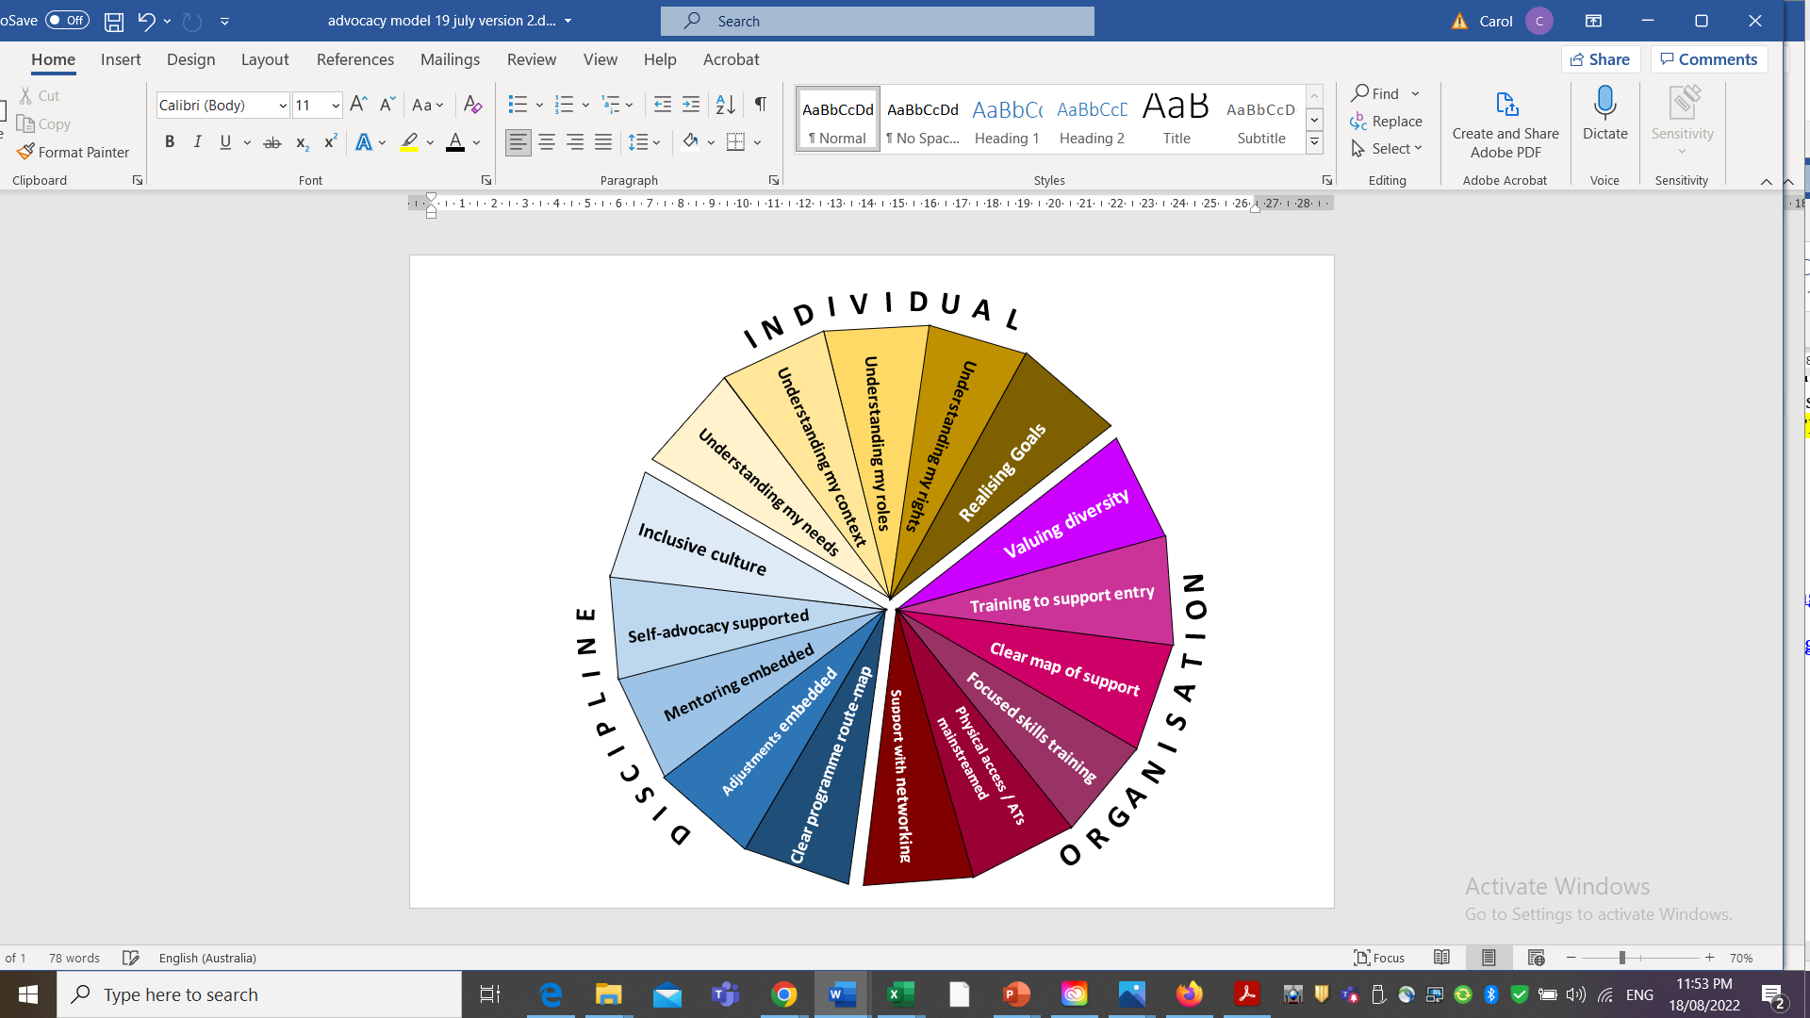
Promoting Self and Shared Advocacy
© Evans, 2022

Slide 25
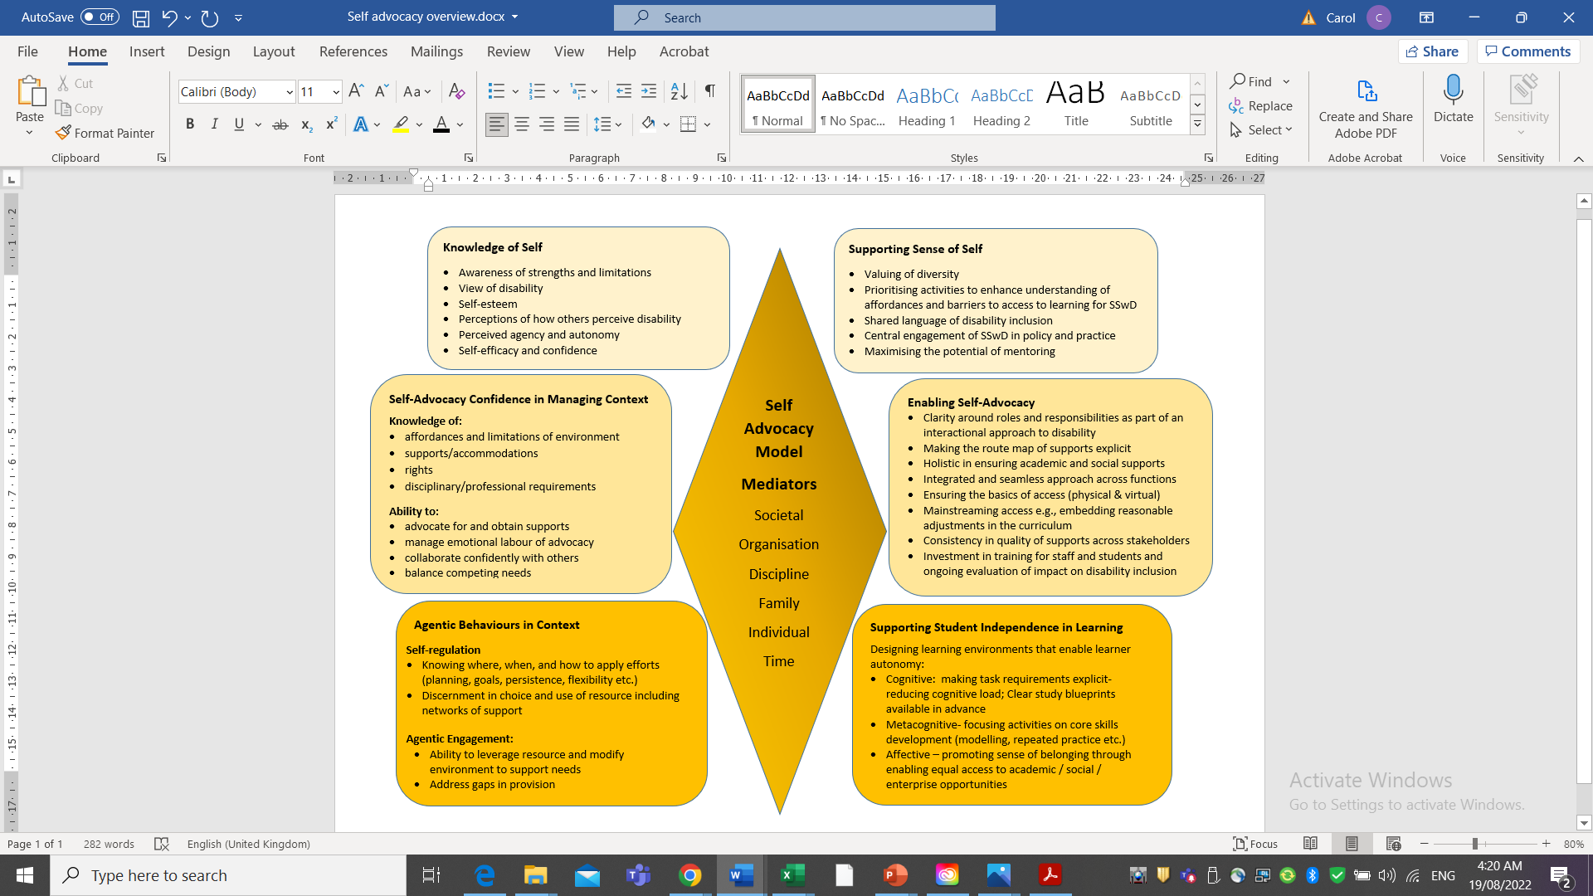
Self Advocacy Model

Slide 26
Simple, Sophisticated & Choreographed
What is the one thing I can do such that by doing it everything else will become easier or unnecessary?
Keller & Papasan, 2019, 107-8)
What is the core question?
BIG ticket items to support DI
What is my one thing right now?

Slide 27
Big ticket items
Big ticket items
Leadership | Embedded in performance review of all
Evidence | Centralised resource base that brings all information together
Evaluation | Analysis of DI at the unit/course level as expectation of course leads
Integrated | Team based design – academic and professional teams
Communication | Explicit about how disability is valued – consistent comms strategy
Student and Staff Voice | Programs designed with SSwD from outset and checked for all rate limiting steps
Training | DI training embedded within CPD for all- evaluation of quality of it
Enabling access | SSwD ownership of supports process – clear route map of supports available
Inclusive learning and teaching | Clarity and focus as to what this is
Assistive technologies | Mainstreamed
Transitions | Pre access support and early opportunities for internships
Self-advocacy | Training in self advocacy embedded within programmes

Slide 28

Questions to ask moving forwards
How can we work together to effect meaningful change?
Where should we focus our efforts?
The DIIF checklist supporting
analysis of disability inclusion

Slide 29

Thank you
Professor Carol Evans
evansc101@cardiff.ac.uk

