Slide 1
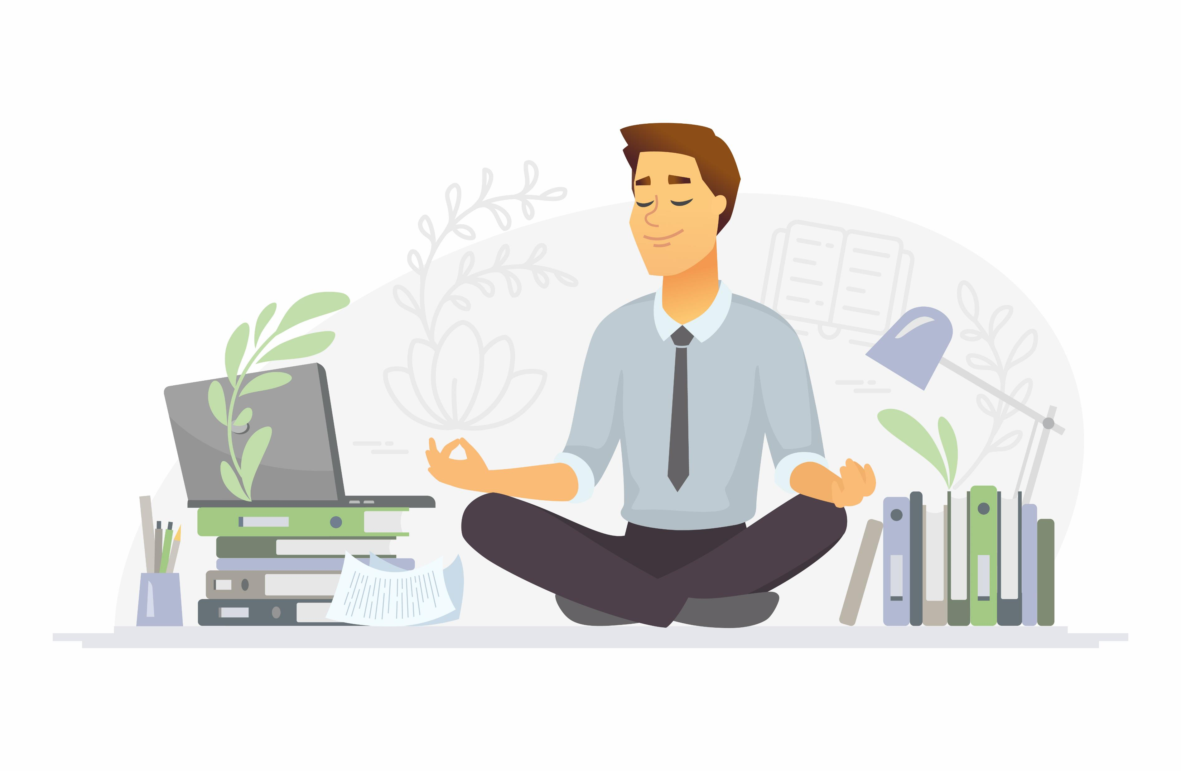
Does Mindfulness Matter?
12 @ 12

Slide 2

Mindfulness
The art of noticing what’s new
Paying attention to the present moment with openness, curiosity and non-judgemental acceptance
It’s a PRACTICE

Slide 3
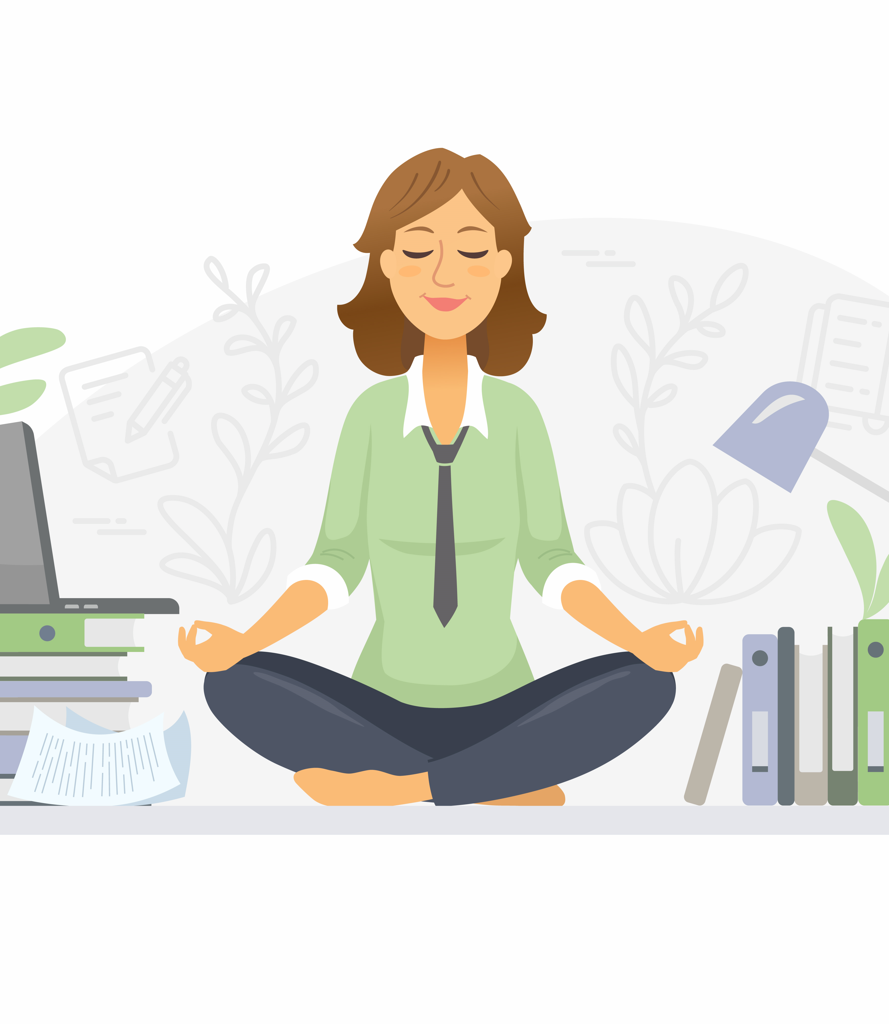
Meta-cognition
You are being mindful when you take control of what you focus on
It’s focusing your attention on your attention
Watching your thoughts as if you were sitting in the back row of a cinema
Is training the mind to be where you choose it to be & and noticing when it has strayed

Slide 4
Slowly count from 1 to 10. Every time you notice your mind has wandered from the task start again at 1.

Slide 5

Changing our brain
Increases the prefrontal cortex matter - improving focus, decision making, self-regulation, emotional awareness, planning, problem solving and creativity
Decreases the amygdala, and so our fear and anxiety arousal –improving our calmness and sense of wellbeing

Slide 6
Mindfulness Matters to us and others
Better listener
More credible
More trustworthy
Better liked
More open to others ideas
Less judgemental
Our work is rated better

Slide 7
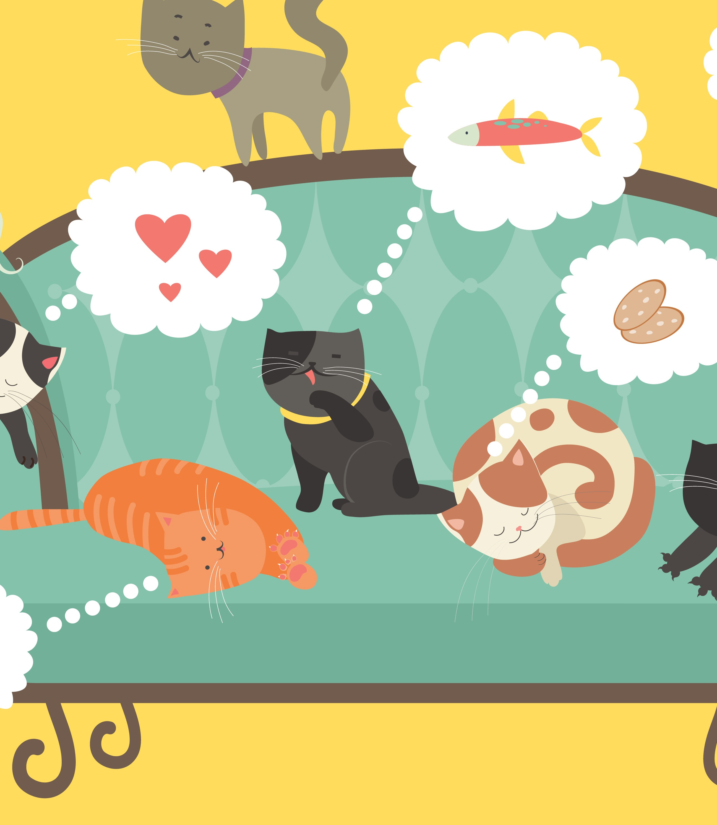
What gets in our way?
Chatter in our brain
  60 000 thoughts a day
  90% of these are repetitive
Running on Autopilot
  Up to 47% of time
  Assume we know things
Wandering mind
  Rehashing past or daydreaming of future
  Multi-tasking

Slide 8
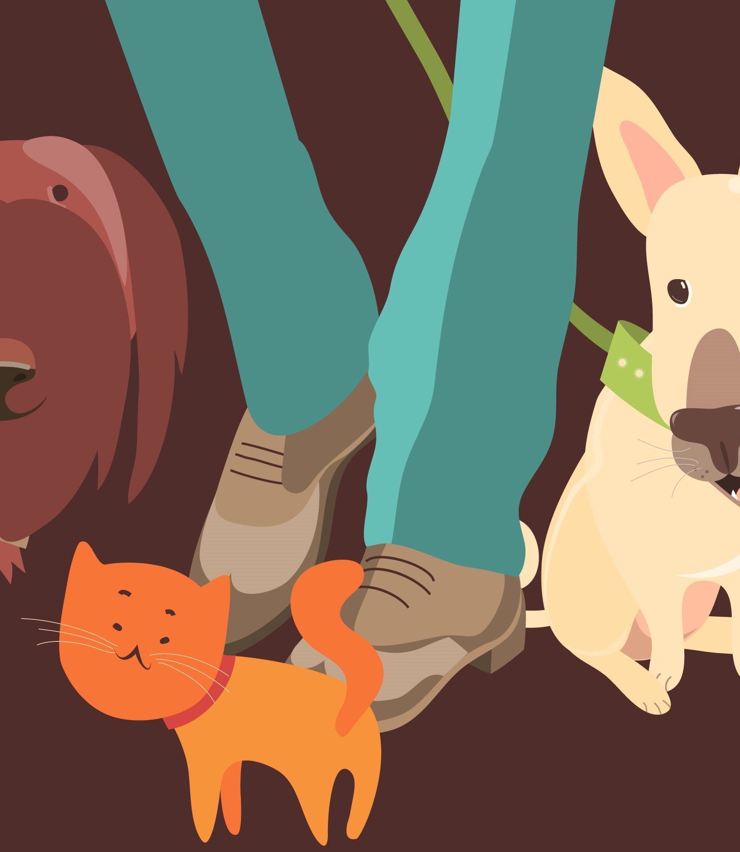
“Unease, anxiety, tension, stress, worry – all forms of fear – are caused by too much future, and not enough presence.
Guilt, regret, resentment, grievances, sadness, bitterness, and all forms of non forgiveness are caused by too much past, and not enough presence.”
Eckart Tolle

Slide 9
Mini Mindfulness Re-set Buttons
Take
3 deep breaths (simple)
Or PLUS – 1st deep breath focus on it relaxing your body, 2nd breath focus on what you’re grateful for right now, 3rd focus on an intention you’ll bring to your task.
STOP
Stop what you’re doing, Take a breath, Observe – what you are feeling, any body sensations, and what you can see, hear, smell or feel in your environment. Proceed with calmness.
Ground
Rub your thumb and index finger together. Notice the ridges of your fingerprint. Try it for 10 seconds at a time.
Or focus on the sensation of your feet on the floor.

Slide 10
Mini Mindfulness Re-set Buttons
Notice
Each day take an everyday experience and slow down to really notice each part. If it’s cleaning your teeth be mindful of how the toothpaste tastes, the sensation of it on each tooth, etc.
What’s new
Each day take an everyday experience and slow down to look for new things you hadn’t noticed before. If it’s listening to music listen to space between notes, if its on a walk immerse yourself in the surroundings, or the sensation of the ground.
Twisters
If you’re about to do some public speaking calm your nerves and fears by spending a few moments repeating a tongue twister.

Slide 11

Want to find out more?
Smiling Mind
Free Mindfulness App
Greater Good in Action
Mindfulness Practices

