Slide 1

Using Strengths: The Goldilocks Way
12 @ 12

Slide 2


Strengths are things at which we
Enjoy doing
Use often
Energise us
Strengths make us feel stronger
Marcus Buckingham

Slide 3
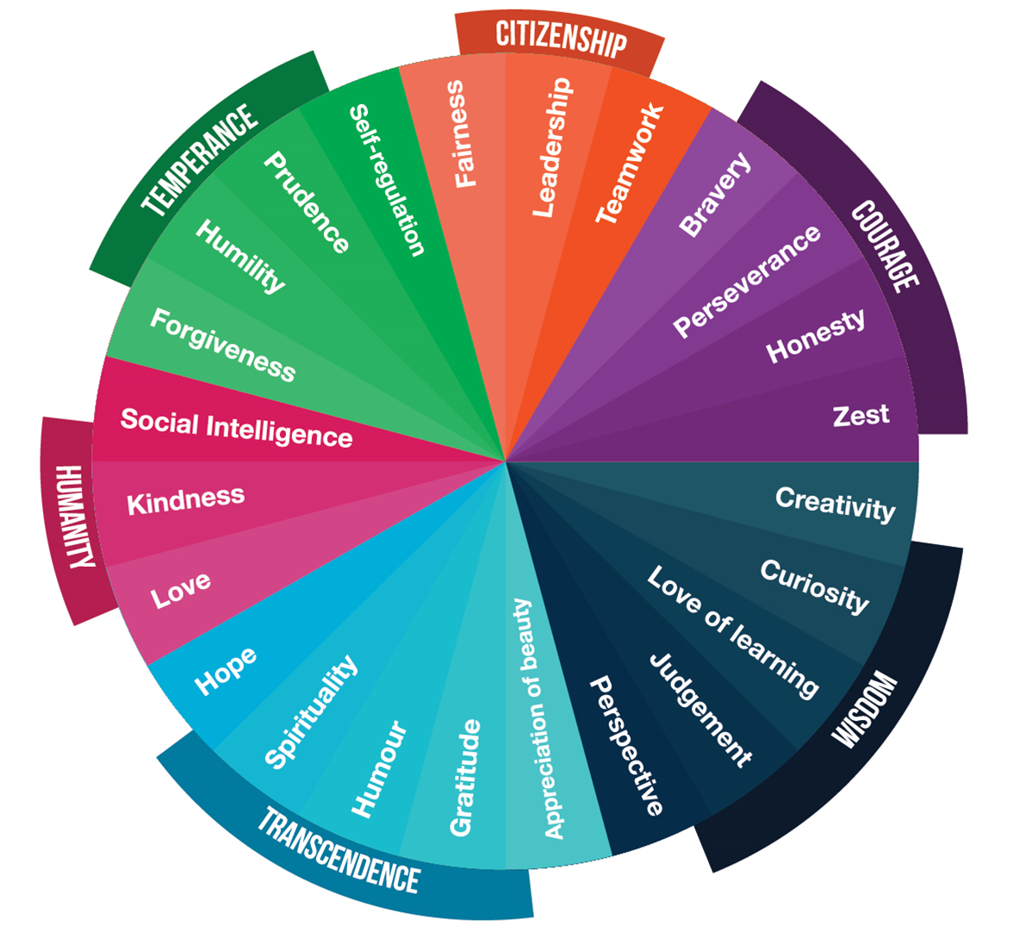

Slide 4
Share a strength
that you
noticed using
in the
last week

Slide 5

It’s helpful to find
the right strengths
in the right amount
for the right situation
Just like Goldilocks

Slide 6

Overplaying Our Strengths
Feel things keep going wrong
Unappreciated
On verge of burning out
Underplaying Our Strengths
Can appear as lack of confidence
We’re uncertain of strengths
and how to apply them

Slide 7
Which
character strengths
might you have
Overplayed
or
Underplayed
recently?

Slide 8
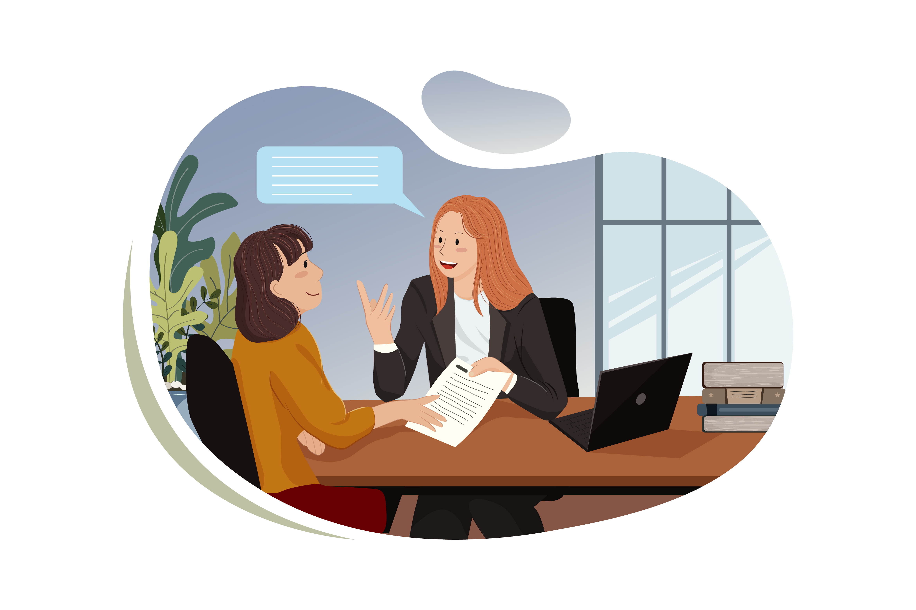
Strengths-based conversations can motivate, strengthen, elevate, and promote confidence, empowerment, and responsibility.
Pernille Hippe Burn

Slide 9

Giving Feedback
Focus on strengths
Performance goes up 36%
Focus on weaknesses
Performance goes down 27%

Slide 10
Developing Your VIA Character Strengths
Take
Take the free VIA Character Strengths survey
Reflect
After you turn off your computer each evening spend 5 minutes reflecting on what character strengths you noticed yourself using today. Which ones might you have overplayed or underplayed.
Choose
Choose one strength that you want to focus on trying to get the Goldilocks amount for tomorrow. Set your intention.

Slide 11

Want to find out more?
VIA Institute on Character
Topics: Strengths-based advice
Michelle Mcquaid
Put Your Strengths to Work (free ebook)

