Slide 1
At Our Best
12 @ 12

Slide 2
Will you grow most in your areas of strength, or your areas of weakness?

Slide 3
Strengths are things at which we
Enjoy doing
Use often
Energise us
Strengths make us feel stronger
Marcus Buckingham

Slide 4
Values in Action
VIA Character Strengths

Slide 5
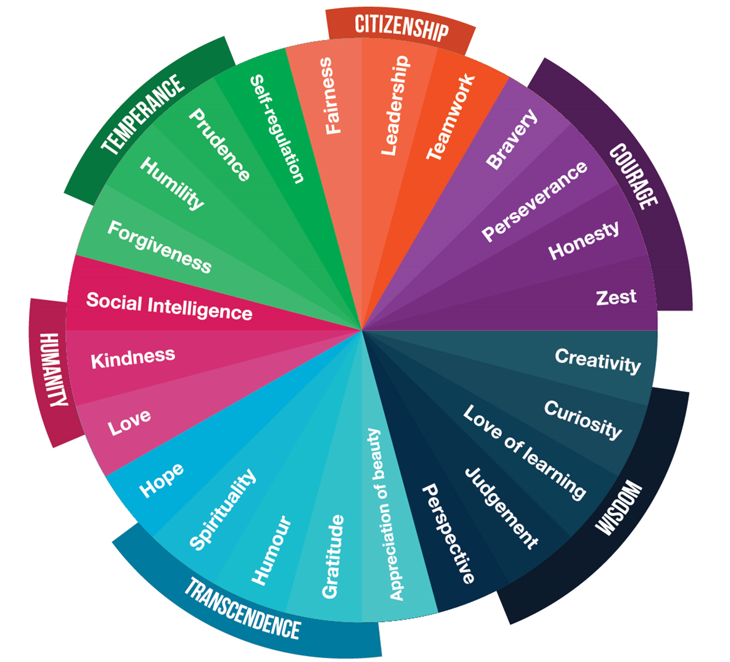

Slide 6
What might be some of your top VIA strengths ?

Slide 7
When we find new ways to use our VIA strengths we are
6x more engaged
3x more satisfied
More resilient to stress
Have better mental health
Adapt better to change
Have more energy and confidence

Slide 8
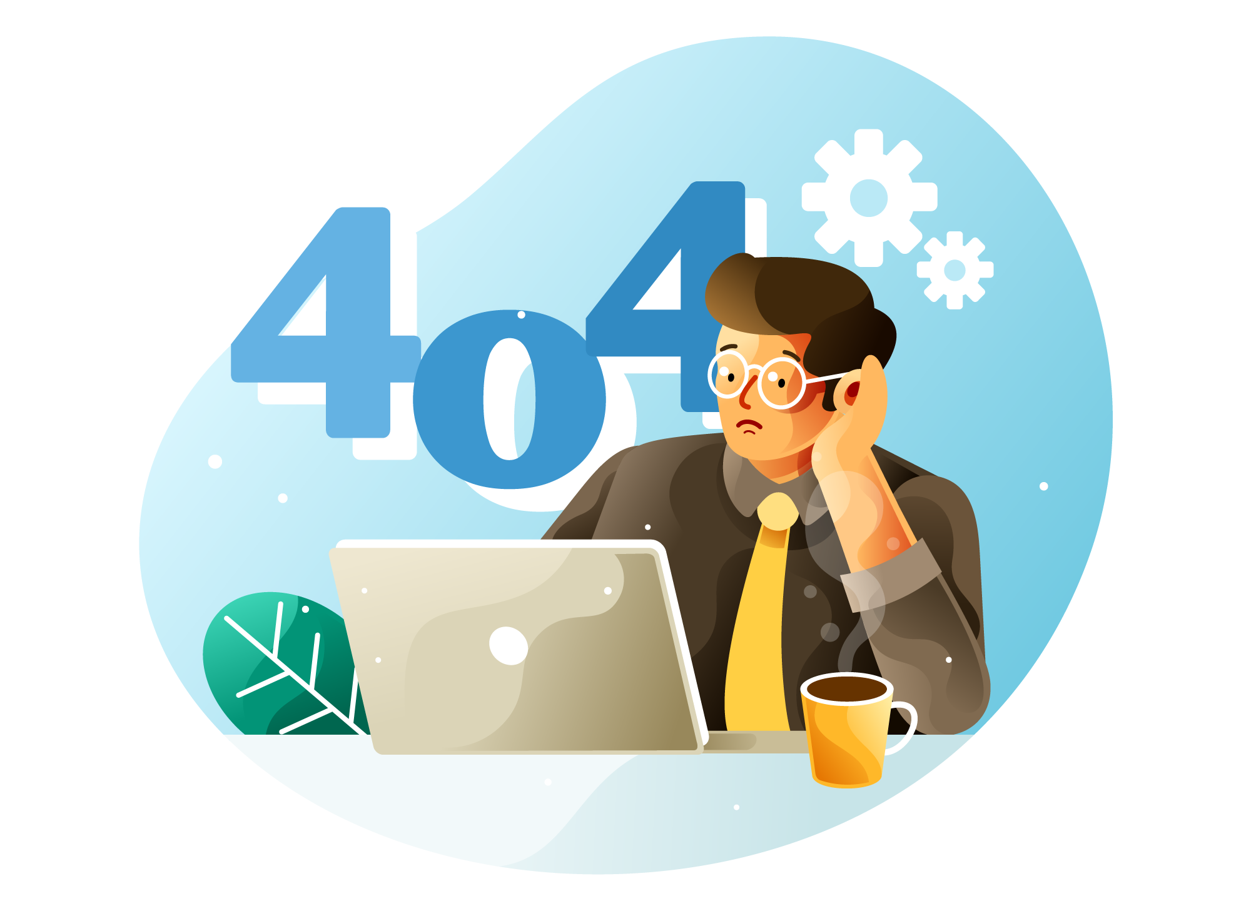
Choose one strength that interested you
Now imagine what it would be like if this strength disappeared from the world for the next month

Slide 9
VIA Character Strengths
Take
Take the free VIA Character Strengths survey
Consider
Consider how you feel about your strengths. Is it: ‘Yes that’s me!’ or “Why is that strength there?’ or “Is this me at my best?”
Notice
Notice how you use your character strengths each day. Try to find new ways to use them.

Slide 10
Want to find out more?
VIA Institute on Character
Free VIA Survey
Marcus Buckingham
Standout Strengths Assessment

