Slide 1
Universal Design for Learning in Tertiary Education - launch

Slide 2
UDL in Tertiary Education eLearning
Presentation: Frédéric Fovet - From curiosity to systemic implementation: Making UDL buy-in a strategic institutional reality
Q&A session
Brief introduction to the UDL in Tertiary Education eLearning course
The official launch of the eLearning
Information on how to access the eLearning and be involved in ongoing conversations about UDL in tertiary education.

Slide 3
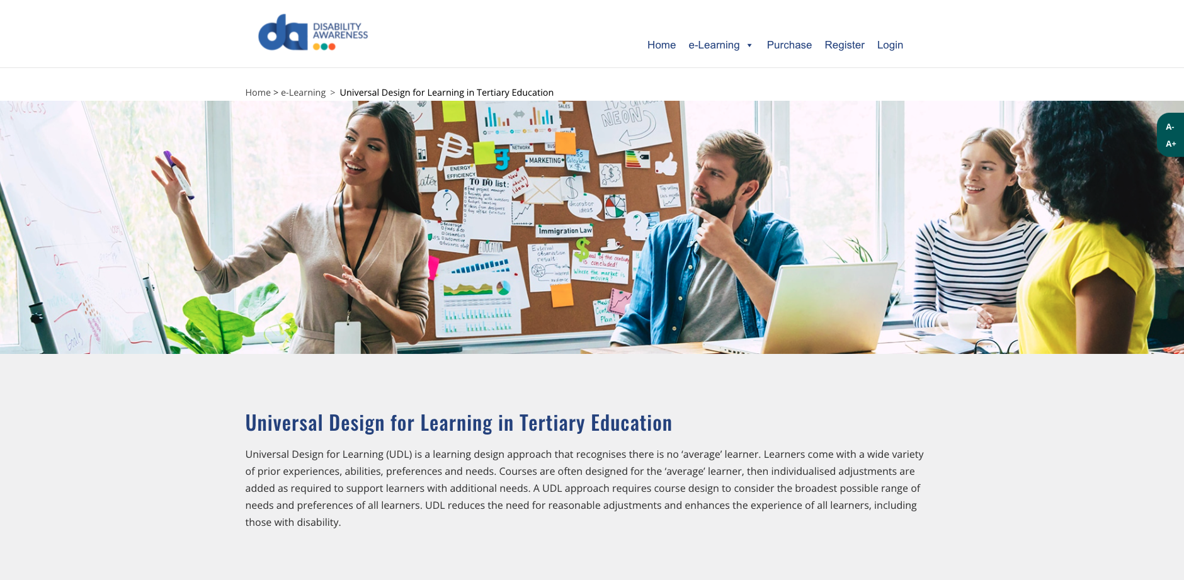
Screenshot of the Universal Design for Learning in Tertiary Education landing page on the Disability Awareness training website.

Slide 4
Acknowledgements
Advisory Group
Dr Alison Casey, University of Notre Dame
Andrew Downie, University of Technology Sydney
Annie Carney, Box Hill Institute
Dagmar Kminiak, University of Sydney
Dr Elizabeth Knight, Victoria University
Dr Erin Leif, Monash University
Jane Goodfellow, North Metropolitan TAFE Western Australia
Jessica Seage, Curtin University
Dr Mary Dracup, Deakin University
Meredith Jackson, TAFE Queensland Skills Tech
Mirela Suciu, University of New England
Dr Stuart Dinmore, University of South Australia
Special thanks to the many others who assisted and supported this project

Slide 5
Official Launch of UDL in Tertiary Education eLearning
A short video from former Disability Discrimination Commissioner and human rights practitioner Graeme Innes AM

Slide 6
UDL in Tertiary Education enrolment details and other information
To enrol in UDL in Tertiary Education training
https://disabilityawareness.com.au/elearning/udl-in-tertiary-education/
For additional UDL in Tertiary Education information and resources visit
https://www.adcet.edu.au/inclusive-teaching/universal-design-for-learning

