Slide 1
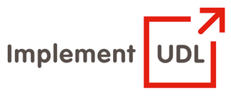

From curiosity to systemic implementation: Making UDL buy-in a strategic institutional reality
UDL in Tertiary Education: Meeting the needs of diverse learners
E-learning Launch/ International Day of People with Disability
Frederic Fovet, School of Education and Technology, Royal Roads University

Slide 2
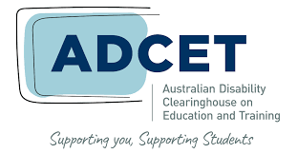
Objectives of the Session
Explore how work related to UDL in tertiary education needs to go beyond pedagogical considerations.
Identify the ‘need’ that makes the adoption of UDL urgent in tertiary education
Examine how to engage in a campus discussion around the ‘how’ of UDL implementation
Identify strategic and organizational challenges to keep an eye on

Slide 3
Format of Workshop
It is always difficult to be fully interactive when online. It can also be challenging to be entirely UDL in short presentations.
I have nevertheless tried to incorporate as many inclusive features as possible:
Have shared with participants an interactive Google doc to gauge the interests of the attendees
Use of interactive activities with Menti.com. Will not switch screens in the interest of time but will talk to the results of the polls.
Will also be monitoring the conference hashtag through the session and for the rest of the day (@Ffovet)

Slide 4
Format of Workshop (contd.)
We will also have approximately 10 minutes at the end of the session for questions. You can also use the chat function throughout and the facilitators will inform me during the talk when questions pop up.
Happy to engage with all participants one on one beyond the session via email or social media.
The slides of the presentation will be available on SlideShare immediately after the workshop (and appear on my LinkedIn and Twitter accounts). I will integrate the Menti slides for your use.

Slide 5
Personal lens and methodological stance
Unique positioning as a scholar: have been both an Accessibility Services manager and a faculty member
Was involved in large scale UDL implementation from 2011 to 2016 across a campus – experienced this process in its full complexity
Have also been Academic Lead/ Program Head at UPEI and RRU, and have needed to guide contract faculty around inclusive teaching and the use of UDL.
Act as a UDL consultant with colleges and universities in Canada.
My research and scholarship also focuses on UDL
I will be drawing from these multiple and varied perspectives
Particularly excited to be making this presentation: (i) It coincides with the International Day of Persons with Disabilities, (ii) I am an alumni of an Australian university, (iii) I have attempted on several occasions during my PhD to generate momentum around UDL within Australia and it is encouraging to see this recent increased degree of interest.

Slide 6
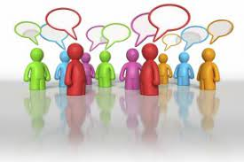
Interactive activity
We will use Menti to quickly poll you as participants.
I will generate the Menti code synchronously as otherwise it resets if not used immediately
Visit www.menti.com and use the code that will be generated during the session
‘What is the degree of comfort and experience your own context/ campus/ office has achieved with regards to UDL implementation?’
Here are the five options you will be able to choose from:
Campus-wide campus implementation
Some in-depth implementation in sporadic pockets within the campus
Campus wide curiosity but not hands on implementation
Budding curiosity around pedagogical benefits of UDL adoption
Interest is only just beginning

Slide 7
Context
There has been much momentum in North America over the last decade around UDL
This in itself is encouraging and leads us to expect effervescence in relation to UDL for the decade to come.
However, there is also a lack of focus on the complexity of the process of change in itself.
There is currently a striking paucity of research around the organizational dimension of UDL implementation and its scaling up.
This is concerning as many communities of practice or individual explorations of UDL by instructors are unsustainable.
Burn out is a very frequent phenomenon among UDL advocates

Slide 8
Part 1: Identifying and using the ‘need’
In this first part of the presentation we will consider how one might contextualize UDL implementation within a pragmatic context of urgency for change.
It is quasi impossible to make UDL appealing to the tertiary sector if we do not first take the time to demonstrate to stakeholders that there is a need for change.
We often, as UDL advocate, rush through this stage but any initiative that fails to evidence the need for change is doomed.
Faculty are bombarded with pedagogical initiatives that compete for their attention. The reflex is to ignore calls for transformation to maintain some sanity.

Slide 9
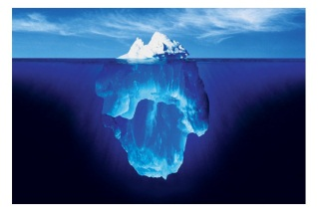

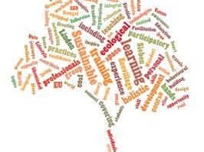
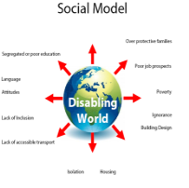

Why is a new framework required? Five factors that are forcing change in Disability & Education
Resource management
Increase in the complexity of diagnoses
Sustainability as a criterion for development
Shift from the medical model to the Social Model
Appearance of an inclusion imperative in student
expectations

Slide 10
Interactive Resources around the Social Model
If faculty are not familiar with the social model of disability, a good resource to trigger a discussion around it is a video by Judith Butler entitled “Examined Life” (first 8 minutes)
Butler, J., & Taylor, S. (2010) Examined Life. YouTube [Video] https://www.youtube.com/watch?v=k0HZaPkF6qE
Another useful, tongue in cheek segment that is useful when introducing the concept of the social mode comes from the UK.
Adams-Spink, G. (2011) Social Model Animation. YouTube [Video] https://www.youtube.com/watch?v=9s3NZaLhcc4&t=20s

Slide 11
The social model of disability
Why is the notion of social model so important?
It positions disability as an interaction between personal embodiments and the design of spaces and experiences
Once an instructor is introduced to the social model, they are likely to shift away from the social model and to embrace their role as designer who can able/ disable learners
When using the social model, one shifts from focusing on the exceptionality of diverse learners to examining the barriers in the learning experience
This barriers analysis is pertinent for all diverse learners
The onus is no longer on the diverse learner to adapt and change
Barriers can be identified and removed through an inclusive design process

Slide 12
Recap on the ‘need’ as it is felt by Accessibility folks
This 5 ‘pillars’ were the result of qualitative data collection during my work at McGill on UDL implementation.
Originally argued for change simply with the Social Model arguments.
The other 4 arguments were added progressively through triangulation with workshop and session participants.
It reflects the reality of a fast changing landscape in inclusion and access to learning in Higher Ed
This pressure is tangible, mounting and is having significant impact: insurmountable wave of demand for services in Accessibility centres and quick rising rise in Human Rights claims and litigation.
The current model of ‘inclusion through accommodations’ no longer works. The system is overloaded and cracking at the seams.
It is no longer sustainable, regardless of perspective.

Slide 13
The ‘need’ for change has wider dimensions
There is also an urgent need for change in the way we address inclusion more generally in the post-secondary sector
Issues at institutional level
Structures in place relate to a world that is no longer a reality
EDI efforts address many campus dimensions but rarely pedagogy itself
Our vision of diverse learners is misleading because the support services that address their needs are fragmented
Hierarchical issues mean these services are reluctant to interfere in pedagogy
At present all support services are grounded in a deficit model view of the non-traditional learner
The deficit model sees the learner as lacking/ interventions happen outside the classroom/ there is no accompanying critical look at pedagogy

Slide 14
The wider ‘need’ for change in the way we conceptualize Inclusion in the Tertiary sector(contd.)
Deficit model interventions occur outside the classroom and create issues of stigmatization and loss of social capital (parallel to the streaming that still occurs in the K-12 sector)
Lack of sustainability of these structures and policy: sustainability of support services, financial sustainability of institutions, sustainability of teaching practices
Issues at instructor level
Apart from medical model services (accommodations and retrofitting) which disempower instructors, the only other model at play is differentiation
Differentiated instruction is problematic from an instructor perspective

Slide 15
Part 2: Moving from curiosity to pragmatic implementation
Moving from the initial curiosity to campus-wide implementation is a complex process
The way we present UDL to instructors and stakeholders needs ton be realistic and pragmatic, as well as lucid.
In this section of the presentation, we will examine some of the subtlety of the discourse that must be developed to get buy-in.
This process is important to examine in organizational and strategic terms, and again there is very little literature on these issues.
As you begin the process of developing UDL in tertiary training, it will be crucial to examine how training on UDL is generally perceived and received.

Slide 16
Showcasing it effectively to colleagues
UDL is a spectrum. Nothing is black and white. All instructors are necessarily doing something UDL already.
The aim is to encourage them to progress slowly on this spectrum, progressively through their career
Help your colleagues situate themselves on this spectrum
UDL has often been presented as something new and ‘out of the box’
This branding can be counter-productive
It is more productive to present UDL as the convenient packaging of many existing principles of learning and teaching/ several philosophical approaches to pedagogy
UDL is a way to find a common discourse around the best practices we are probably all already exploring actively
It is often difficult to implement UDL if an instructor/ department/ faculty has not clearly identified teaching objectives/ core competencies being taught and assessed

Slide 17
The ‘check list’ pitfall
UDL is not a checklist.
It is a process rather than a deliverable.
Two instructors may come up with different re-design solutions to a barrier identified in teaching.
Those re-design solutions will depend on the instructor’s content area, experience teaching, classroom environment, undergrad vs. grad class, ease with design thinking, etc.
Seeing UDL as a checklist is reductionist
We need to remain vigilant to avoid this common pitfall

Slide 18
Caveat: Not just colleagues who need to understand your objectives!
It is important to do this job of introducing UDL not just with colleagues but with students as well.
Students can be resistant to change in the classroom even when the change in question represents a shift to a more accessible, more inclusive and more student-centered pedagogy.
I often call this phenomenon ‘transitional friction’: students need to understand the changes we make to learning and the objectives of these changes.
Students must become partners in the work we carry out around UDL
This means that we must find a language to discuss UDL with students, as well as organic opportunities to trigger these conversations.

Slide 19
Debunking certain myths: Implementing UDL is easy!
Like any sustainable change UDL implementation is resource extensive to start with in the short term, and then enables you to reduce friction, tension, retrofitting efforts and accommodation worries in the long term.
The reflection and integration of UDL strategies must be progressive for fear of becoming overwhelming, exhausting or burdensome. It’s a spectrum. Move your professional reflection along this spectrum slowly and methodically.
If you fail, try again! Many instructors try one UDL strategy, fail to obtain immediate positive feedback and abandon immediately as a result. Give it time. The learner too needs to understand the shift you are operating.

Slide 20
Debunking certain myths: UDL is more suitable to certain HE disciplines than others
Do you think this is an accurate statement?
If so, what leads you to make this assessment?
What disciplines, according to you, might lend themselves better to UDL than others?

Slide 21
Part 3: Strategic and organizational challenges
More widely, management of change around UDL implementation must be examined as an organizational process of management of change.
UDL implementation is extremely complex in the tertiary sector.
As a sector this is a field that is multilayered, complex, and highly political.
A suitable lens must be developed to fully capture this complexity and plan proactively for it.

Slide 22
Navigating a delicate landscape
There is a need for a coordinated approach at the blue print stage: Who has ownership over the momentum?
What are this stakeholder’s existing relationships with other key units?
Accessibility services are not the natural stakeholder to lead implementation – ambivalence of preaching a model that clashes with one’s own funding model
Danger in preaching to the converts – any implementation strategy must seek to reach the most reticent instructors/ stakeholders.
Strategic implementation must acknowledge the political complexity of the process of management of change in higher education.
Need to acknowledge that inclusion goes beyond impairment and concerns racialized students, first generation students, Indigenous students, socio-economically challenges learners, members of the LGBTQ2S+ community, etc.
Needs to create osmosis and involved a variety of supporting student affairs personnel.
Many of the staff members who support these students are reluctant to trigger a reflection around inclusive pedagogy – hierarchical reticence to disrupt and engage with instructors

Slide 23
How would I go about it strategically if I wanted to explore UDL further?
Top down or bottom up? Which is the best way of implementing UDL?
What factors should I take into account when making these decisions?
What are some the effective strategies observed out there in the field?
Just like ‘one size does not fit all’ in the classroom, there is no single UDL implementation model that works for all institutions
There is a need for mapping of the context, history, culture, before a unique UDL implementation plan can be designed.
Importance of carrying out this work proactively, not after the facts – when it is too late.

Slide 24
Need for an ecological lens on UDL implementation across institutions
An ecological lens will be essential in carrying out this ecological mapping and addressing the uniqueness of each landscape.
An ecological lens will be capable of acknowledging the complexity of the landscape
It allows for the proactive strategic planning of systemic UDL implementation across large organizations
The following slides is an illustration from an article I have published on this topic. I will read out the examples of ecological variables that come into action in the UDL implementation process which are mentioned in the illustration (institutional culture and history, red tape and admin heaviness/ willingness to streamline, support from senior administration/ embedding of UDL in mission statement, multiple competing stakeholders, collaboration with natural stakeholders, administrative strategic planning, credibility with student body, size and resources, external variables affecting all parts of the campus).

Slide 25
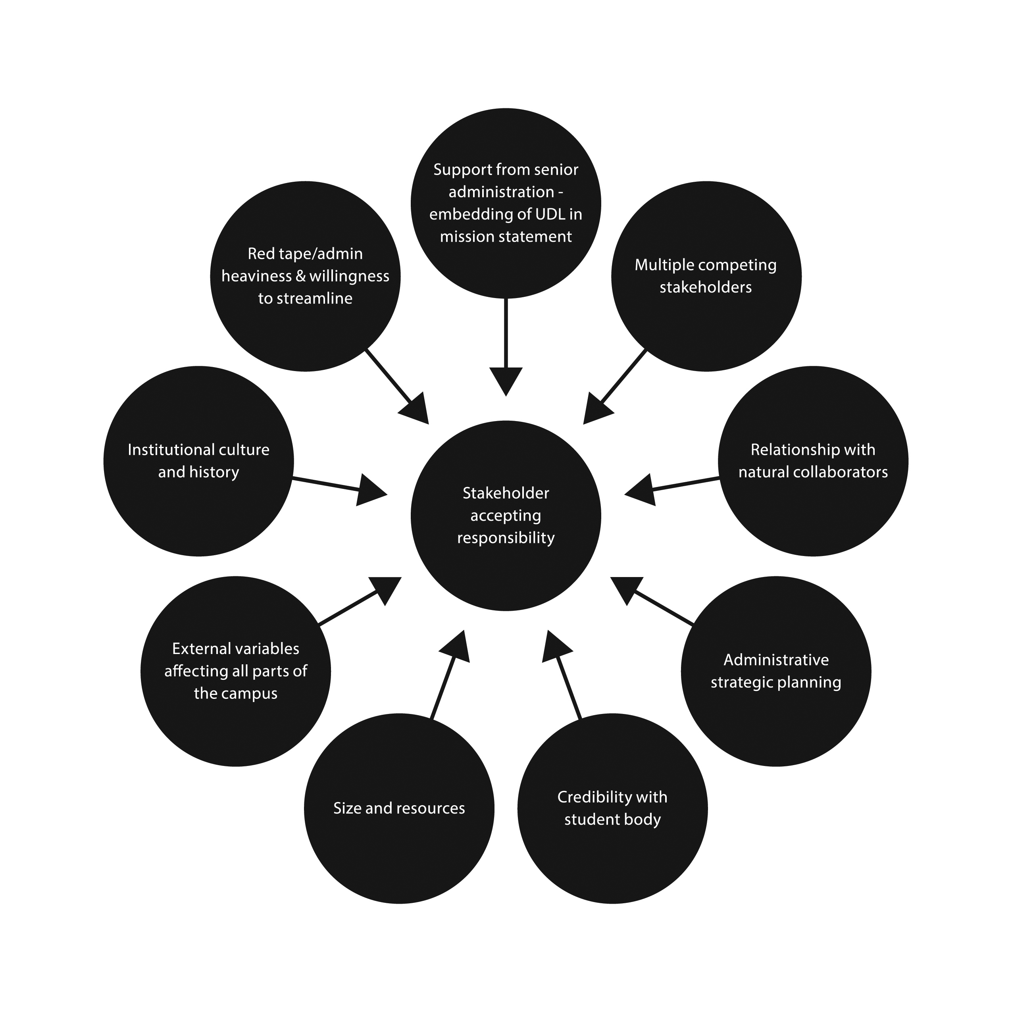
Need for an ecological lens on UDL implementation across institutions.

Slide 26
How to avoid reinventing the wheel
Take a look at what is being done out there and where you might want to look for examples and best practices that have proven useful in landscapes similar to your own.
Where is UDL being implemented in HE?
http://udloncampus.cast.org/page/udl_institutions
What disciplines is it being applied to?
http://udloncampus.cast.org/page/udl_examples

Slide 27
Gauging lucidly the complexity of UDL implementation
Be transparent with the stakeholders: they must all understand how you are moving away from a medical model approach, and why.
Examine your motivational factors. An inclusive framework does not get implemented just because it is socially just. That is wishful thinking and will backfire.
Pro-social choices are not carried out just because of the value of the outcomes; they are the result of a complex (and often unconscious) ‘cost analysis’ by your brain.
Examine the facilitator that motivate you and others. Identify the stressors that create resistance. Assess how to positively balance this analysis in favour of UDL implementation and learn how to keep your momentum & motivation up.

Slide 28

Interactive activity - How has the COVID pandemic changed attitudes towards inclusion and UDL?
We will use Menti to quickly poll you as participants.
I will generate the Menti code synchronously as otherwise it resets if not used immediately
Visit www.menti.com and use the code that will be generated during the session
Do you feel that the COVID crisis has:
(1) improved awareness of accessibility and inclusion, and made UDL more appealing
(2) made accessibility and inclusion more challenging, and has been detrimental the buy-in for UDL

Slide 29
Additional caveat: Examining the impact of COVID crisis
This is a profoundly disrupted landscape:
Some unprecedented initiatives have emerged during the pandemic.
Instructors are responding to the urgency with creative innovations, often overnight.
These practices are usually not inherently accessible or inaccessible. It becomes a matter of degree of use/ detail of the implementation effort (e.g. flipped classroom, synchronous vs. asynchronous participation, transformation of exams for open book assessment, etc.). A rich and complex reflection around ‘barriers’ is necessary just-in-time
Interaction with accessibility services is now much more difficult and accessibility services are often these days confronted with practices they have had no chance to evaluate.
An accommodations approach is often simply not available during the COVID pivot.
The result of this matrix is that instructors are constantly assessing inclusive nature of their practices live and in the moment. UDL is the only lens available to them

Slide 30
References & Resources
Black, R. D., Weinberg, L. A., & Brodwin, M. G. (2015). Universal design for learning and instruction: Perspectives of students with disabilities in higher education. Exceptionality Education International, 25(2), 1-16
Boothe, K., Lohmann, M., Donnell, K., & Hall, D. (2018) Applying the Principles of Universal Design for Learning (UDL) in the College Classroom. Journal of Special Education Apprenticeship, 7(3).
Burgstahler, S.E. (2015) Universal Design in Higher Education: From Principles to Practice. Harvard Education Press, MA
Capp, M. (2018) Teacher confidence to implement the principles, guidelines, and checkpoints of universal design for learning. International Journal of Inclusive Education
Cook, S. C., & Rao, K. (2018). Systematically Applying UDL to Effective Practices for Students with Learning Disabilities. Learning Disability Quarterly, 41(3), 179–191
Dalton, E. M., Lyner-Cleophas, M., Ferguson, B. T., & McKenzie, J. (2019). Inclusion, universal design and universal design for learning in higher education: South Africa and the United States. African Journal of Disability, 8, 519
Dean, T., Lee-Post, A., & Hapke, H. (2017). Universal design for learning in teaching large lecture classes. Journal of Marketing Education, 39(1), 5-16
Fovet, F. (2021) Developing an Ecological Approach to Strategic UDL Implementation in Higher Education. Journal of Education and Learning, 10(4).

Slide 31
References & Resources (contd.)
Fovet, F. (Ed.) (2021) Handbook of Research on Applying Universal Design for Learning Across Disciplines: Concepts, Case Studies, and Practical Implementation. IGI Global
Fovet, F. (2020) Universal Design for Learning as a Tool for Inclusion in the Higher Education Classroom: Tips for the Next Decade of Implementation. Education Journal. Special Issue: Effective Teaching Practices for Addressing Diverse Students’ Needs for Academic Success in Universities, 9(6), 163-172. http://www.sciencepublishinggroup.com/journal/paperinfo?journalid=196&doi=10.11648/j.edu.20200906.13
Griful-Freixenet, J., Struyven, K., Verstichele, M., & Andries, C. (2017) Higher education students with disabilities speaking out: perceived barriers and opportunities of the Universal Design for Learning framework. Disability & Society, 32, 10
James, K. (2018) Universal Design for Learning (UDL) as a Structure for Culturally Responsive Practice. Northwest Journal of Teacher Education, 13(1), Article 4.
Kennette, L., & Wilson, N. (2019) Universal Design for Learning: What is it and how do I implement it? Transformative Dialogues: Teaching & Learning, 12(1)
Nieminen, J.H., & Pesonen, H.V. (2020) Taking Universal Design back to its roots: Perspectives on accessibility and identity in Undergraduate Mathematics. Education Sciences, 10(1). 2020, 10(1), 12
Novak, K. & Bracken, S. (Eds.) Transforming Higher Education through Universal Design for Learning: An International Perspective. Routledge

Slide 32

Questions

Slide 33


Contact details
Frederic Fovet (PhD.)
Associate Professor, School of Education and Technology, Royal Roads University
Frederic.fovet@royalroads.ca
@Ffovet
www.implementudl.com

