Slide 1
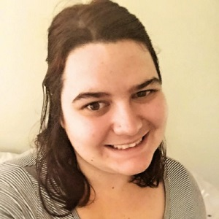
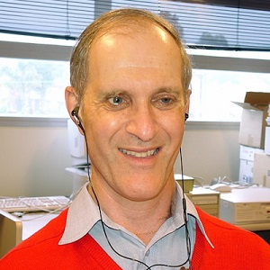
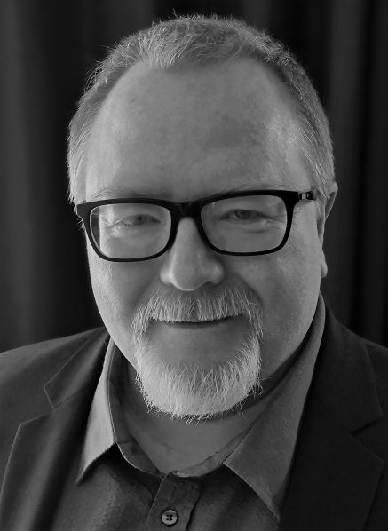
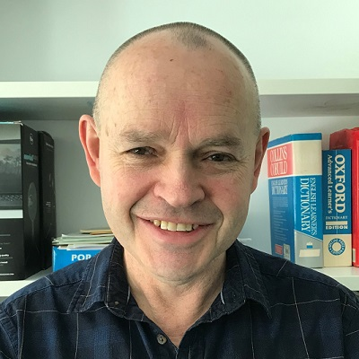
Screen Readers: Everything Access and Teaching Staff should know
Darren Britten • Andrew Downie • Kiah Buhler • Doug McGinn

Slide 2
Screen Readers 101
What is a Screen Reader? What does it do? How does it work?
Over the next 50 minutes we will seek to unpack these questions and dispel some of the myths around accessibility and screen readers. Andrew, Kiah and Doug will share their unique insights and experiences to help you in making the world a little more screen reader-friendly.

Slide 3
Acknowledgements
In the spirit of reconciliation we would like to acknowledge the Traditional Custodians of country throughout Australia and their connections to land, sea and community. We pay our respect to their elders past, present and emerging and extend that respect to all Aboriginal and Torres Strait Islander peoples today. While virtually connected today we are presenting geographically dispersed and acknowledge the Wurundjeri people of the Kulin nation in Victoria, the peoples of Stoney Creek nation in Tasmania and the Cammeraygal people in NSW.

Slide 4
Andrew Downie

Slide 5
What is a screen reader?

Slide 6
How intelligent are they?

Slide 7
How do screen readers convey information in tables?

Slide 8
What can and cannot be read with a screen reader?

Slide 9
Kiah Buhler

Slide 10
What equipment can you use with a screen reader?

Slide 11
Do commands vary between screen readers?

Slide 12
Can a person using a screen reader read information as fast as their sighted colleagues?

Slide 13
Is it only blind people that use screen readers?

Slide 14
Doug McGinn

Slide 15
Where do screen reader users get training?

Slide 16
Where can screen reader users go to get support?

Slide 17
Are screen reader users the experts in accessibility?

Slide 18
Darren Britten

Slide 19
What can you do to make the world a little more screen reader friendly?
Use headings in your documents and online content
Use the accessibility checker in Microsoft Office
Provide meaningful links
Adding context and meaning to your content
Name your files with meaningful titles
Say what you mean when recording or describing a function

Slide 20
What can you do to make the world a little more screen reader friendly?
Provide keyboard shortcuts/guides to students
Put important information up front
Include screen reader users in projects and program development
And most importantly….ask someone

Slide 21
Further information and resources
Australian Disability Clearinghouse on Education and Training
ZOOM - Hot Keys and Keyboard Shortcuts and Microsoft Teams - Keyboard shortcuts
Improve Accessibility with the built-in Microsoft Office Accessibility Checker
Disability Awareness eLearning

Slide 22
Further information and resources
A guide to Hierarchical Headings and The Importance of Correct Document Structure by Andrew Downie
Upcoming ADCET Guidelines: Online Tertiary Access for Students and Staff who are Blind or Vision Impaired

Slide 23
Thank You

