Slide 1
Ally Deployment & Sticky Points
Marika Leopold & Jen Cousins

Slide 2
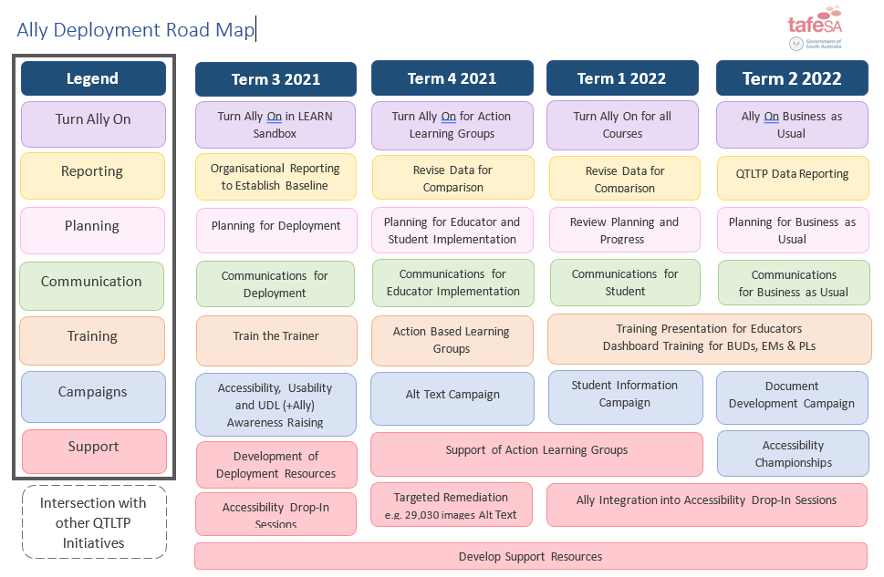
Ally Deployment Road Map

Slide 3
Deployment Considerations
Approach to turning it on
Targets / KPIs
Testing in our LMS
Capabilities of the educators
Professional Learning and Resources
Messaging
Notes:
Approach to turning it on
A staged approach was selected to scaffold and prepare resources, capability of our educators and provide information to workgroups
Targets / KPIs
Organisationally initial targets are to show improvement - promoting softer skills and organisational awareness raising on accessibility, growth of in skills and increase in attitudinal recognition of importance of UDL, usability and accessibility of resources and learning materials
Within courses we are encouraging educators aim for a course rating in the green zone
Testing in our LMS
Before organisational deployment we have enabled Ally within our test site. This has allowed us to problem solve, test and trial. Also provides a ‘safe space’ for our Ally Champions and Action Learning Groups to ‘play’ and become familiar with Ally before moving to ‘live’ space. - Found Ally so intuitive that people moved quickly into ‘live space’
Capabilities of the educators
We wanted to scaffold and support educators through a suite of resources
Had a look at the available resources through Ally to support educator development – Steps and information provided through Ally is very supportive and educators will be upskilling incidentally through engaging with Ally feedback
Professional Learning and Resources
Developed How To Reference Guides based on those available through Ally, holding Accessibility, Usability & UDL Drop In Session, Train the Trainer Session through Ally to upskill Ally Champions to empower them to support their teams
Messaging
We have developed a couple of ‘Tag Lines’ to support educators with their decision making about what and when they will remediate or adjust materials to fix identified issues. FIX, FLAG, FUTURE is our main tag – Quick Fix – Flag for fixing soon – Plan to fix in the future. These decisions may be based on the complexity of the issue, additional training or time to make changes

Slide 4
Sticky Points
Integrating with other initiatives
Ally Centric Remediation
Copyright
Attitudinal Barriers
Notes:
Integrating with other initiatives
TAFE SA has a variety of projects in which dove tail. This has required effective communication and collaboration to see how Ally aligns and is impacted by other projects and system.
Ally Centric Remediation
We recently discovered that Ally stores any remediation work uploaded through the Ally feedback option within the Blackboard cloud. This is a potential risk if we no longer have Ally we will lose any work stored with Ally. Recommending staff make changes, upload documents directly into our LMS – not through Ally
Copyright
Sought advice from National Copyright Unit re the format shifting through Alternative Formats. That advice has allowed us to create a set of guidelines for staff
Attitudinal Barriers
I don’t have students with disability in my classes so why do I need to make it accessible?

Slide 5
What we’ve discovered?
Accessible Document Development
The Scope of Professional Learning
Intuitive/easy to use and rapid uptake
LMS Settings
Not all is at is seems
People are loving it!
Notes:
Accessible Document Development
If we start with sound accessible documents prior to uploading into the LMS – reduces remediation work. Training and support will be occurring to upskill and promote good practices in document development using the native ‘Check Accessibility’ feature in Word and PowerPoint
The Scope of Professional Learning
Our focus will need to be on document development , tables and tagged PDFs
Intuitive/easy to use and rapid uptake
People are becoming very excited once they start using and engaging with Ally. Ally provides a variety of information on the types of issues, what they are, how they impact the course score, how to fix and Ally also provides information in a variety of ways to assist with decision making on what to fix within a course – from quick fixes, low scoring items or by category such as all items with colour contrast issues.
LMS Settings
Within our LMS – Ally’s Alternative Formats are only available on uploaded documents in the LEARN environment, not books, pages and other native activities or resources within the LMS
We also link assessments as a quality assurance measure so these are not checked either.
We've discovered many anomalies
We've discovered many anomalies e.g. if we fix within Ally the fixes will not stay with the original document, not all features have translated as planned, organisational reporting as an exported excel is not user friendly, some identified issues are not easy to decipher
People are loving it!
Uptake is growing rapidly and people like the gamification nature of the scoring.

