Slide 1
Reasonable Adjustment: What is reasonable?
Presented by:
Brandon Taylor, Mental Health & Wellbeing Strategy Manager

Slide 2
What is Reasonable Adjustment
DEFINITION:
A ‘reasonable adjustment’ is a measure or action taken to assist a student with disability to participate on the same basis as students without disability.
It applies to all areas of enrolment, participation, curriculum, facilities and services.
An adjustment is reasonable if it is based on the individual’s needs
and abilities and is balanced with the interests of all parties affected.
This includes the interests of:
the learner with disability
associate(s) of the learner
the training provider
teachers and staff members involved with assisting the learner
other learners

Slide 3
Disability Discrimination Act 1992
Disability Standards for Education 2005
Factsheet Disability Standards for Education
These standards clarify the obligations of education and training providers to make sure that learners with disability can access and participate in education without experiencing discrimination.
RTOs are required to take action to ensure people with disability have equal access to education and training
The DDA makes it unlawful to refuse a person admission to a course on the basis that they are unlikely to be able to gain employment because of their disability
RTOs are obligated to make reasonable adjustment if they know an adjustment is required
Reasonable adjustment is not intended to bridge the gap between the learner’s aspirations or career goals and their current capacity to successfully complete the training
The DDA does not require RTOs to deliver services that they are not in the business of providing

Slide 4
When to apply Reasonable Adjustment?
We don’t apply reasonable adjustment just because someone happens to have a disability
Reasonable adjustment does not give learners with disability an advantage over others. Nor does it change course standards or outcomes or guarantee success
We only need to apply adjustments where they are required and reasonable within the context of the training package
It is also not about making unreasonable adjustment; every reasonable adjustment needs to be justified and must uphold the integrity of the qualification
Reasonable adjustment in teaching, learning and assessment activity lessens the impact of an individual’s disability on their capacity to learn. But, the learner still needs to do the work and demonstrate the required knowledge
A reasonable adjustment can be as simple as providing extra time to read learning resources in an exam or installing a particular type of software on a computer for a person with low vision
Notes:
been the industry's standard dummy text ever since the 1500s,

Slide 5
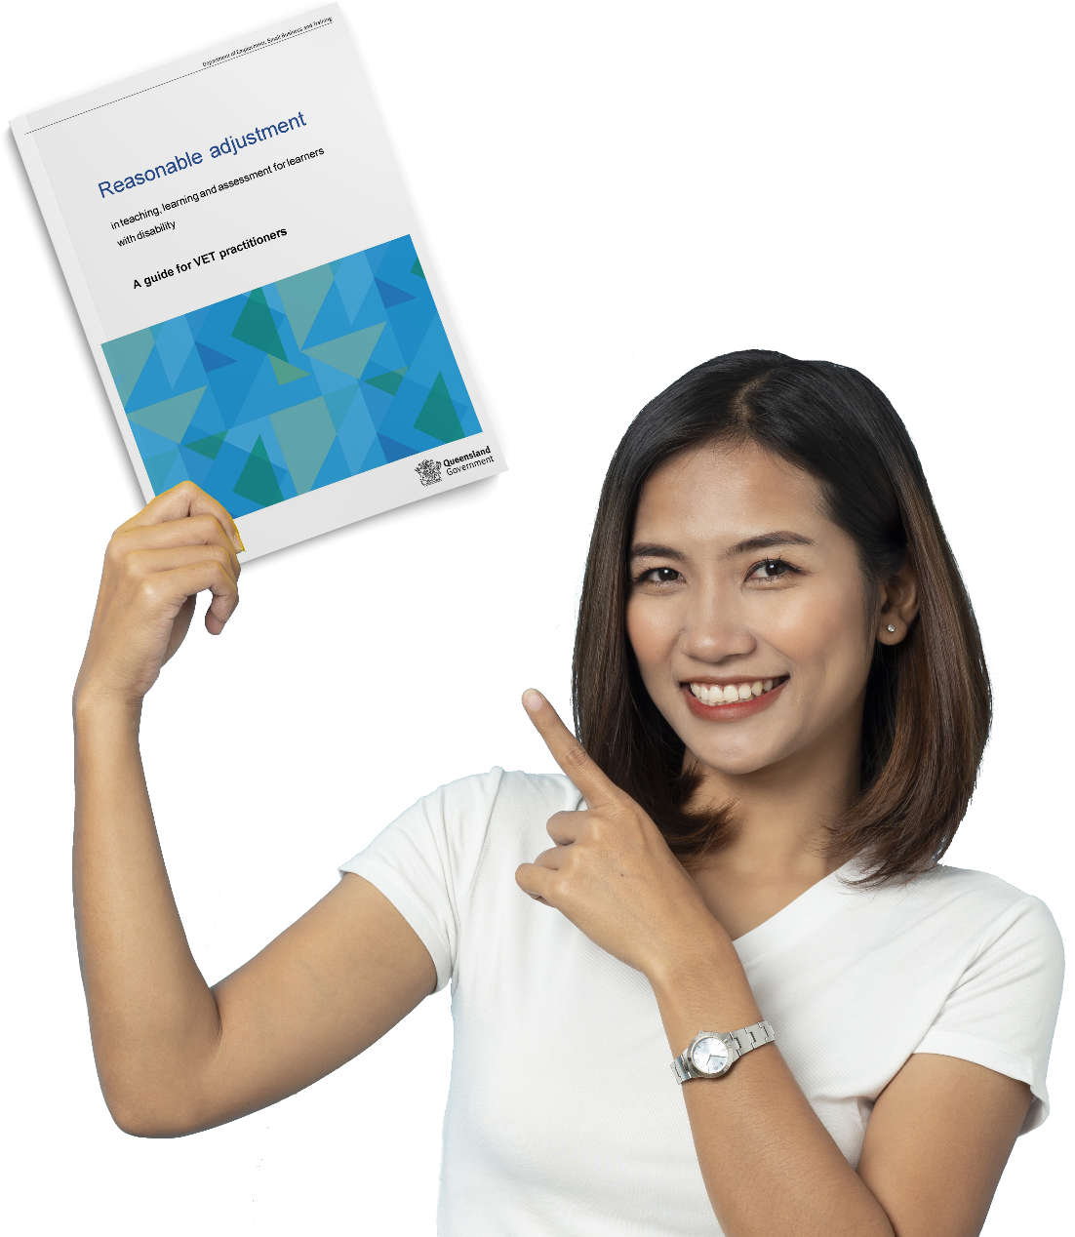
The Standards for Registered Training Organisations (RTOs) 2015
Principles of access and equity are embedded throughout the Standards for Registered Training Organisations (RTOs) 2015 and include direct reference to course integrity, flexibility and ensuring reasonable adjustment is applied and monitored
The Standards for RTOs, Disability Standards for Education, Principles of Universal Design and Inclusive Learning Frameworks all compliment each other in this area
Practical applications of reasonable adjustment can be found in this Guide

Slide 6
What is our process at TAFE Queensland?
Students are encouraged to disclose that they have a disability at enrolment and are asked – Do you have a disability?
Every student that states Yes – receives an email from Student Support telling them about our services, examples of disability and medical conditions common in our student population and strongly encourage them to register with our services
Many students across the tertiary sector do not disclose at enrolment
However, disclosure of disability can happen at any time during a student’s program
We cannot cater for what we don’t know or apply retrospective adjustments to assessments

Slide 7
When a student registers with our AccessAbility services
TAFE QUEENSLAND BRISBANE – Reasonable Adjustment
01
1:1 confidential conversation about individual disability, learning challenges, medical condition or mental health AND whether the disability may or may not impact on the person’s ability to attend, participate and be successful (consultation is vital)
Many students with disability do not need our services, are independent or can advocate adjustments for themselves - this is a good thing!
Parents, carers and external support agencies can attend
Registration will result in the AccessAbility Officer creating a Student Outline for the Faculty – detailing the
background, suggestions and potential reasonable
adjustments, where relevant
02
03
04

Slide 8
Our Cohort…
Increasing autism & specific learning difficulties
Significant increase in presenting complexity and co-existing concerns
Increases we are seeing with our cohort
Increasing number of those with diagnosis yet conversely increasing disclosure without diagnosis
Growth in student mental ill health
Notes:
been the industry's standard dummy text ever since the 1500s,

Slide 9
We sometimes see this…..
Student / parent expectations –
Fix this!
Demands & challenges to personal integrity
Your organisation (you) should do this…
We’ve paid for this course why hasn't he passed?
“I have rights….. under the DDA you should….”

Slide 10
The previous challenges for many students and parents
Years of meetings and battles to get a disability or learning difficulty diagnosis and a fair go at High School
High School disability officers provide a different service compared to TAFE AccessAbility Officers
Helicopter parents and students in the shadow
It is a transition for both student and parent and their first time in the post-school world
They are on their ‘L plates’

Slide 11
Evidencing Reasonable Adjustment
Educational staff:
Must be able to justify adjustments made or reasons for not allowing adjustments
Should discuss the reasonable adjustment options with the student and document the reasonable adjustment on assessment documentation

Slide 12
Evidencing Reasonable Adjustment
Through their assessments, students still need to be able to present themselves as having the knowledge and skills implicit in the award.
Reasonable adjustment can be applied to how a student participates and demonstrates their skills but it can not remove standards and must maintain the integrity of the course e.g. verbal assessment for a Cert III Fitness student with severe dyslexia (able to verbally identify all the bones, muscles and functions in an assessment) and great difficulty
with spelling and reading.
This would be different for a Nursing student as reading and writing this content would be inherent in the role.
Notes:
been the industry's standard dummy text ever since the 1500s,

Slide 13
Language that works….. and what doesn’t!
Wheelchair bound? – the person is not tied to the wheelchair
Sara uses a wheelchair
Visually impaired?
Mark has a vision impairment
When meeting with a student and an Auslan interpreter – look and face the student, not the interpreter
Mental ill health or Mental health condition
Safety alone is RARELY a valid reason to say ‘you can’t do this’. Consultation and consideration of
potential reasonable adjustment/s must be explored.
If participation is denied purely due to a disability then this is most likely discriminatory on the basis of disability.
Notes:
been the industry's standard dummy text ever since the 1500s,

Slide 14
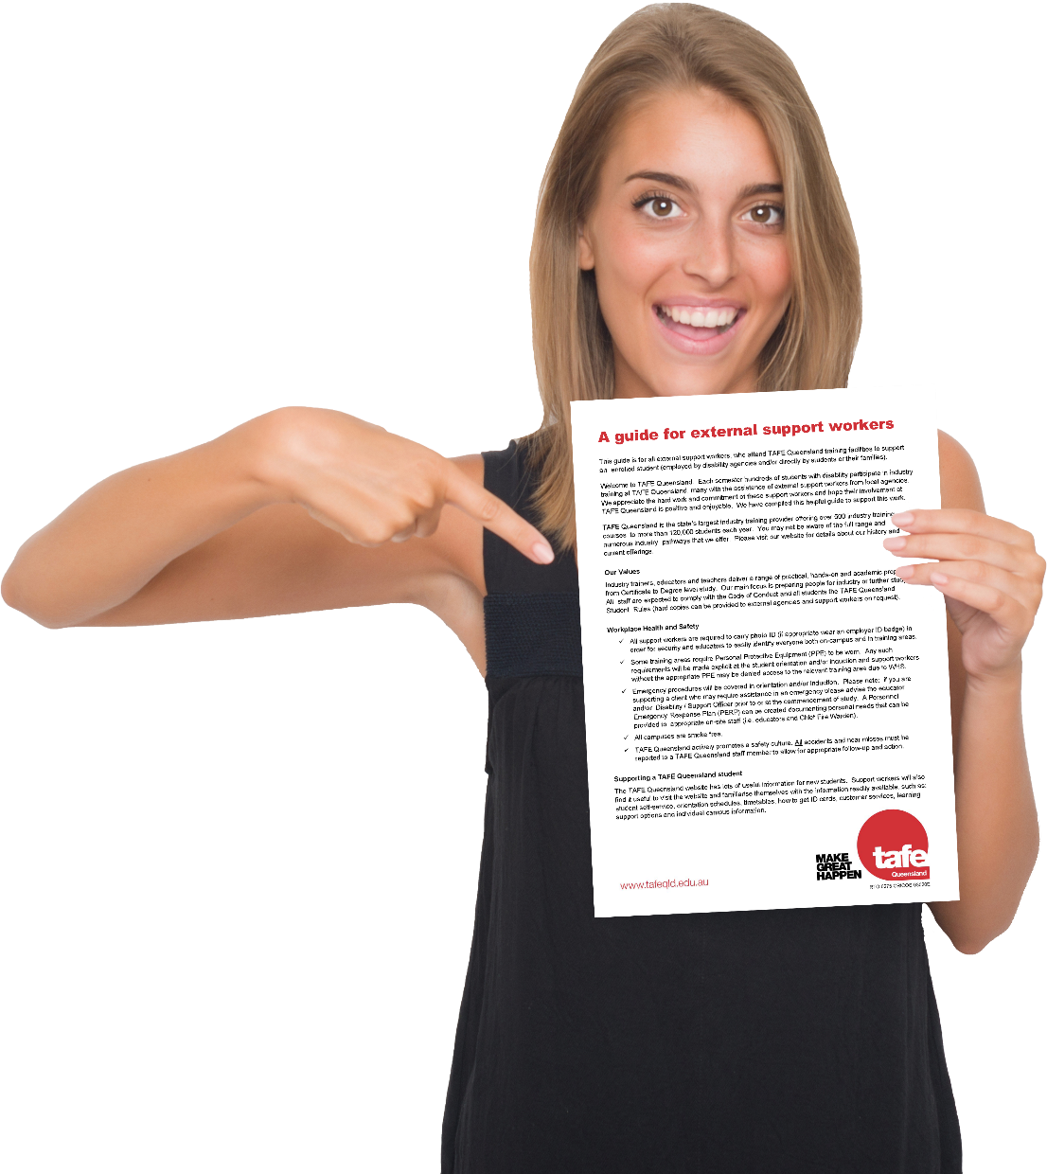
The NDIS and external support workers
Reasonable adjustment and the National Disability Insurance Scheme (NDIS)
A key principle underpinning the NDIS is equal right of access to services, consistent with the goals of the National Disability Strategy, which aims to maximise the potential and participation of people with disability
The NDIS does not replace the obligations of mainstream services, such as VET. Rather, it funds personalised support related to the functional impact of an individual’s disability where those supports are not part of another service system’s universal service obligation or covered by reasonable adjustment
TAFE Queensland Guide for External Support Workers on SPOT

Slide 15
Some tips…
Ensure there has been consultation with the student and monitor. If it isn’t working, Stop…. Review…. Consult…..
If you are not sure, don’t do it alone
(none of us are experts on all disabilities)
Some tips to remember --- Some tips to remember
Tips
A teacher does not need a Student Outline or support letter from AccessAbility Services in order to apply a reasonable adjustment
Don’t make assumptions
Seek opinion from colleagues on what is reasonable
Reasonable adjustment is designed to enable participation and the Standards clearly state it does not guarantee success
Notes:
been the industry's standard dummy text ever since the 1500s,

Slide 16
Q&A

