Slide 1
Universal design research project cycles 1 and 2
Annemaree Gibson & Annie Carney
Teaching & Learning Specialists
Box Hill Institute
May 26 2021 | Annemaree Gibson & Annie Carney

Slide 2
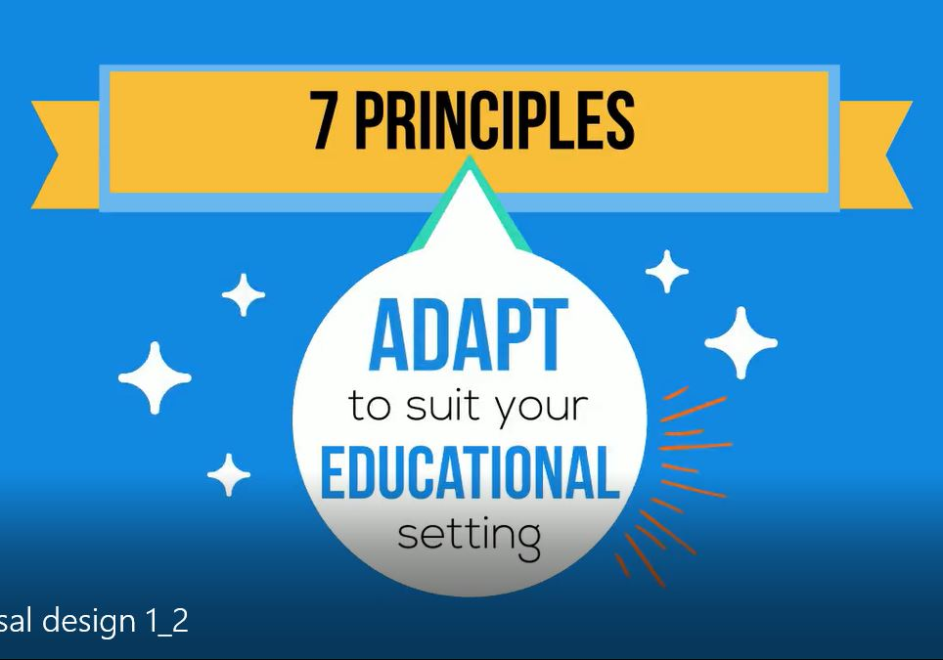
A research project
How can VET teachers apply the Principles of Universal Design in Education to support learners of all abilities?

Slide 3


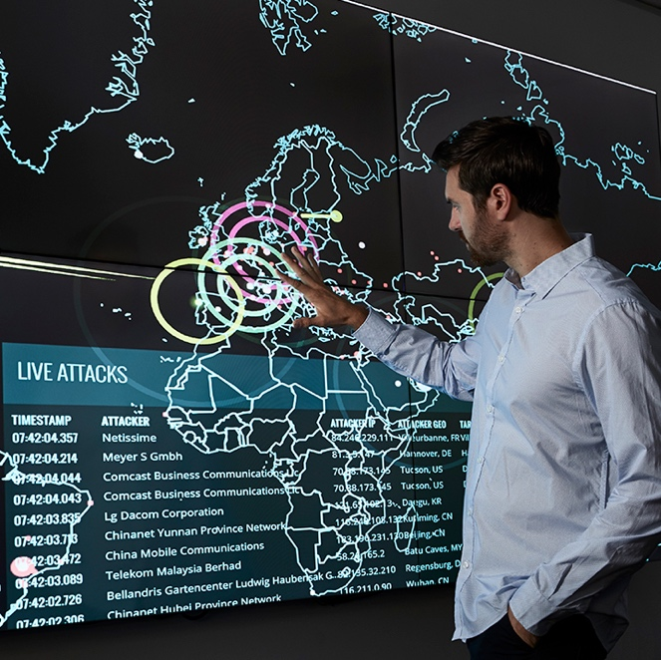
The research cycles
CYCLE 1
CYCLE 2
PUDDLEs
Collaborate
Implement
Reflect
Evaluate
Analyse
Explore
Pivot
Further enquiry

Slide 4
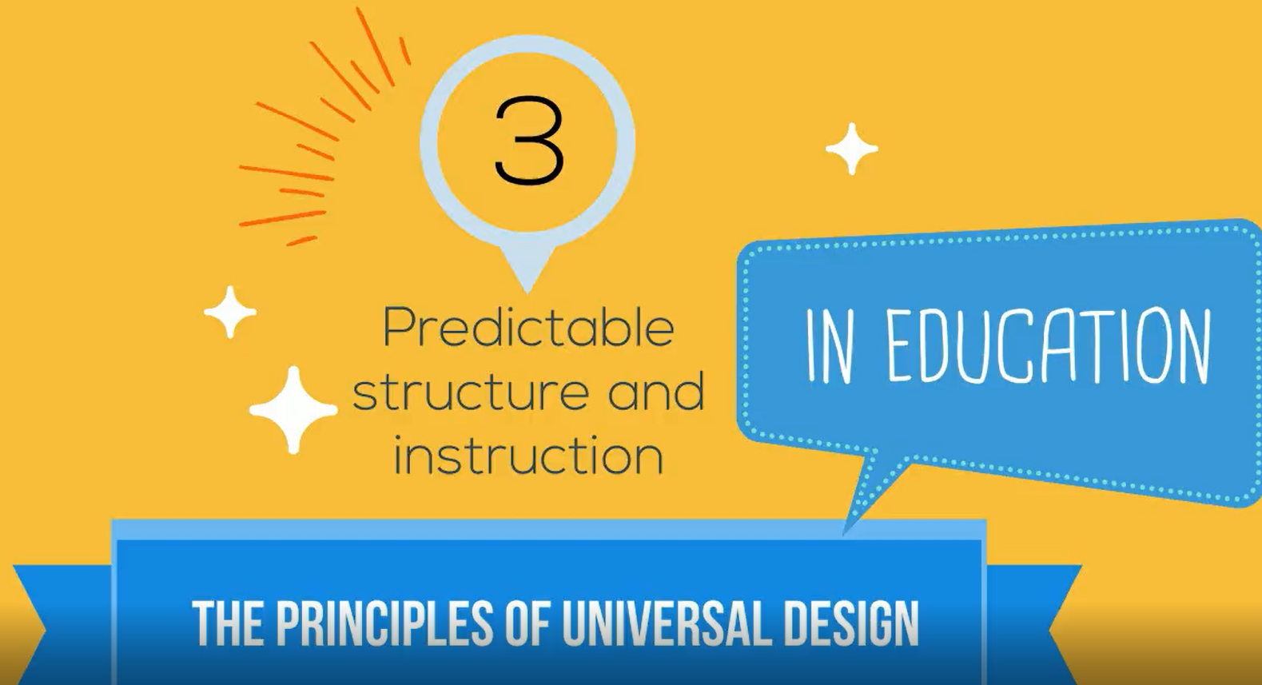
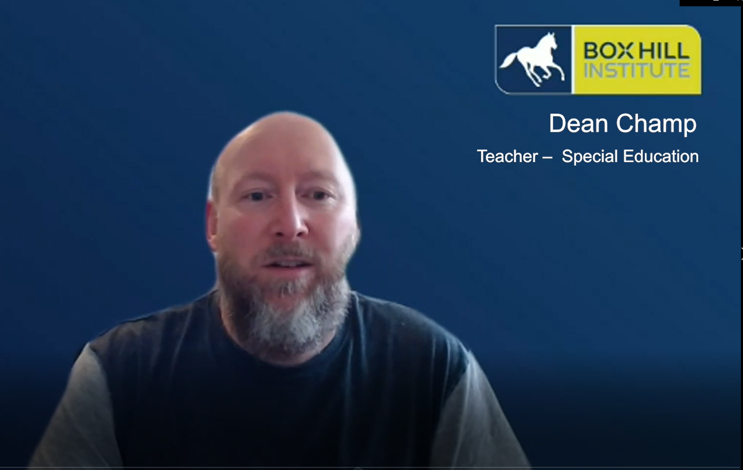
Cycle 1: Collaboration
Animated video + Expert teacher + Sharing
Dean Champ
Teacher – Special Education

Slide 5

Cycle 1: Implementation
Community of practice
Universal Design for VET teachers course
A research project:
" How can VET teachers apply the Principles of Universal Design in Education to support learners of all abilities? "
Notes:
.

Slide 6
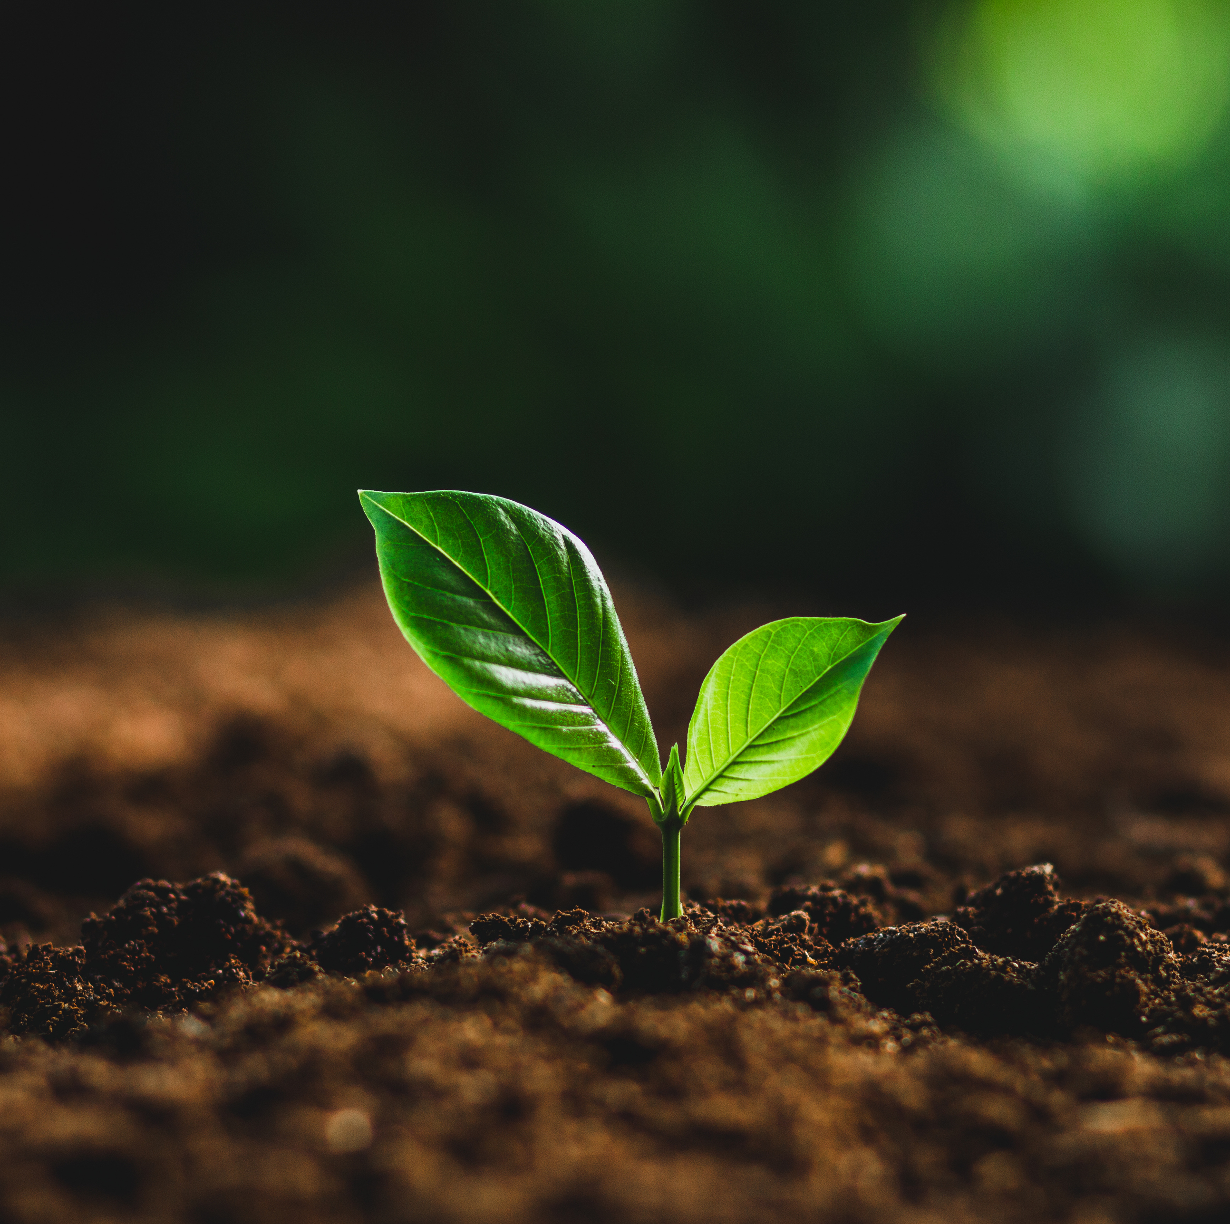
What the data suggests in cycle 2
Insufficient data
  Limited participants
  Short timeframe
Why?
  Participation barriers
  Too early

Slide 7

EMAR CPDE outcomes – cycle 2
Time to consider and adapt
Enrolment comparison
Make compulsory or promote?
  Intrinsic versus extrinsic motivation
  Communication strategies

Slide 8

Cycle 2 conclusions
EMAR tool
  Effectiveness: critical decision points
  Where we are now
  Where to next?
Further enquiry
  Emerging themes
  Literature and environmental review
Photo by Javier Allegue Barros on Unsplash

Slide 9

Principles of Universal Design Development Learning Essentials (PUDDLEs)
'Acronyms are a powerful tool for recalling information which makes them a fantastic memory aid.' Dr Sharmon, Deakin University

Slide 10
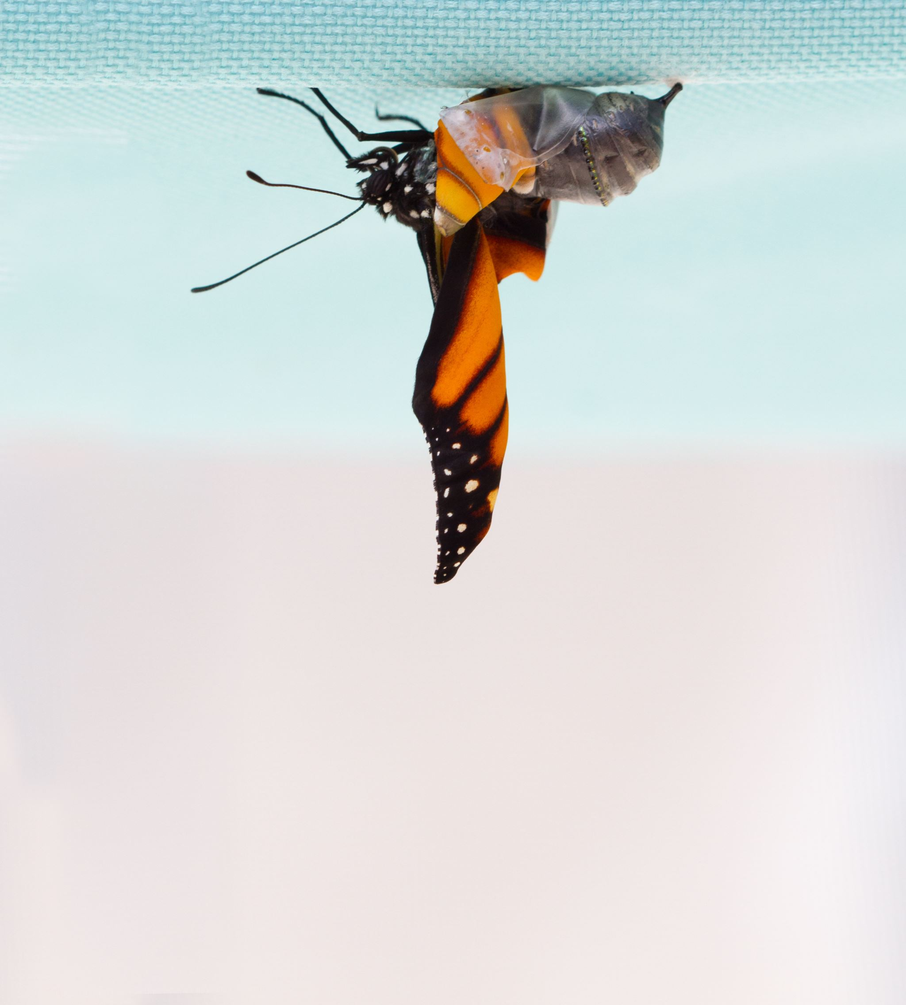
Change Agents
Planting early adopters to act as change agents in faculties.
Or
Faculty pilot programs.

Slide 11

What is on the horizon?
Environmental scan
  What can we borrow?
Further enquiry
  Rubric
  Checklist
  Template
Dublin University College have a UDL Moodle template, UDL implementation rubric and checklist

Slide 12
Can be replicated or elaborated
The activity or work has significance beyond the individual context: Breaks new ground or is innovative

Slide 13
References
ACCESS Project, 2011, 'Universal Design for Learning: A Concise Introduction', Colorado State University [PDF] http://accessproject.colostate.edu/udl/modules/udl_introduction/udl_concise_intro.pdf
ADCET: Universal Design https://www.adcet.edu.au/disability-practitioner/course-design-and-implementation/universal-design
Altrichter, H., Posch, P. & Somekh, B. 1993,Teachers Investigate Their Work: An Introduction to the Methods of Action Research, Routledge, London https://kangkholidblog.files.wordpress.com/2018/03/herbert-dkk-teachers-investigate-their-works.pdf
Australian Vocational Education and Training Research Association, 2021. Webinar 7: Human research ethics. [Online]
Available at: https://avetra.org.au/events.php/40/webinar-7-human-research-ethics
Burgstahler, S. 2020, Universal Design of Instruction (UDI): Definition, Principles, Guidelines, and Examples, DO.IT (Disabilities, Opportunities, Internetworking and Technology) https://www.washington.edu/doit/universal-design-instruction-udi-definition-principles-guidelines-and-examples
CAST, About Universal Design for Learning, https://www.cast.org/impact/universal-design-for-learning-udl
Connell, B. R., Jones, M., Mace, R., Mueller, J., Mullick, A., Ostroff, E., Sanford, J., Steinfeld, E., Story, M. Vanderheiden, G. 1997, The Principles of Universal Design, The Center for Universal Design, NC State University https://projects.ncsu.edu/ncsu/design/cud/about_ud/udprinciplestext.htm
McPherson, M. & Nunes, M. B., 2004. Developing Innovation in Online Learning: An Action Research Framework. 1 ed. London: Routlege-Falmer.
National Centre for Student Equity in Higher Education (NCSEHE) 2018, Deakin University — Inclusive Curriculum and Capacity Building (ICCB), Curtin University.
Nous Group. (2019). Improving assess and achievement for students with a disability - final report. Melbourne: Box Hill Institute (commissioned on behalf of the TAFE network).
OECD, 2009. Creating Effective Teaching and Learning Environments: First Results from TALIS, s.l.: Source OECD.
Pitman, T. (2021, February 14). Disability not the problem, awareness and accessibility are. Retrieved from Campus morning mail: https://campusmorningmail.com.au/news/disability-not-the-problem-awareness-and-accessibility-are/
Rickinson, M., Mildon, R. & Donovan, J., 2020. What does it mean to use research evidence well in education?. https://www.eisummit.org/events: Evidence and Implementation Summit 2021.
Venville, A., Street, A. & Fossey, E., 2014. Student perspective on disclosure of mental illness in post-compulsory education: displacing doxa. Disability & Society, 29(5), pp. 792-806 .

