Slide 1


Access Plans for VET Educators
Jen Cousins and Meredith Jackson

Slide 2
The why of our project?
Emerging Discussions – VET, NDCO, ATEND
DDA and Disability Standards for Education not well understood
Access Plans require disclosure
Training Packages not always written inclusively
Funding models differ between States/Territories
Limited VET guidance / professional learning resources
Low levels of awareness /understanding about:
Impacts of Disability on participation/learning
Reasonable adjustment
Inconsistent implementation of Accessibility Plans

Slide 3
Project Aims
Supporting Educators and Equity Practitioners
Building networks for support and collegiality
Promoting partnership in supporting students
Developing understanding of Student/Equity Services
Broadening/Deepening understanding of reasonable adjustments and responsibilities
Engaging in consistent conversations

Slide 4
What are we trying to achieve?
Improve correlation between equity practitioners, educators and students in responding to Access Plans
Build educator capability and confidence with student conversations on inherent requirements and reasonable adjustments
Streamline organisational processes
Create a national model –National Training packages
Strengthen student voice and self-advocacy

Slide 5
Topics
What is an Access Plan
Legal Framework
An Access Plan’s Purpose
Role of Equity Services, Educators and Students
Confidentiality and Disclosure
Inherent Requirements and Reasonable Adjustments
Implementing, Documenting and Reviewing Access Plans

Slide 6
What’s in the Resource?
Presentation PPT
Session Guidelines
Case Studies
Activity Sheets
Resources

Slide 7

PPT Presentation

Slide 8
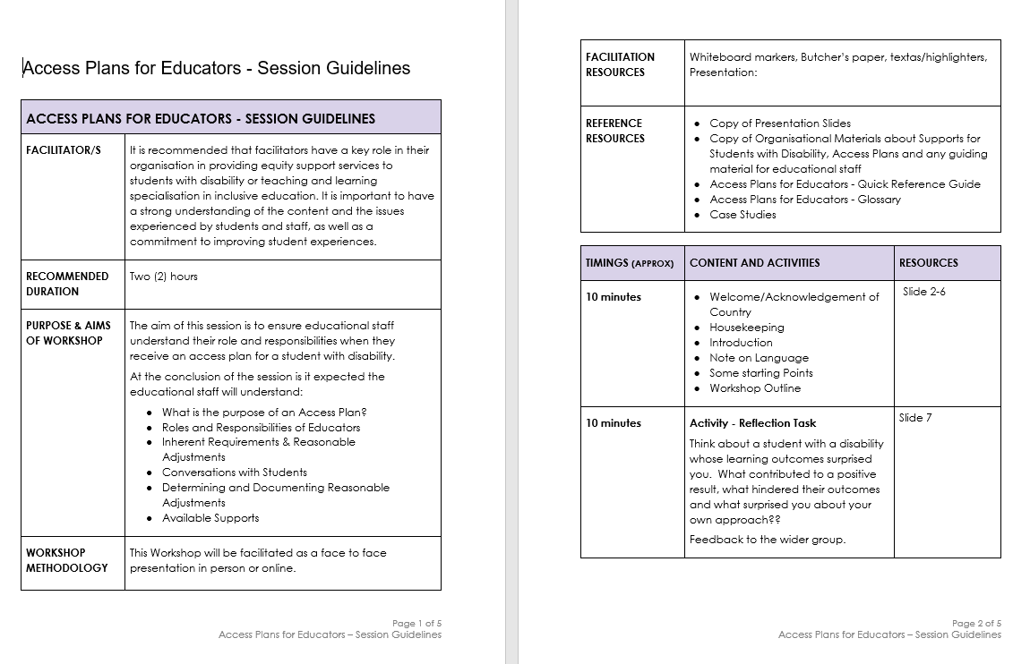
Session Guidelines

Slide 9
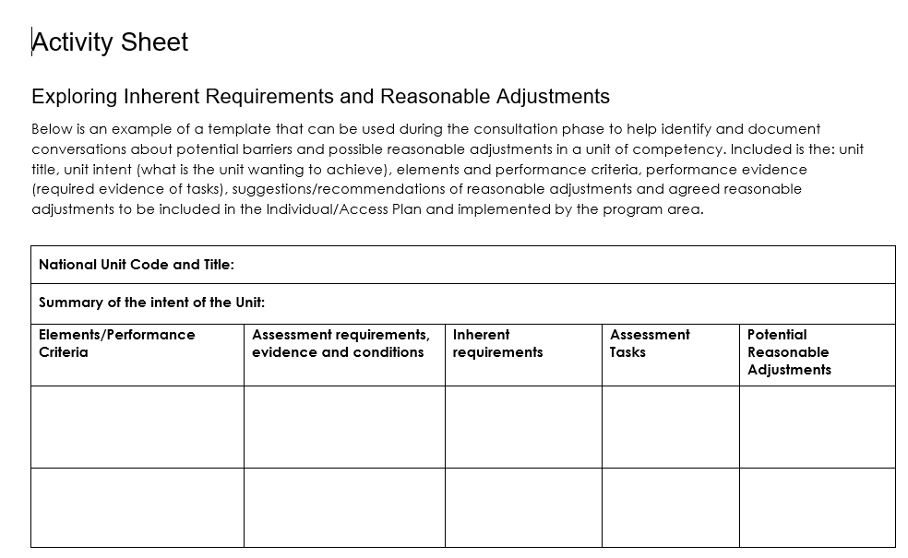
Activity Sheets

Slide 10
Resources
Fact Sheet – Outlining Process
Quick Reference Guide – Links and Resources
Glossary – Key Terms and Concepts

Slide 11

Case Studies
Profile of a Student
Impact on Learning
Implications for Student
Event/Scenario
Suggested Reasonable Adjustments / Inclusive Practices
Examples - Sarah, Tayla, Ravi and Andre
This Photo by Unknown Author is licensed under CC BY-SA-NC

Slide 12
Activity - Break Out Group Discussions
key issues you observe regarding responses to access plans
key challenges in building educator capability regarding access plans
strategies that you have used to improve responses to
access plans

Slide 13
Why this methodology?
Face to Face
Engagement
Myth busting
Unpacking
Sensitive
Previous Experience
Can be Contextualised

Slide 14
Ways to use the resource
PD Gaps
Cohorts
Professional Learning Schedule
TAE Delivery
Enhancing Complaints Resolution
Continuous Improvement

Slide 15
Key Messages in Delivery
Sense of belonging
The Importance of Conversation
Intervening Early
Partnership
Educator Empowerment

Slide 16

Questions??
This Photo by Unknown Author is licensed under CC BY

