Slide 1
How ClaroRead helps people to read and write
Mary Wilcox
Product Evangelist

Slide 2








About Claro Software
20 year old British Assistive Technology software publishers
  22 people, based in Preston, UK.
Founded by academics and technologists
  Commercial and free products
Owned by Lingit (since 2018), a Norwegian company who also develop software to assist with reading and writing

Slide 3
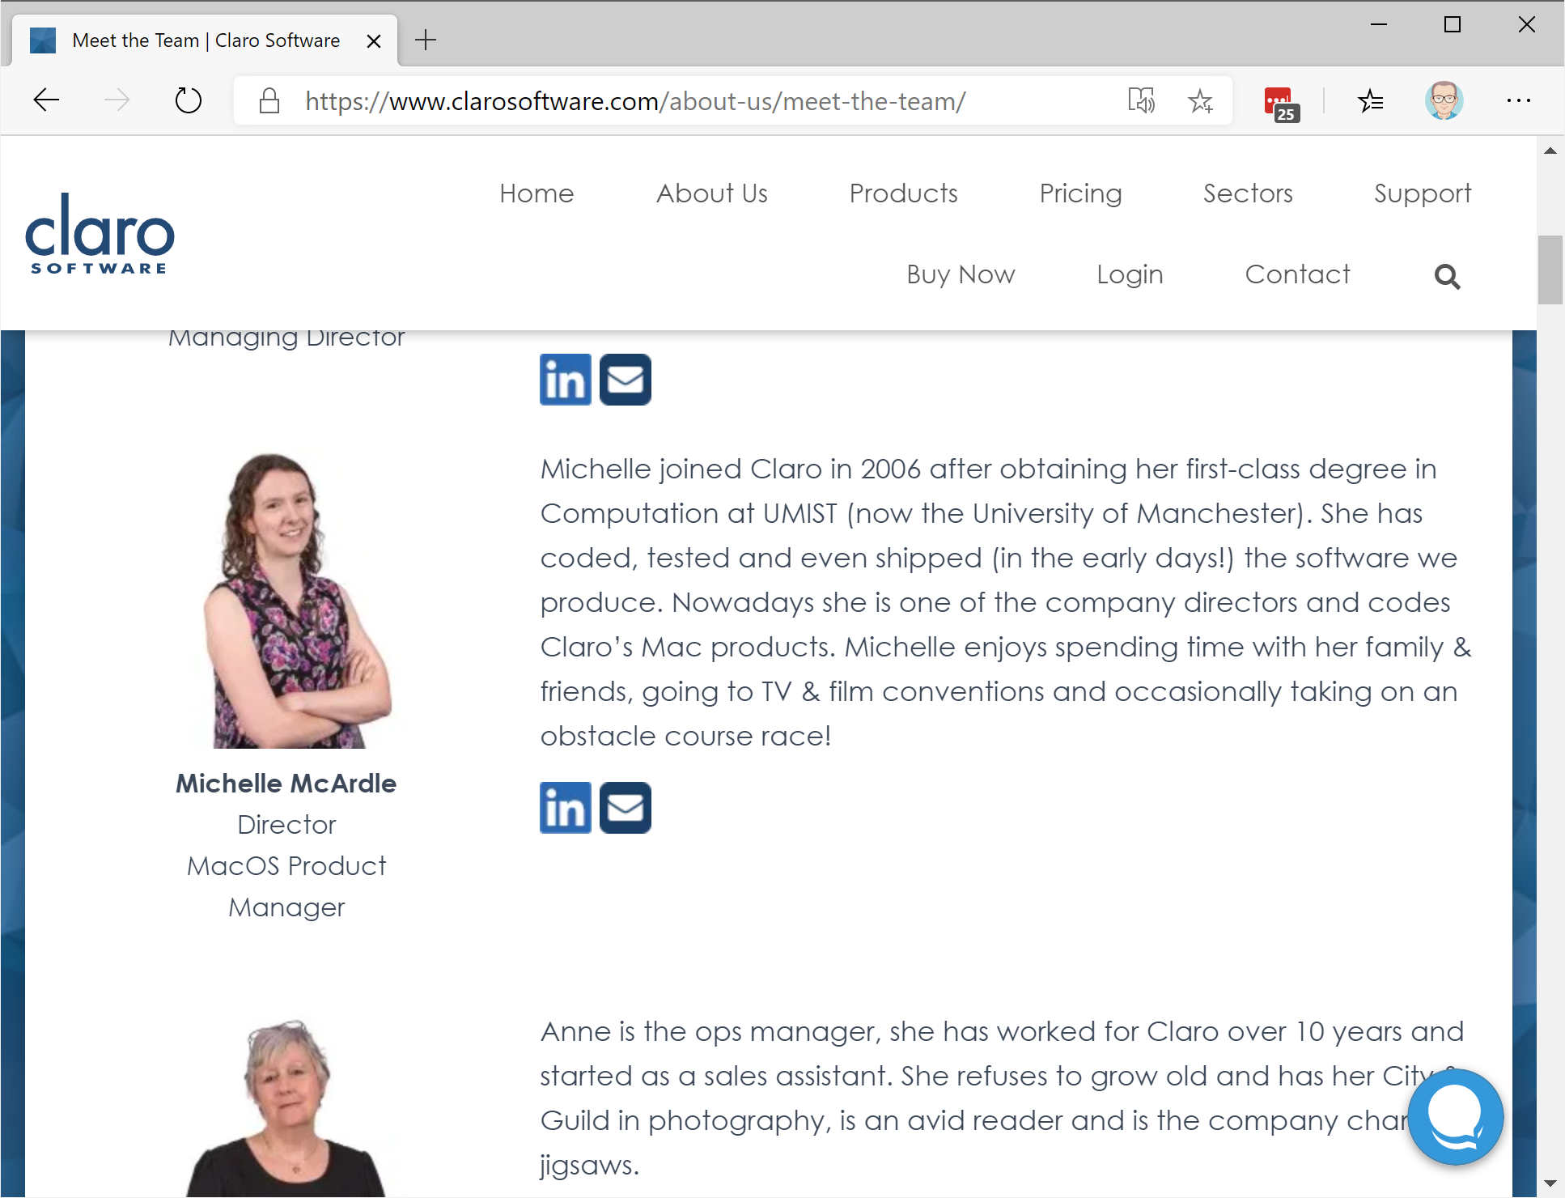
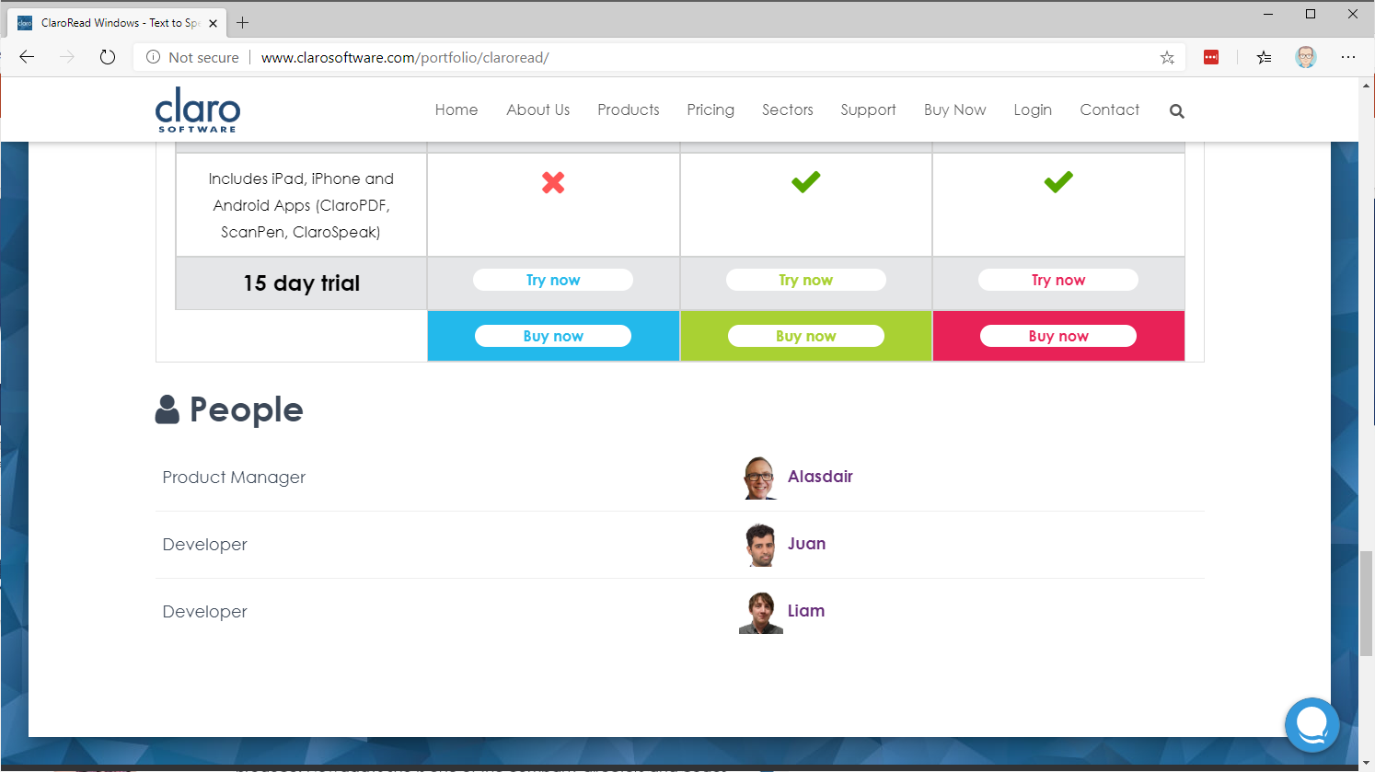
Meet the Team

Slide 4
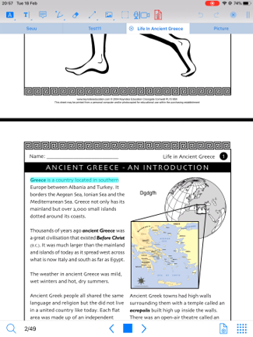
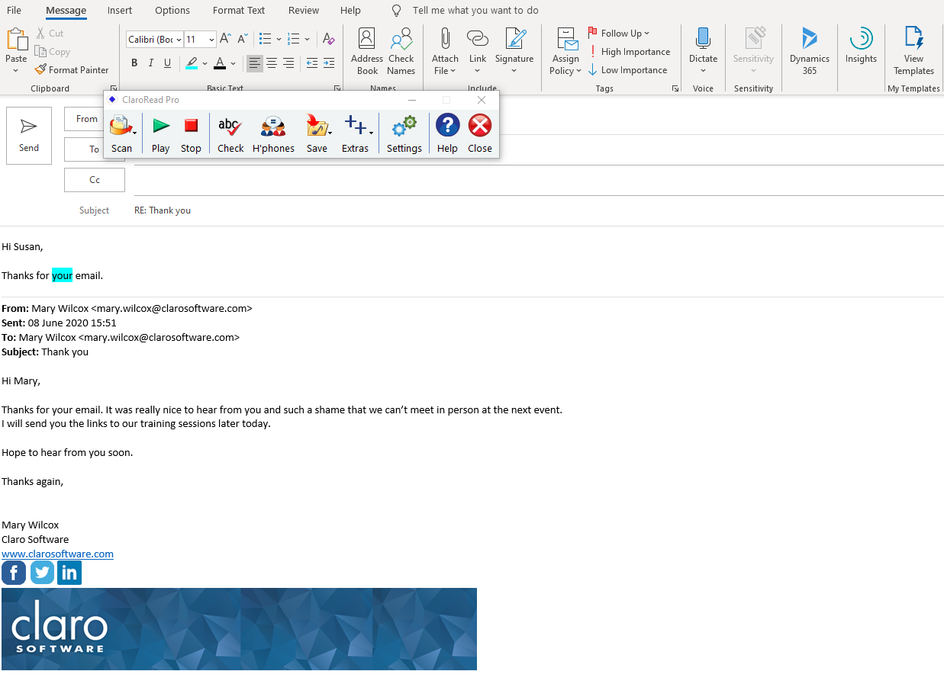
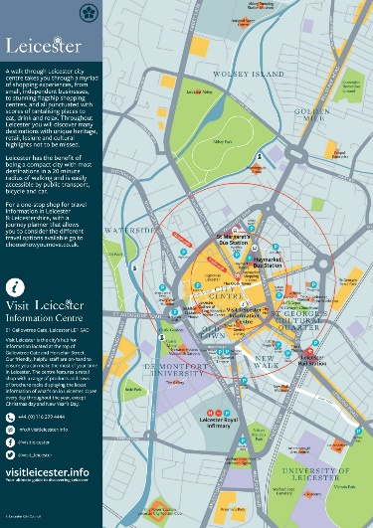
Read any document
Text in an image
Read in your browser
Read emails
PDFs
Word documents
Proof scanning

Slide 5
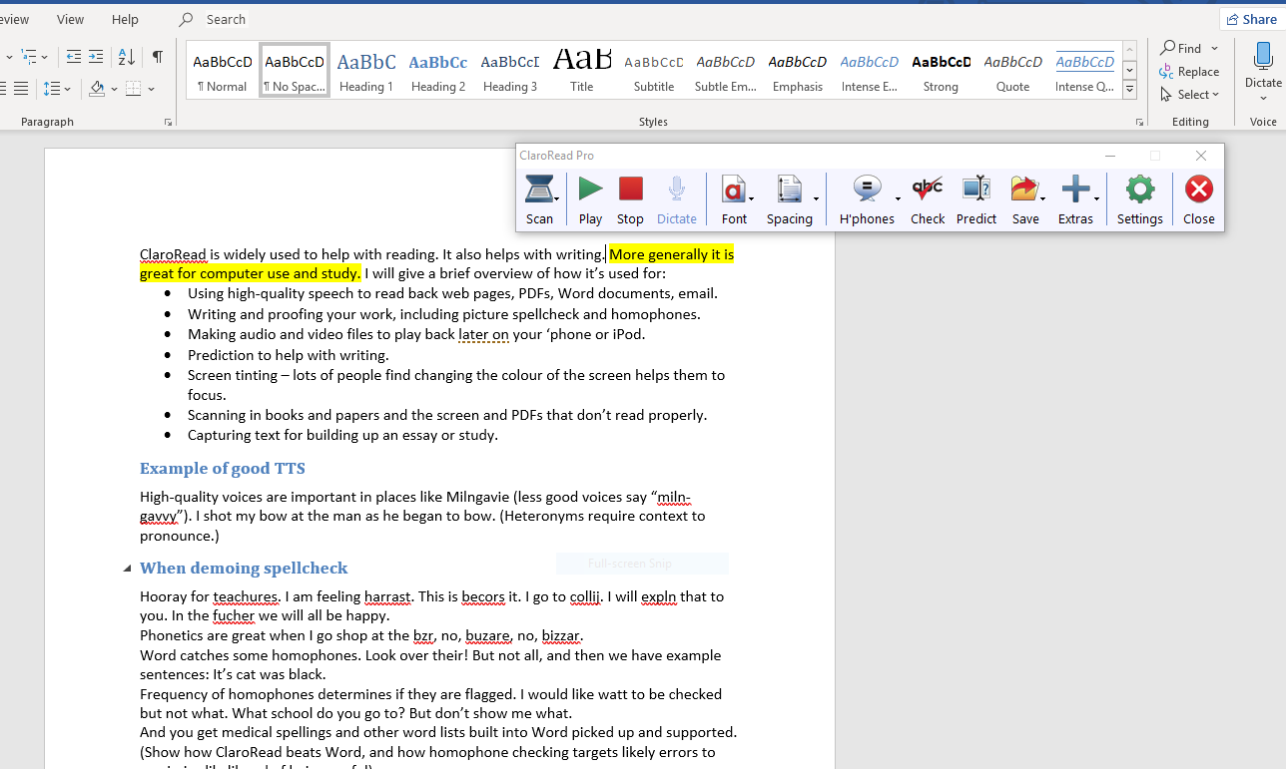
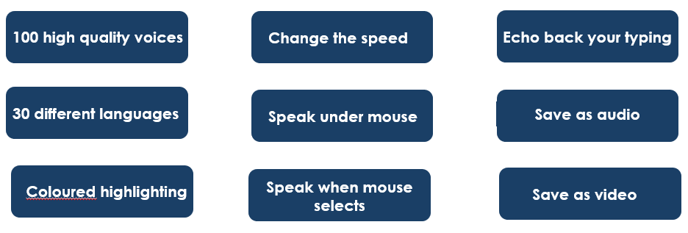

Text-to-speech
100 high quality voices
Change the sped
30 different languages
Coloured highlighting
Colored highlighting
Shortcut to Dragon
Echo back Dragon

Slide 6
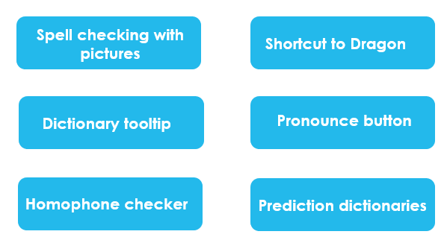
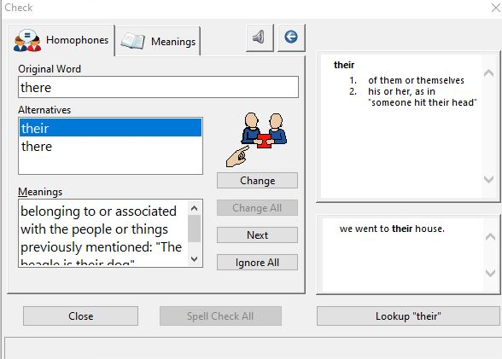

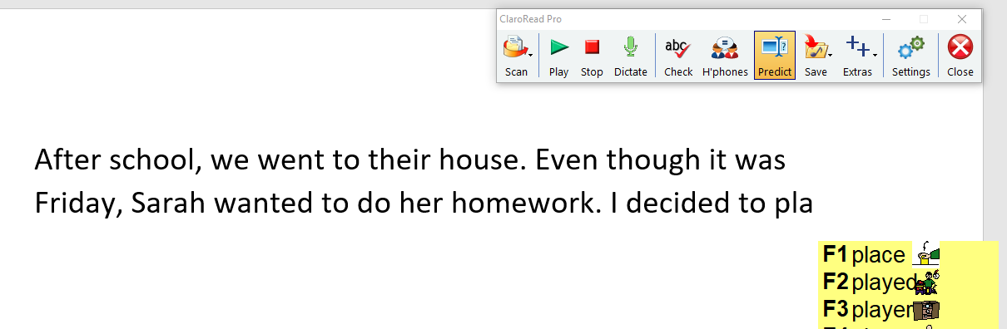
Assistance with spelling
Prediction dictionaries

Slide 7
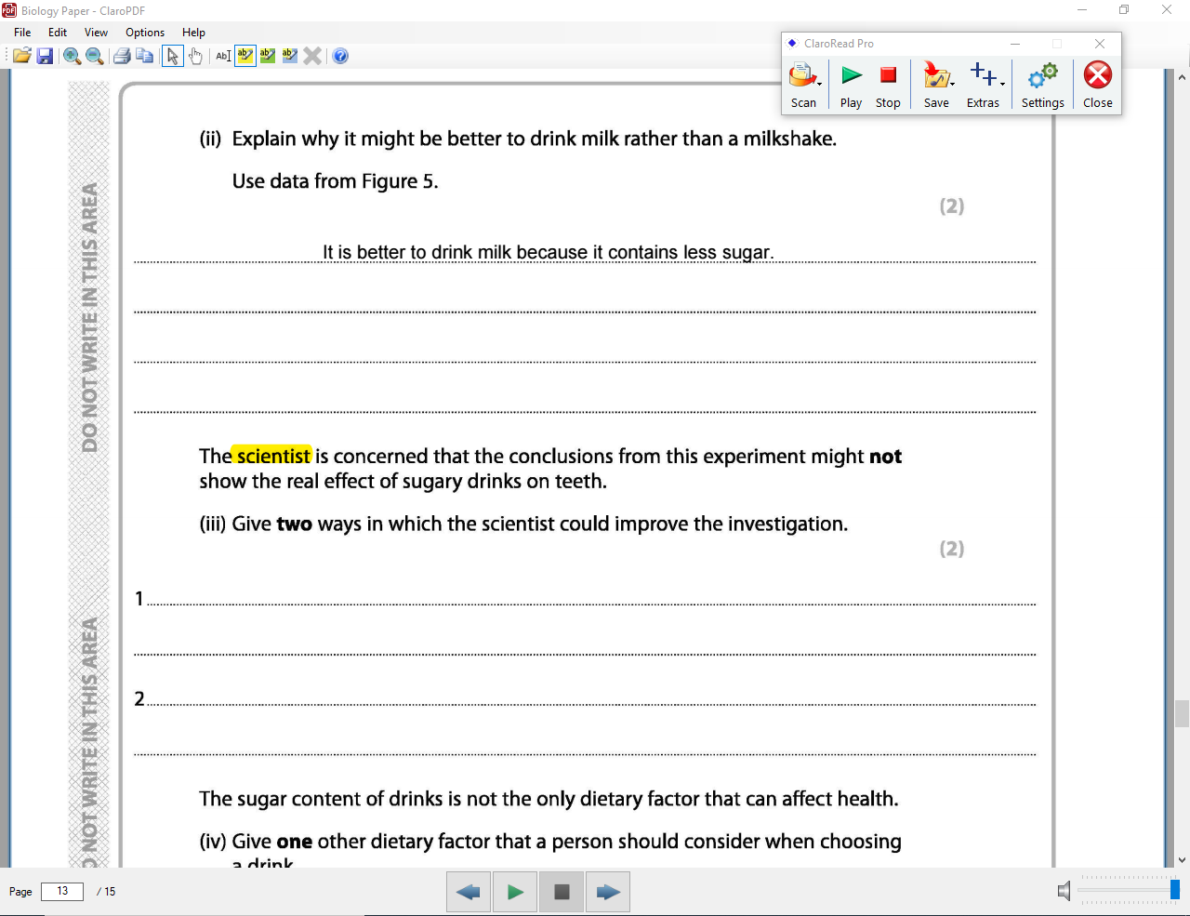
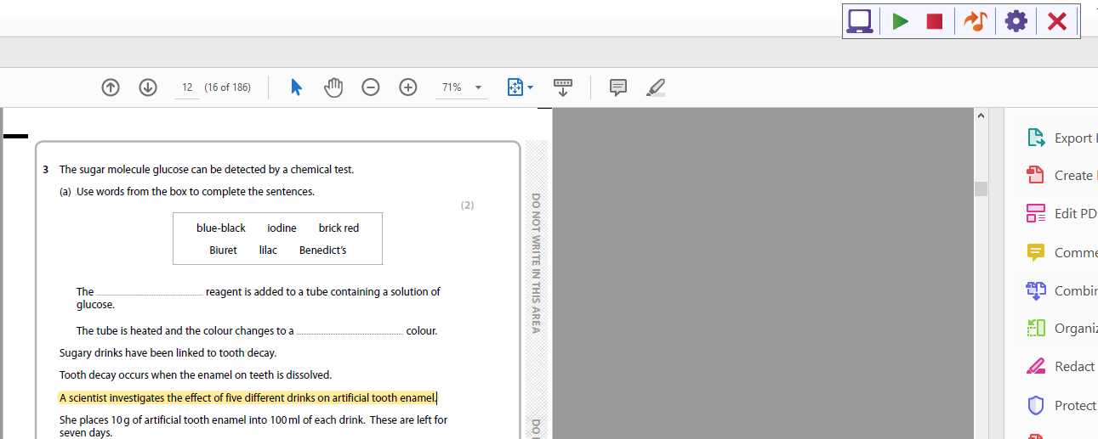
ClaroRead in exams

Slide 8
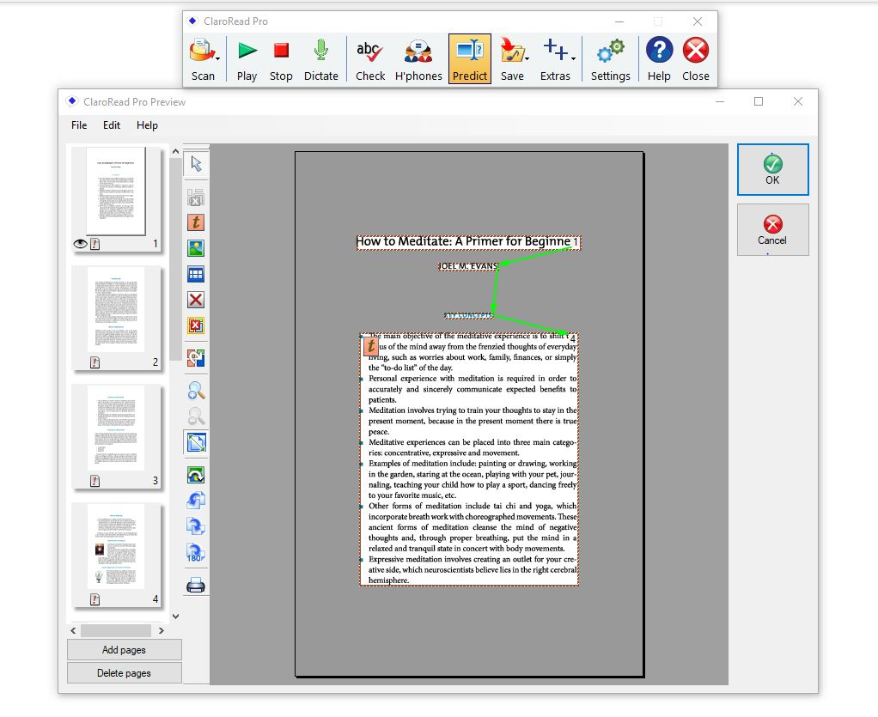
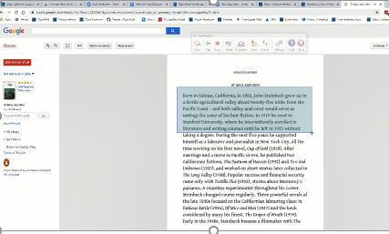

Make any document accessible
Scan from screen
OCR
Proof scanning
Auto Converter
Proof scanning

Slide 9
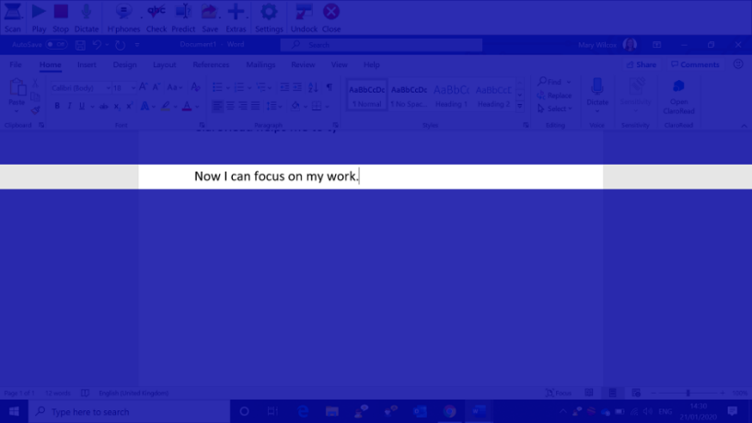
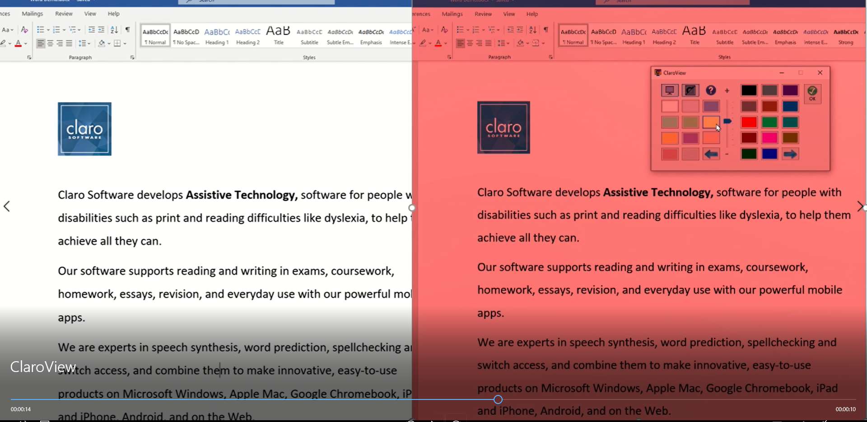
Tint the screen
True black feature
Available in Chrome browser
Ruler
Your choice of colour
Window
Save as video

Slide 10
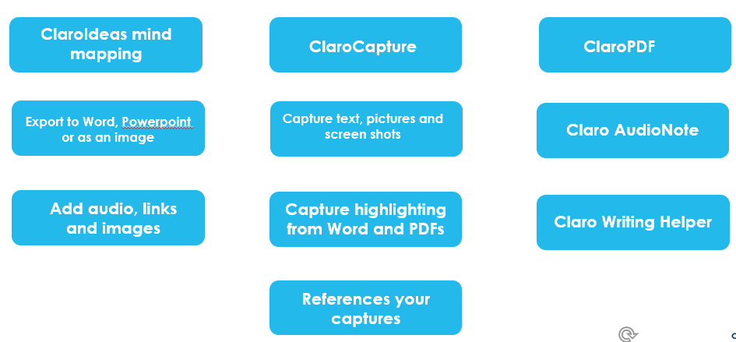
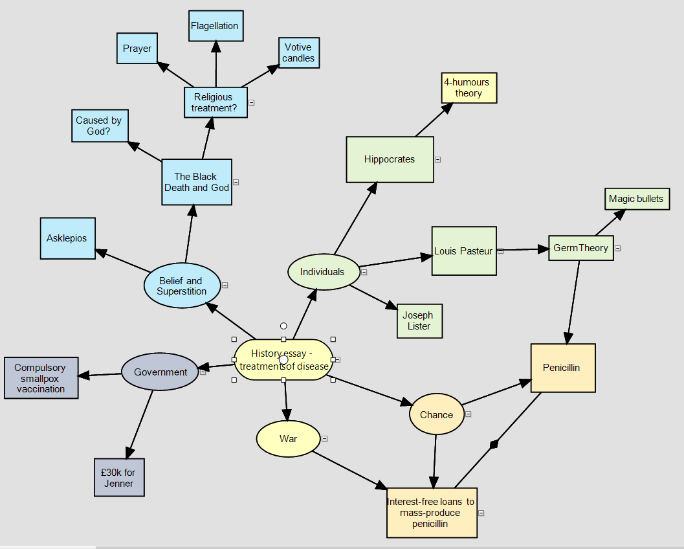

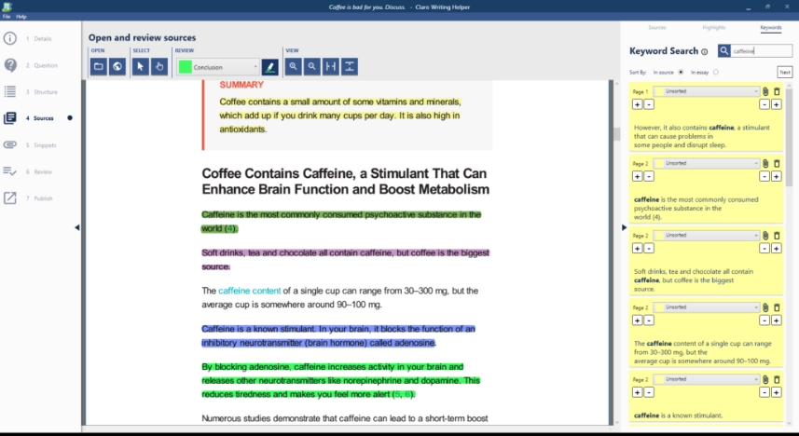
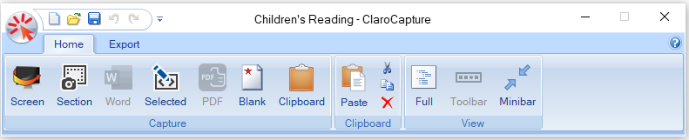
Study Tools

Slide 11
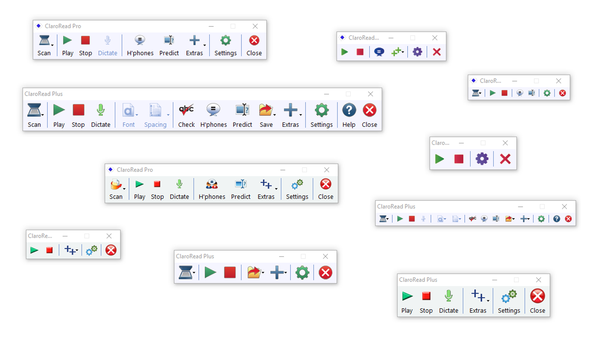
Customise the toolbar

Slide 12
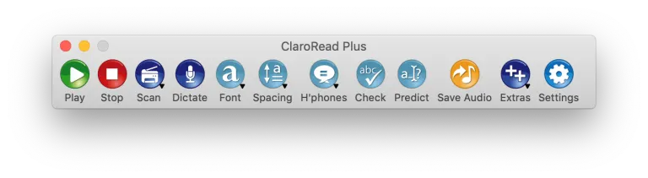
ClaroRead Mac
Dark Mode
Spell checking, homophone checking and prediction
ClaroIdeas
PDF reading
Apple Dictate – it's no Dragon, but it's there!
Even works in Catalina!

Slide 13
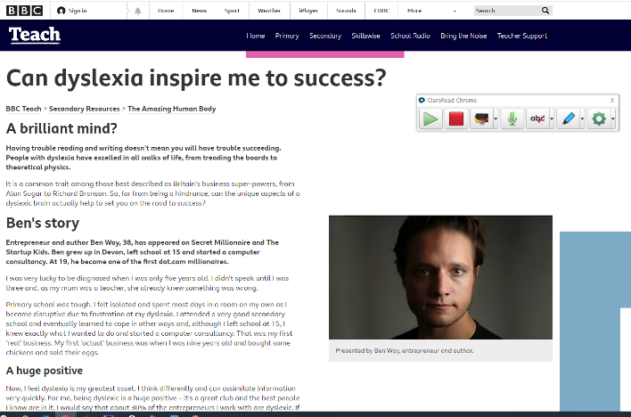
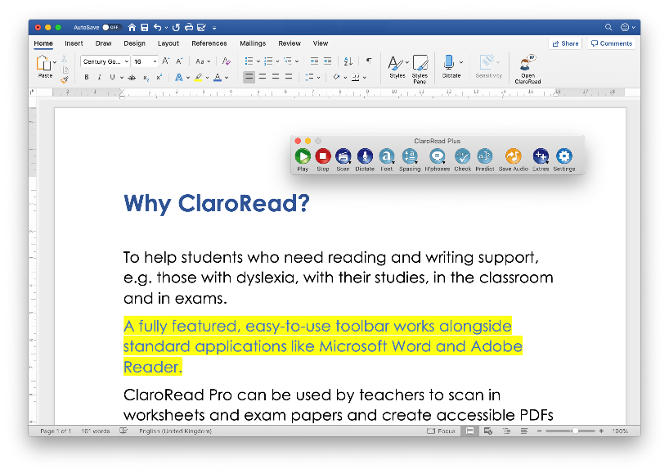
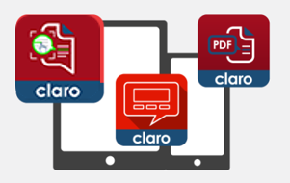
Available on multiple platforms
ClaroRead Mac
iOs and android Apps
ClaroRead Web apps
ClaroRead Chrome
Claro Scanpen
ClaroSpeak
Prof scanning
ClaroPDF

Slide 14
Prices
Home, School and Go package is an annual license including use at home. Contact Spectronics for prices.
Free 15 day individual and 30 day site license trials are available. Contact Jim at Sprialis Consulting for arrangements.
10% discount available on everything except ClaroRead SE.
 | Individual | School Site License | College Site License | University Site License
ClaroRead SE | $105 | $1050 | $2990 | $3520
ClaroRead Plus | $325 | $2645 | $4850 | $7400
ClaroRead Pro | $350 | $2990 | $5200 | $7750

Slide 15
Free offerings!
Free license of ClaroRead for all Accessibility Advisors
Online CPD courses available
15 day individual trials and 30 day site license trials
Free android apps and basic iOS apps
Claro ePub Reader
For arranging trials and support contact
Jim@sprialisconsulting.com

Slide 16
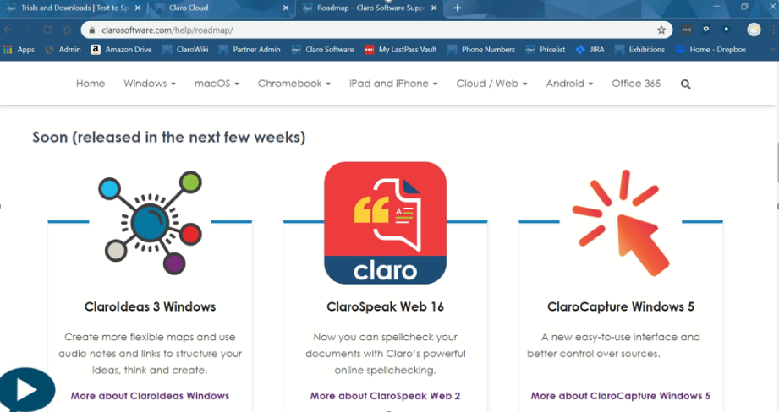
Roadmap

Slide 17
Help and Support
www.spectronics.com.au
Visit the Spectronics website www.spectronics.com.au. Phone support available
Watch the Claro YouTube channel for webinars and video tutorials

Slide 18

Thanks!
Mary Wilcox
mary.wilcox@clarosoftware.com

