Slide 1
Microsoft Teams
Assistive Technology Interoperability & Accessibility Features

Slide 2
Agenda
Who Are We?
Short Introduction to Ourselves & Atos
Microsoft Teams General Features
General Overview of Teams
Microsoft Teams Assistive Technology Interoperability
Interoperability of Market Leading Assistive Technologies
Microsoft Teams Integrated Assistive Features
Overview of the Features Teams Provides from an Accessibility Standpoint

Slide 3
Who Are We?

Slide 4
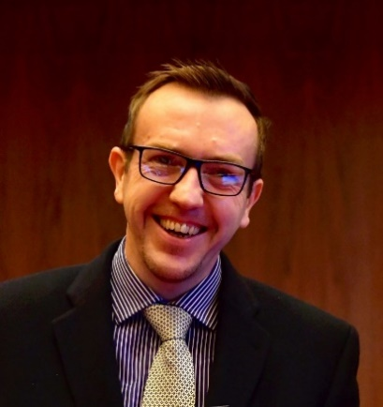


Who Are We?
Neil Milliken
Neil Milliken is Global Head of Accessibility at Atos, an invited expert for the W3C Cognitive Accessibility Taskforce, member of the Atos Scientific Community & Atos Distinguished Expert.
He is co-founder of AXSChat Europe’s largest twitter chat with a focus on Accessibility & Inclusion.
Neil is a member of the Board of Directors for World Institute on Disability, a non-exec at Genius Within & Chair of the Diversity Board for Institute of Coding.
Neil was named in the top ten of the Shaw Trust Disability Power 100 list in 2018 and was named D&I practitioner of the year in the 2019 Disability Smart Awards.
@NeilMilliken
Neil.Milliken@atos.net

Slide 5
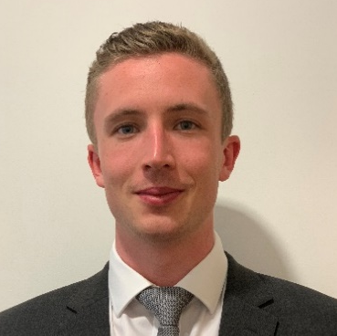
Who Are We?
Mark Wilcock
Mark Wilcock is an Accessibility Specialist at Atos, CPWA Certified, an ex-contributing member of the W3C WCAG Working Group for WCAG 2.1 and W3C Cognitive Accessibility Taskforce and an Atos Expert for Immersive Experiences.
He is the co-chair for the development of the Digital Accessibility Specialist Apprenticeship standard, the first global apprenticeship standard for Accessibility.
@MarkAWilcock
Mark.Wilcock@atos.net

Slide 6



Who Are We?
Atos
110,000
Employees
Atos is a Microsoft Partner and involved in many of their initiatives.
Atos provides a number of offerings regarding Accessibility.
Atos is leading Accessibility via IAAP, United Nations, W3C & Institute for Apprentices.
Find out more about Atos’ Accessibility Department
Worldwide Digital
Leader
Operates in 72 Countries

Slide 7
Microsoft Teams
General Features

Slide 8
General Features
Overview
Chat for Today’s Teams
Communicate in the moment and keep everyone in the know
A Hub for Teamwork
Give your team quick access to information they need right in
Office 365
Customizable for
Each Team
Tailor your workspace to include content and capabilities your team needs every day.

Slide 9
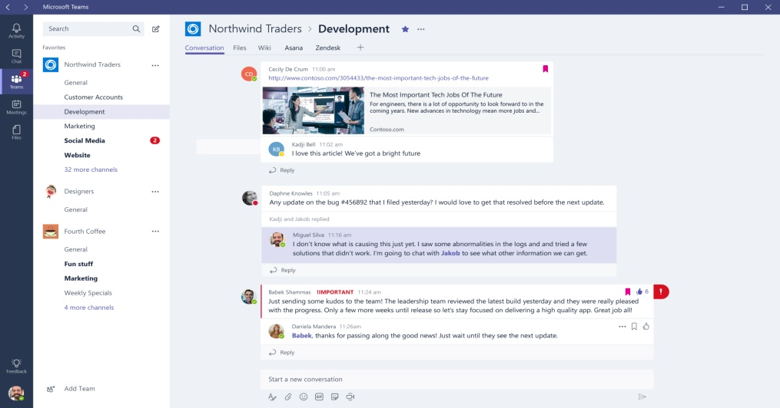
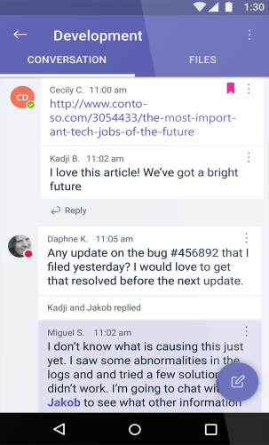
General Features
Private Conversations
People can see content and chat history anytime.
Team chats and activities are visible to the entire team.
Use private chats for small group conversations.
Mobile access on Android, iOS and Windows Phone.

Slide 10
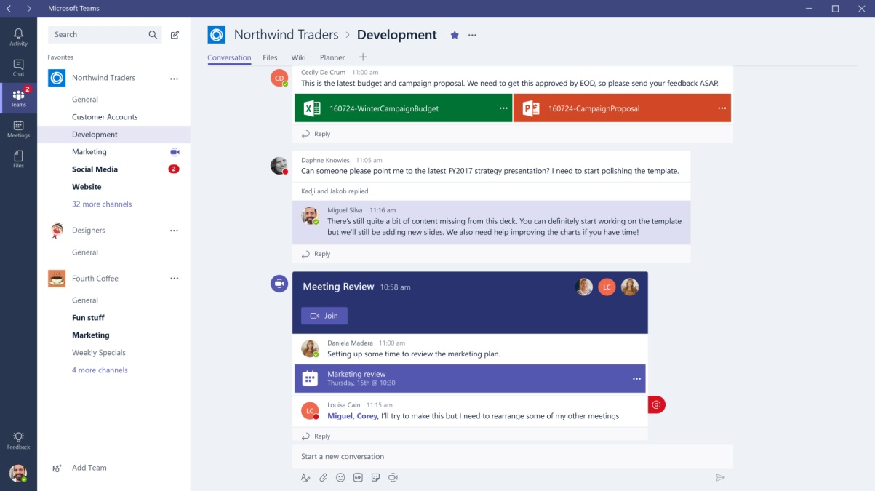
General Features
Collaborative Working
Chat, content, people, and tools live in a team workspace.
Voice and video meetings right within Teams.
Built-in access to SharePoint, OneNote and Planner.
Work with Office and other documents right in the app

Slide 11



General Features
Supported Platforms
Desktop
Web
Mobile
Provides support for audio, video, and content sharing for team meetings, group calling, and private one-on-one or private multi-party calls.
Full-functioned chat client that can be used from a variety of browsers.
Geared at users participating in chat-based conversations while on the go , and currently allows users to have peer-to-peer audio call.

Slide 12
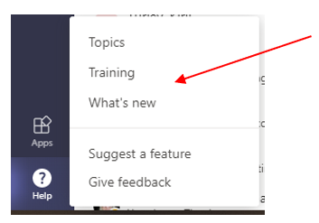
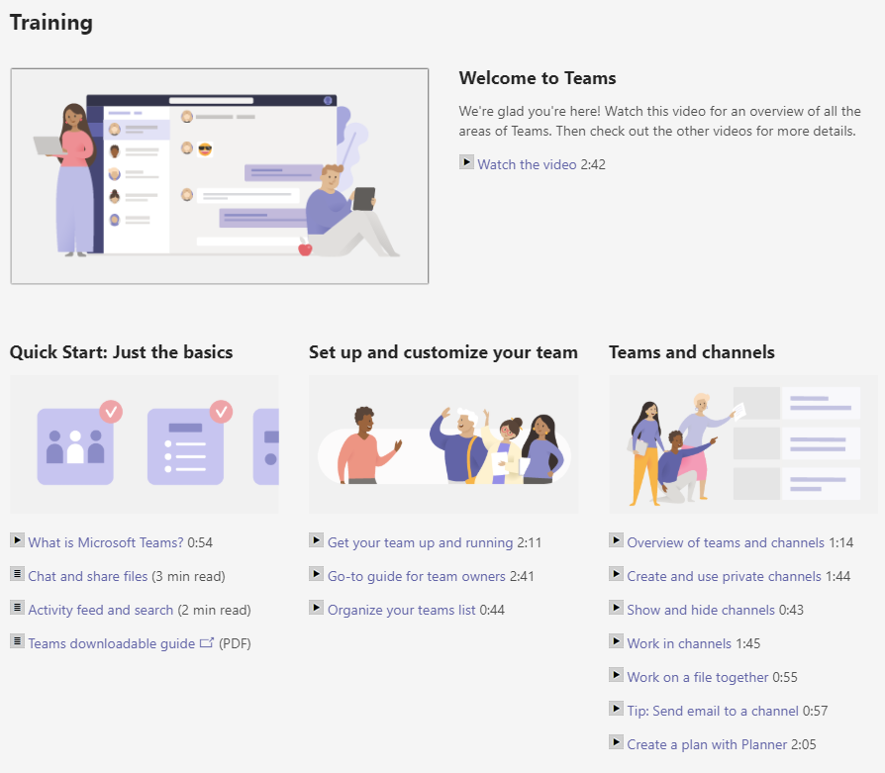
General Features
Things for Consideration
Microsoft Teams is the fastest growing offering due to the number of users onboarding.
This explosive growth means frequent changes.
Some of the features discussed may not be available to yourself, due to organisational settings or version installed.
Features are still being actively integrated, and developed. New innovative features are constantly being deployed.

Slide 13
Microsoft Teams
Assistive Technology Interoperability

Slide 14




Assistive Technology Interoperability
Speech Recognition
Currently limited interoperability with leading speech recognition products.
Microphone required for use by both Teams and Speech Recognition.
Microsoft Dictation (Windows Key + H) can be used for general text dictation.
Dragon NaturallySpeaking can be used with workarounds implemented.

Slide 15
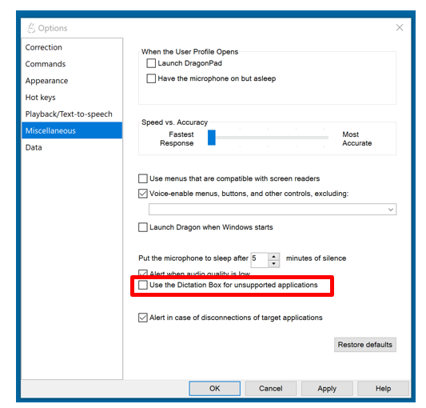
Assistive Technology Interoperability
Dragon NaturallySpeaking
Important to note that Microsoft Teams is ‘currently’ not an official Dragon supported application.
Dictation cannot be achieved natively using Dragon Dictation (Disable Dragon Dictation Box).
Standard navigation commands via Dragon do not work within Teams.

Slide 16
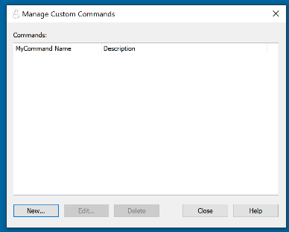
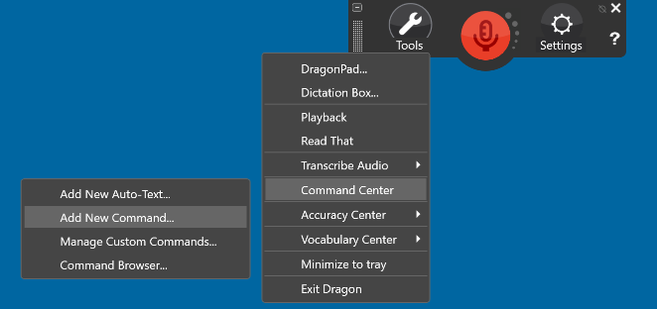
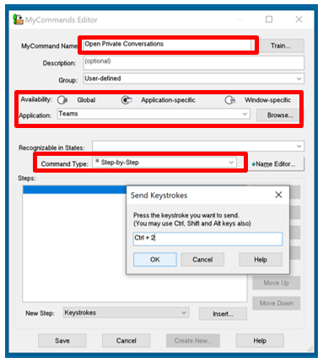

Assistive Technology Interoperability
Dragon NaturallySpeaking Cont.
Dragon’s features can assist to alleviate some of the issues currently experienced.
Using Dragon Custom Commands for navigation via Microsoft Teams hotkeys.

Slide 17


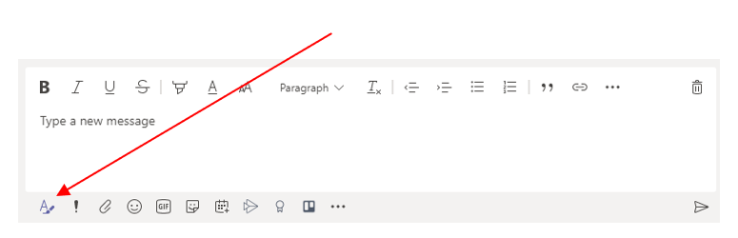
Assistive Technology Interoperability
Job Access with Speech (JAWS)
Designed and developed with JAWS support.
In-depth training and walkthroughs for Teams have been developed by Microsoft and Freedom Scientific.
Challenges still exist with content though such as being unable to assign alt text to images in Teams.
Accessible meeting and communication etiquette is important including structuring chats and link text.

Slide 18
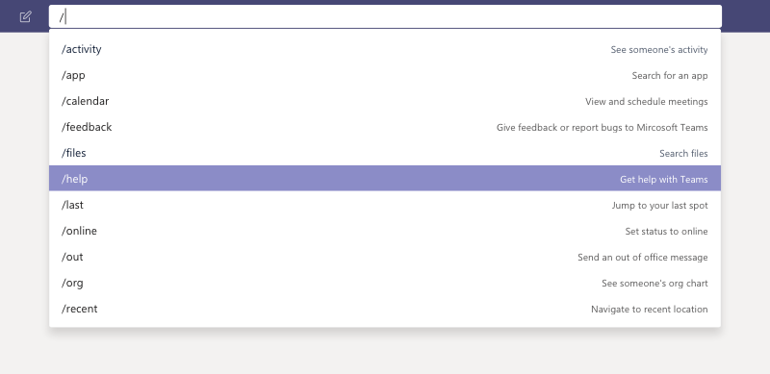
Assistive Technology Interoperability
Job Access with Speech (JAWS) Cont.
Commands are shortcuts for performing common tasks in Teams: update your status, go to a specific channel, show your recent files and saved messages, and more.
CLTR + R to access Search field.
Command | What it does
/activity | See someone's activity.
/available /away /busy | Set your status.
/call | Call a phone number or Teams contact.
/dnd | Set your status to do not disturb.
/files | See your recent files.
/goto | Go right to a team or channel.
/help | Get help with Teams.
/join | Join a team.
/keys | See keyboard shortcuts.
/mentions | See all your @mentions.
/org | See someone's org chart.
/saved | See your saved messages.
/testcall | Check your call quality.
/unread | See all your unread activity.
/whatsnew | See what's new in Teams.

Slide 19
Assistive Technology Interoperability
Job Access with Speech (JAWS) Cont.
Freedom Scientific and Microsoft have developed training about how to use Screen Readers in Microsoft Teams.
Microsoft Training
Using Microsoft Teams with a Screen Reader: Frequently Asked Questions (Article)
Use a screen reader to explore and navigate Microsoft Teams (Article)
Basic tasks using a screen reader with Microsoft Teams (Article)
Use a screen reader to work with files in Microsoft Teams (Article)
Freedom Scientific Training
Chatting in Microsoft Teams (Video)
Microsoft Teams and JAWS, Beyond the Basics (Video)
An Introduction to Microsoft Teams and JAWS (Videos & Guides)
Microsoft Teams JAWS Training Playlist (Video)

Slide 20

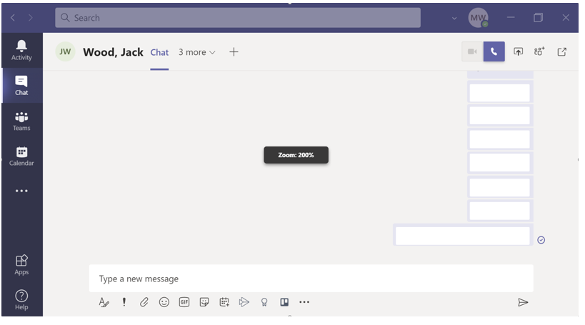
Assistive Technology Interoperability
Screen Magnifier/ZoomText
In-built Zoom feature (similar to standard browsers) 60% to 200%
ZoomText has moderate support for Teams.
Text is not crystal clear when magnified using ZoomText.
Focus and cursors enhancements work appropriately.
Note: Using the in-built Zoom feature the layout of content and interface controls will change.

Slide 21
Microsoft Teams
Integrated Accessibility Features

Slide 22
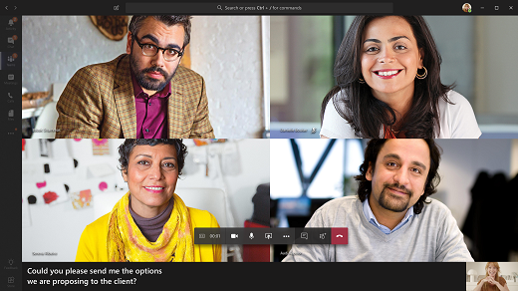
Integrated Accessibility Features
Live Closed Captions
Teams can provide Realtime captions.
Live captions can make your meeting more inclusive for people:
  Who are deaf or hard-of-hearing
  Different levels of language proficiency
  In loud places
Speaker identification (i.e. ‘James: Hello’)
Note: The Live Closed Caption feature may need to be enabled by your IT administrator for Teams

Slide 23
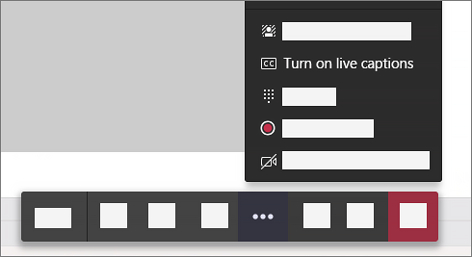
Integrated Accessibility Features
Live Closed Captions Cont.
To use live captions in a meeting, go to your meeting controls and select More options More options button > Turn on live captions.
The option to turn live captions on in a meeting's call controls
To stop using live captions, go to the meeting controls and select More options More options button > Turn off live captions.
Note: Live captions aren’t currently available in all languages

Slide 24
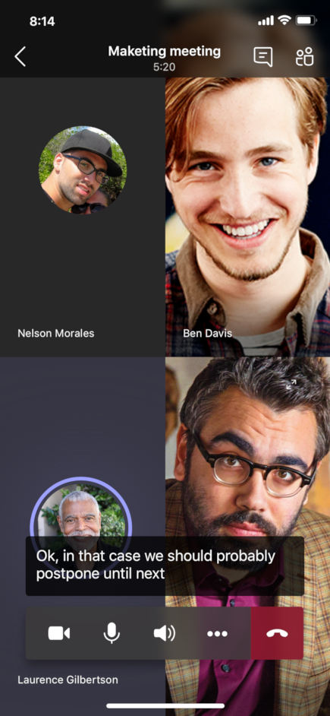
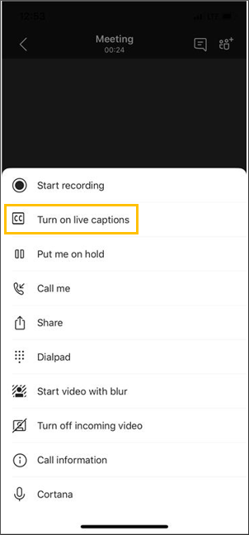
Integrated Accessibility Features
Live Closed Captions Cont.
Captions can likewise be enabled on mobile by in the meeting controls, select More Options > Turn on Live Captions
For the most accurate captions possible, try to follow these best practices:
  Speak clearly, slowly, and directly into the mic. As your distance from the mic increases, captions may become less accurate.
  Avoid locations with background noise.
  Avoid having multiple people speak at the same time.

Slide 25
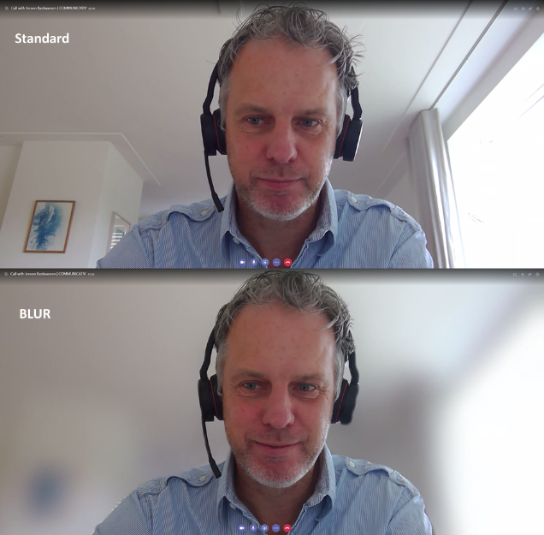
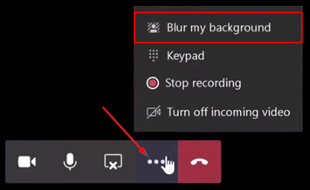
Integrated Accessibility Features
Meeting Options
Intelligent background blurring or set a static background photo.
Go to your meeting controls and select More action > Apply background effects.
Select Blur to blur your background or choose from the available images to replace it. To upload an image of your own, select Add new and pick a .JPG, .PNG, or .BMP file from your computer.
To turn off background effects, select .
Note: If you don't see this option in the menu, the feature might not be available on your device yet.

Slide 26
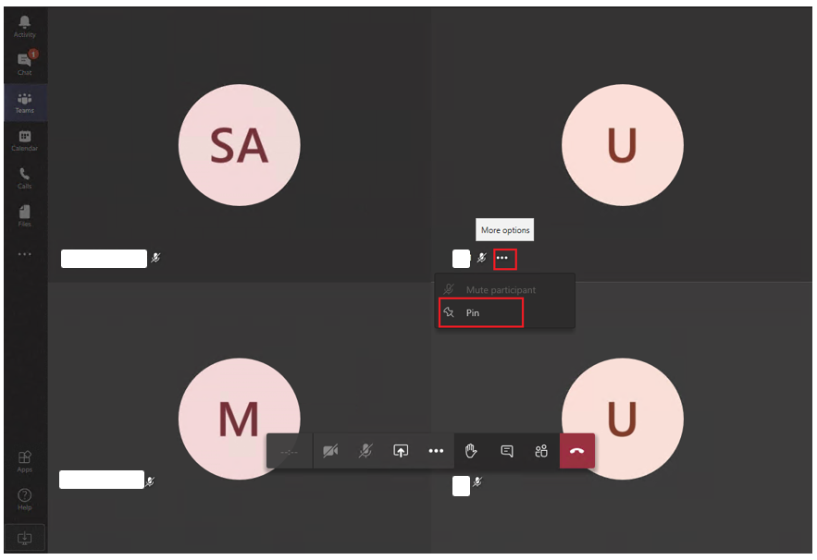
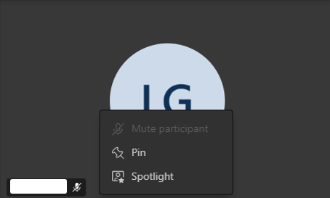
Integrated Accessibility Features
Meeting Options Cont.
Pining participants
Spotlighting participants
Background Noise Suppression
Note: This must be enabled by each participant in their settings.

Slide 27
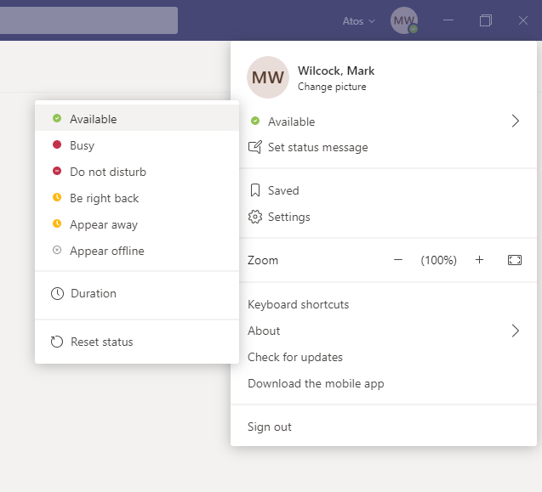
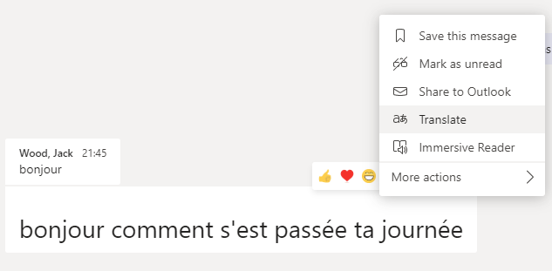
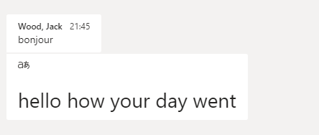
Integrated Accessibility Features
Chat Options
Activity Status
Limit distractions (with ‘Do Not Disturb’)
Language Translation
Translate 90+ languages without leaving Teams and keep the conversation flowing.
Note: The translation feature may need to be enabled by your IT administrator for Teams

Slide 28
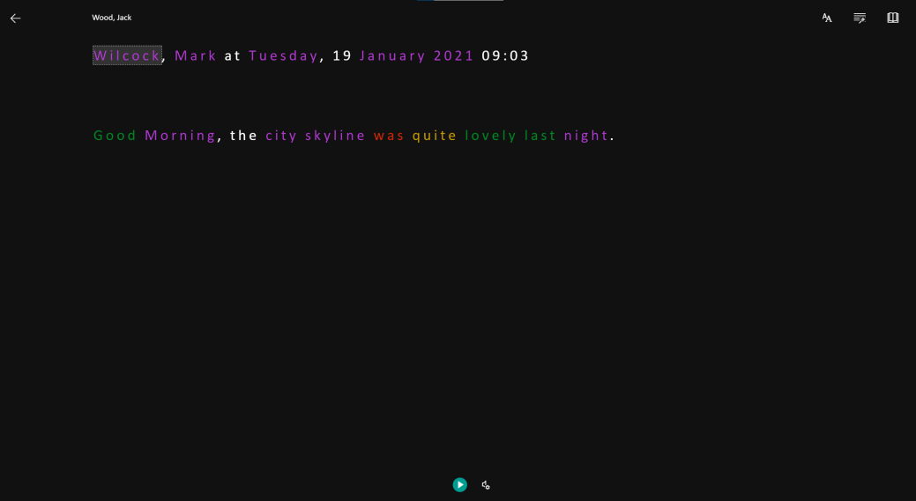
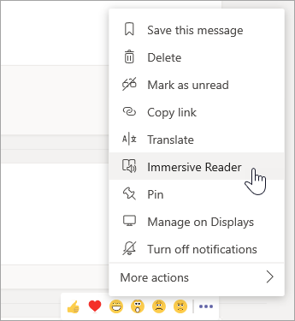

Integrated Accessibility Features
Immersive Reader
Hear posts, chat messages, and assignments read aloud using Immersive Reader.
Immersive Reader also includes grammar tools such as Parts of Speech and Picture Dictionary.
Open Immersive Reader from a message
Select More options
and then Immersive Reader

Slide 29
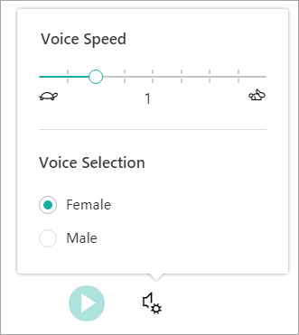
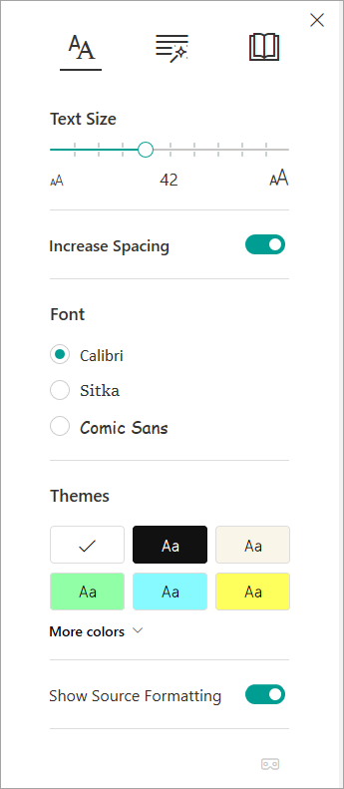
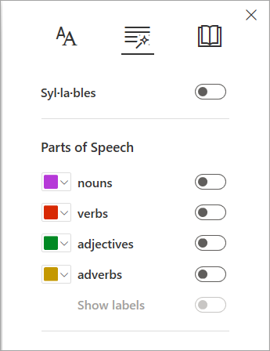
Integrated Accessibility Features
Immersive Reader Cont.
Listen
Have content read back with customisable settings.
Text Options
Text options can help you focus on your content and remove visual distraction.
Parts of Speech in Grammar Options
Highlight syllables, nouns, verbs, adjectives and adverbs.

Slide 30
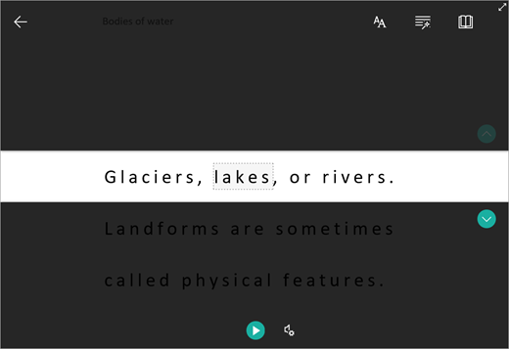

Integrated Accessibility Features
Immersive Reader Cont.
Line Focus
Concentrates your focus by highlighting: one, three or five lines.
Picture Dictionary
Provides a picture for a selected word that helps define that word.
Translate
Allows text to be translated in whole or each single word.

Slide 31
Integrated Accessibility Features
Zoom In/Out
Use your keyboard or mouse to make the Teams interface bigger or smaller, using the same familiar controls you might already be using with your browser.
Magnification from 60% to 200%
Note: High magnification will lead to a change in interface layout
Action | Windows | Mac
Zoom in | CTRL + = CTRL + (rotate mouse wheel up) | COMMAND + = Command+(rotate mouse wheel up)
Zoom out | CTRL + - CTRL + (rotate mouse wheel down) | COMMAND + - COMMAND + (rotate mouse wheel down)
Reset zoom | CTRL + 0 | COMMAND + 0

Slide 32
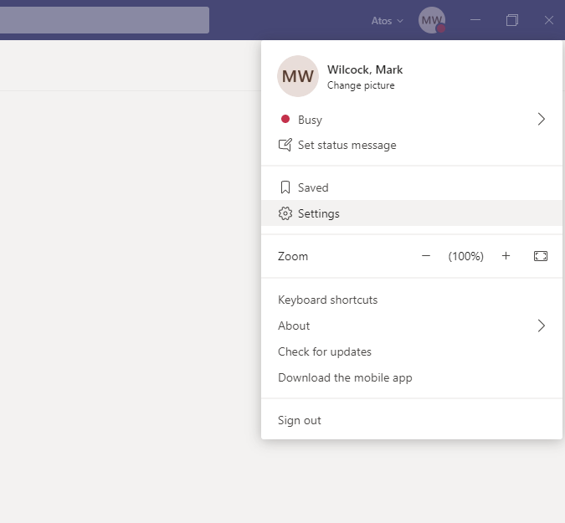
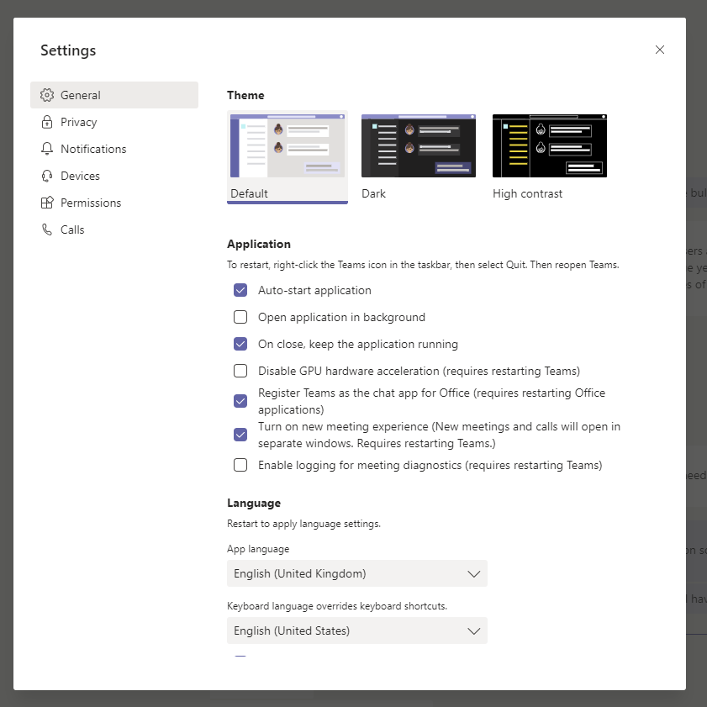
Integrated Accessibility Features
Colour Contrast/Modes
Teams provides the means to alter the colour settings between:
  Default Mode
  Dark Mode
  High Contrast Mode
Select your profile picture at the top of the app, then select Settings > General. In the Theme section, click High contrast. You can also select the Dark or Default theme.

Slide 33
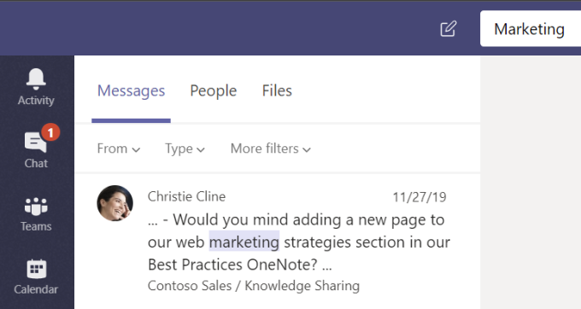
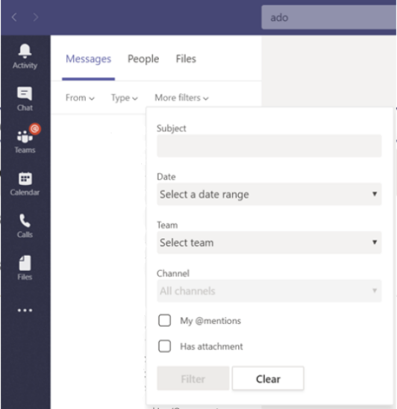
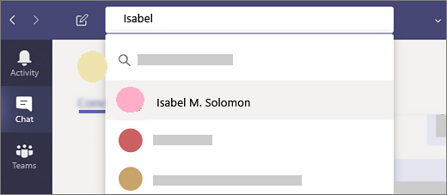
Integrated Accessibility Features
Enhanced Search
Enhanced search provides the function to search and filtering options to help you find messages, people, files, and other information shared in Teams.
Filter your results by location, date, team or more.

Slide 34
Integrated Accessibility Features
Keyboard Navigation
Keyboard shortcuts can be easier than using the touchscreen and are an essential alternative to using a mouse.
Teams provides specific shortcuts for a variety of scenarios including:
  General Shortcuts​
  Navigational Shortcuts​
  Messaging Shortcuts​
  Meeting and Call Shortcuts
Action | Desktop Shortcut | Web Shortcut
Show keyboard Shortcuts | CTRL + Period (.) | Ctrl+Period (.)
Go to Search | CTRL + E | CTRL + E
Start a new chat | CTRL + N | Left ALT + N
Open Settings | CTRL + Comma (,) | CTRL + Comma (,)
Open Help | F1 | CTRL + F1
Open Chat | CTRL + 2 | CTRL+ SHIFT + 2
Open Calls | CTRL + 5 | CTRL + SHIFT + 5
Go to compose box | ALT + SHIFT + C | ALT + SHIFT + C
Accept audio call | CTRL + SHIFT + S | CTRL + SHIFT + S
Decline call | CTRL + SHIFT + D | CTRL + SHIFT + D

Slide 35
Questions

Slide 36
Thank you
For more information please contact: mark.wilcock@atos.net

