Slide 1
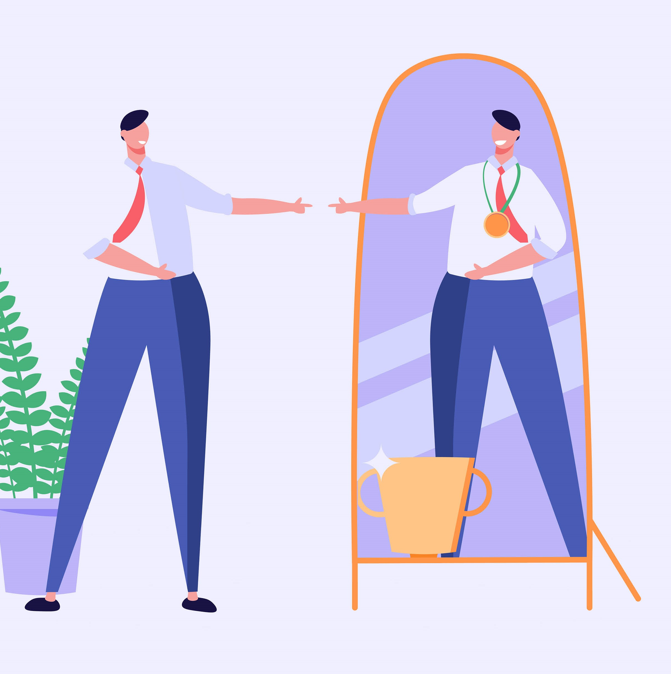
Create An Inner Ally
12 @ 12

Slide 2
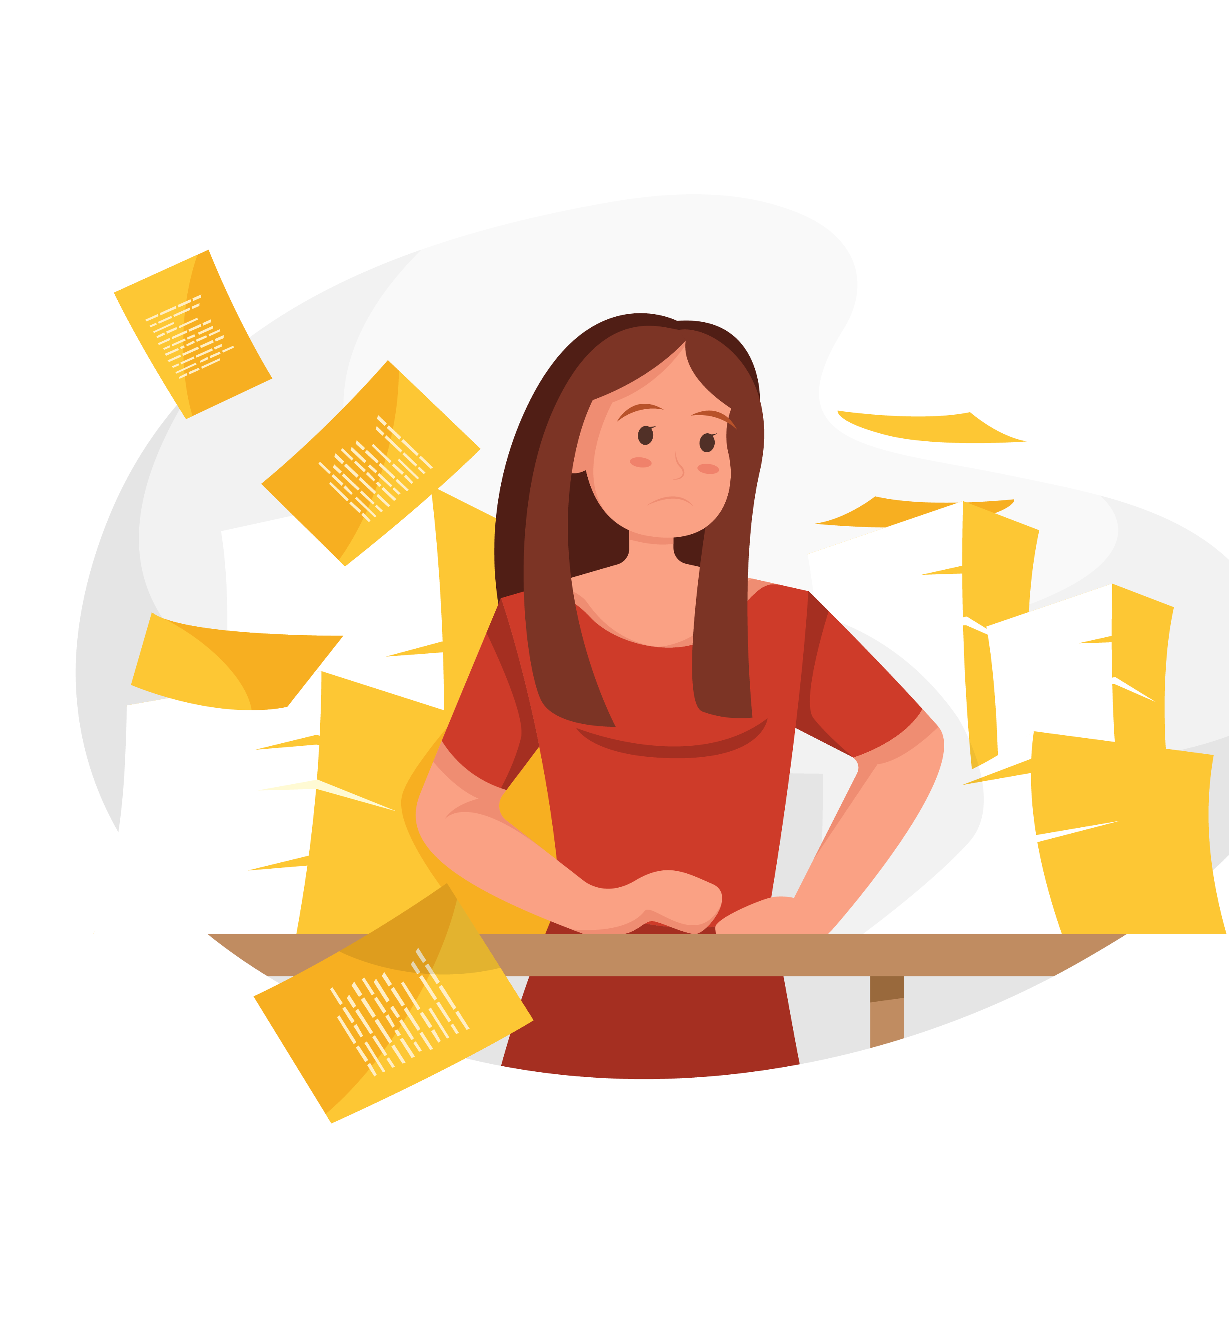
What do you say to yourself when you:
make mistakes
fall short of your expectations
mess up in some way ?

Slide 3
So why are we so mean to ourselves?
Does it work?
The Evidence says NO
We become afraid of our own self criticisms We avoid new challenges
So it has the opposite effect to what we wanted

Slide 4
“When we treat others with respect and caring, the best in them usually comes out.
Much the same would happen if we could treat ourselves in the same way.
Yet most of us are better friends to others than we are to ourselves.”
Rick Hanson

Slide 5
Self Compassion treating ourselves with the same kindness and care we ‘d give to a good friend or loved one Evidence it’s a powerful way - to cope with stress - boost wellbeing & resilience - avoid burnout

Slide 6
3 Steps to Self-compassion
Notice
Notice our self-criticisms in a balanced way – don’t ignore or exaggerate (mindful awareness & acceptance)
Remind
Remind ourselves it’s just part of being human. Rather than feel disconnected it connects us with others
Show
Show yourself some caring and unconditional acceptance. Say to yourself what you would say to a close friend or loved one.

Slide 7
Instead of mercilessly judging and criticizing yourself for various inadequacies or shortcomings, self-compassion means you are kind and understanding when confronted with personal failings – after all, who ever said you were supposed to be perfect?
Dr Kristin Neff

Slide 8
Want to find out more?
Kristin Neff
Self-compassion.org
Tara Brach
RAIN of Self-compassion

