Slide 1
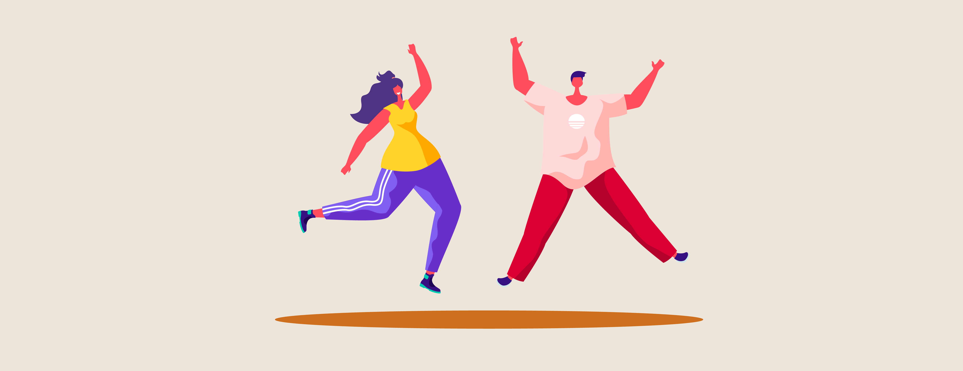
Jolts of Joy
12 @ 12

Slide 2
Do positive emotions just make us feel good?
See more possibilities
Better at solving problems
Think more quickly and creatively
Connect better with others
Builds our resilience
Creates upward spiral of wellbeing – emotional, social and physical

Slide 3
What are positive emotions?

Slide 4
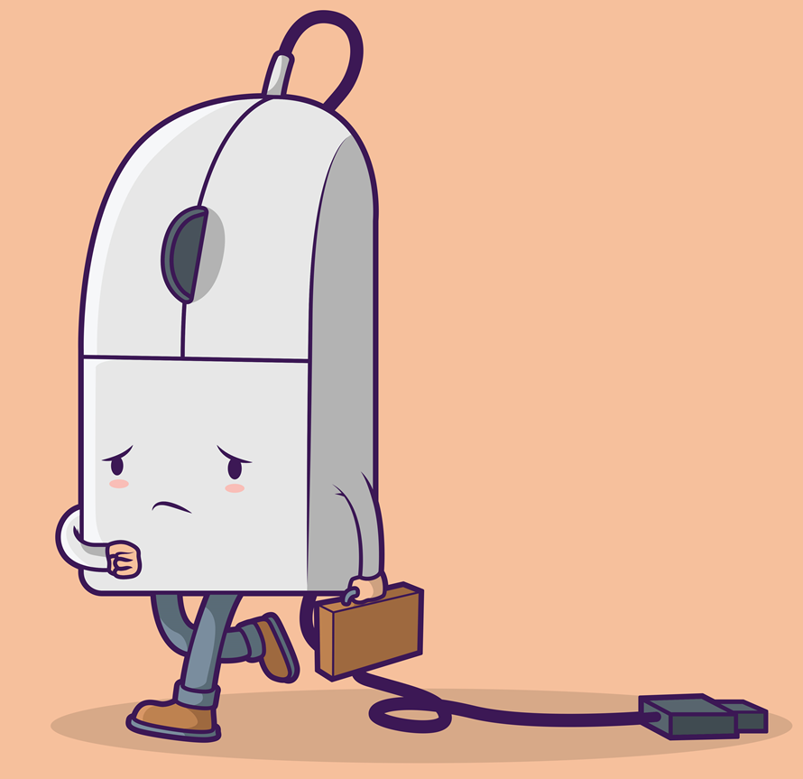
Too many negative emotions can create a downward spiral that
Reduces creativity and problem solving
Makes it harder to see the bigger picture
Less likely to ask for help when you need it
Reduces work performance
Strains our relationships

Slide 5
Jolts of Joy

Slide 6
What jolts of joy do you use now ?

Slide 7
You may want to try this
Write
Write down 5 jolts of joy you can quickly reach for when you need to inject some heartfelt positivity into your day.
Keep
Keep this list handy – on your desk, on your phone, or in your diary.
Reach
After you notice negativity narrowing in on your mood, reach for a jolt of joy and notice how your brain responds.

Slide 8
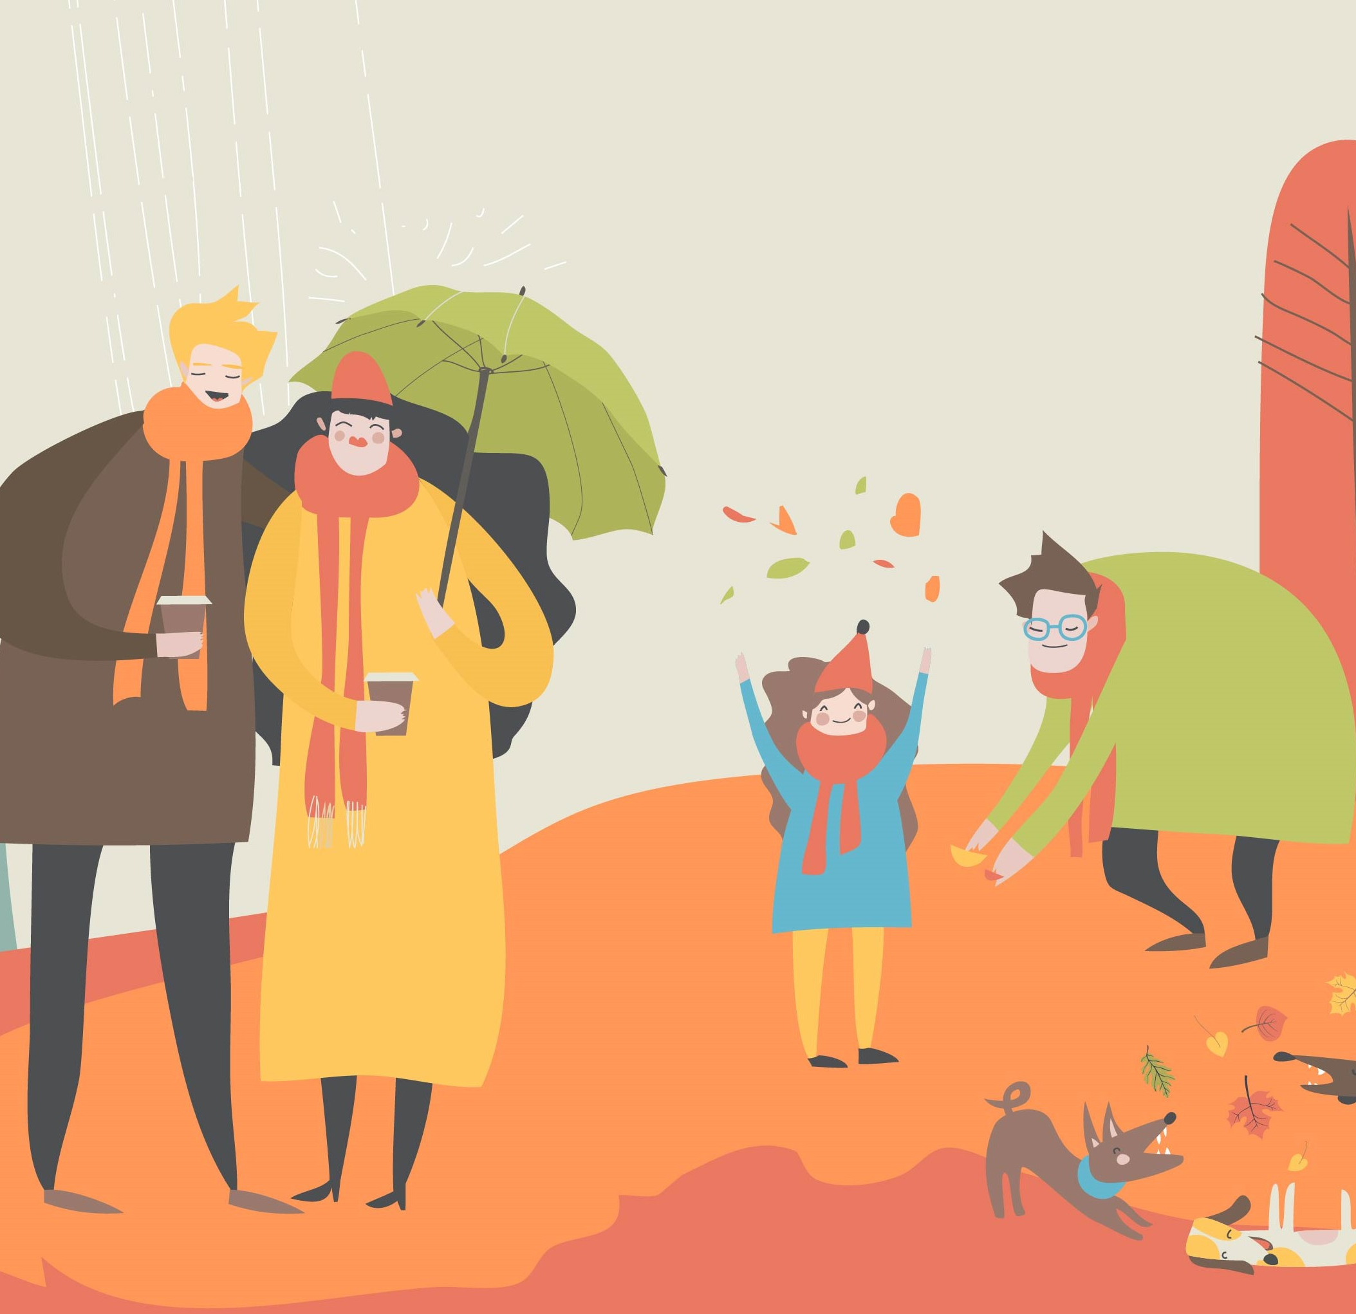
Or try Connecting with Nature
Find time each week to spend some time in nature
and/or
After you notice you’re feeling upset or really struggling take a few minutes to go outside into nature.
Sit in the garden, go for a bush walk, visit a park, watch the ocean waves, or take a few moments to notice a great sunset.
Allow yourself to be fully aware of your surroundings – what you can see, hear, smell and touch - and experience a sense of awe.
.

Slide 9
What can you do to bring some jolts of joy into your day?

