Slide 1
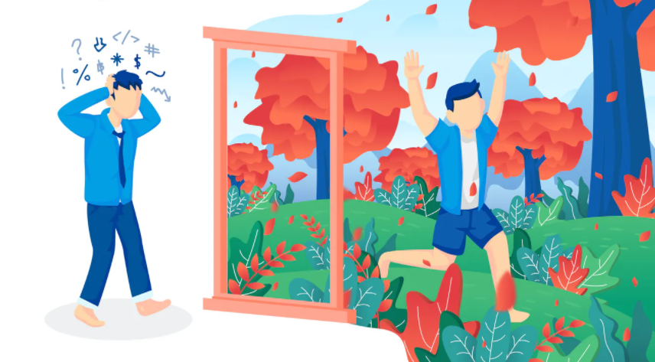
Rethinking Stress
12 @ 12

Slide 2
What messages do you hear about stress?
What do you say when you talk about stress?

Slide 3
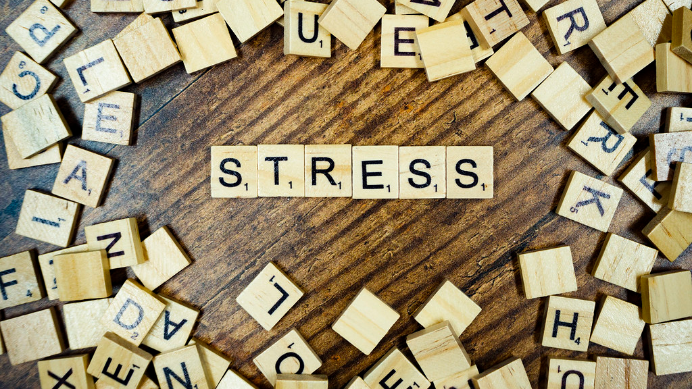

Slide 5
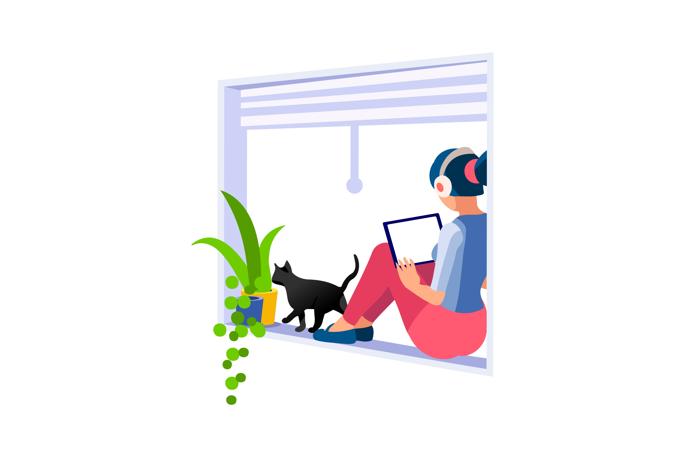
When you change your mind about stress your body changes too
Alia Crum

Slide 6
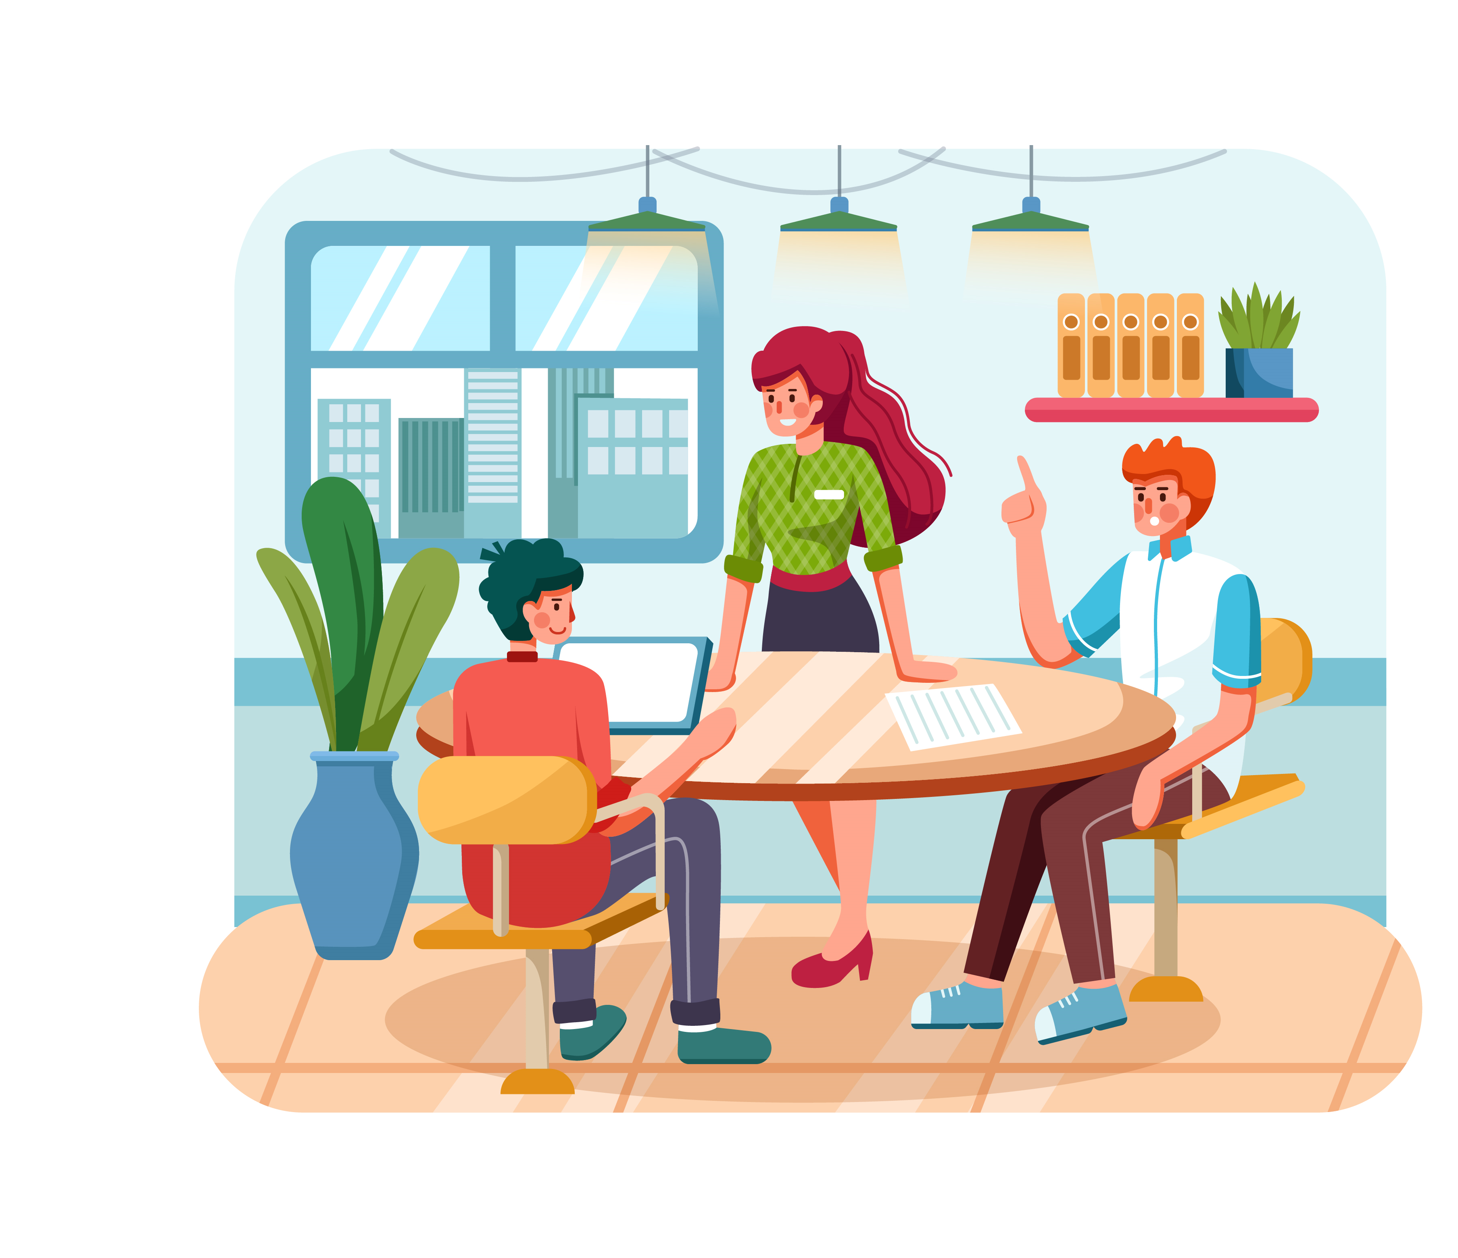
Your ‘heart is in it’.
Something important to you is at stake
Stress in enhancing your capacity to stand up and take action
Or reach out and ask for help
Courageous and/or connected

Slide 7
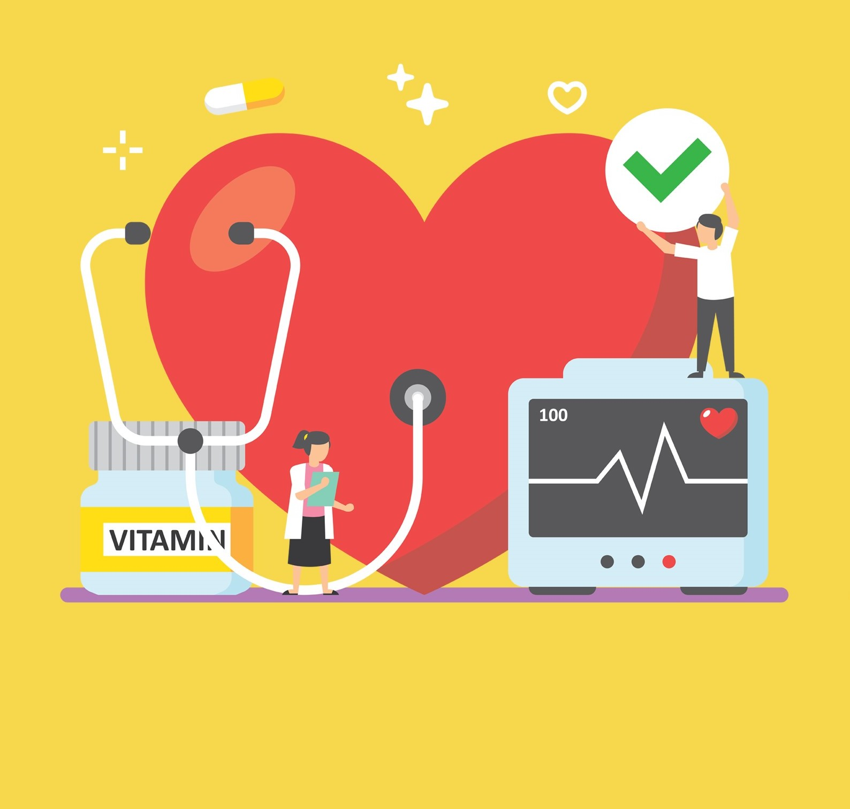
Rethinking our Body’s stress response
Helpful for performance
Biology of courage and joy
Oxytocin – cuddle hormone
Oxytocin protects & heals cardiovascular system

Slide 8
You may want to try this
Notice
Acknowledge your stress. Rather than saying “I am stressed” say “I am feeling stressed” or “I am noticing that I am feeling stressed right now.” See if you can find specific words to describe your stress.
Consider
What’s at stake and why does it matter to you? “I am stressed about this because I care about _______”.
Choose
How might you choose an enhancing mindset stress response? Can you choose courage or connection? What’s the opportunity to learn and grow from this?

Slide 9

Want to find out more?
Kelly McGonigal
TedTalk How to Make Stress Your Friend
Alia Crum
Stanford University free Rethinking Stress On-line Course

