Slide 1
Supporting people with disability to succeed in higher education: Results from a national survey of students
Associate Professor Tim Pitman
02 September 2020

Slide 2
About the survey
Online survey conducted between May and July 2020
Over 1,700 valid responses to survey
35 universities represented in the survey
Nationally, Students with Disability :

Slide 3
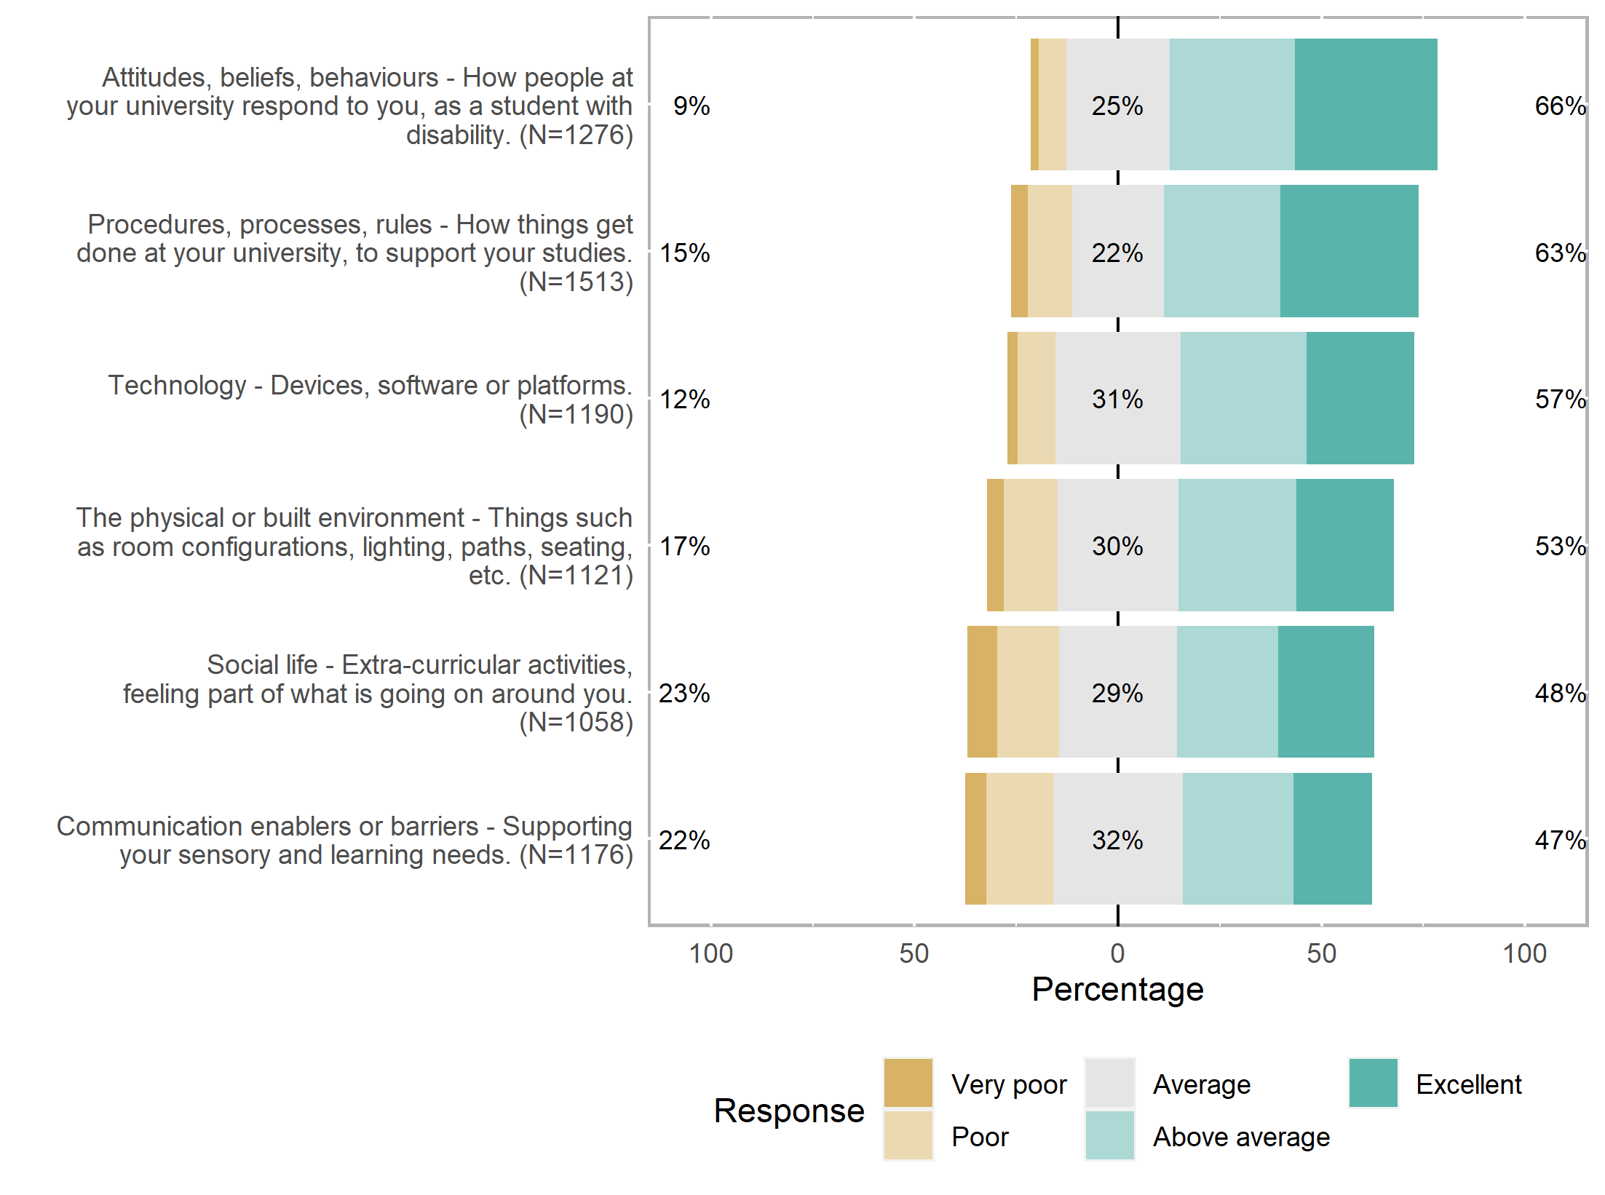
Satisfaction by type of support
Nationally, Students with Disability :

Slide 4
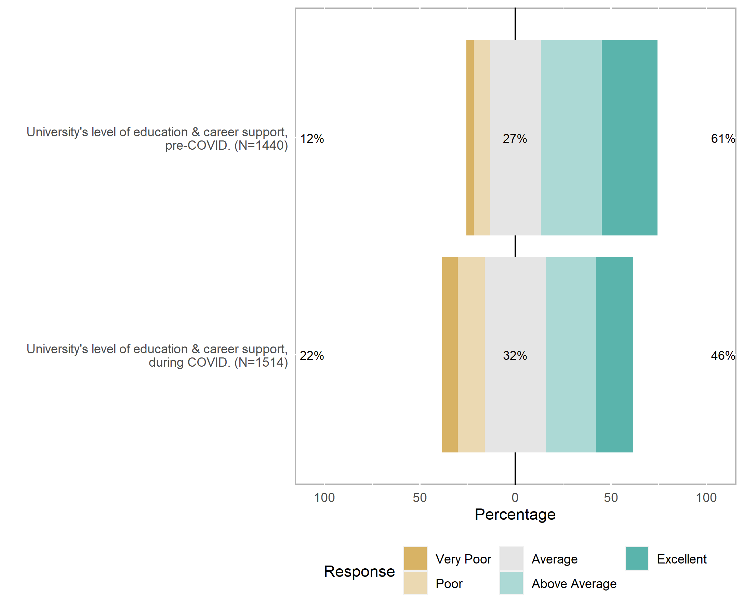
Overall satisfaction with support, before and after COVID-19
Nationally, Students with Disability :

Slide 5
What next?

Slide 6
Thank you
Website: ncsehe.edu.au
Email: ncsehe@curtin.edu.au
Twitter: @ncsehe
Facebook: @ncsehe

