Slide 1



Online Education Supports –
Deaf and Hard of Hearing Students
Cathy Easte, Manager Student Disability and Accessibility, Griffith University
Bobbie Blackson, Senior Disability Advisor, Deaf Student Support Program, Griffith University
Gary Kerridge, National Disability Coordination Officer, Region 24, South Eastern SA

Slide 2
Challenges
To provide equal access to platforms that are primarily auditory
To ensure inclusion, not just access to classes
New and many different platforms
Apprehension and anxiety of students and teaching staff
Technology limitations
Experience of students and staff with technology
Not all Deaf and Hard of Hearing student are the same
Institutions having to do more captioning, more student need
Students who do not need captioning in class need captioning online

Slide 3
Needs of Students
Access to Live classes – captioning / Interpreting / both
Access to recordings of classes for review
Access to all additional study materials – including videos and podcasts
Access to notetaking or transcripts to make notes from
Access to technology
Ability to use such technology and this may need training
Help with English Grammar – non penalties
Access to Academic staff (not by email/phone)
Needs may change from class to class

Slide 4

Technology
Access in different platforms
MS Teams
Blackboard Collaborate Ultra
Zoom
Echo360
YouTube
Commercial Videos
Older lecture recordings
Podcasts
Auto Captioning Apps (Live Scribe / MS Translator / Web captioner
VVT files and removing time codes – HappyScribe

Slide 5

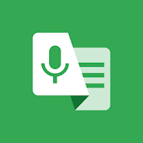
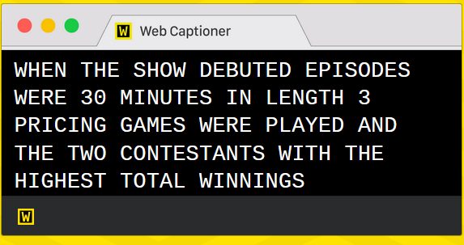

Free Auto Captioning Apps available
MS Translator LiveTranscribe
– Apple and Android - Andriod only
Web Captioner – browser based and limits with Mic input – still investigating this one
Otter Ai – 600 minutes free limit/ mth

Slide 6
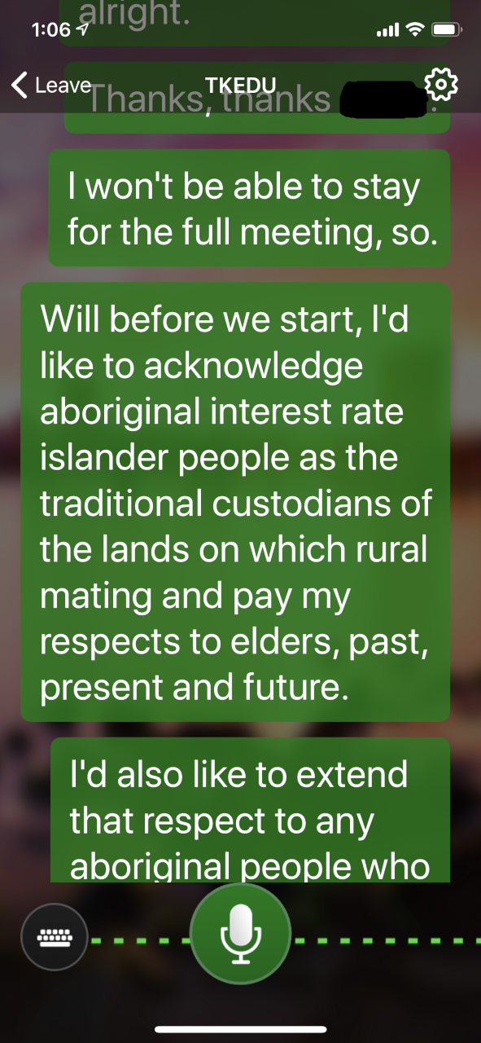
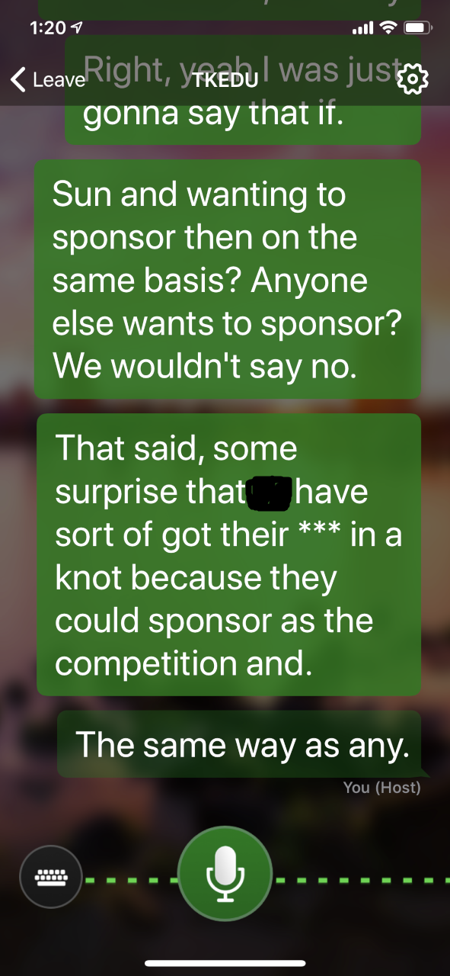
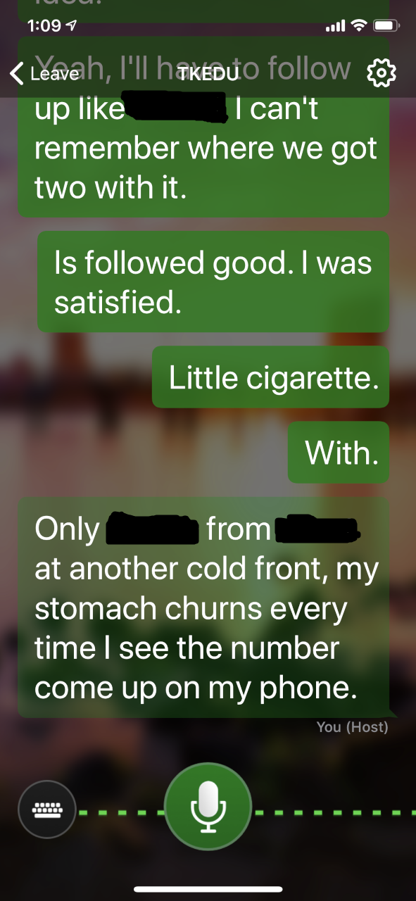
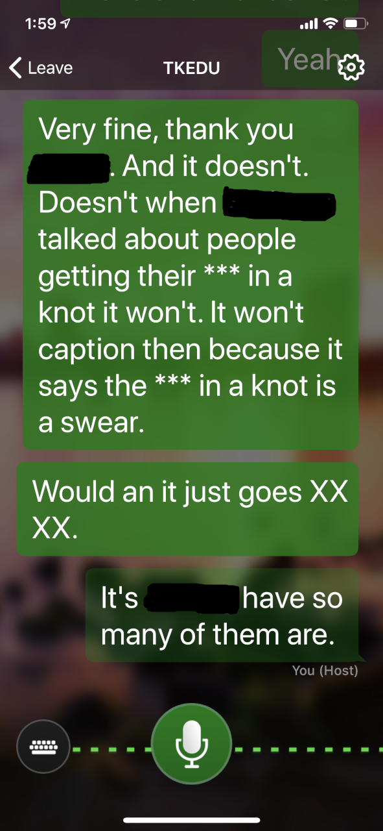
Auto Captioning – when it goes wrong

Slide 7
What Works with What
Will record with captions, Real-time Closed captioning
Will Record, Auto Captions only, Transcript editable in MS Stream
Live Lectures can be streamed to Captioning Service, Has ASR (automatic speech recognition interactive transcripts), Can upload any Video for Closed Captioning by Provider or Auto Captioning for transcript access
Will record with captions, Real-time Closed captions. No transcript available – even from Caption provider
Allows independence from platform – will affect lecture recordings and limited if number of students in live class on Blackboard
Zoom
MS Teams
Echo360/ ASR
Blackboard Cllaborate
External Caption Set Up 1CapApp (example)

Slide 8
Important Considerations
Creation of notes
Student Engagement
Access to platforms
Other students and learning needs in classes also
Number classes in a day and energy levels of student
Timing of Access
Microphone input – sound input affects caption /interpreting output
Teaching needs are different to meeting needs

Slide 9
Auslan interpreting for Online Platforms
Auslan is a 3D language. It makes use of space, size, handshapes and movements.
Communicating online flattens and forces Auslan into a 2D mode. Person often has to adjust by slowing down, and shift hands and body to different angles.
Auslan can be either simultaneous (e.g. Australian anthem) or consecutive (more common).
Interpreters on TV – more signing, less fingerspelling. Greater use of space – similar to theatrical interpreting. No interaction with audience.

Slide 10
Auslan interpreting for Online Platforms
If a word is fingerspelt, and is missed, this has an impact on comprehension. IRL, interpreter can be prompted to repeat that word. Online, more difficult to alert.
Vital that interpreter and deaf student can see each other clearly ←→ communication: engagement and participation in class.
Vital that interpreter has teaching content on hand to make sense of what they are hearing. Getting these beforehand is important.

Slide 11
Auslan interpreting for Online Platforms
Watching Auslan and captions/PowerPoint at the same time is very challenging.
Imagine reading German captions but listening to French. You get a bit of both, but not the whole of each. Brain cannot process two languages simultaneously. Must choose between one or other to get useful chunks of information.
For that reason, PowerPoint before or transcript after are valuable.

Slide 12
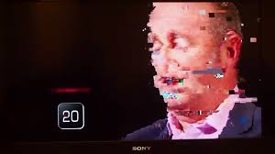
Auslan interpreting for Online Platforms
Freezing and/or pixelation are real issues.
Deaf student is already behind others as they are getting the information second hand through interpreter. Internet difficulties can add to this.
Adds to micro interruptions and impacts on processing.

Slide 13
Auslan Interpreting Tips for Online Platforms
TIPS
Test run with student, interpreter, academic beforehand
Sort out lighting and positioning in screen
Sort out camera, audio (if applicable) connectivity
Send weekly content to student, interpreter or interpreter coordinator beforehand
Set up a text back up – e.g. chat function in Teams or Zoom.

Slide 14
How Deaf and HOH Students are Impacted
Micro distractions
Knowing who is speaking
Contributing to discussions
Connectivity
Language issues
Anxiety

Slide 15
Tips for Students
Use a stand for phones or tablets
Use a separate captioning link (where possible)
Pin the interpreter
Use different link and device for interpreter (where possible)
Minimise distractions
Check audio
Check connectivity
Be aware of needs and prepare beforehand
Where possible prepare interpreters and captioners beforehand

Slide 16
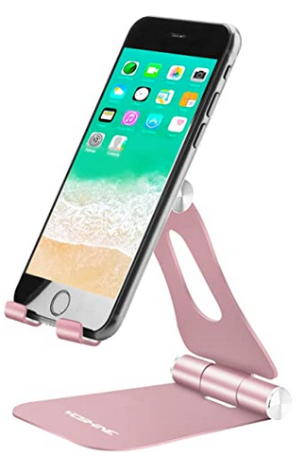
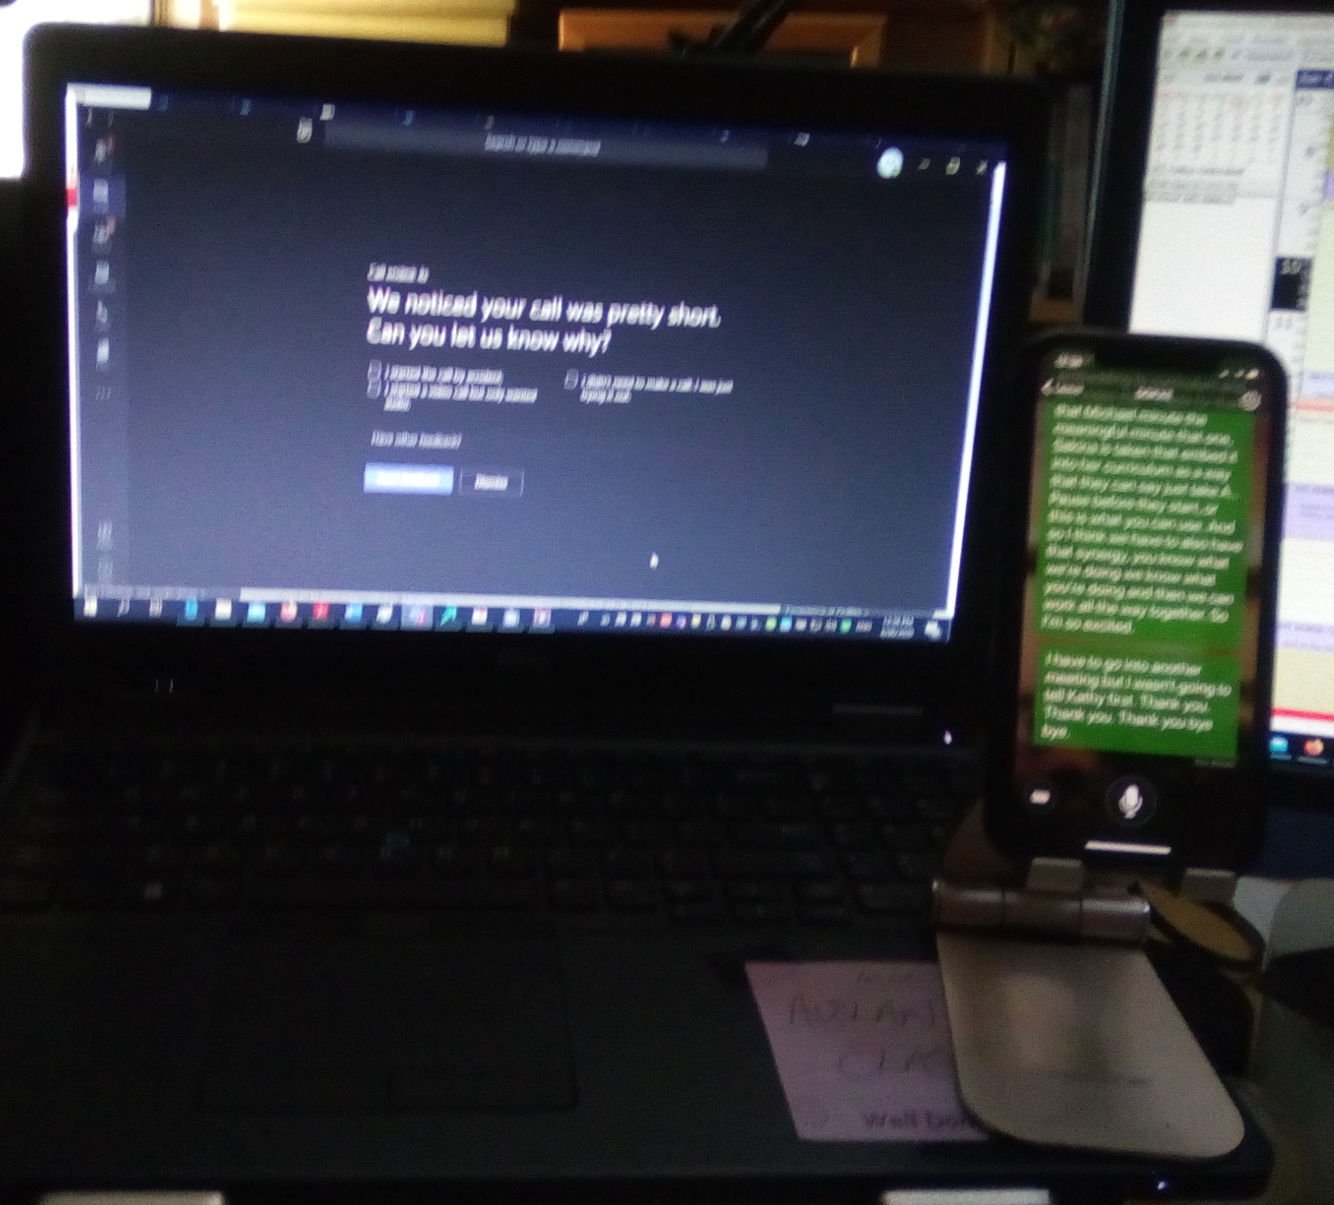
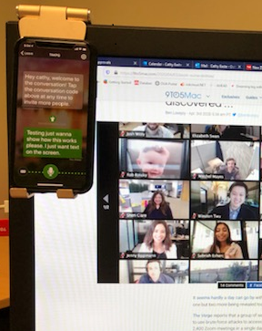
Phone/ Tablet Stands

Slide 17
Tips for Teachers/Lecturers
Be aware of needs and prepare beforehand
Record classes where possible to allow review
If possible, limit number participants that can be seen on a screen at one time
Establish protocols for chat, questions, discussions, muting mics to limit background noise
State name when talking (every person, every time)
Build in pauses – allows captions catch up, students to read and participate if desired
Make sure caption options are turned on – explain how do this
Provide PowerPoints ahead of class if possible
Invite students to talk about accessibility concerns
Start a continuing dialogue with your students – check in on needs regularly

Slide 18
Thank You
Cathy Easte, Manager Student Disability and Accessibility, Griffith University
    c.easte@griffith.edu.au
Bobbie Blackson, Senior Disability Advisor, Deaf Student Support Program, Griffith University
deafstudentsupportprogram@Griffith.edu.au
b.blackson@Griffith.edu.au
Gary Kerridge, National Disability Coordination Officer, Region 24, South Eastern SA
    Gary.Kerridge@NDCORegion24.com

