Slide 1



The 2020 vision for note taking
We’re using notes to improve learning!

Slide 2

Agenda
(Brief!) introduction to Sonocent
Discussion around note-taking and learning retention
Addressing the “Notetaker’s Dilemma”
Glean by Sonocent: Demonstration
Free Glean Access for 2020
An opportunity to design and implement a pilot study!
It’s great to have you here!

Slide 3
A brief Sonocent timeline
Over 13 years’ experience in helping institutions improve note-taking support.
2020
2014
2018
2019
2007
Glean
the 2020 vision
has arrived
Most frequently recommended AT software in UK
2015
500+ North American
colleges using Sonocent technology
BETA release of Sonocent’s web app -
Glean
Sonocent founded
Sonocent launched in North America

Slide 4
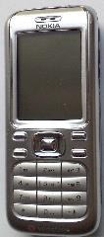
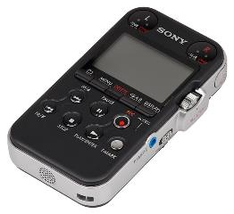

The year was 2005…

Slide 5
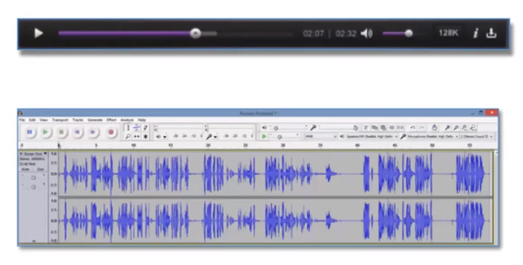

Information within audio recordings is not very accessible

Slide 6
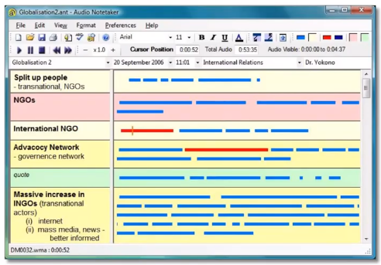
Accessible Audio is born
Navigation
Concentration
Annotation
Organisation

Slide 7
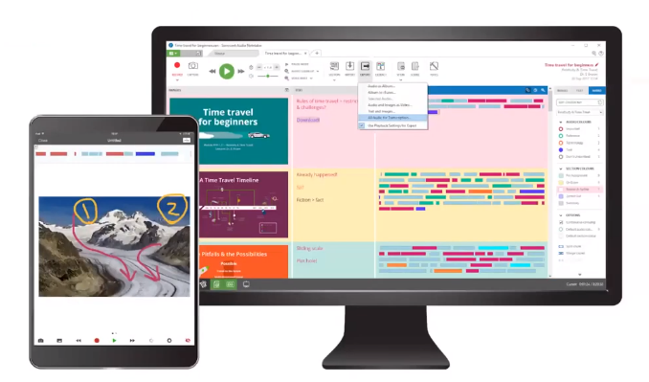

Slide 8
In the last 13 years Sonocent has learned a lot...
5,000+
Students
1,200+
Disability
Services
Professionals
500+
Studies & Research Papers

Slide 9



Providing note taking support is getting harder
Challenge to administer Dependence on others to learn | Unreliable quality Catering to different learning environments | Greater cost than value Poor notes impact learning

Slide 10

Over the years, 2 key things we have learned:
Note taking from spoken information is
frustrating
The role of note taking within the learning retention process

Slide 11
Note taking is frustrating
On average, students’ notes capture just
“incomplete”
35%
“not useful”
“messy”
of lecture
information*.
“stressful”
“distracting”
65% of information is going to waste
* Peverly, S. T., & Wolf, A. D. (2019), 'Note-taking' in The Cambridge Handbook of Cognition and Education, (pp. 320–355).

Slide 12
Incomplete notes lead to poor grades
Reviewing and re-purposing notes is an integral part of the learning retention process….
“… accurate and complete notes are critical for students to be successful in content area classes.” *
* Boyle, J.R. (2019),

Slide 13
Improve note taking - and attainment
89%
of students using Sonocent Audio Notetaker at
George Mason University saw an improvement
in their grades.

Slide 14

The continued need for note taking
Passive learning is not effective
Sustained concentration is challenging - especially when viewing online content
Creating good notes is a scaffolded learning process
Accessing content is not the same as learning from content
49%
of students take notes with online content
Only
20%
of content is recalled without notes*
*Kayla Morehead et al, ‘Note taking habits of 21st Century college students: implications for student learning, memory, and achievement’ in Memory (2019)

Slide 15
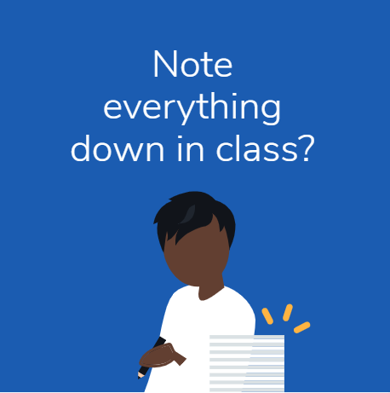

Team Write
Team Listen
Notes:
Note taking implicitly involves task switching, regardless of whether we’re taking notes from in-person or online learning. We generally call it the notetaker’s dilemma.
During class, this student doesn’t want to miss getting anything down in their notes.
But that means that they miss out on asking questions and participating fully in class.
On the other hand, to engage and fully listen in class this student finds taking notes too distracting.
But after class they haven’t got comprehensive notes to return to and synthesise for their learning.
It’s difficult to do both.
This is why students tell us:
“I can't focus on what is being said while I am writing.”
“I struggle to keep up / to write down enough detail before the lecturer moves on.”
Because the act of taking notes distracts us from fully engaging with and understanding the content, and important information gets missed.
I think this is something we can all relate to, but which is going to be even more pronounced for students with any additional barriers to class note-taking.
Studies have found that 95% of students with a LD / dyslexia struggle with note-taking: more than any other academic requirement. It’s an frustratingly common problem.

Slide 16

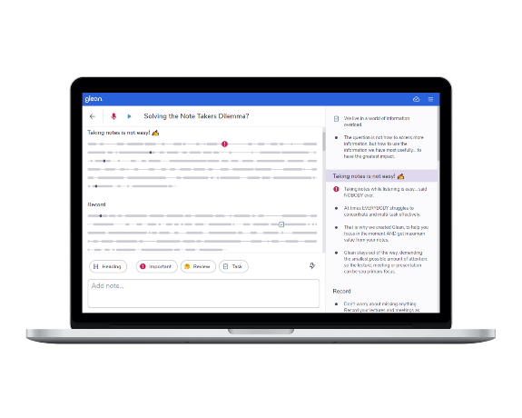
So we designed
Glean.
Yay!

Slide 17
The Glean Vision
Nurture note taking skills through technology
Improve learning outcomes
Increase adoption of useful technology
We’re using notes to improve learning!

Slide 18
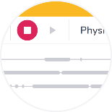
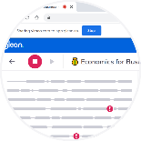
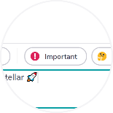
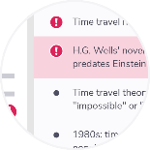
Put an emphasis on note taking
Capture everything Combine audio, slides, and your own text notes in one place | Learn online or in person Take valuable notes from a professor speaking in class or on video | React in real-time Focus on active listening by highlighting moments with Quick Labels | Review at your own pace Come back and review whenever you need to (it works offline too)

Slide 19

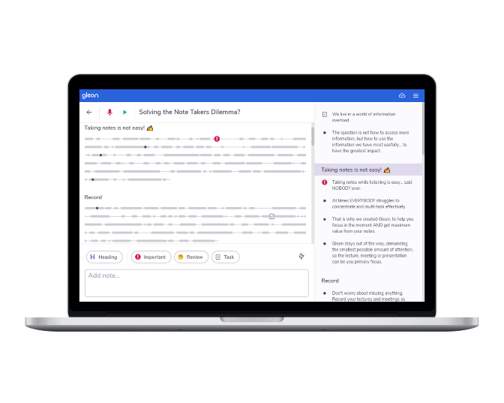
Let’s take a look at Glean
You can use Glean with Windows, Mac and Chrome!

Slide 20
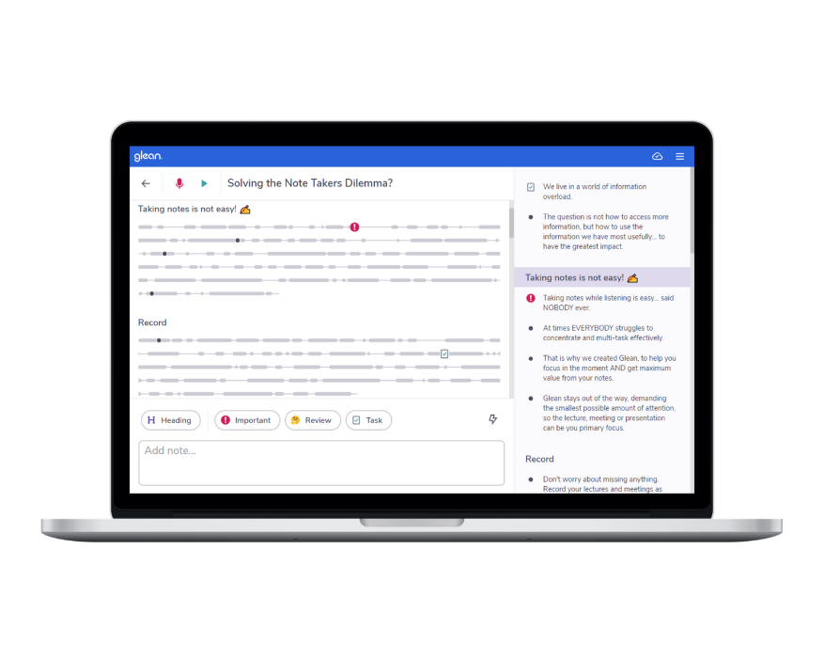

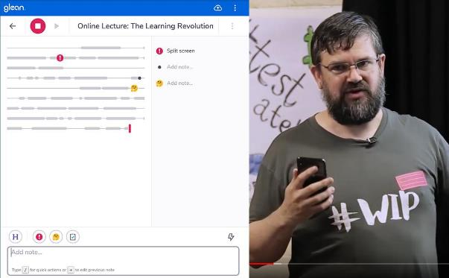
Note taking is important in our process of studying from new information

Slide 21
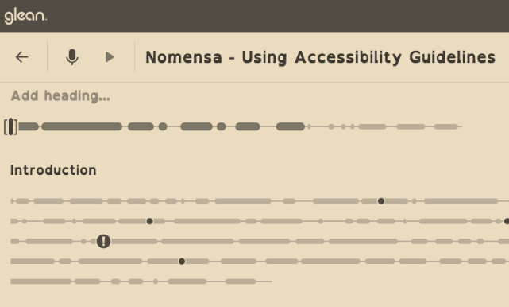
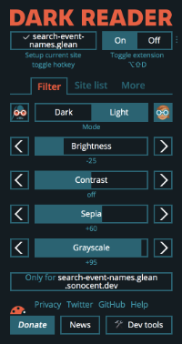
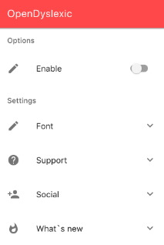

Slide 22
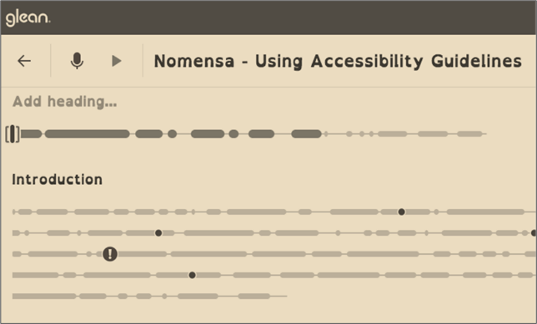
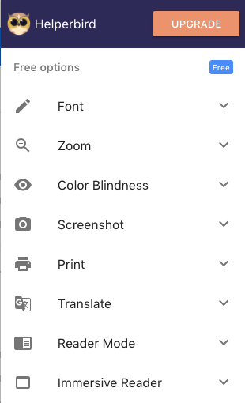


Slide 23

🎯 Distraction-free note taking
Glean helps users engage fully in the moment:
Clean, simple interface.
Demands the smallest possible
amount of attention.
Ensures the content, not the tool, is the focus.

Slide 24

v
“Glean solves my ‘forever’ problem - having a rapid way of taking notes. Because it’s so quick, I don’t lose track of what’s going on”.
William
Glean BETA user
Design for Industry Student
Northumbria University, UK.

Slide 25
🎯 Accessible & intuitive to use
Accessible design:
  Accessibility built in from the ground up.
  Intuitive user experience.
  Minimal learning curve.
Accessible platform:
  Web-based: works on Chromebooks / laptops.
  Works both online and offline.
  Backed up in the cloud: access any time, anywhere.

Slide 26
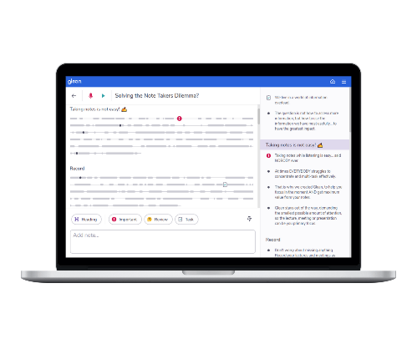
Take great notes with Glean
Get unlimited free access to Glean for your students until December 31st
Request access
https://glean.sonocent.com/free-access-anz/

Slide 27
Any questions?
Mobile apps
Screenreader compatible
Privacy & security
Will it replace
Audio Notetaker?
How much
cloud storage?
Transcription
Thank you!

