Slide 1
Transition to higher education for students on the autism spectrum
Alison Nuske
PhD Candidate
College of Nursing and Health Sciences
Flinders University
Supervisors
Dr. Fiona Rillotta College of Nursing and Health Sciences Flinders University | Assoc. Prof. Michelle Bellon College of Nursing and Health Sciences Flinders University | Professor Amanda Richdale Olga Tennison Autism Research Centre School of Psychology & Public Health La Trobe University

Slide 2
Reference
Nuske, A., Rillotta, F., Bellon, M., & Richdale, A. (2019). Transition to higher education for students with autism: A systematic literature review. Journal of Diversity in Higher Education. 12(3). 280-295. doi: 10.1037/dhe0000108

Slide 3
A note on language and terminology

Slide 4
Background
Increasing prevalence of ASD (Baio, 2018)
Increasing number of students on the autism spectrum enrolling in higher education (Mulder & Cashin, 2014)
Transition to higher education is a complex process
Adult learning environment
Requires students to self-disclose and advocate for themselves
First year of university = increased risk for student attrition or failure (Bell et al., 2017)

Slide 5
Review question
What are the experiences of individuals with autism and/or their family members regarding transition to higher education?

Slide 6
The literature review
Databases searched: Medline, CINAHL, ProQuest (articles only), PsycINFO, Scopus, and Informit.
Keywords: Autism spectrum disorder OR Asperger; higher education OR further education OR tertiary education OR postsecondary education OR university OR college; transition.

Slide 7
11 articles for review
United States = 4
Sweden = 2
United Kingdom = 2
Australia = 1
Belgium = 1
Republic of Ireland = 1

Slide 8
Articles (1-6)
Alverson, C. Y., Lindstrom, L. E., & Hirano, K. A. (2015). High school to college: Transition experiences of young adults with autism. Focus on Autism and Other Developmental Disabilities, 1-13. doi:10.1177/1088357615611880
Anderson, C., & Butt, C. (2017). Young adults on the autism spectrum at college: Successes and stumbling blocks. Journal of Autism and Developmental Disorders, 47(10), 3029-3039. doi:10.1007/s1080
Baric, V. B., Hemmingsson, H., Hellberg, K., & Kjellberg, A. (2017). The occupational transition process to upper secondary school, further education and/or work in Sweden: As described by young adults with Asperger syndrome and attention deficit hyperactivity disorder. Journal of Autism and Developmental Disorders, 47, 667-679. doi:10.1007/s10803-016-2986-z
Bell, S., Devecchi, C., Mc Guckin, C., & Shevlin, M. (2017). Making the transition to post-secondary education: Opportunities and challenges experienced by students with ASD in the republic of Ireland. European Journal of Special Needs Education, 32(1), 54-70. doi:10.1080/08856257.2016.1254972
Cai, R. Y., & Richdale, A. L. (2016). Educational experiences and needs of higher education students with autism spectrum disorder. Journal of Autism and Developmental Disorders, 46(1), 31-41. doi:10.1007/s10803-015-2535-1
Dymond, S. K., Meadan, H., & Pickens, J. L. (2017). Postsecondary education and students with autism spectrum disorders: Experiences of parents and university personnel. Journal of Developmental and Physical Disabilities, 29(5), 809-825. doi:10.1007/s10882-017-9558-9

Slide 9
Articles (7-11)
Madriaga, M., & Goodley, D. (2010). Moving beyond the minimum: Socially just pedagogies and Asperger’s syndrome in UK higher education. International Journal of Inclusive Education, 14(2), 115-131. doi:10.1080/13603110802504168
Mitchell, W., & Beresford, B. (2014). Young people with high‐functioning autism and Asperger's syndrome planning for and anticipating the move to college: What supports a positive transition? British Journal of Special Education, 41(2), 151-171. doi:10.1111/1467-8578.12064
Peña, E. V., & Kocur, J. (2013). Parents' experiences in the transition of students with autism spectrum disorders to community college. Journal of Applied Research in the Community College, 20(2), 25-32. Retrieved from http://works.bepress.com/edlyn_pena/11/
Simmeborn Fleischer, A. (2012). Support to students with Asperger syndrome in higher education—the perspectives of three relatives and three coordinators. International Journal of Rehabilitation Research, 35(1), 54-61. doi:10.1097/MRR.0b013e32834f4d3b
Van Hees, V., Moyson, T., & Roeyers, H. (2015). Higher education experiences of students with autism spectrum disorder: Challenges, benefits and support needs. Journal of Autism and Developmental Disorders, 45(6), 1673-1688. doi:10.1007/s10803-014-2324-2

Slide 10
Bioecological theory model

Slide 11
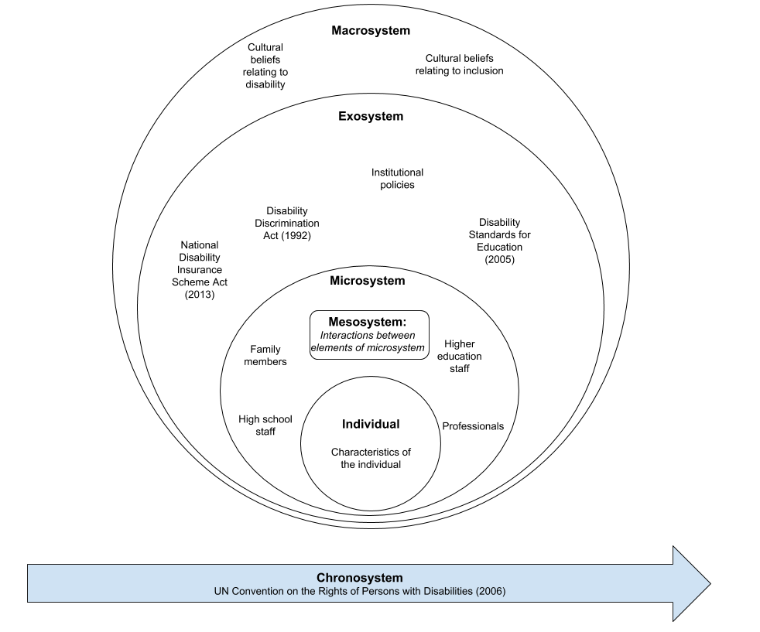
Individual

Slide 12
Challenges associated with the characteristics of ASD ^{(4, 5, 6, 8, 10, 11)}
Social communication difficulties
Sensory processing difficulties
Need for structure and routine
Difficulties with planning, time management
Independent living skills

Slide 13
Strengths ⁽¹¹⁾
Strong memory
Dedication
Focus
Eye for detail

Slide 14
Self awareness and Disclosure ^{(1, 5, 6, 9, 11)}
Self-awareness can vary (may not identify that they need assistance)
Delay in disclosing/seeking assistance
Doubts about disclosure
Wanting to “fit in”
Deficits in self-determination skills

Slide 15
Mental health and wellbeing ^{(2, 3, 5, 8, 11)}
Increased stress and anxiety
Stress and anxiety can be improved by timely support and early preparation and planning

Slide 16
Support

Slide 17
Family support (1, 2, 3, 4, 5, 6, 7, 8, 9, 10, 11)
Emotional and psychosocial support
Often take on active role in disclosure or initiating access to support services

Slide 18
Professional support ^{(4, 5, 8, 9)}
Support
Help with planning, providing information
Need knowledge and understanding of ASD
Honest, reliable. Provide clear and easy to understanding information

Slide 19
Support and Collaboration

Slide 20
Collaboration ^{(1, 2, 3, 5, 6, 10)}
Transition should be a collaborative effort
Pre-planning from school years
Challenges to collaboration ^{(5, 6, 9)}
Awareness of rights and responsibilities as outlined in relevant legislation
Privacy legislation
Adult learning environment

Slide 21
Important considerations
Early access to services and accommodations
Delay in disclosure/disclosing
Role of family support
Impact of privacy legislation and “adult learning environment” expectations
Staff knowledge and understanding of autism spectrum disorders
Individualised planning

Slide 22
The current study
Research question: What are the facilitators and barriers to transition to university for individuals on the autism spectrum?

Slide 23
What the current study hopes to achieve
Understand the experiences of students on the autism spectrum and their family members during transition
Examine the experiences, understanding and knowledge of university staff.
Evidence-base to ensure the development of best practice
Inform recommendations for training and staff development

Slide 24
Inclusive research practices
Input on research tools → advisory group
Autism CRC’s Inclusive Research Practice Guides and Checklists for Autism Research
Available at: https://www.autismcrc.com.au/knowledge-centre/resource/inclusive-research

Slide 25
Advisory group
Feedback on
interview questions, planned methodology, terminology
decisions regarding changes in direction for the study
Expected involvement of a maximum of one or two hours a month on an ad-hoc basis (via email, phone, face-to-face)
Role is voluntary
Input to be acknowledged in final thesis and in there may be opportunities to contribute to peer-reviewed journal articles

Slide 26
Components of the study
Phase one: an online survey + case studies
Phase two: focus groups (online and face-to-face)
This research project has been approved by the Flinders University Social and Behavioural Research Ethics Committee (Project Number: 8242). For more information regarding ethical approval of the project only, the Executive Officer of the Committee can be contacted by telephone on (08) 8201 3116, by fax on (08) 8201 2035, or by email to human.researchethics@flinders.edu.au

Slide 27
Online survey
Students on the autism spectrum who have completed at least one semester (6 months) of undergraduate study at an Australian university
Family members of students who have completed at least one semester (6 months) of undergraduate study at an Australian university who provided support during the transition period or first year of university
University staff members who have had interactions with students on the autism spectrum

Slide 28
Further information
On the ADCET news page
Available at: https://www.adcet.edu.au/resource/10077/students-on-the-autism-spectrum-seeking-experiences-of-transition-to-university/

Slide 29
Results and findings
A summary of the results will be shared on the Transition to University for students on the autism spectrum Facebook page.
Available at: https://www.facebook.com/AutismTransition2Uni/
We will also look to present our findings at conferences and webinars beginning in late 2020.

Slide 30
Contact Alison Nuske for more information: alison.nuske@flinders.edu.au

