Slide 1
Supporting students with disability during and beyond higher education
Associate Professor Tim Pitman and Mr David Eckstein

Slide 2
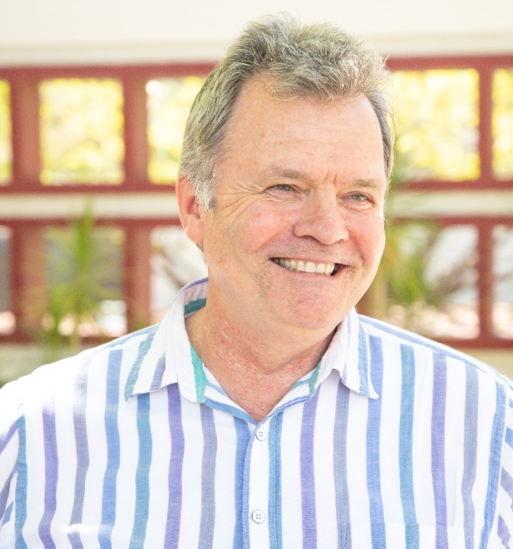
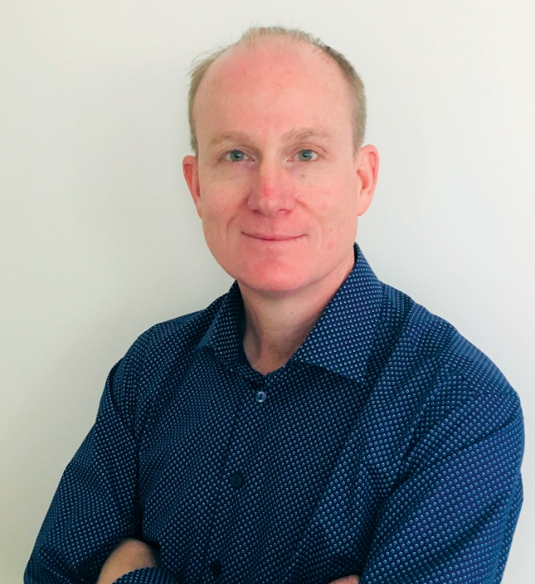
2020 NCSEHE Equity Fellows
Mr David Eckstein
Associate Professor Tim Pitman
Swinburne University
Curtin University
Meaningful jobs for graduates with disability:
From luck to business as usual
Supporting people with disability from regional,
rural and remote Australia, to succeed in higher education

Slide 3
Before we start…
The creation of categories is part of a process of the identification of the self.
Sometimes categorisation is done by the individual.
Sometimes it is done by a group.
Sometimes it is done by society as a whole.
Sometimes it is helpful, at other times it hinders.

Slide 4
Changes in categories over time
Category | Rate in 1992 (as defined by Disability Support Officers) | Rate in 2017 (As defined by the students themselves)
Hearing | 10% | 7%
Learning | 23% | 15%
Mobility | 20% | 8%
Vision | 11% | 11%
Medical | 12% | 41%
Other | 4% | 45%
Sources: Andrews, R. J. and J. Smith (1992) & Department of Education and Training (2019).
Question: are these categories the ones we should be using?

Slide 5
“If we are required to report, count, are funded, and held accountable for something, it starts to matter a lot. It encourages institutions to put in place mechanisms that are accessible, for champions to raise the issue and push for further development within institutions, and for students to push for its greater implementation.”
Wheelahan, L., et al. (2003).

Slide 6
Australian Higher Education Participation for PwD: 2009 - 2018
80,000
70,000
70,143
65,646
60,000
61,072
57,154
50,000
52,418
47,980
43,732
40,000
39,798
36,966
30,000
32,658
20,000
10,000
0
2009
2010
2011
2012
2013
2014
2015
2016
2017
2018
Source: https://docs.education.gov.au/node/53030

Slide 7
Australian Higher Education Retention of Students with Disability (after 1st year)
National retention rate Retention rate for students with disability
Source: https://docs.education.gov.au/node/53030

Slide 8
Completion rate after 9 years (2005 Bachelor cohort)
Source: Department of Education (2014).

Slide 9
The cumulative effect of disadvantage
Source: Department of Education, Skills & Training, 2014
Question: What are some of the particular issues faced by students with disability, from regional Australia?

Slide 10
Preparing Students with Disability to get meaningful work after graduation
Nationally, Students with Disability:
Are 7% more likely to be out of work
Are 6% more likely to be in work that does not use their skills or education
Account for 2% of students in employer graduate programs
Question: In your opinion, what is the biggest barrier to Students with Disability getting meaningful work?
Nationally, Students with Disability :

Slide 11
Preparing Students with Disability to get meaningful work after graduation
Tailored interventions help (Kilpatrick et al, 2015)
Poll
Does your university/TAFE/school run programs to help Students with Disability get meaningful work?
Open questions
What kinds of programs are run?
What kinds of programs would you like to see being run?
What prevents universities from providing (more) programs?

Slide 12
Preparing Students with Disability to get meaningful work after graduation (continued)
Poll
In your experience, what’s the best source of careers information for Students with Disability?

Slide 13
National consultation
National student survey
National staff survey
Roundtable discussions
REGISTER YOUR INTEREST IN TAKING PART
RESULTS
Open access tools and guidelines for all universities to use
Inaugural national summit for universities to:
Share information
Generate institution-specific strategies and plans

Slide 14
Thank you
Website: ncsehe.edu.au
Email: ncsehe@curtin.edu.au
Twitter: @ncsehe
Facebook: @ncsehe

