Slide 1
Disability, higher education and e-learning: Moving beyond accessible web design
Katie Ellis, Director, Centre for Culture & Technology, Curtin University
Mike Kent, School of Media, Creative Arts and Social Inquiry
Tim Pitman, National Centre for Student Equity in Higher Education Equity Fellow at Curtin University

Slide 2
Before we start…
The creation of categories is part of a process of the identification of the self.
Sometimes categorisation is done by the individual.
Sometimes it is done by a group.
Sometimes it is done by society as a whole.
Sometimes it is helpful, at other times it hinders.

Slide 3
“If we are required to report, count, are funded, and held accountable for something, it starts to matter a lot. It encourages institutions to put in place mechanisms that are accessible, for champions to raise the issue and push for further development within institutions, and for students to push for its greater implementation.”
Wheelahan, L., et al. (2003).

Slide 4
Changes in categories over time
Category | Rate in 1992 (as defined by Disability Support Officers) | Rate in 2017 (As defined by the students themselves)
Hearing | 10% | 7%
Learning | 23% | 15%
Mobility | 20% | 8%
Vision | 11% | 11%
Medical | 12% | 41%
Other | 4% | 45%
Sources: Andrews, R. J. and J. Smith (1992) & Department of Education and Training (2019).

Slide 5
Australian Higher Education Participation for PwD: 2009 - 2018
80,000
70,000
70,143
65,646
60,000
61,072
57,154
50,000
52,418
47,980
43,732
40,000
39,798
36,966
30,000
32,658
20,000
10,000
0
2009
2010
2011
2012
2013
2014
2015
2016
2017
2018
Source: https://docs.education.gov.au/node/53030
Source: https://docs.education.gov.au/node/53030

Slide 6
Australian Higher Education Retention of Students with Disability (after 1st year)
Source: https://docs.education.gov.au/node/53030

Slide 7
Completion rate after 9 years (2005 Bachelor cohort)
Source: Department of Education (2014).

Slide 8
The research project
Literature review and environmental scan
Performance review of the case study institution
Online survey of student with disability

Slide 9
The survey respondents (n=229)
140
120
100
80
60
40
20
0
Hearing
Learning
Mobility
Visual
Medical
Other

Slide 10
Reported technologies used in home and university settings
120
100
80
60
40
20
0
Screen Reader
Dictation Software
eBooks
Captioned Screen
Smartphone apps
Other
Content
University
Home

Slide 11
At university, do you prefer using technology specifically designed for people with disability, or ‘mainstream’ technology?
90
80
70
60
50
40
30
20
10
0
Mainstream much better
Mainstream usually better
Depends on issue
Disability-specific usually better
Disability-specific much better

Slide 12
Overall findings
The significant improvement of participation of people with disability is heartening, yet still more needs to be done to support these students in succeeding at the same rates as their peers.
Students with medical-related conditions are significantly over-represented in online studies, meaning these students have a particular and pressing need for technological support.
The most commonly-used assistive technologies are e-Books and Smartphone Apps, both at home and at university. This may indicate that assistive technologies are becoming increasingly mainstreamed
Notwithstanding the need for some very specific technologies, more students find mainstream technologies to be more helpful than disability-specific technologies
However, universities still have a large role to play in providing essential infrastructure to support students, even as they bring their own technological solutions to their study. These include physical spaces, computers/laptops; and the social inclusion of students, particularly those studying online.

Slide 13
Access to Education – Disability Discrimination Act 1992
Education
(2) It is unlawful for an educational authority to discriminate against a student on the ground of the student’s disability:
(a) by denying the student access, or limiting the student’s access, to any benefit provided by the educational authority; or
(2A) It is unlawful for an education provider to discriminate against a person on the ground of the person’s disability:
(a) by developing curricula or training courses having a content that will either exclude the person from participation, or subject the person to any other detriment; or

Slide 14
Disability Standards for Education 2005
The objects of these Standards are:
(a) to eliminate, as far as possible, discrimination against persons on the ground of disability in the area of education and training; and
(b) to ensure, as far as practicable, that persons with disabilities have the same rights to equality before the law in the area of education and training as the rest of the community; and
(c) to promote recognition and acceptance within the community of the principle that persons with disabilities have the same fundamental rights as the rest of the community.

Slide 15
United Nations Convention on the Rights of Persons with Disability 2006
Preamble: Recognizing the importance of accessibility to the physical, social, economic and cultural environment, to health and education and to information and communication, in enabling persons with disabilities to fully enjoy all human rights and fundamental freedoms…
Article 9: To enable persons with disabilities to live independently and participate fully in all aspects of life, States Parties shall take appropriate measures to ensure to persons with disabilities access, on an equal basis with others, to the physical environment, to transportation, to information and communications,
Article 24: … ensure that persons with disabilities are able to access general tertiary education, vocational training, adult education and lifelong learning without discrimination and on an equal basis with others. To this end, States Parties shall ensure that reasonable accommodation is provided to persons with disabilities.

Slide 16
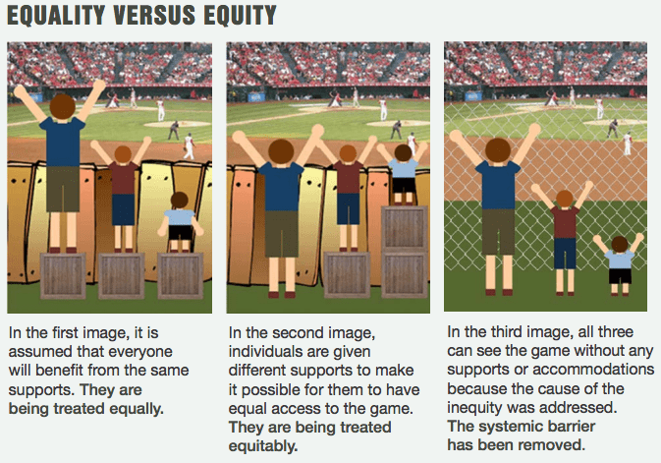
Motivations for the study

Slide 17
Some recommendations
The university should, as soon as practical, adopt an efficient automated captioning system for all recorded lectures to provide a timely captioning service to all students.
Consideration needs to be given to an inclusive digital learning strategy that embraces students with complex medical disabilities and those in the ’other” category of disabilities – most notably students with mental illness, both of which are over represented in the online learning cohort.
Assistance and provision of digital technologies need to be revised to better target student needs to better accommodate the 33% of respondents to this study who found them inadequate.
Technical support for students with disabilities studying online and external to campus require urgent review to better accommodate the needs of these students.
Consideration needs to be given to the provision of social and emotional support for students with disabilities studying online and external to campus.

Slide 18
Acknowledgements
The research underpinning this presentation was funded through the Curtin Teaching Innovation Grants Scheme (2018).

