Slide 1

Accessibility in Office 365 and Windows 10
Troy Waller
Learning Delivery & Accessibility Specialist
@hojusaram
@MSFTEnable

Slide 2



Let’s get social!
@hojusaram
linkedin.com/in/troywaller/
fb.me/TroyWallerMLC
@MSAuEdu

Slide 3
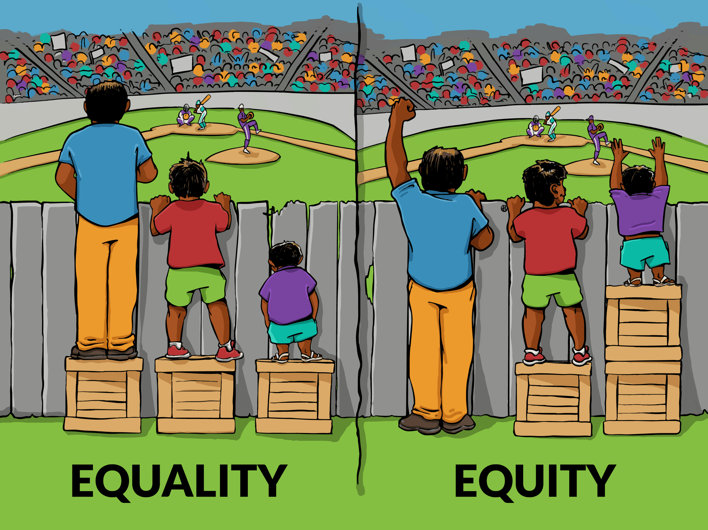
© 2015 IISC http://interactioninstitute.org/wp-content/uploads/2016/01/IISC_EqualityEquity.png

Slide 4
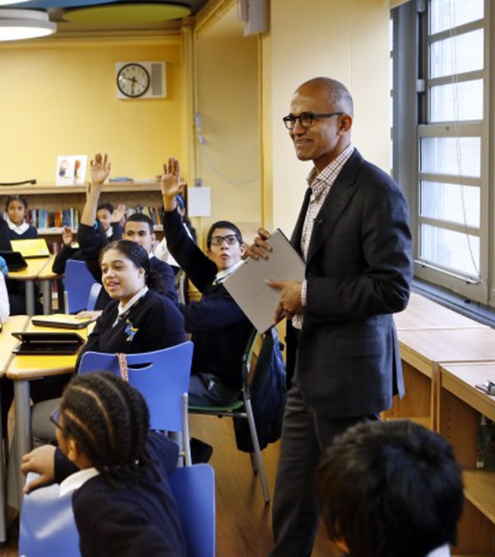
"Our mission is to empower every person and every organisation on the planet to achieve more."

Slide 5
Promoting independence
Learning
Visual
Hearing
Mobility
Neurodiversity
Mental Health
Dyslexia
Dysgraphia
Dyscalculia
Low vision
Blind
Colorblind
Deaf
Hard of Hearing
Cerebral Palsy
Muscle Dystrophy
Amputation
Autism
ADD/ADHA
Seizure
Anxiety
Depression
OCD

Slide 6



Inclusive Classroom
Reading
Support
Writing
Support
Communication

Slide 7
Reading Support

Slide 8

Microsoft Hackathon 2015 winner changes lives!
Notes:
Satya Nadella's son

Slide 9

Immersive Reader

Slide 10
Demo

Slide 11

High interest, low ability
“Nearly all of the study teachers mentioned how Learning Tools enabled their readers, regardless of skill level, to access content aimed at a higher reading level. In this case, “access” means comprehension of content that had previously been unavailable.”

Slide 12
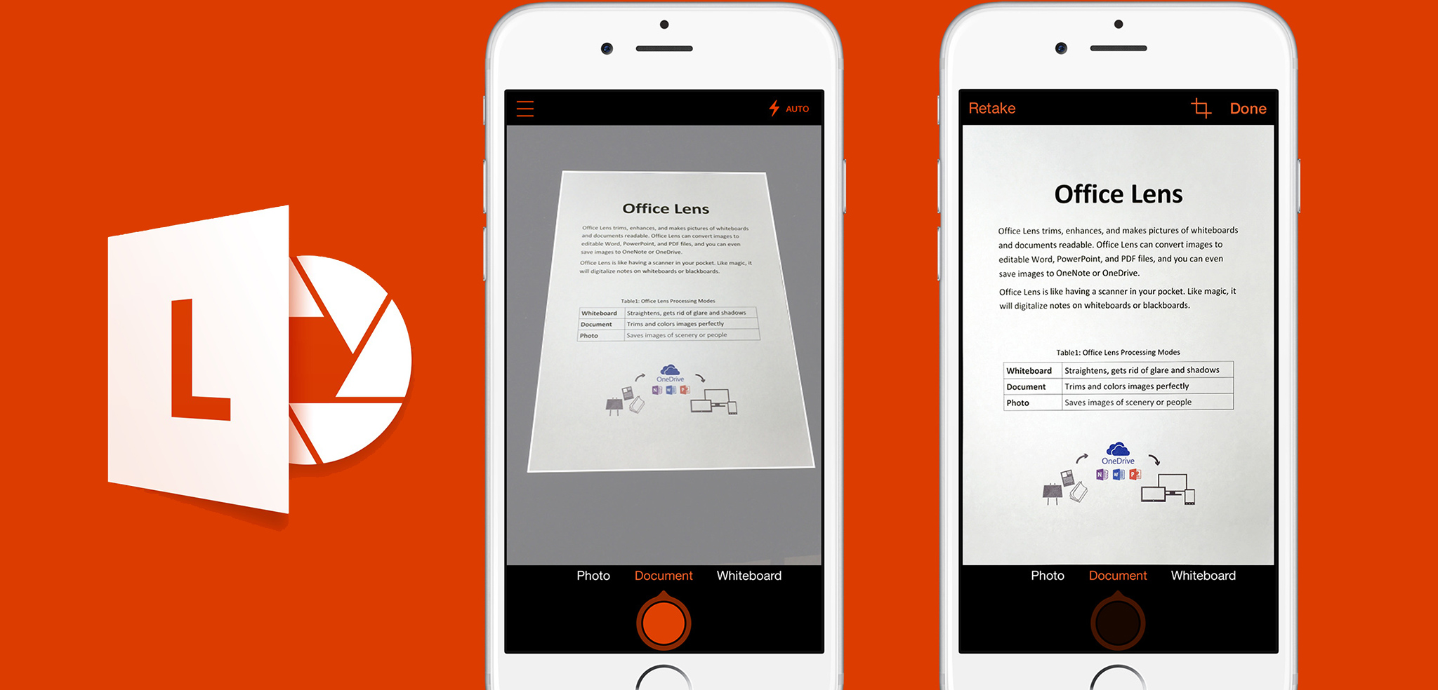
Notes:
https://www.youtube.com/watch?v=jzZ3WVhgi5w

Slide 13


Native to Office

Slide 14




Immersive Reader is available in
Office 365, Office 2019 and Office Online

Slide 15

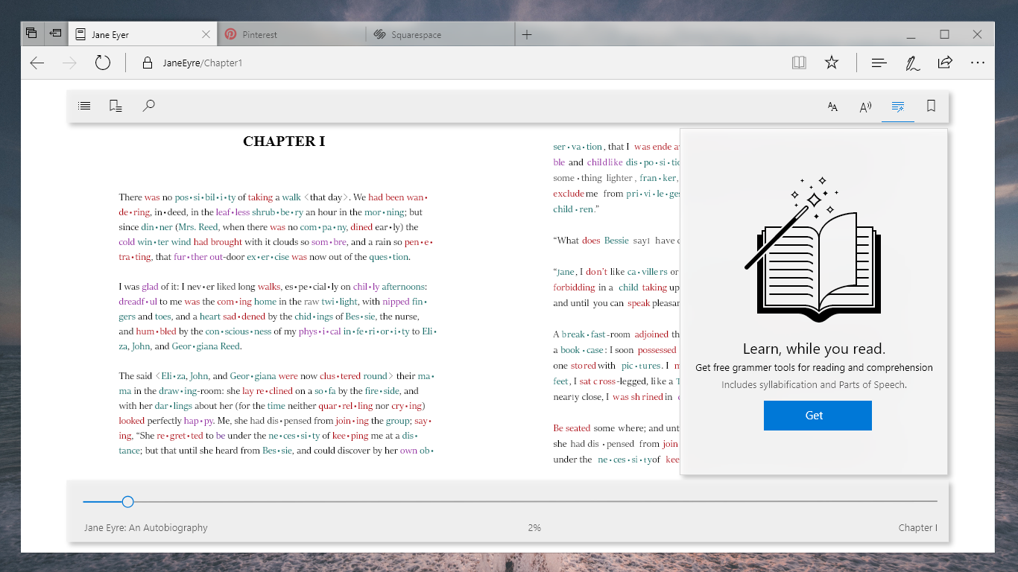
Edge, Windows 10

Slide 16
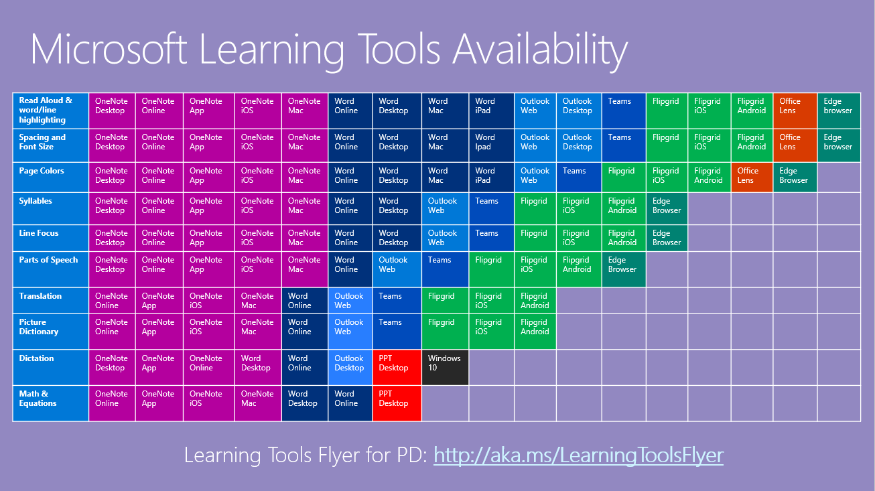

Slide 17
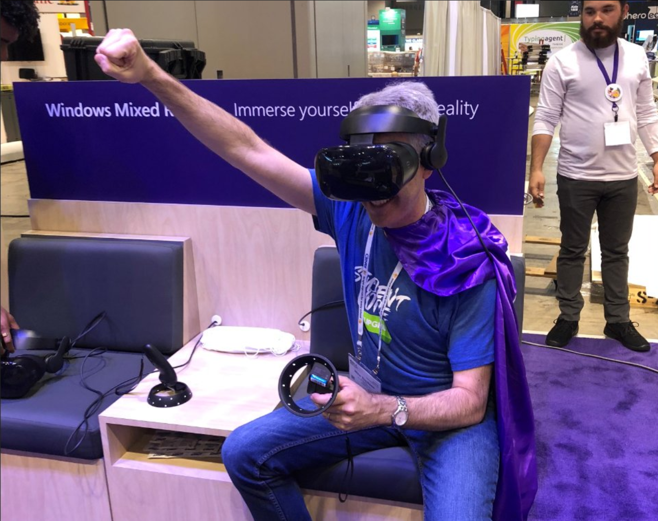

Slide 18
Immersive Reader in Virtual Reality (Beta)
Target audiences: ADHD, autism, dyslexia, visual impairments (which includes Senior Citizens)
“VR with Purpose” – using VR in a new way for schools.
We will be testing this out over the few months, researchers involved

Slide 19
Writing support with Dictation, Editor, and Word Prediction

Slide 20
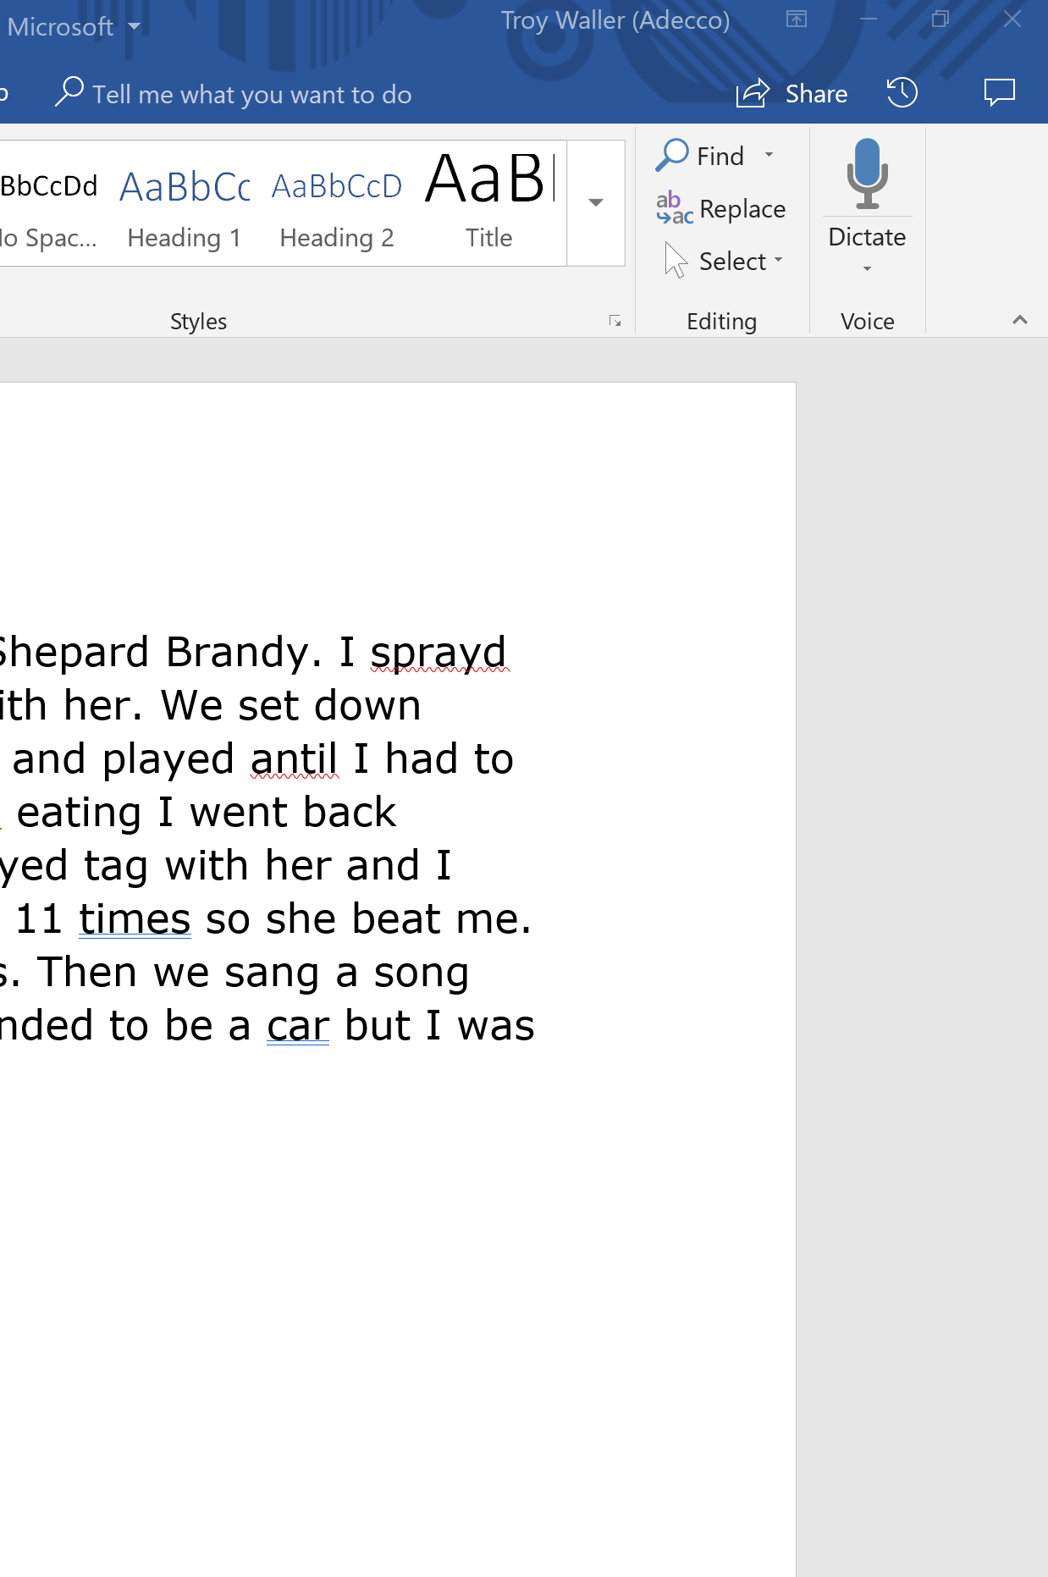
Dictation

Slide 21
Demo

Slide 22

Say the following phrases to add punctuation to your text:
Period
Comma
Question mark
Exclamation point
Exclamation mark
New line
New paragraph
Semicolon
Colon
Open quote
Close quote
Open quotes
Close quotes

Slide 23
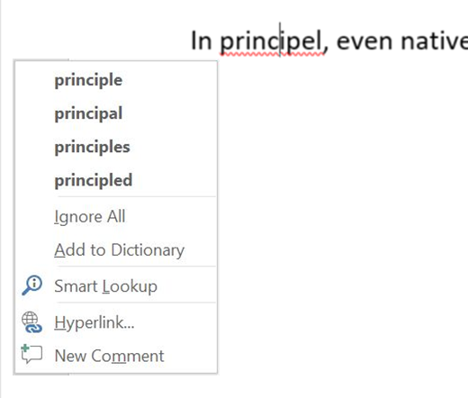
Spelling check – Challenges for people with Dyslexia
Challenges | Traditional Office Spelling menu
Difficulty perceiving the differences & determining which is correct, in a list of similarly spelled words Burdened by too many choices Unique spelling error patterns | No context or other cues to help choose the right word Up to 5 different suggestions Prone to show “No Suggestions” for high edit-distance errors

Slide 24
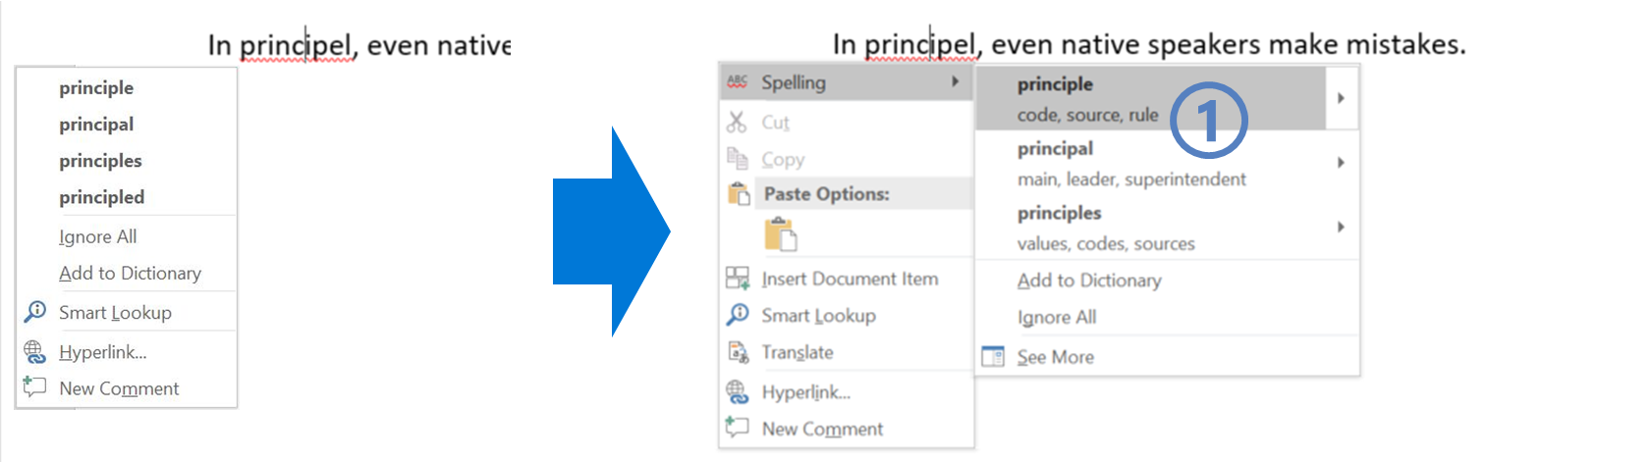
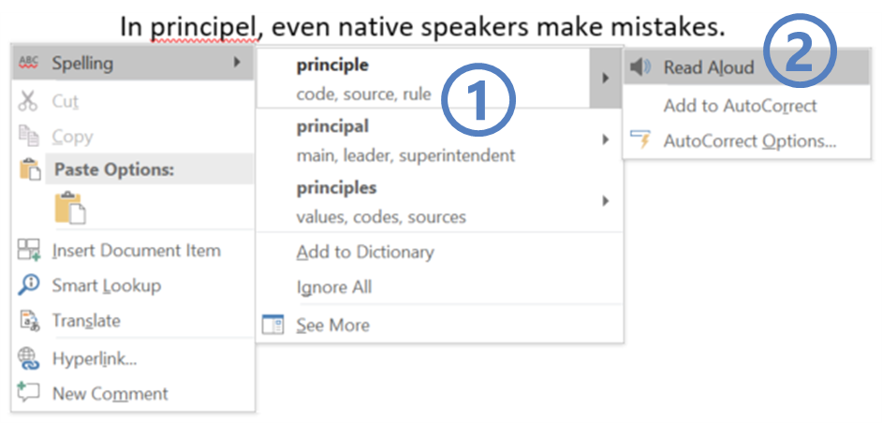
Editor – Inclusive design to benefit everyone
Contextual cues help people identify the right choice
  Synonyms help disambiguate between similar-looking suggestions
  Read Aloud (of both suggestions & synonyms) aids comprehension
Better suggestions and significantly reduced incidence of “No Suggestions”
Improved compatibility with screen readers and other ATs

Slide 25
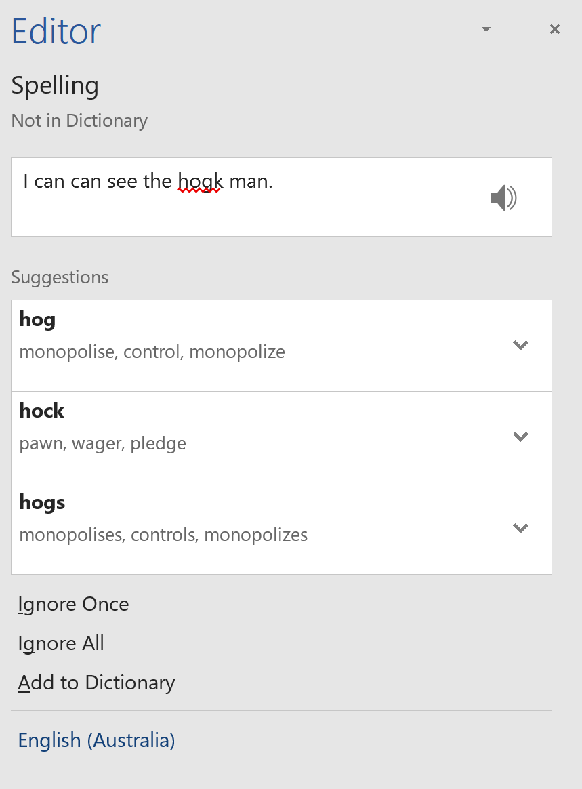
Core Scenarios
Editor Overview Pane: Find & Fix the issues you care about
A categorised Overview of writing enhancement opportunities
  Corrections are issues you’re strongly advised to fix
  Refinements give optional advice on stylistic or situational matters
  Counters and Checkmarks track progress & celebrate achievement
Draws attention to elements of Good Writing
  Gives students a dashboard for self-assessment
  Gives teachers a scorecard to drive learning goal conversations
  Presents the breadth and depth of checks in a manageable way
Flexible Workflow choices let you spend time purposefully
Scrub the document one Category at a time
Fix in a recommended sequence: Spelling > Grammar > Refinements
Focus attention on Categories important for your Writing Goals

Slide 26


Early Feedback
I was working with a student (with dyslexia) last week who was trying to put together his resume. About 10 minutes in, he felt so defeated because his errors felt like roadblocks. He knew what he wanted to say, he just couldn’t get the words close enough and he wanted to give up.
This feature (Editor) opened a door for him, it allowed him to focus on the content and ideas he was trying to get down. The options and synonyms gave him independence to not have to ask, or have someone sit by him and coach him through the entire document.
Robin Lowell
Microsoft Innovative Education Expert, and a special education, science, and mathematics teacher, as well as teacher of blind and visually impaired students.

Slide 27
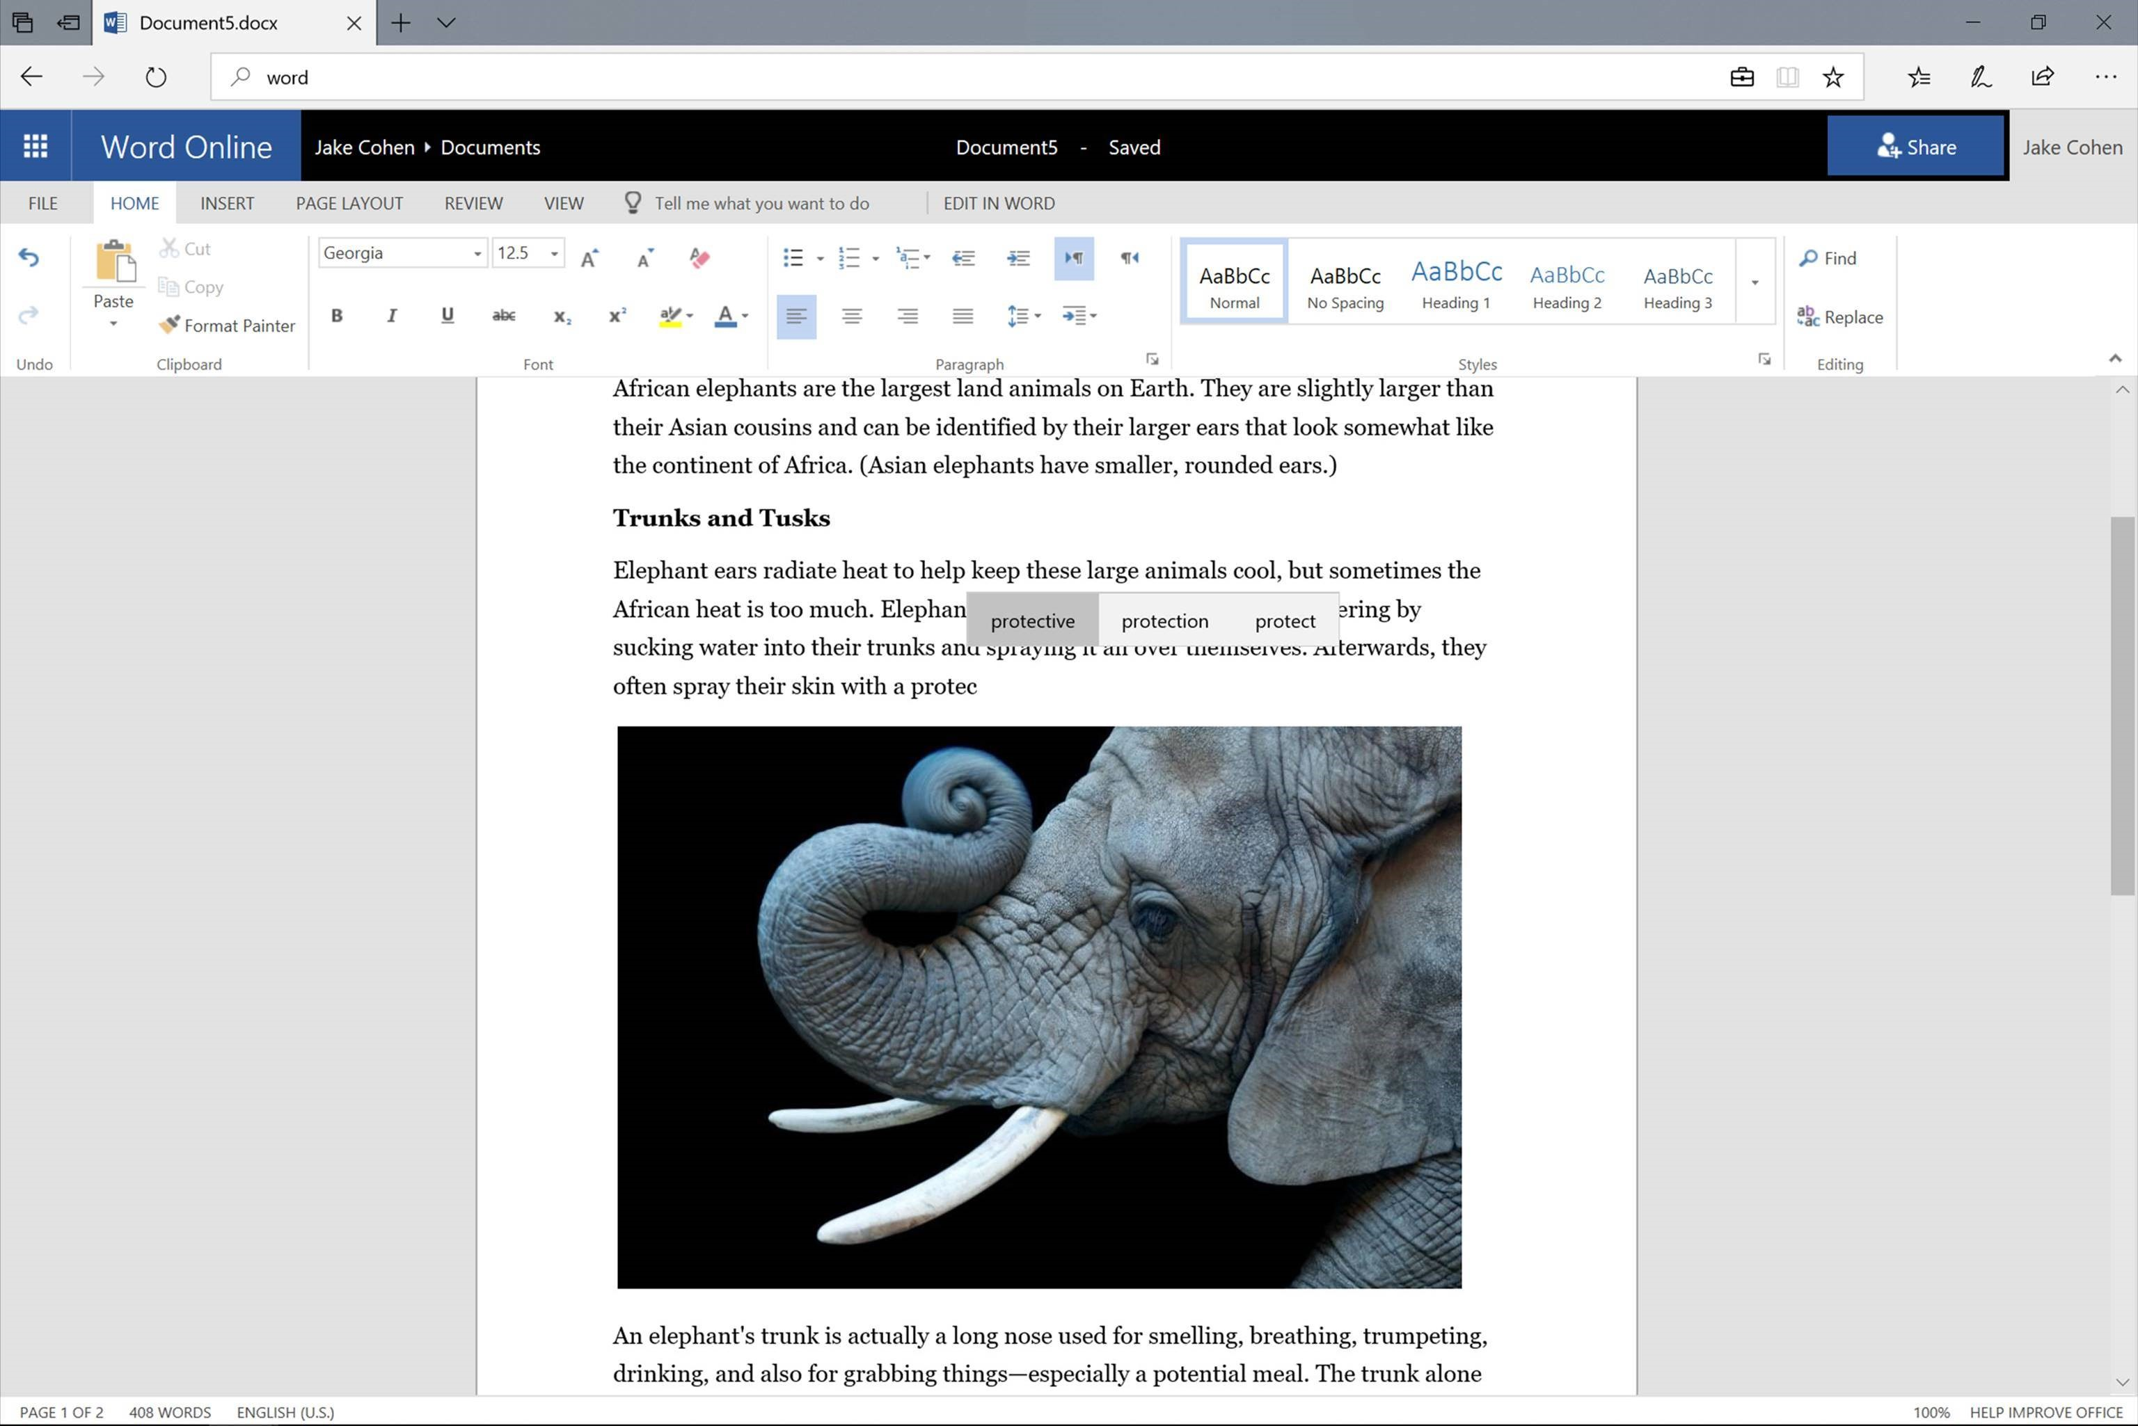
Word Prediction for Windows 10

Slide 28
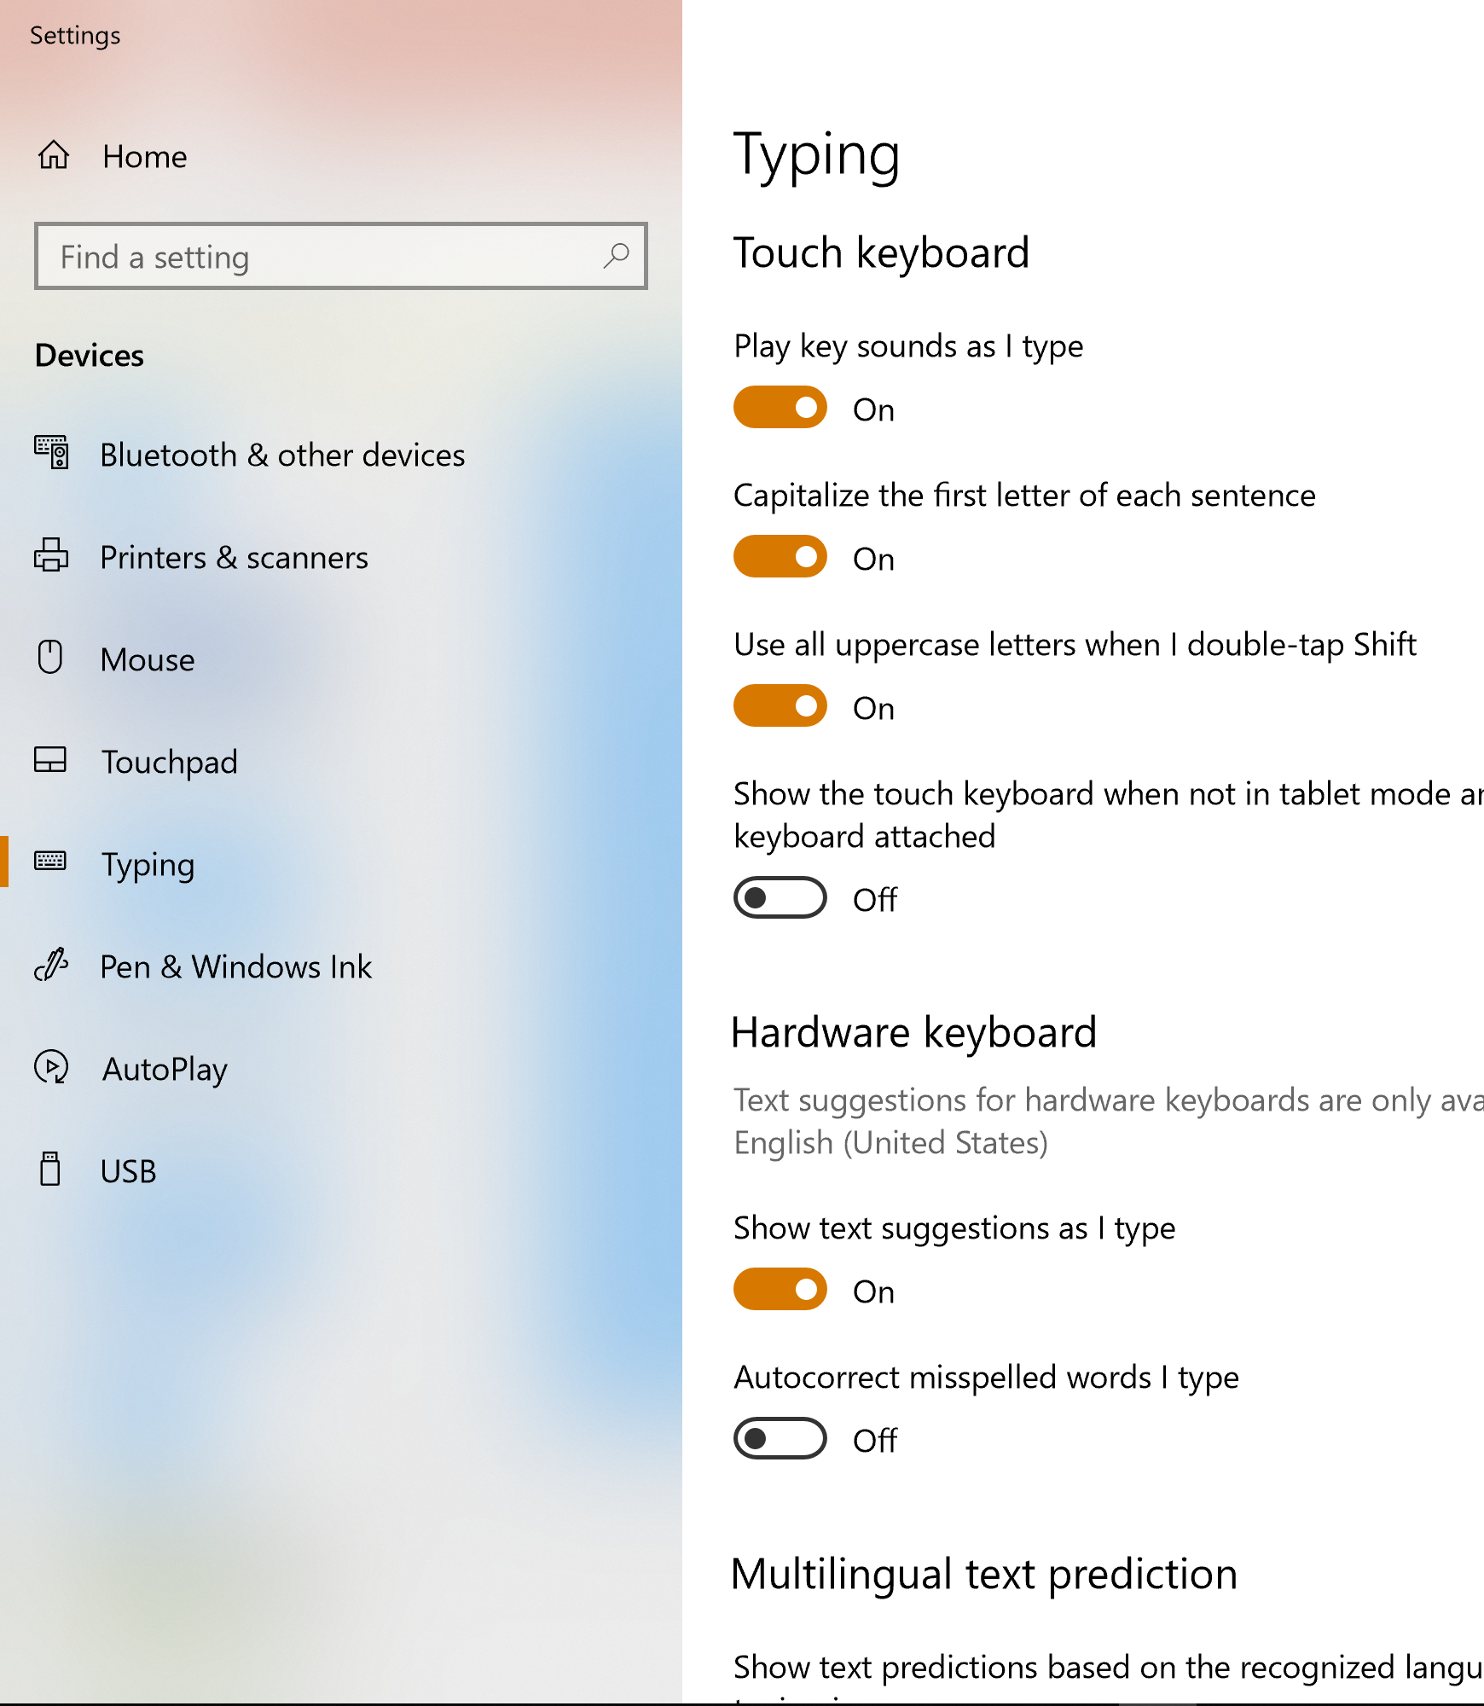
Word Prediction, Windows 10

Slide 29
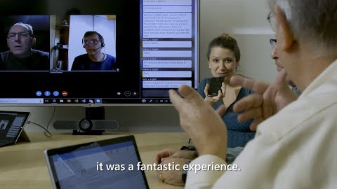
Support for the deaf

Slide 30
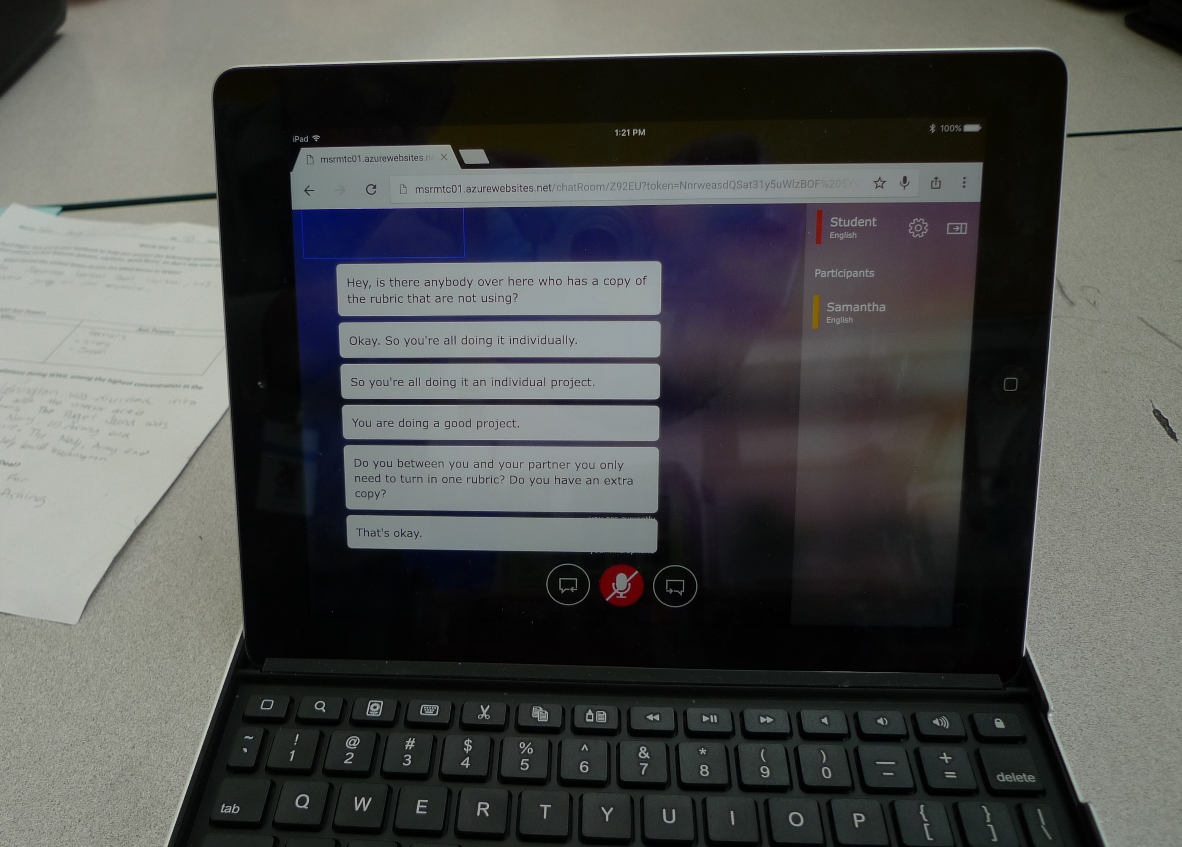

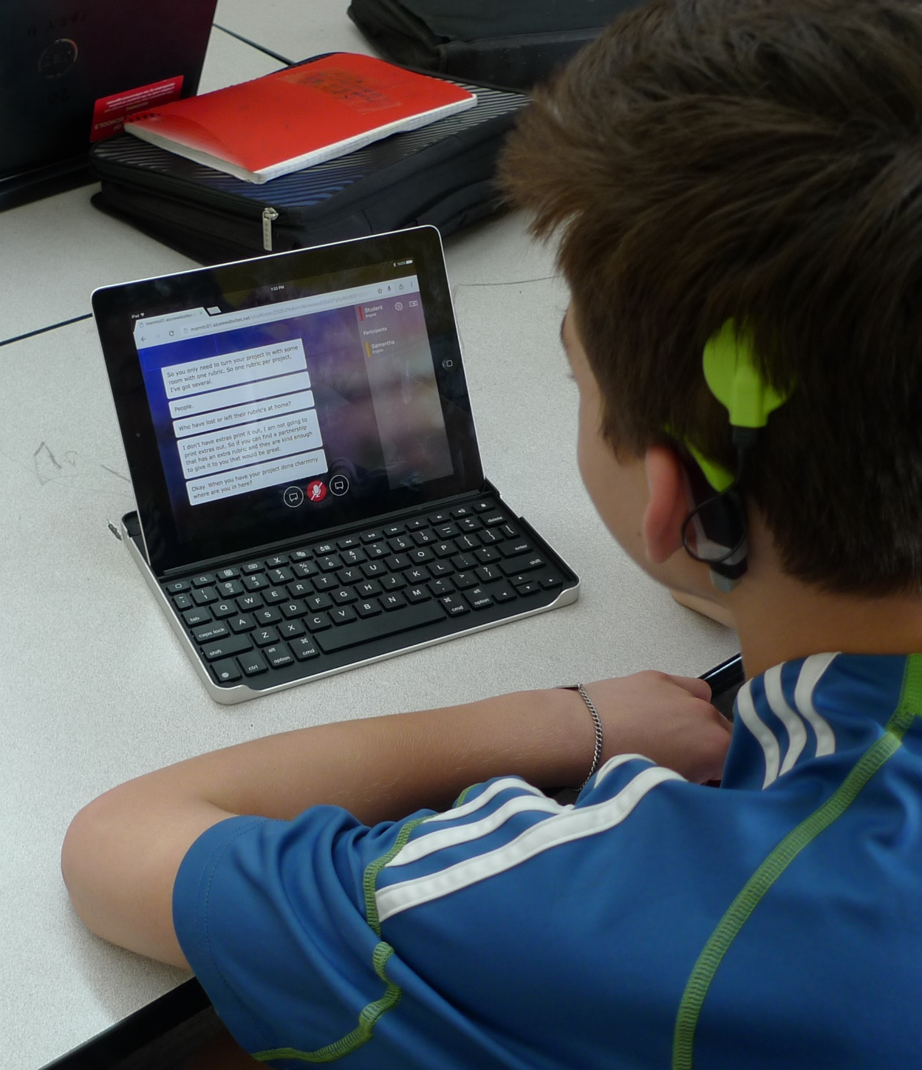
Microsoft Translator translator.microsoft.com

Slide 31

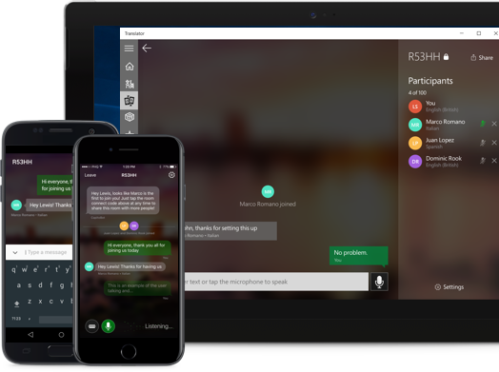
Microsoft Translator
  Smartphone apps for in-person, multi-device translation for two or more participants, speech or text
  10 speech languages and 63 text languages
  Up to 100 participants at the same time
  Free Apps on iOS, Android, Windows UWP, PowerPoint and web.
  https://translator.microsoft.com/help/education/

Slide 32




Windows 10 Accessibility
vision
hearing
physical
cognition
Make your device easier to see or use without a screen.
Make your device easier to hear or use without sound.
Make your device easier to use of you have limited reach or strength.
Make it easier to focus and get things done with Windows.
www.microsoft.com/en-au/Accessibility/windows

Slide 33
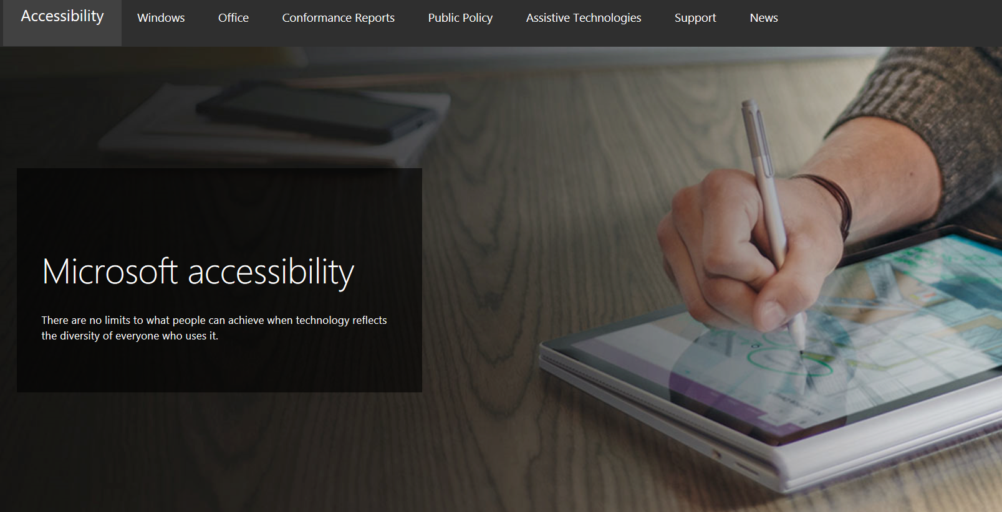
Connect with us in person today or anytime through our support and feedback channels.
  Call the Disability Answer Desk: aka.ms/AccessibilitySupport
  Give suggestions in User voice: aka.ms/AccessibilityFeedback
  Message us on social media: twitter.com/MSFTEnable
Notes:
Take them to : Aka.ms/AccessibilitySupport

Slide 34

Get the Inclusive Classroom IT Deployment Guides
http://aka.ms/InclusiveDeployment

Slide 35
Freedom to explore possibilities
Built-in accessibility solutions from Microsoft help reduce the stigma of challenges and provide users with the tools they need to fully engage with content in powerful new ways.
Reading
Learning Tools and immersive
reader technologies provide a critical link for students who need help accessing course content
Writing
Tools like Enhanced Dictation help make writing and in-class note taking easier and more efficient
Instruction
Automated alt text and Translator ensure that students can access the content that teachers are presenting

Slide 36
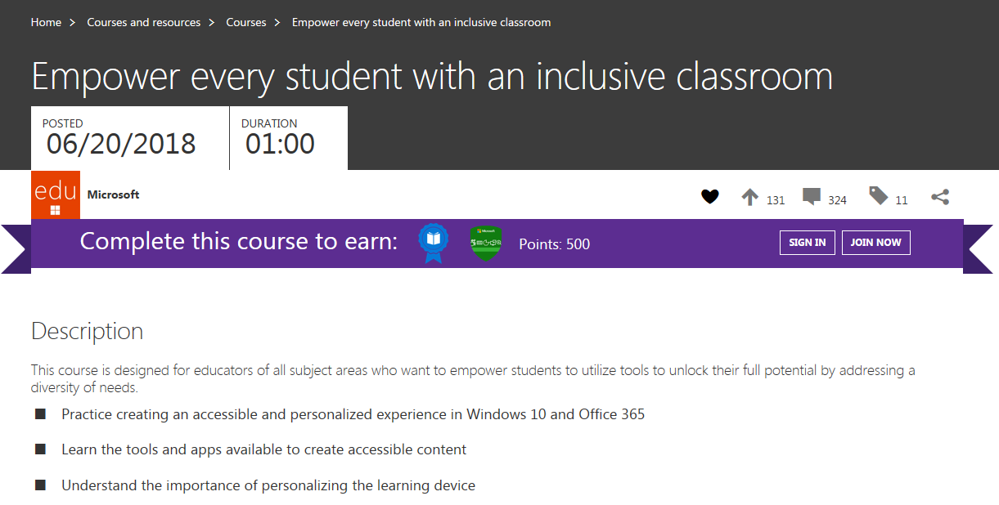
Click here to access

Slide 37
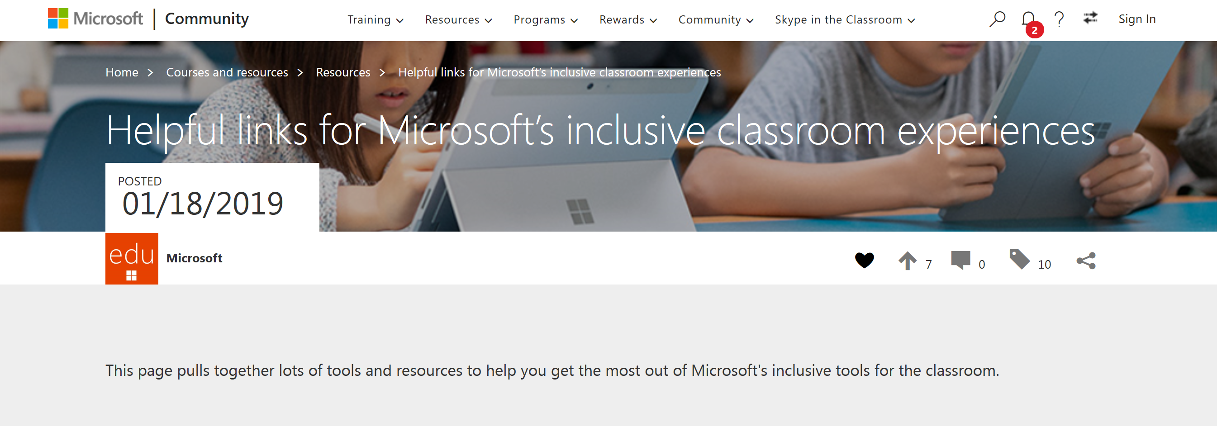
Click here to access

Slide 38
Explore more: Microsoft Accessibility resources
5 free things to try today
Communicate in new ways and collaborate
seamlessly with Office 365
Engage your diverse audience by
presenting with subtitles
Create assignments that are accessible by design
Go paperless with Office Lens and Seeing AI
Encourage independent reading and writing
5 resources to bookmark and share
Educator Training on Inclusive Content
Educator Training for Personalising Learning
Office 365 Accessibility Support Documentation
Answer Desk for Accessibility Support
Microsoft Accessibility Overview

Slide 39






Achieving more with accessibility – Inclusion in Action series
Andrew, a young boy who read for the first time with Learning Tools.
Justin, a young man who uses Office 365 to communicate with the world.
Veronica, a student with low vision who created a perfect Sway.
Cameron, a university lecturer who believes it is an exciting time to be a blind person with Seeing AI.
Jack, a teacher who shows students what is possible with Office 365 and Narrator.
Steve, who navigated a medical crisis with OneNote to access printed documents.

Slide 40
Let’s stay social!
@hojusaram
linkedin.com/in/troywaller/
fb.me/TroyWallerMLC
@MSFTEnable

