Slide 1
Incorporating Universal Design for Learning within Assessment
Presented by Dagmar Kminiak & Terri Mears
Disability Services

Slide 2
Agenda
Current Climate at University of Sydney
UDL Principles
UDL in Assessment
Implementation at University of Sydney
Next Steps for University of Sydney

Slide 3
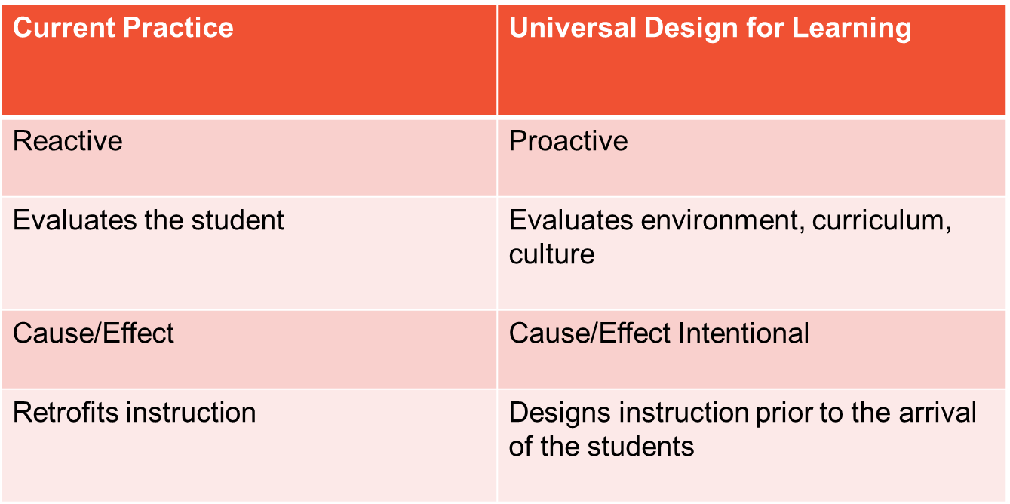
Current Climate at USYD

Slide 4
Big Picture Changes at the University
Faculty Restructure
New learning Management system (CANVAS)
Significant Curriculum Reform - Including the development of university wide rubrics, learning outcomes for curriculum components, defining graduate qualities and changes to assessment plans.
The Curriculum Reform will have a significant & direct impact on how students access their study in the future
Student Experience Strategy
Notes:
DK

Slide 5
Definition of Universal Design for Learning
Universal Design for Learning:
Is a set of principles for curriculum development that give all individuals equal opportunities to learn.
Is intended to increase access to learning by reducing physical, cognitive, intellectual, and organisational barriers to learning.
Provides a blueprint for creating and implementing flexible learning environments, goals, pedagogies, materials, and assessments that accommodate learner differences.
www.cast.org

Slide 6
Provide Multiple Means of Engagement
Provide options for recruiting interest
Provide options for sustaining effort and persistence
Provide options for self regulation
Purposeful, motivated learners
Center for Applied Special Technology (CAST)

Slide 7
Provide Multiple Means of Representation
Provide options for perception
Provide options for language, mathematical expressions and symbols
Provide options for comprehension
Resourceful, knowledgeable learners
Center for Applied Special Technology (CAST)
Notes:
DK

Slide 8
Provide Multiple Means of Action & Expression
Provide options for physical action
Provide options for expression and communication
Provide options for executive function
Strategic, goal-directed learners
Center for Applied Special Technology (CAST)
Notes:
DK

Slide 9
UDL within Assessment
The goal of applying UDL to assessment is to design and develop assessment which allows participation and success for all students.
Uses the same assessment outcome targets for all students, however provides benefits in workload flexibility and learning management tools for students.
Provides equivalence in learning via multiple means of demonstrating that learning.
Reduces staff workload through minimising the need for in semester bespoke adjustments for disability conditions.
Notes:
DK

Slide 10
Tips for Planning Assessments using UDL
Provide regular feedback
Formative assessments
Involve learners in their learning process using assessment data
Peer feedback
Allow students to submit sections of a large project
- Support learner variability through flexible assessments
- Clear expectations around assessments and learning outcomes
- Eliminate unnecessary barriers in assessment
- Provide sample or previous exams
Notes:
DK

Slide 11
Implementation of Universal Design for Learning at University of Sydney
Collaboration with Faculty of Arts and Social Sciences
Collaboration with the Discipline of Rehabilitation Counselling
Disability Services Key Stakeholder Forum

Slide 12
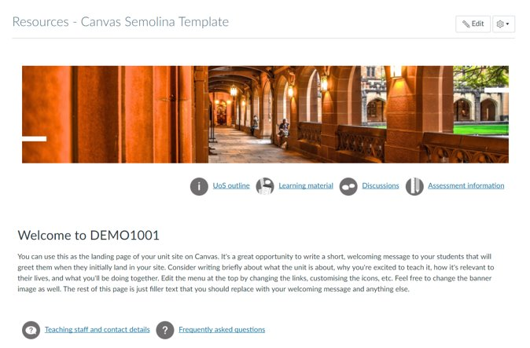
Canvas (Learning Management System)

Slide 13
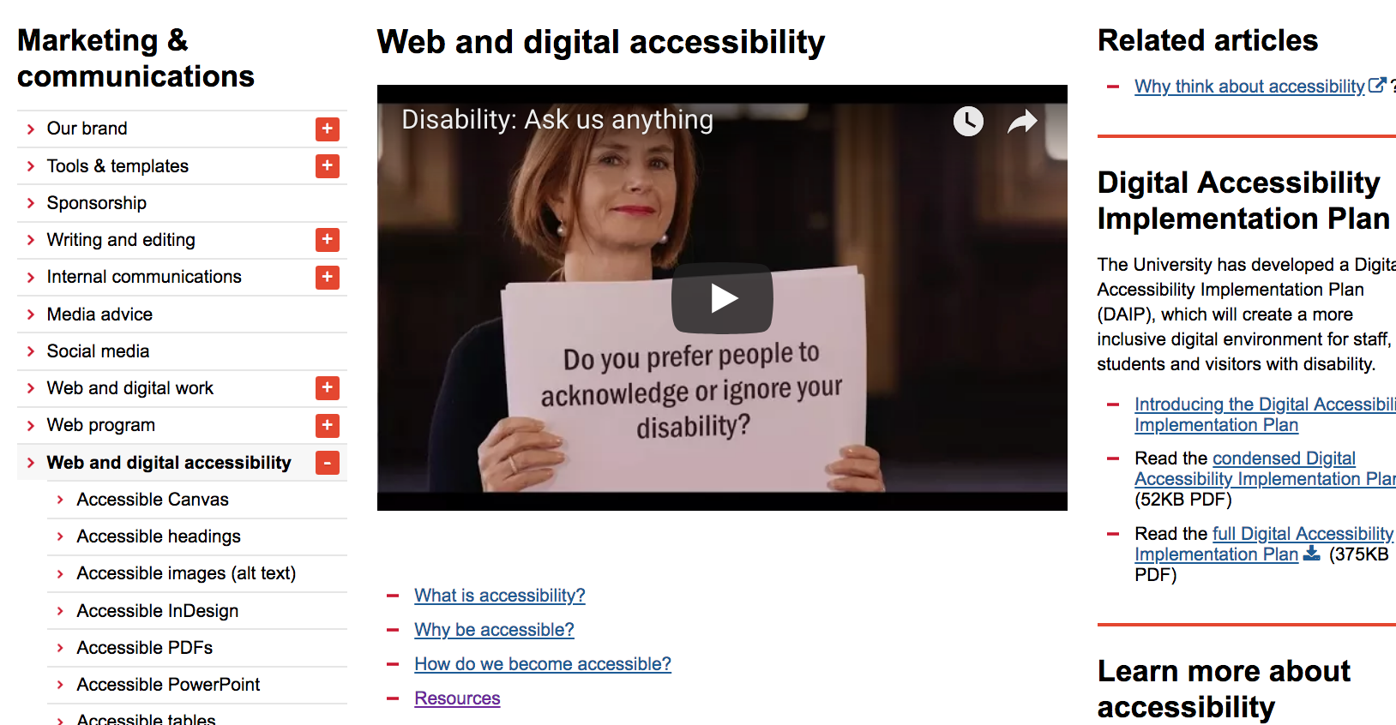
Digital/Online Material

Slide 14

Next Steps
Key outcome within the new University Disability Inclusion Action Plan 19-24
University wide Education/Training
Resources
Pilot
Notes:
DK

Slide 15
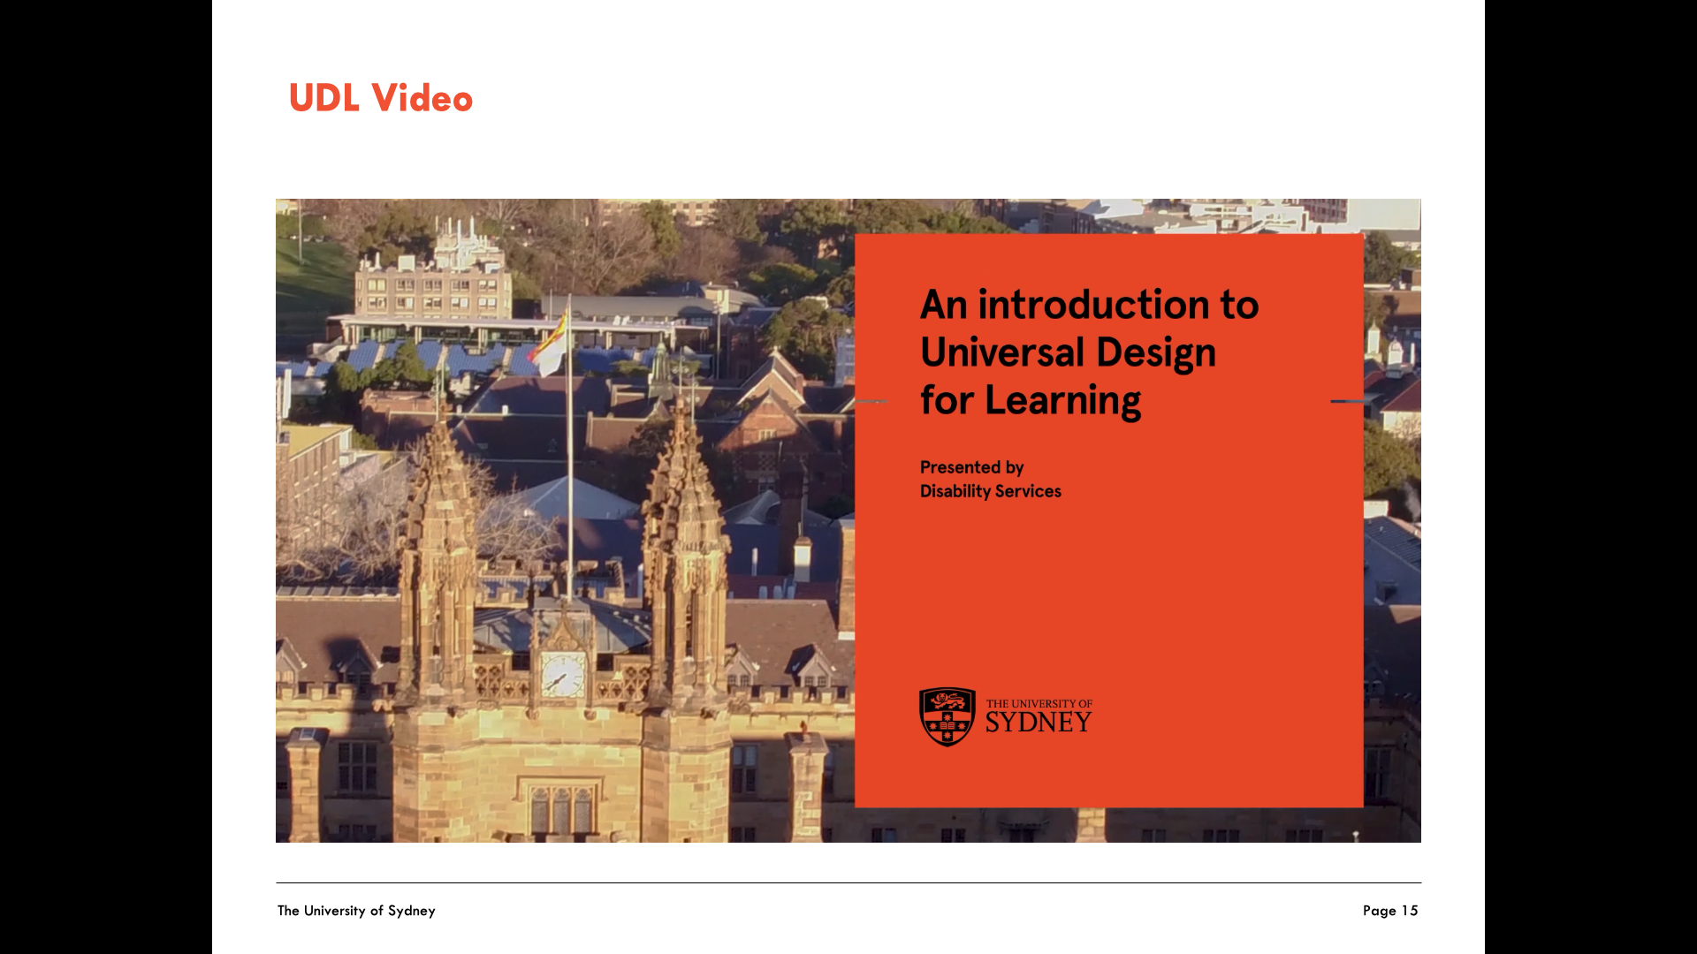
UDL Video-Screenshot of Video
URL for the video: https://www.youtube.com/watch?v=rvYqg13tECk&feature=youtu.be

Slide 16
Questions?

