Slide 1


White Questions – Black Answers
Presented by
Sharon Kerr
PhD candidate University of Sydney
The University of Sydney Page 1

Slide 2
Acknowledgement
Before I start I would like to acknowledge the traditional owners of the land on which we meet and elders both past and present. I would also like to acknowledge the traditional owners of the knowledge which I am going to share. In particular the input of Dr John Gilroy (my supervisor), members of my Indigenous Advisory Group: Roslyn Sackley, Maria Robinson and Naomi Carolin who continue to provide guidance and insight with regard to Indigenous knowledge and cultural safety; and people who have generously shared their stories with me for this research.
Page 2

Slide 3
White questions – Black answers.
As a teacher and a support practitioner I had a number of questions that I have set out to find the answers to. Some of these you may share:
My questions:
Why it is that Aboriginal and/or Torres Strait Islander students with disability are not presenting for support?
What are the barriers both real and perceived for students who need support?
How can we mitigate the impact of these barriers?
Page 3

Slide 4
White questions – Black answers.
A report compiled by the Australian Institute of Health and Welfare (AIHW) (2011) using 2006 census data, examined responses from Indigenous adults with a disability and their attitudes towards further study and documented that:
– 30% of Indigenous Australians aged 18–64 years with the most severe levels of disability had wanted to pursue further study in the 12 months prior to survey and 13% were unable to do so because of caring or family reasons
Page 4

Slide 5
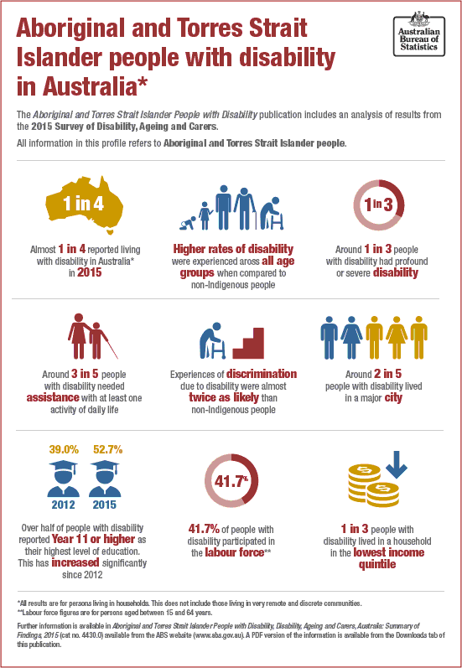




disability
(ABS, 2018)
Page 5

Slide 6
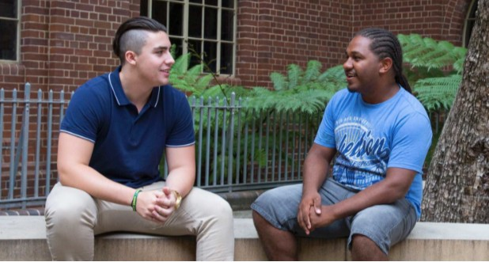
White questions. Black answers.
Multiple barriers exist for Indigenous students with a disability. These are different for each individual, thus the need to listen to your students and identify their needs.
Page 6

Slide 7
White questions. Black answers.
From the literature barriers include:
Poor access to quality education from preschool to year 12 Implication:
students may have poor foundational learning skills
Page 7

Slide 8
White questions. Black answers.
Unemployment
Implications:
both the world of education and the world of work may be foreign to the students and their families
students may be studying in an environment of economic stress
Page 8

Slide 9
White questions. Black answers.
Incarceration
Implications:
incarcerated students may not have access to the internet or the learning resources and support of other students
personal, family or community experience with incarceration may impact on a student’s personal confidence of succeeding at study and transitioning to employment and a career
Page 9

Slide 10
White questions. Black answers.
Poor health and access to health services
Implications:
Students may be impacted by either their own poor health or the health of their family members for whom they carry carer responsibilities.

Slide 11
White questions. Black answers.
Accommodation
Implications:
Students may not have secure or appropriate accommodation conducive to studying.

Slide 12
White questions. Black answers.
Limited expectations.
Implications:
Students may not have mentors in their family and community that believe in their ability to succeed in higher education or have the capacity to encourage them at times of difficulty.

Slide 13
White questions. Black answers.
Cultural perspective of disability and cultural interface with higher education support services.
Implications:
students may not recognise that their particular challenge is labelled as a disability for which assistance is available
students may not wish to identify and adopt what they perceive to be a deficit label

Slide 14
White questions. Black answers.
Cultural perspective of disability and cultural interface with higher education support services continued …
Implications:
students may find the requirements for verifying their entitlement to support onerous
students may not have undergone the testing required by support services

Slide 15
White questions. Black answers.
Access barriers relating directly to having a disability (both diagnosed and undiagnosed)
Implications:
– students may not be aware that their education provider has a legal obligation to provide learning materials in an accessible format and therefore not seek alternative formats of texts to enable access.

Slide 16
White questions. Black answers.
Access barriers relating directly to having a disability (both diagnosed and undiagnosed) continued…
Implications:
students may not be aware of the use of assistive technologies to enable access
students may interpret their inability to engage with learning as a personal shortcoming rather than recognising that support is available for what may be a learning or sensory disability

Slide 17
White questions. Black answers.
Geographic location
Implications:
students may not have access to good public transport and may also have issues associated with not wanting to leave their families to go and study
students may not have access to internet

Slide 18
White questions. Black answers.
Barriers for Indigenous students with a disability are multiple and real – as institutions there is much we can do to support our students and mitigate the impact of these barriers.
Let’s take a look at the current approach of our institutions to supporting Indigenous students with a disability.

Slide 19
White questions. Black answers.
A 2016 audit of the websites and public information of Australia’s 40 Universities revealed:
35 of the university disability support services did not indicate support services available to Indigenous students.
Of the five universities that did indicate support services available to Indigenous students on their websites, three of these achieved this through the design element of having a link to all student services, including Indigenous student support services on the sidebar.

Slide 20
White questions. Black answers.
One university included acknowledgement of country on every page of the website which hyperlinked through to the Indigenous student support page.
None of the 40 universities had information on their disability services website regarding the availability of Indigenous staff for students to contact.
38 of the 40 universities had information about Indigenous support services. Two universities did not have any information. Both of these were private universities.

Slide 21
White questions. Black answers.
33 universities did not indicate support available for students with a disability on their Indigenous support services page .
None of the universities had information regarding male or female counsellors available for Indigenous students.
None of the universities had information regarding assistive technologies available to Indigenous students.
Only 7 of the universities had information regarding employment while studying for their Indigenous students.

Slide 22
White questions. Black answers.
On the positive side:
34 Universities had supportive spaces for Indigenous students,
35 Universities provided academic and administrative support,
35 Universities provided tutoring for Indigenous students,
34 Universities provided support with finances,
28 Universities provided alternate entry pathways.

Slide 23
White questions. Black answers.
Only seven universities provided the opportunity for Indigenous students with a disability to present directly for help without supporting documentation.
33 universities required students to provide documentation from a specialist medical or allied health practitioner prior to the process for support being able to commence. (One university noted a ten step process for all students to proceed through in order to receive a Learning Action Plan (LAP), noting that once it lapsed, a new LAP would need to be applied for and secured prior to further assistance being given.)

Slide 24
White questions – black answers.
What can my institution do to improve support?
When we are speaking with our Indigenous students and their support networks we need to listen and be committed to responding appropriately. By way of example:
If our processes and requirements for support are creating barriers – change them.
If there is a reluctance to be saddled with a deficit label – don’t insist on using them – normalise the support requirements of the student – offer assistive technologies the same as you may any other technology to support success (e.g. “Grammarly’)

Slide 25
White questions – black answers.
What can my institution do to improve support?
Work shoulder to shoulder with the Indigenous support staff in your institution to ensure that support is co-ordinated and responsive to the needs of your Indigenous students with a disability.
Ensure that all disability support staff are committed to ensuring a culturally safe support environment for Indigenous students with a disability and be aware of the perspective of disability held by Indigenous staff and students.
Don’t forget the needs of part-time, distance and online Indigenous students with a disability. (Our responsibility is the same to them as it is our internal students.)

Slide 26
References
ABS. (2018). Disability, Ageing and Carers, Australia: Summary of Findings, 2015 ABS4430.0. Canberra: Commonwealth of Australia.
AIHW,. (2011). Australian Institute of Health and Welfare : Aboriginal and Torres Strait Islander people with disability: wellbeing, participation and support IHW 45. Canberra: Commonwealth Government of Australia.
Craven, R., & Dillon, A. (2013). Indigenous Australian Student's Participation in Higher Education and Potential Ways Forward. In R. Craven & J. Mooney, Seeding Success in Indigenous Australian Higher Education: (1st ed.). City The Emerald Publishing Group Limited.
Craven, R., & Mooney, J. (2013). Seeding success in indigenous Australian higher education. London: Emerald Group.
Day, D., & Nolde, R. (2009). Arresting the decline in Australian indigenous representation at university. Equal Opportunities International, 28(2), 135-161.
Gilroy, J. (2015). The theory of the cultural interface and Indigenous people with disabilities in New South Wales. Balayi: Culture, Law And Colonialism, 10, 44 – 58.
Gilroy, J., Donelly, M., Colmar, S., & Parmenter, T. (2013). Conceptual framework for policy and research development with indigenous people with disabilities. Australian Aboriginal Studies, 2, 42+.
Harrison, L. (2014). Prisoners and their access to the internet in the pursuit of education. Alternative Law Journal,, 39(3), 159 – 162.
Harrison, N. (2011). Teaching and learning in Aboriginal education. South Melbourne, Vic.: Oxford University Press.
Kutay, C., Mooney, J., Riley, L., & Howard-Wagner, D. (2012). Experiencing Indigenous Knowledge Online as a Community Narrative. The Australian Journal Of Indigenous Education, 41(01), 47-59.

