Slide 1
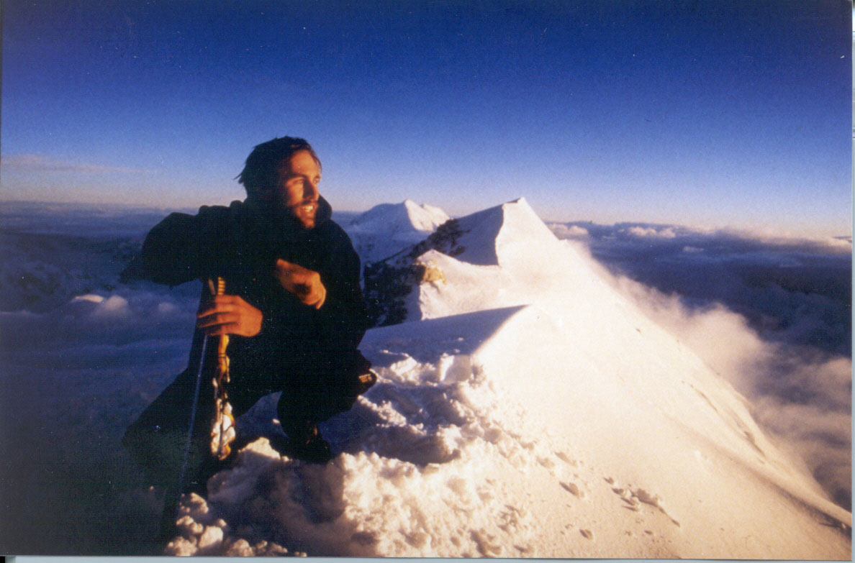
Making Statistics and Mathematics Courses accessible to Blind and Vision Impaired Students Pauline Pannell, Una Jansen Van Rensburg and Kim Louw University of Western Australia

Slide 2
Overview
Few blind people achieve in higher mathematics
Making math and stat more accessible
Which strategy to adopt?
Case Study. Una learns Statistics
Short Film: teaching SPSS Using Code
Notes:
packages

Slide 3
Useful distinction for our purposes is between people who are vision impaired, including the legally blind who may be able to use some vision in accessing learning materials and those who need to rely totally on non visual means to access information.

Slide 4
Different learning style
Superior tactile, auditory discrimination, verbal processing, memory span and long term memory
Disadvantaged in spatial learning. Spatial information becomes a series of items.
Source: Pasqualotto, A and Proulx, M. (2012) The role of visual experience for the neural basis of spatial cognition. Neuroscience and Biobehavioral Reviews (36) 1179-1187
Congenitally Blind Differ from Acquired Blind.
May still be able to visualise
Source: Figueiras, L and Arcavi, A 2014 A touch of mathematics. Coming to our senses by observing the visually impaired. Mathematics Education (46) 123-133.

Slide 5
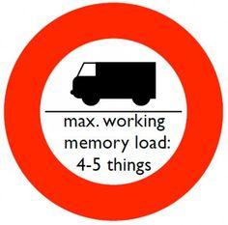
MUCH bigger demand on working memory for both low and vision impaired and blind:
Information gained in series of chunks
Either haptic, auditory or visual

Slide 6
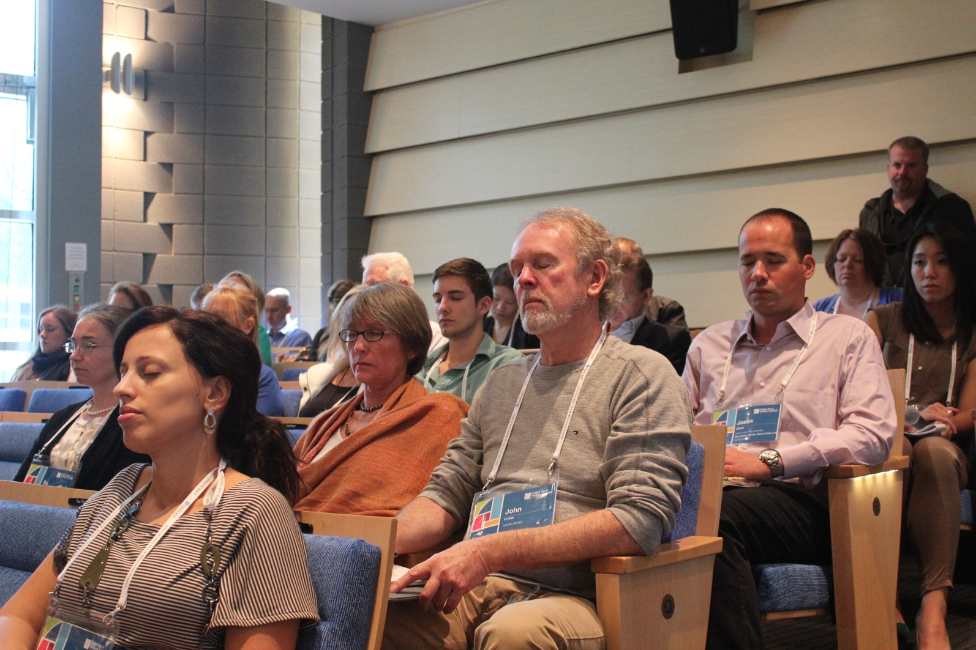
Experiential Exercise for You
Close your eyes
Notes:
I am going to read out a description of a simple line graph.
When I ask you to open your eyes, you’ll see the graphic of the item…

Slide 7
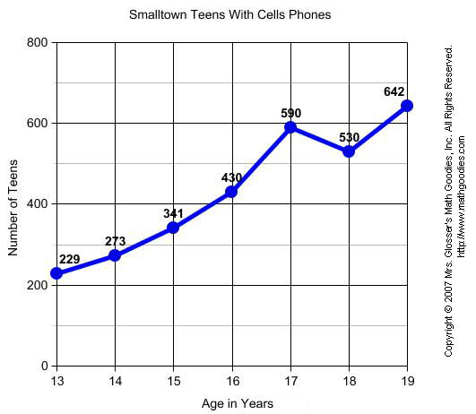

Slide 8
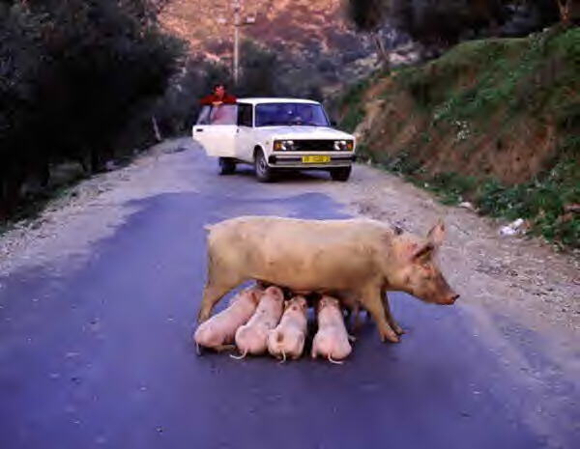
Road Blocks to Learning
Notation not accessible by screen reader or Braille
Numerical and statistical reasoning depends on conveying visual and spatial features…example standard deviation

Slide 9
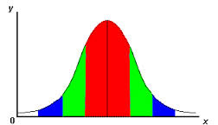
Statistics is Spatial
Notes:
?

Slide 10
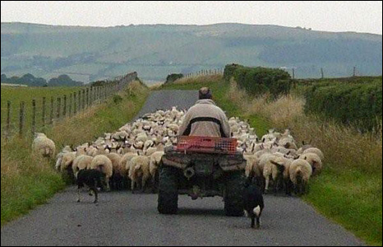
Blocking the Road to Learning
Academics can’t or won’t adapt teaching style: use of
vague verbal directional cues …look over here
Mental Fatigue
Total additional time required to access course Sources: Spindler, R. (2006) Teaching mathematics to a student who is blind. Teaching Mathematics and its Applications (25) 3 120-126. Gibson W.E and Darron C. (1999) Teaching statistics to a student who is blind. Teaching of Psychology. (26) 13-131.

Slide 11
Improving Access Clay, wood, paper models, puff paint Tactile embossing print technology with associated software Pictures in a flash (raised line drawings on swell paper)

Slide 12
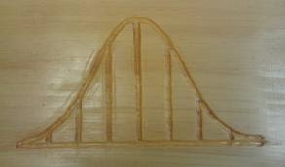
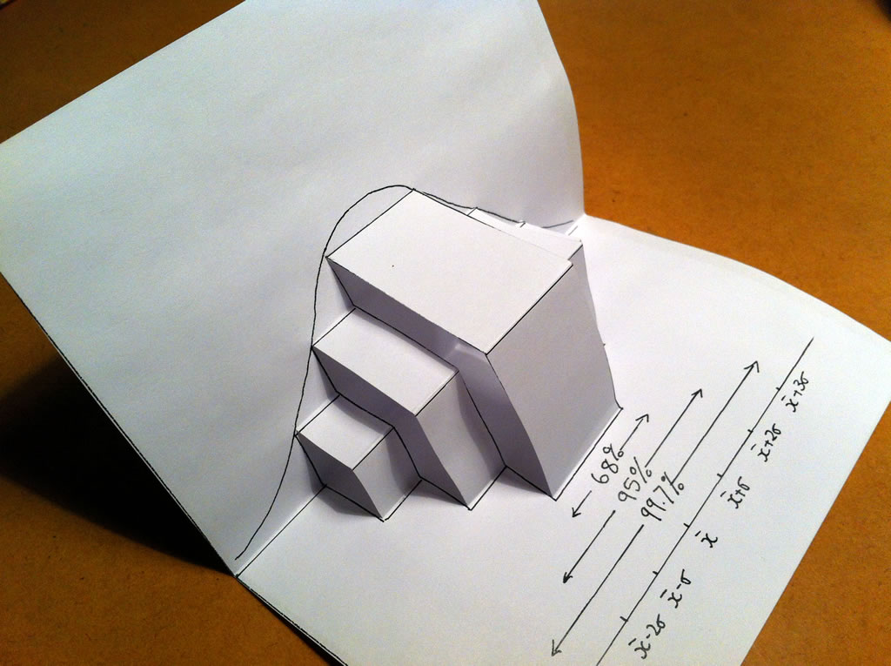
2d and 3d models are effective tools for conveying spatial concept but time consuming
http://www.uncp.edu/academics/colleges-schools-departments/departments/sociology-and-criminal-justice/visual-impairment-and-teaching-statistics/directions-construction-teaching-artifacts
http://mathslinks.net/faculty/normal-distribution-foldable

Slide 13
Improving Access Braille code to Latex and vice versa Universal Braille code for mathematics (LAMBDA project) Edwards, A. McCartney, H. and Fogarolo F. (2006) Lambda: A multimodal approach to making mathematics accessible to blind students. Translation of mathematical notation into words and captioning of graphics for screen readers Course delivered and assessed over extended time

Slide 14
Improving Access Open book assessment Untimed assessment Academics must be educated, coaxed to adopt accessible teaching style Proctor or sighted education assistant

Slide 15
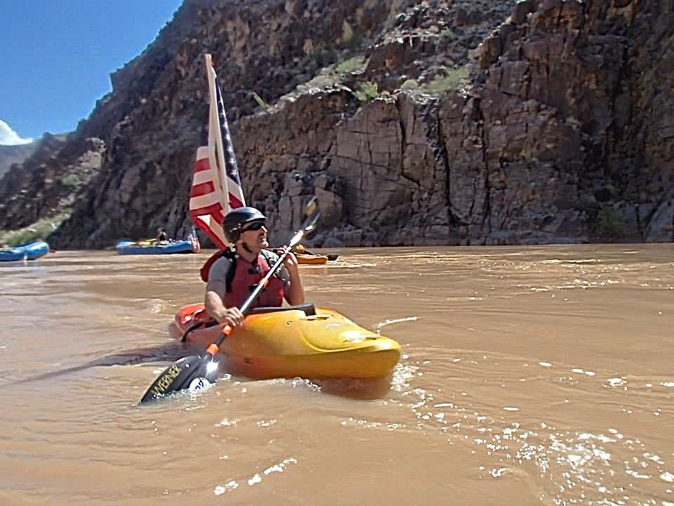
Lonnie Bedwell blind white water paddler 226-mile, 16-day journey on Colarado River http://www.grindtv.com/outdoor/excursions/post/veteran-becomes-first-blind-kayaker-to-paddle-grand-canyon/

Slide 16
Role Sighted Education Assistant Competent in the subject Convert teaching materials Develop a repertoire of shared meaning Plan for replacement May also become tutor Assist in exam Role clarity

Slide 17
Which strategy to adopt? Student’s background in math/stat Which technology depends on: students current technology capacity to learn new technology time to adopt or learn technology interface between technologies Level of staff input Availability of skilled staff to provide training and support

Slide 18
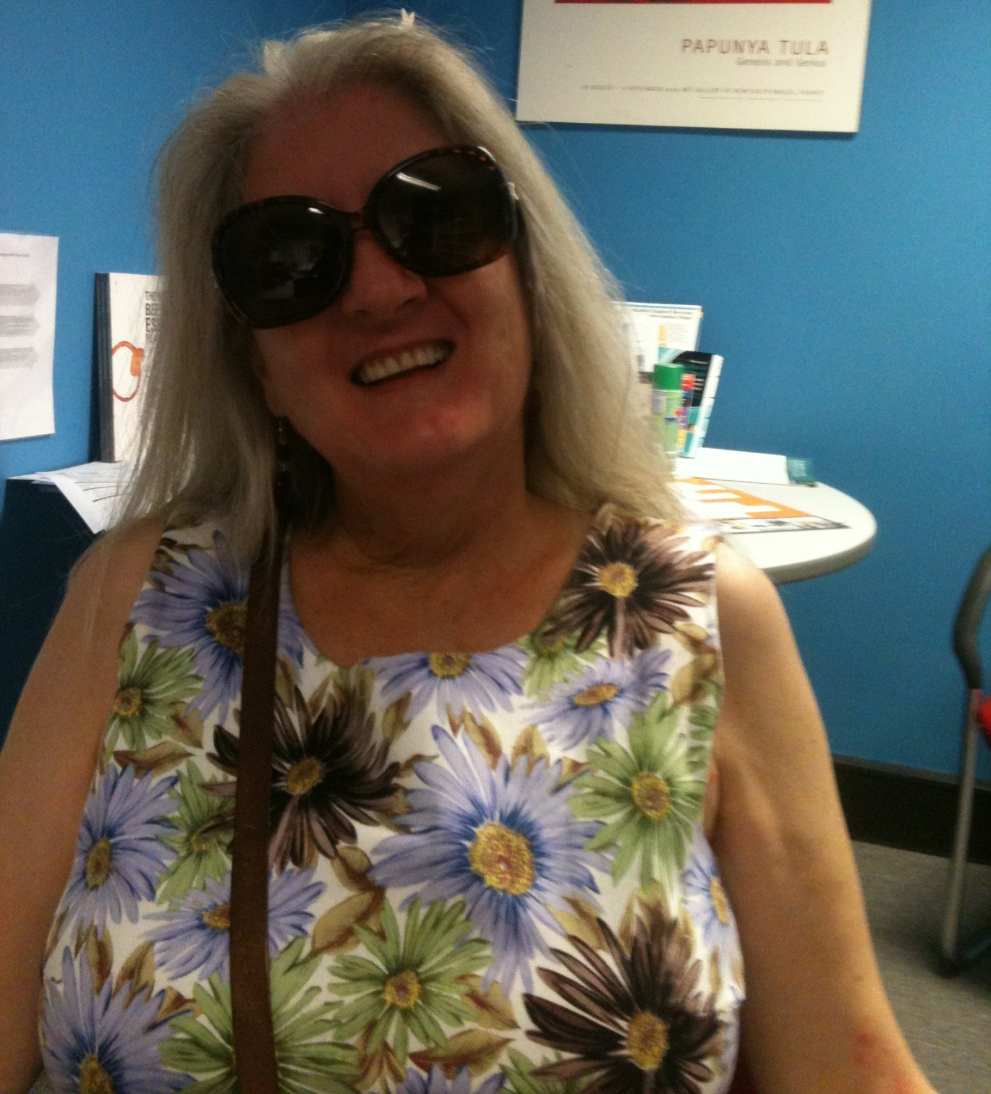
Una
Jansen Van
Rensburg
Student UWA

Slide 19
Background Double major in Psychology 2012-2015 Normal sight up to age 21 Maths up to Year 12 Algebra versus geometry Visual and spatial strength Screenreader JAWS (others e.g. Window Eyes, NVDA, Zoomtext)

Slide 20
Making the course accessible First challenges What to expect Making use of sighted assistants Started preparation before semester Meeting the needs evolved over time

Slide 21
Inaccessibilities and Solutions Textbook and lecture slides Greek symbols Graphic images and graphs

Slide 22
Inaccessibilities and Solutions Lectures “A picture speaks a thousand words”…?? Think of line graph of the normal distribution Formulae: close eyes for an example

Slide 23
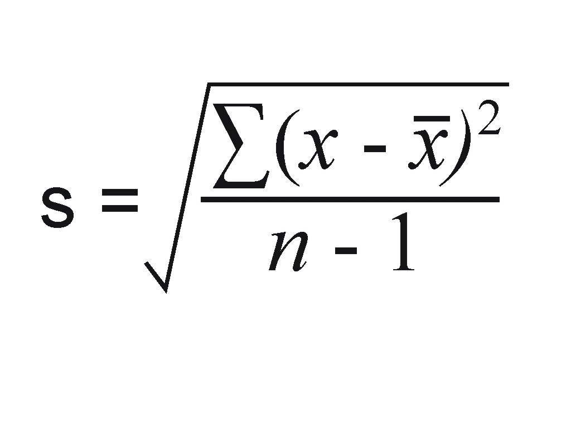
Formula for Standard Deviation

Slide 24
Sentence wording of formulae eg:
S = square root of: sum of (x minus mean of x) squared, everything over n minus 1
Talking calculator
Calculator in SPSS software

Slide 25
Assistant and Student Interaction
Conversion and editing of lecture slides (write out symbols as words, describe images)
Student commitment
Time with assistant
Graphs: tracing/drawing on plastic/embossed printer

Slide 26
SPSS (Statistics software) Lab Exam Part of Unit Assessment Time pressure in labs JAWS not reliable Output window not accessible Transport to Excel necessary Locate Excel file, locate table, locate cell (time!)

Slide 27
Workable Strategy
View lab slides beforehand
Attend and listen
Do analysis afterwards with sighted assistant
Timed Lab exam demonstrating SPSS skills DIFFICULT
A Solution for analyses….

Slide 29
Only take stats if essential Career counselling and course planning Stay motivated Extra time units require double or more time clarifying lecture material explanation of visuals repeat of lab sessions Consider doing few units per semester It can be done!

Slide 30
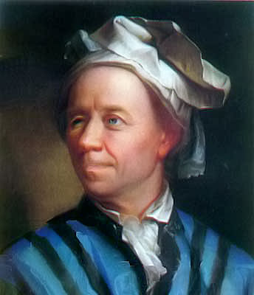
Conclusions Student intellectual and emotional resilience Collaborative and engaged teaching staff early learning materials Equity staff commitment

Slide 31
Acknowledgements Antony Gray Kim Louw Short film can be viewed at http://youtu.be/6EwbhDFZpUM 'bonus' video, which you can find here: http://youtu.be/UEUQmLMK2_M

